Slide 1
18-7
This work is licensed under a Creative Commons Attribution-Sharealike 4.0 International License.
Please add this statement to all the videos you create.
English Bible quotes are from the World English Bible US, which is in the public domain.
Notes:
Ch
18 Saul and David – Part 2
1. David at Nob and Saul’s vengeance - 1 Sam 21 – 22 ( Left Top)
2. The Rock of Escape -1 Sam 23 (Right Top)
3. David spares Saul’s life -1 Sam 24 (Right Center)
4. David spares Saul’s life again -1 Sam 26 (Right Bottom)
5. Saul and the witch of Endor -1 Sam 28:3-25 (Left Bottom)
6. David returns and finds that Ziklag has been raded -1 Sam 29-30 (Left Center)
7. David morns for Saul and Jonathan – 1 Sam 31, 2 Sam 1 (Center)

Slide 2
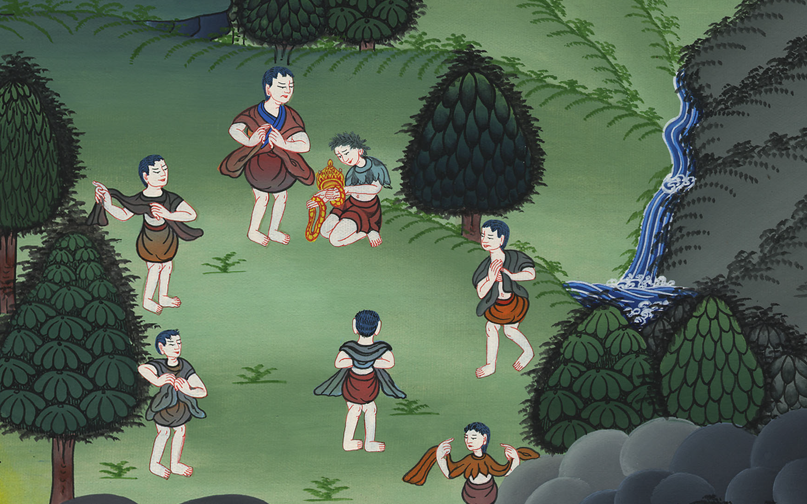
David mourns for Saul and Jonathan – 1 Samuel 31,
2 Samuel 1

Slide 3
7. David mourns for Saul and Jonathan – 1 Samuel 31, 2 Samuel 1 (Center)

Slide 4
David mourns for Saul and Jonathan – 1 Samuel 31,
2 Samuel 1

Slide 5
1Samuel31:1Now the Philistines fought against Israel; and the men of Israel fled from before the Philistines, and fell down slain on Mount Gilboa.

Slide 6
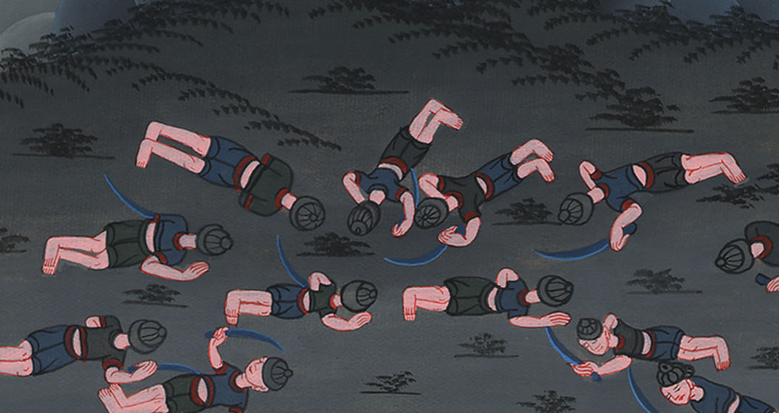
1 Samuel 31:1

Slide 7
2The Philistines overtook Saul and his sons; and the Philistines killed Jonathan, Abinadab, and Malchishua, the sons of Saul.

Slide 8
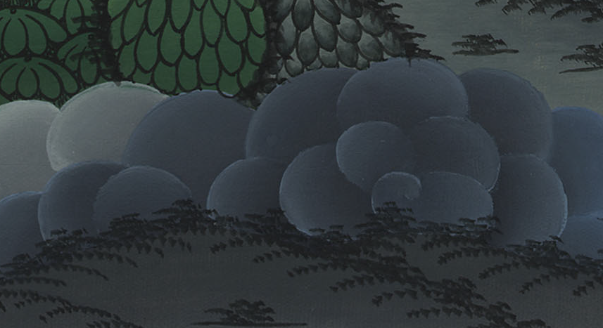
1 Samuel 31:2

Slide 9
3The battle went hard against Saul, and the archers overtook him; and he was greatly distressed by reason of the archers.

Slide 10
1 Samuel 31:3

Slide 11
4Then Saul said to his armor bearer, “Draw your sword, and thrust me through with it, lest these uncircumcised come and thrust me through and abuse me!” But his armor bearer would not, for he was terrified. Therefore Saul took his sword and fell on it.

Slide 12
1 Samuel 31:4

Slide 13
6So Saul died with his three sons, his armor bearer, and all his men that same day together.

Slide 14
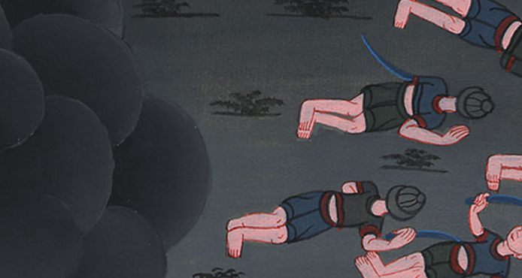
1 Samuel 31:6

Slide 15
At this time David was in Ziklag.
2on the third day, behold, a man came out of the camp from Saul, with his clothes torn and earth on his head. When he came to David, he fell to the earth and showed respect.

Slide 16
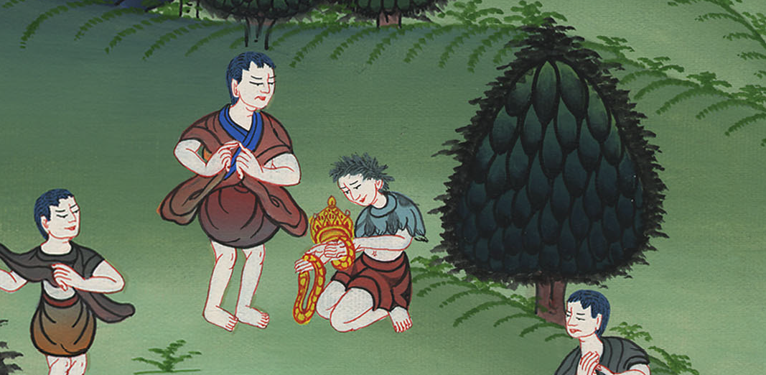
2 Samuel 1:2

Slide 17
3David said to him, “Where do you come from?”
He said to him, “I have escaped out of the camp of Israel.”

Slide 18
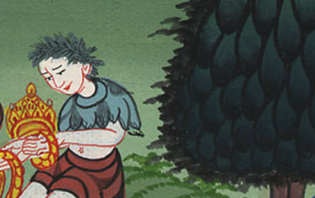
2 Samuel 1:3

Slide 19
4David said to him, “How did it go? Please tell me.”
He answered, “The people have fled from the battle, and many of the people also have fallen and are dead. Saul and Jonathan his son are dead also.”

Slide 20
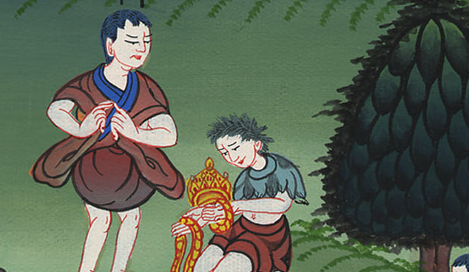
2 Samuel 1:4

Slide 21
11Then David took hold on his clothes and tore them; and all the men who were with him did likewise.

Slide 22
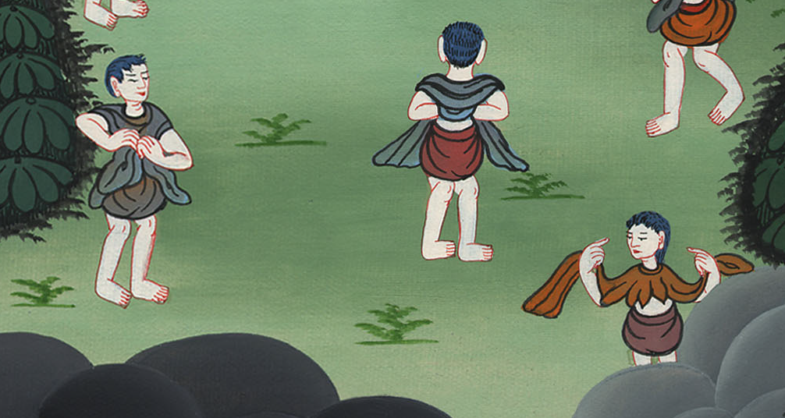
2 Samuel 1:11

Slide 23
12They mourned, wept, and fasted until evening for Saul and for Jonathan his son, and for the people of Yahweh, and for the house of Israel, because they had fallen by the sword.

Slide 24
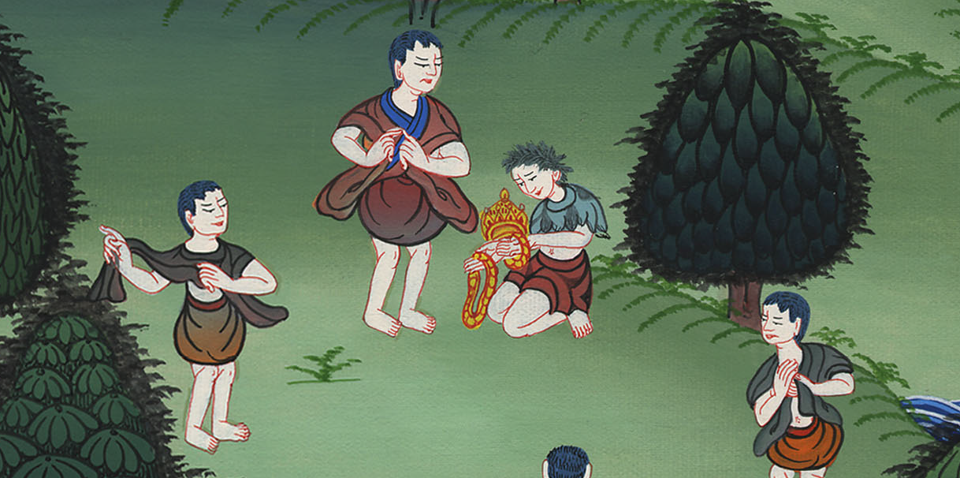
2 Samuel 1:12

