Slide 1
19-1
This work is licensed under a Creative Commons Attribution-Sharealike 4.0 International License.
Please add this statement to all the videos you create.
English Bible quotes are from the World English Bible US, which is in the public domain.
Notes:
Ch
19 David
1. Two Kings - 2 Samuel 2:4; 2:8-9; 3:1; 4:5 - 5:4 (Top)
2. Return of the ark to the city of David - 2 Sam 6:1-23 (Right Center)
3. David's reception of Mephibosheth - 2 Sam 9 (Right Bottom)
4. David, Bath-sheba and Uriah - 2 Sam 11 (Center Bottom)
5. Nathan confronts David - 2 Sam 12:1-14 (Left Bottom)
6. Solomon is born - 2 Sam 12:15-25 (Left Center)

Slide 2

Two Kings –
2 Samuel 2:4; 2:8-9; 3:1; 4:5 - 5:4

Slide 3
1. Two Kings - 2 Samuel 2:4; 2:8-9; 3:1; 4:5 - 5:4 (Top)
John

Slide 4
Two Kings –
2 Samuel 2:4; 2:8-9; 3:1; 4:5 - 5:4

Slide 5
The Lord spoke to David and told him to take his family to the town of Hebron to live with his family.
2Samuel2:4The men of Judah came, and there they anointed David king over the house of Judah.
John

Slide 6
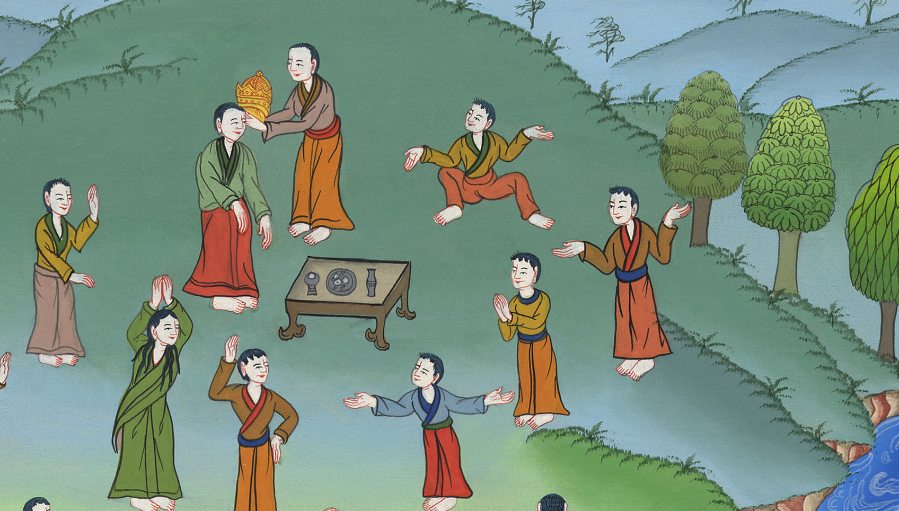
2 Samuel 2:4

Slide 7
8Now Abner the son of Ner, captain of Saul’s army, had taken Ishbosheth the son of Saul and brought him over to Mahanaim. 9He made him king over Gilead, over the Ashurites, over Jezreel, over Ephraim, over Benjamin, and over all Israel.
John

Slide 8
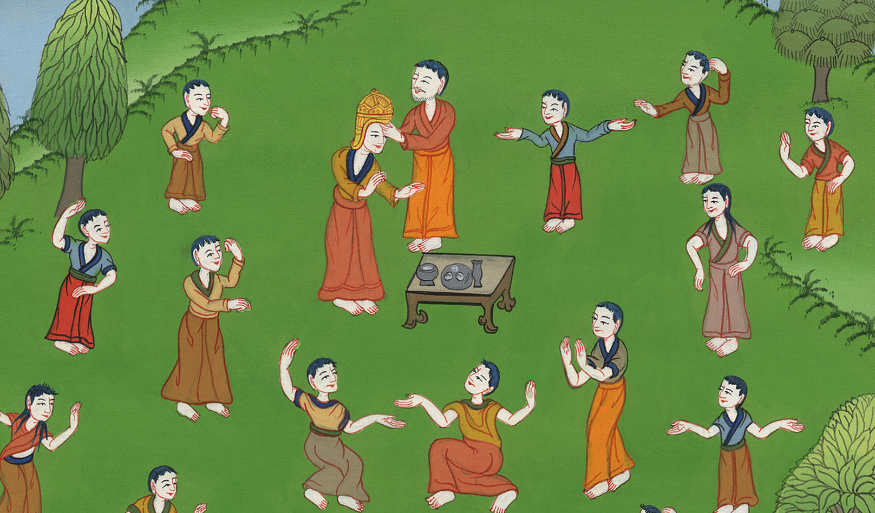
2 Samuel 2:8,9

Slide 9
3:1Now there was long war between Saul’s house and David’s house. David grew stronger and stronger, but Saul’s house grew weaker and weaker.
John

Slide 10

2 Samuel 3:1

Slide 11
One day two men from Ish-Bosheth’s army found him sleeping. They killed him.
John

Slide 12
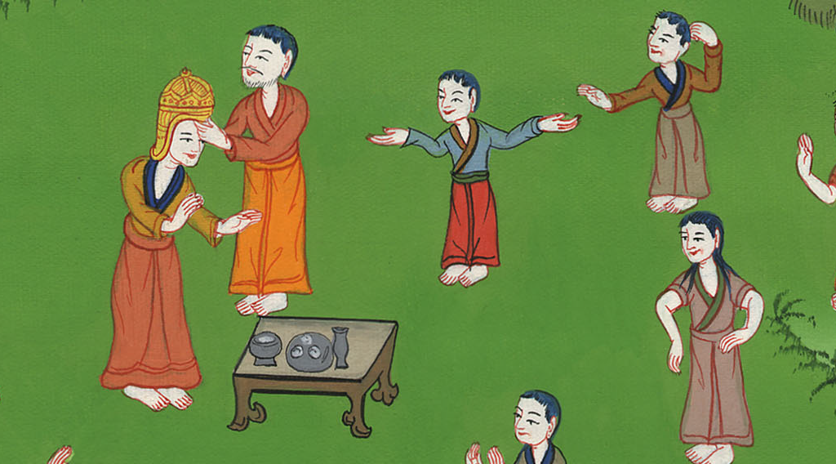

Slide 13
5:1Then all the tribes of Israel came to David at Hebron and spoke, saying, “Behold, we are your bone and your flesh.
John

Slide 14

2 Samuel 5:1

Slide 15
2In times past, when Saul was king over us, it was you who led Israel out and in.
John

Slide 16
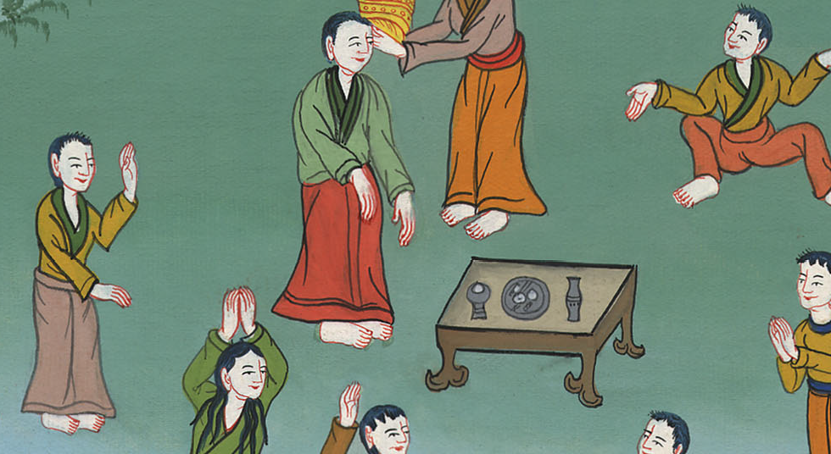
2 Samuel 5:2

Slide 17
2…Yahweh said to you, ‘You will be shepherd of my people Israel, and you will be prince over Israel.’”
John

Slide 18
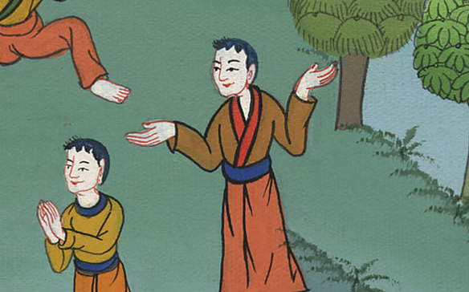
2 Samuel 5:2

Slide 19
3So all the elders of Israel came to the king to Hebron, and King David made a covenant with them in Hebron before Yahweh; and they anointed David king over Israel.
John

Slide 20
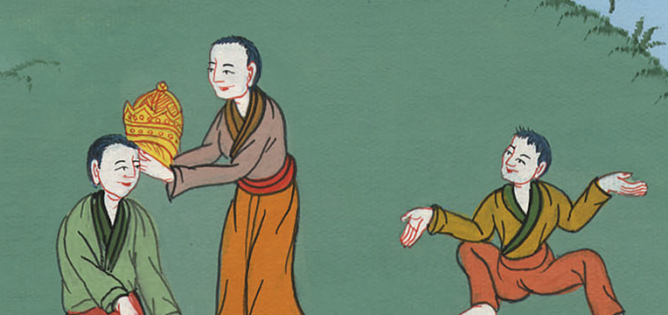
2 Samuel 5:3

Slide 21
4David was thirty years old when he began to reign, and he reigned forty years.
John

Slide 22
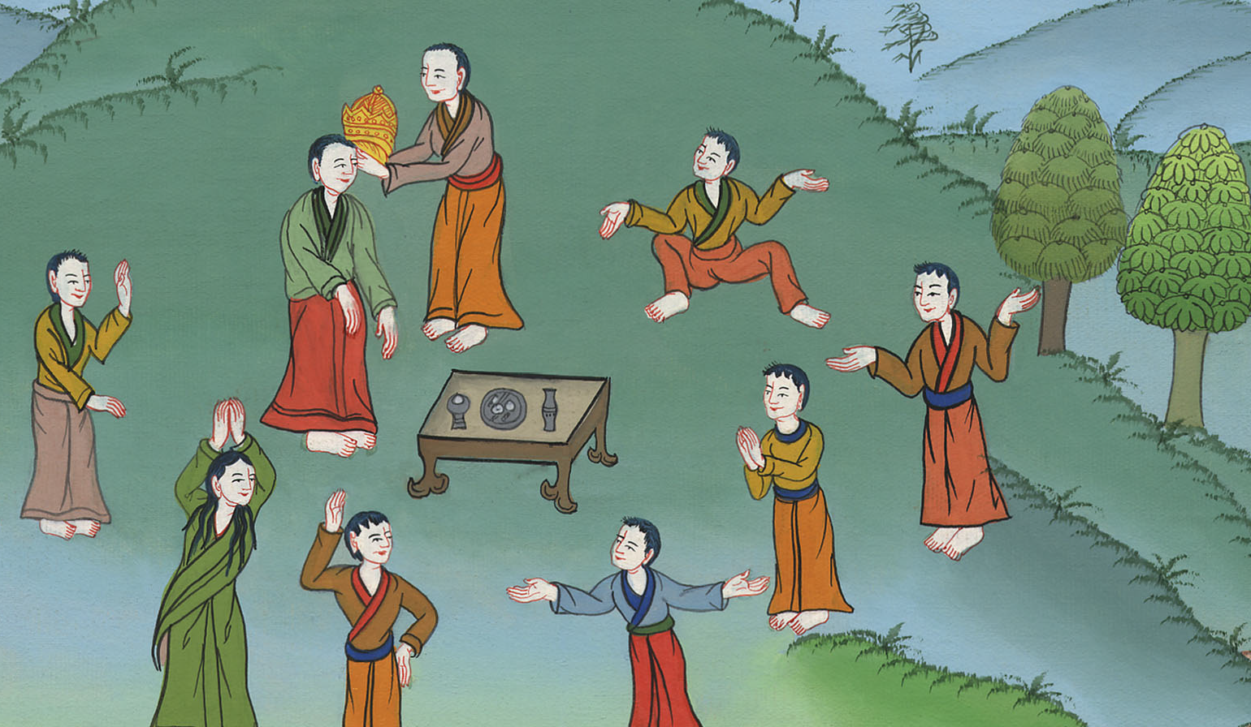
2 Samuel 5:4

