Slide 1
19-2
This work is licensed under a Creative Commons Attribution-Sharealike 4.0 International License.
Please add this statement to all the videos you create.
English Bible quotes are from the World English Bible US, which is in the public domain.
Notes:
Ch
19 David
1. Two Kings - 2 Samuel 2:4; 2:8-9; 3:1; 4:5 - 5:4 (Top)
2. Return of the ark to the city of David - 2 Sam 6:1-23 (Right Center)
3. David's reception of Mephibosheth - 2 Sam 9 (Right Bottom)
4. David, Bath-sheba and Uriah - 2 Sam 11 (Center Bottom)
5. Nathan confronts David - 2 Sam 12:1-14 (Left Bottom)
6. Solomon is born - 2 Sam 12:15-25 (Left Center)

Slide 2
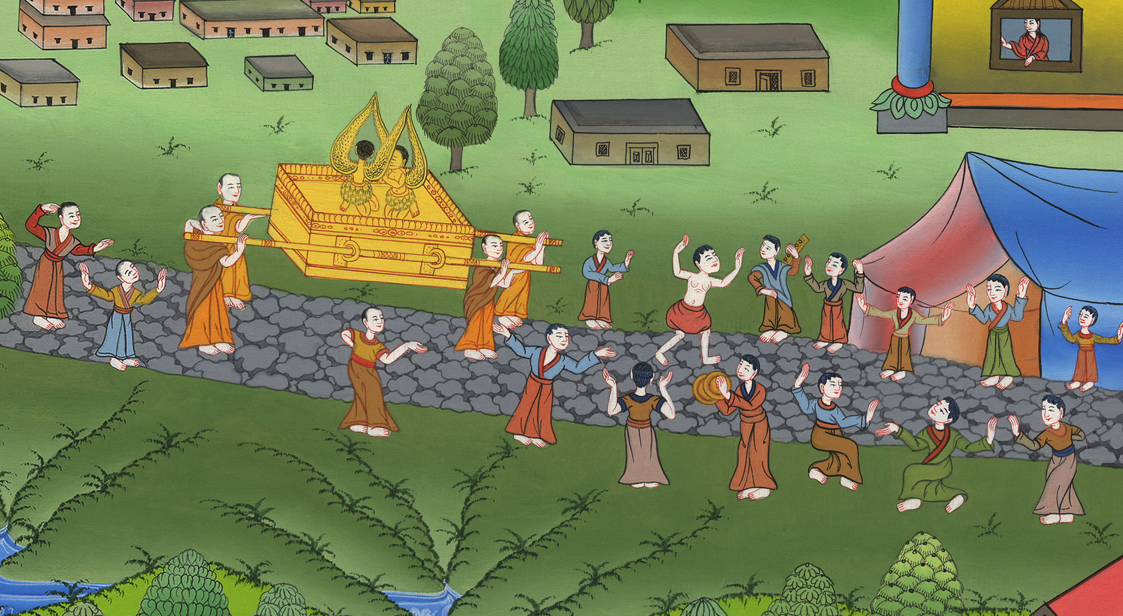
Return of the ark to the city of David - 2 Samuel 6:1-23 །

Slide 3
2. Return of the ark to the city of David - 2 Samuel 6:1-23 (Right Center)
John

Slide 4
Return of the ark to the city of David - 2 Samuel 6:1-23 །

Slide 5
2 Samuel6:2David arose and went with all the people who were with him from Baale Judah, to bring up from there God’s ark, which is called by the Name, even the name of Yahweh of Armies who sits above the cherubim.
John

Slide 6
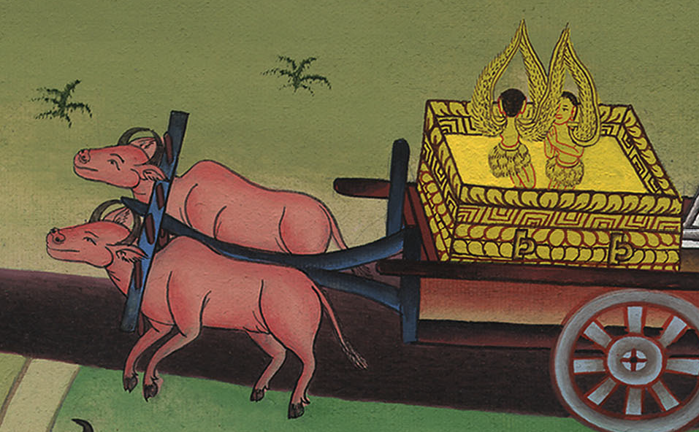
2 Samuel 6:2

Slide 7
3They set God’s ark on a new cart, and brought it out of Abinadab’s house that was on the hill; and Uzzah and Ahio, the sons of Abinadab, drove the new cart.
John

Slide 8
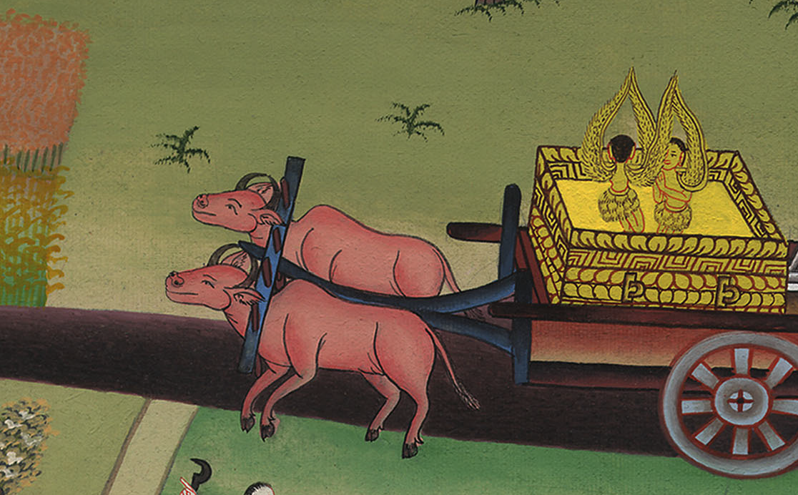
2 Samuel 6:3

Slide 9
5David and all the house of Israel played before Yahweh with all kinds of instruments made of cypress wood, with harps, with stringed instruments, with tambourines, with castanets, and with cymbals.
John

Slide 10
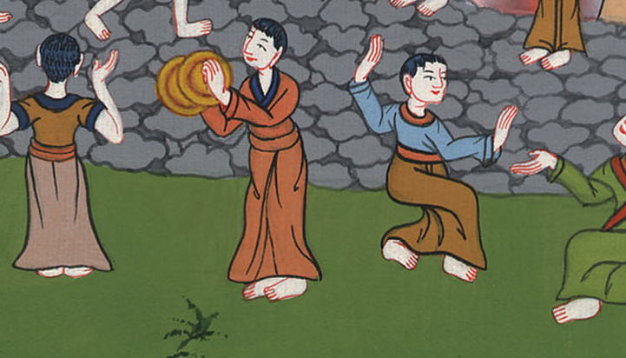
2 Samuel 6:5

Slide 11
6When they came to the threshing floor of Nacon, Uzzah reached for God’s ark and took hold of it, for the cattle stumbled.
John

Slide 12
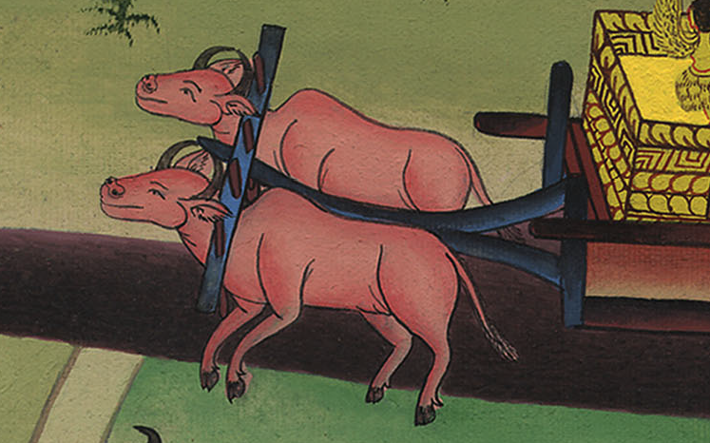
2 Samuel 6:6

Slide 13
7Yahweh’s anger burned against Uzzah, and God struck him there for his error; and he died there by God’s ark.
John

Slide 14
2 Samuel 6:7

Slide 15
9David was afraid of Yahweh that day; and he said, “How could Yahweh’s ark come to me?”
John

Slide 16
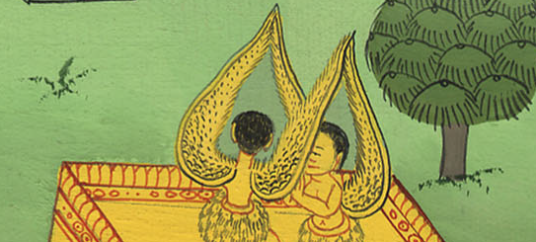
2 Samuel 6:9

Slide 17
10So David would not move Yahweh’s ark to be with him in David’s city; but David carried it aside into Obed-Edom the Gittite’s house.
John

Slide 18
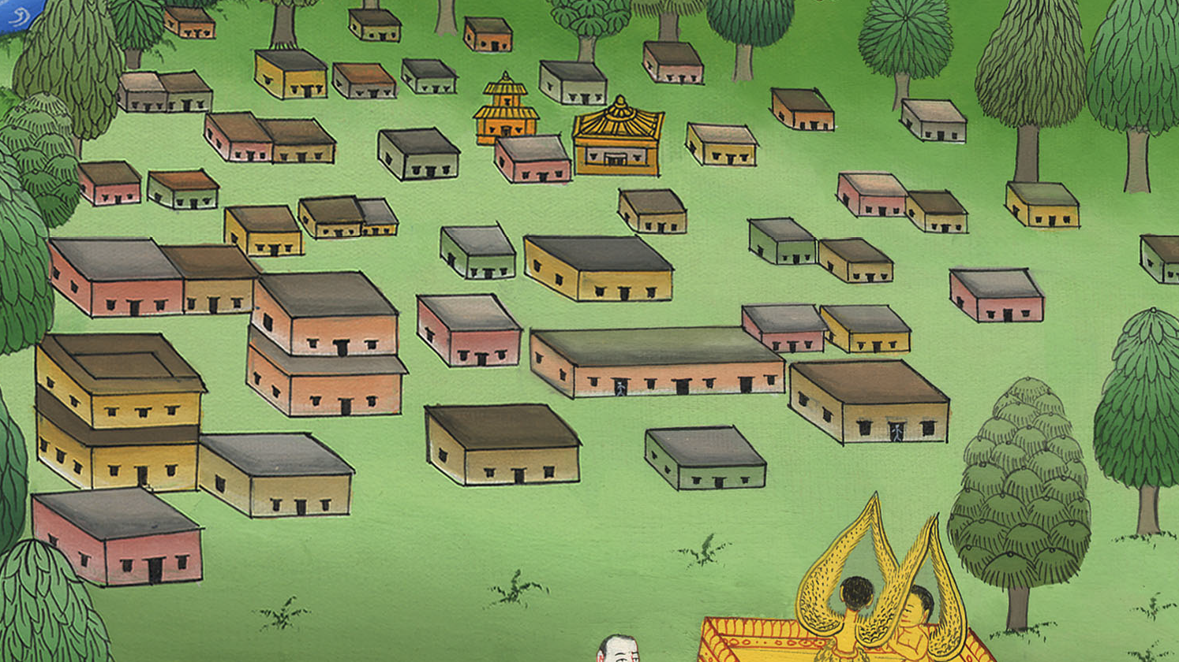
2 Samuel 6:10

Slide 19
11Yahweh’s ark remained in Obed-Edom the Gittite’s house three months; and Yahweh blessed Obed-Edom and all his house.
John

Slide 20
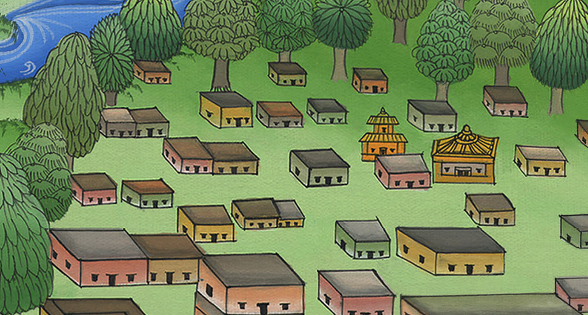
2 Samuel 6:11

Slide 21
12King David was told, “The Lord has blessed the family of Obed-Edom. He has also blessed everything that belongs to him. That’s because the ark of God is in Obed-Edom’s house.”
John

Slide 22
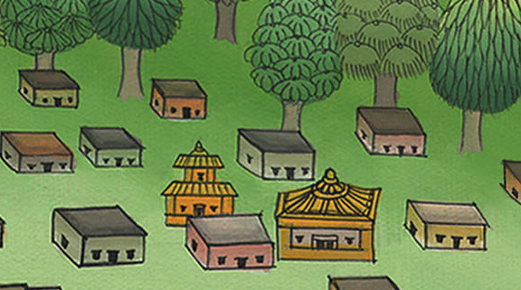
2 Samuel 6:12

Slide 23
12…So David went and brought up God’s ark from the house of Obed-Edom into David’s city with joy.
John

Slide 24
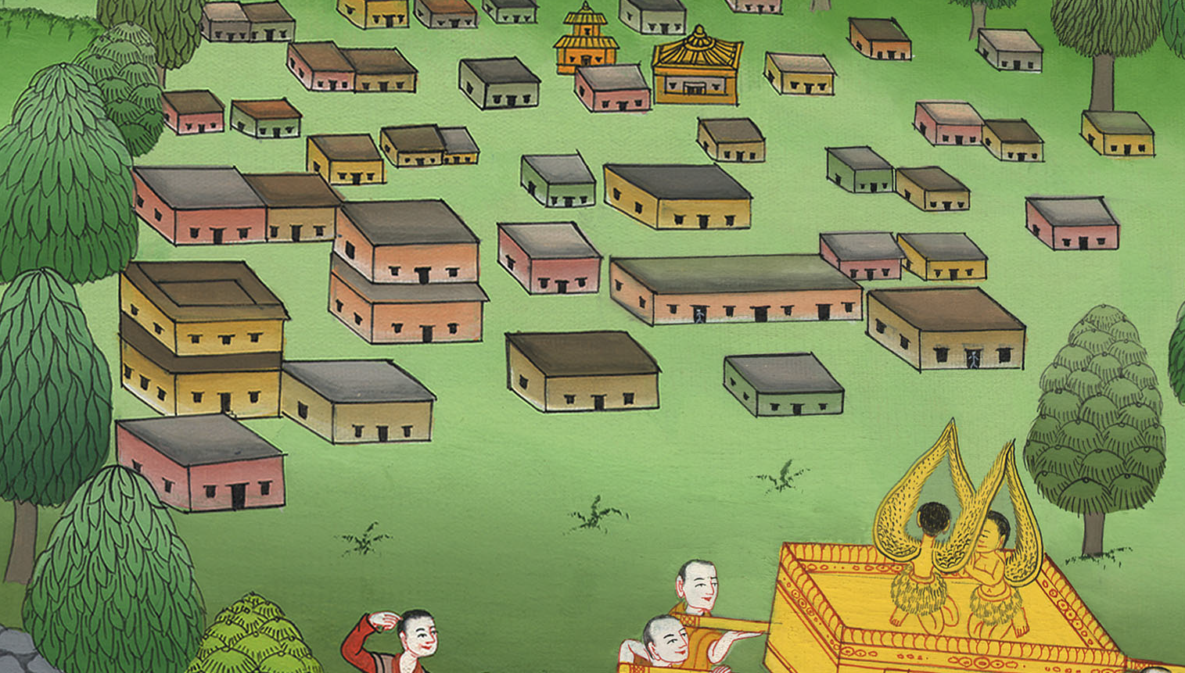
2 Samuel 6:12

Slide 25
(This time they carried the ark in the way God had instructed Moses) 13When those who bore Yahweh’s ark had gone six paces, he sacrificed an ox and a fattened calf.
John

Slide 26
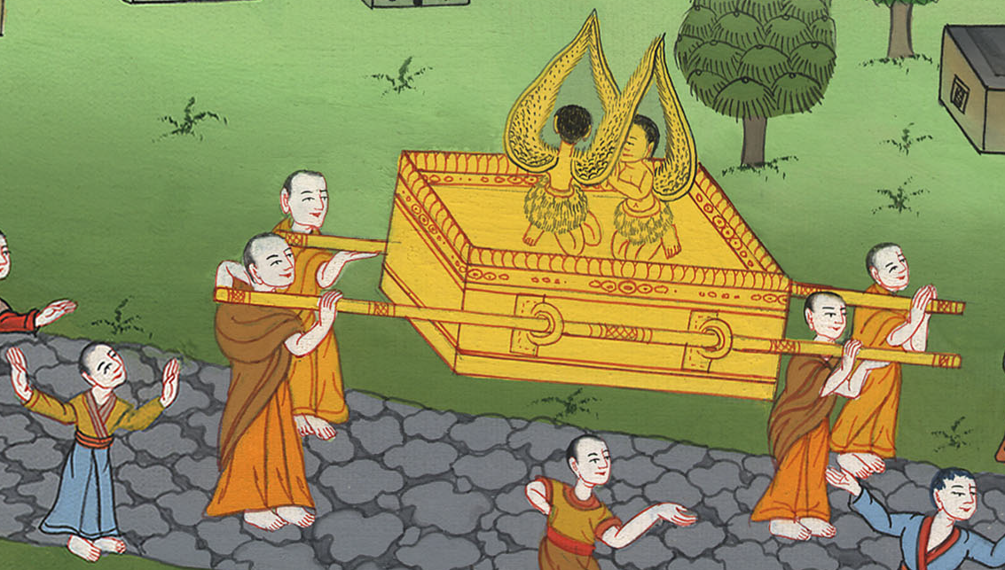
2 Samuel 6:13

Slide 27
(Moses had given instructions how the ark was to be carried)
John

Slide 29
14David danced before Yahweh with all his might; and David was clothed in a linen ephod.
John

Slide 30
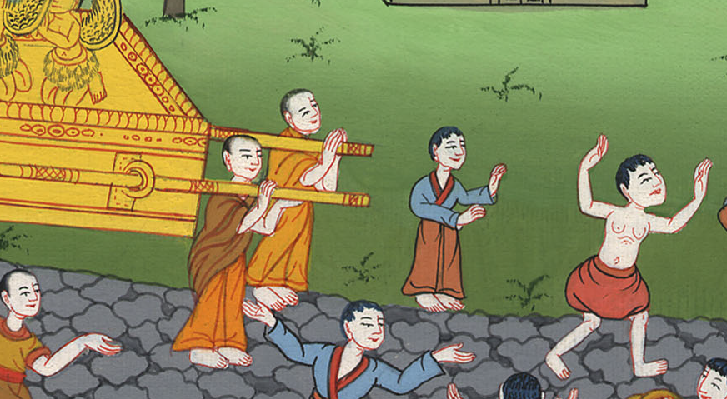
2 Samuel 6:14

Slide 31
15So David and all the house of Israel brought up Yahweh’s ark with shouting and with the sound of the trumpet.
John

Slide 32
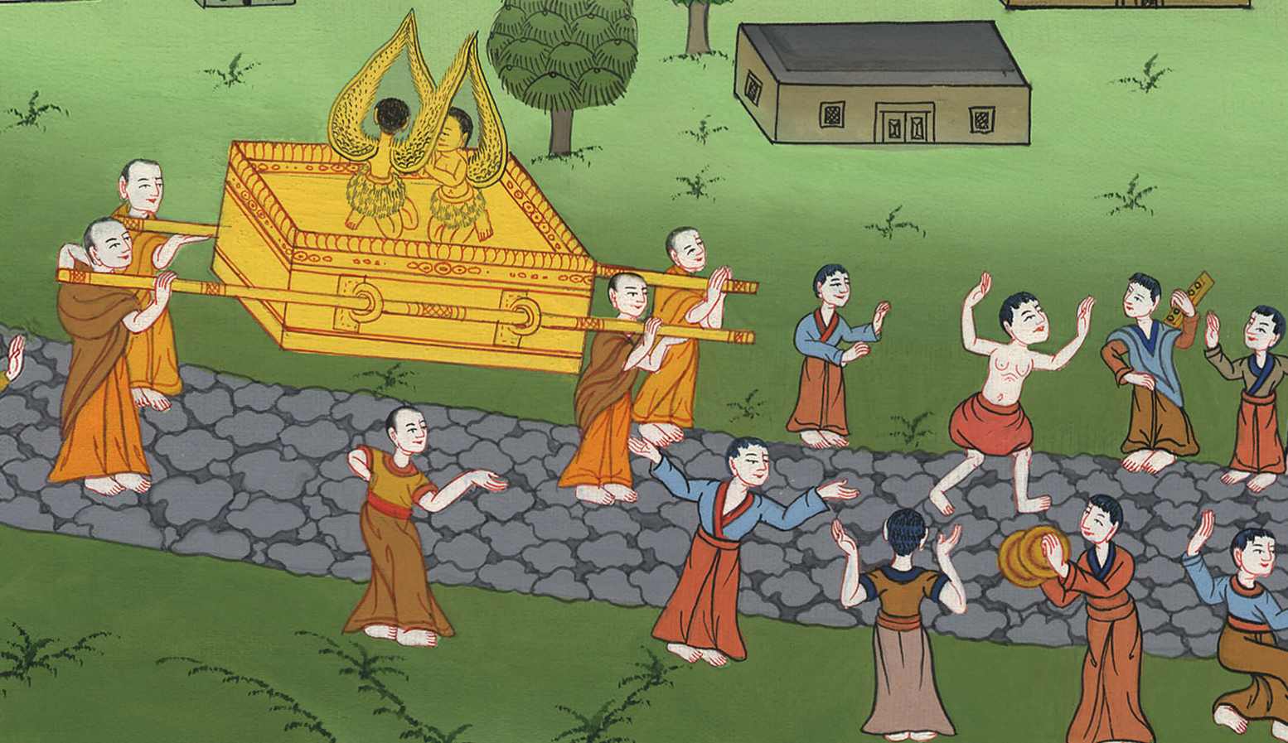
2 Samuel 6:15

Slide 33
16As Yahweh’s ark came into David’s city, Michal the daughter of Saul looked out through the window and saw King David leaping and dancing before Yahweh; and she despised him in her heart.
John

Slide 34
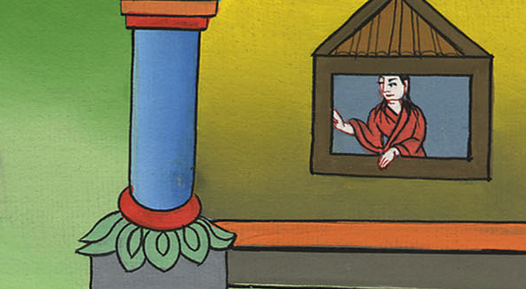
2 Samuel 6:16

Slide 35
17They brought in Yahweh’s ark, and set it in its place in the middle of the tent that David had pitched for it; and David offered burnt offerings and peace offerings before Yahweh.
John

Slide 36
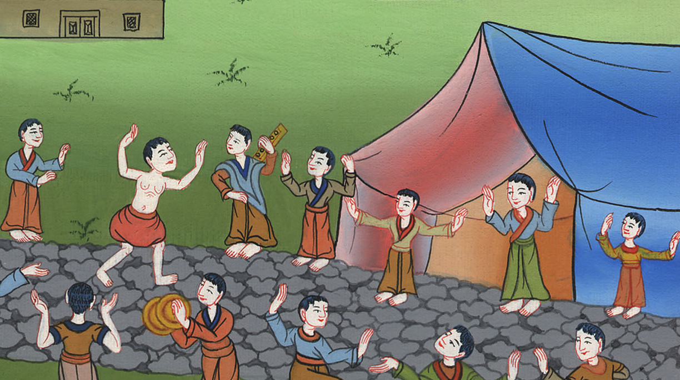
2 Samuel 6:17

Slide 37
20Then David returned to bless his household. Michal the daughter of Saul came out to meet David, and said, “How glorious the king of Israel was today, who uncovered himself today in the eyes of his servants’ maids, as one of the vain fellows shamelessly uncovers himself!”
John

Slide 38
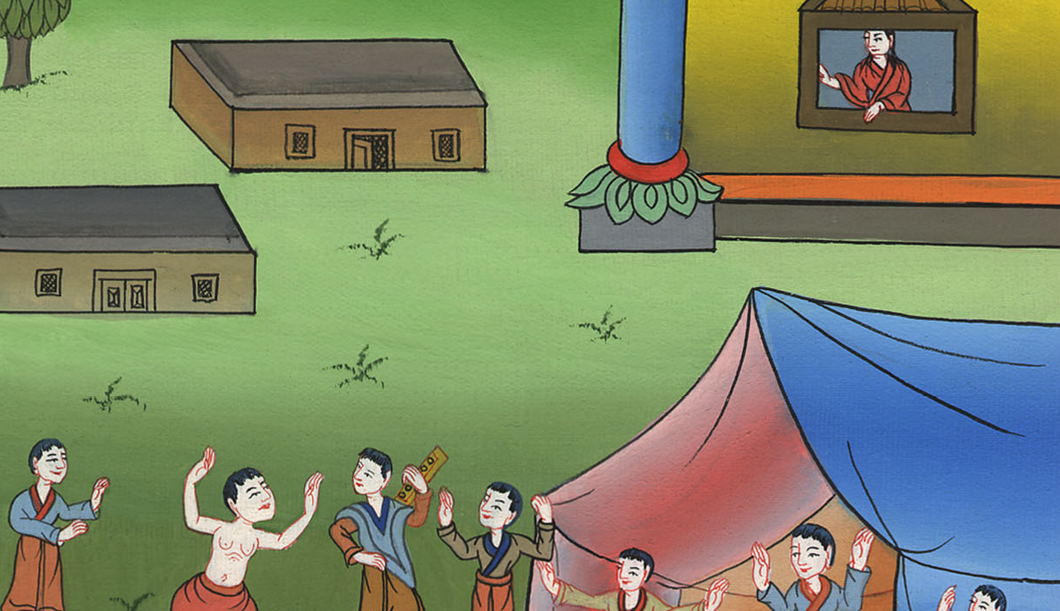
2 Samuel 6:20

Slide 39
21David said to Michal, “It was before Yahweh, who chose me above your father, and above all his house, to appoint me prince over the people of Yahweh, over Israel. Therefore I will celebrate before Yahweh.
John

Slide 40
2 Samuel 6:21

