Slide 1
19-3
This work is licensed under a Creative Commons Attribution-Sharealike 4.0 International License.
Please add this statement to all the videos you create.
English Bible quotes are from the World English Bible US, which is in the public domain.
Notes:
Ch
19 David
1. Two Kings - 2 Samuel 2:4; 2:8-9; 3:1; 4:5 - 5:4 (Top)
2. Return of the ark to the city of David - 2 Sam 6:1-23 (Right Center)
3. David's reception of Mephibosheth - 2 Sam 9 (Right Bottom)
4. David, Bath-sheba and Uriah - 2 Sam 11 (Center Bottom)
5. Nathan confronts David - 2 Sam 12:1-14 (Left Bottom)
6. Solomon is born - 2 Sam 12:15-25 (Left Center)

Slide 2
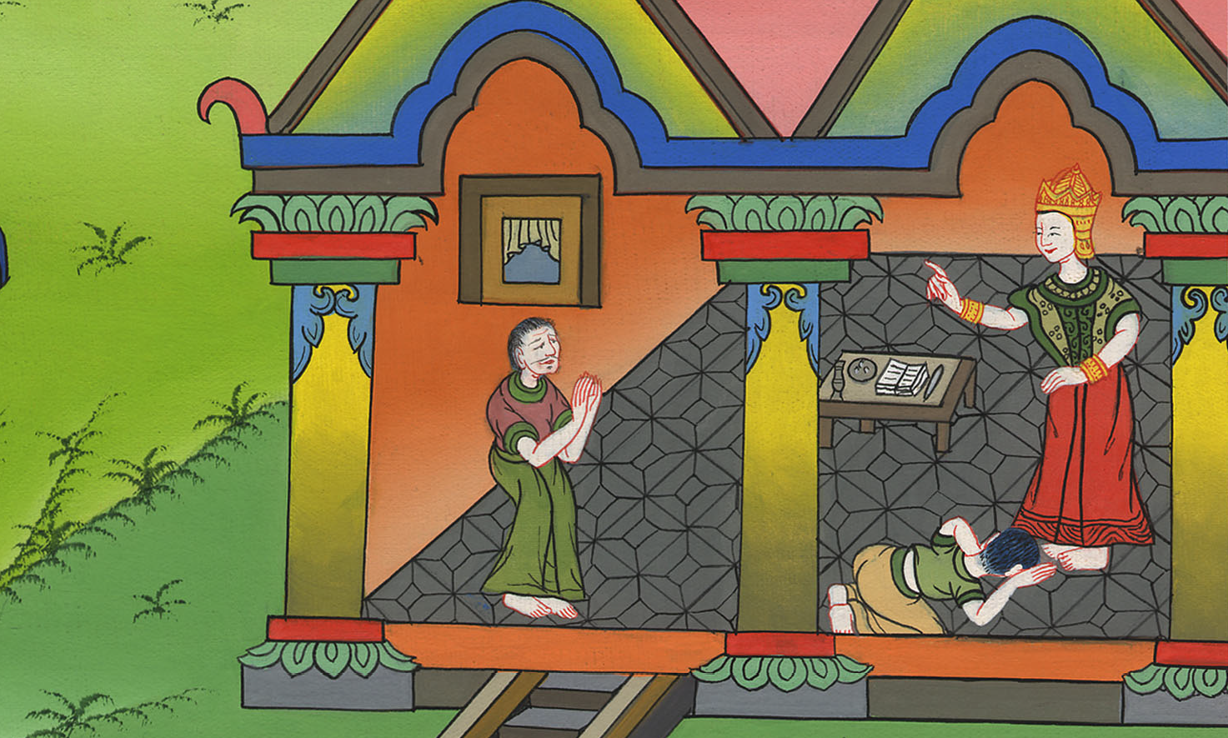
David's reception of Mephibosheth - 2 Samuel 9

Slide 3
3. David's reception of Mephibosheth - 2 Samuel 9 (Right Bottom)
John

Slide 4
David's reception of Mephibosheth - 2 Samuel 9

Slide 5
2 Samuel9:3The king said, “Is there not yet any of Saul’s house, that I may show the kindness of God to him?”
John

Slide 6
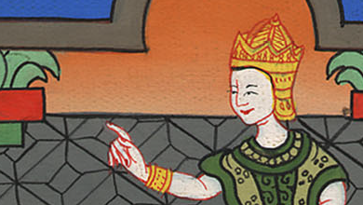
2 Samuel 9:3

Slide 7
Ziba said to the king, “Jonathan still has a son, who is lame in his feet.”
John

Slide 8
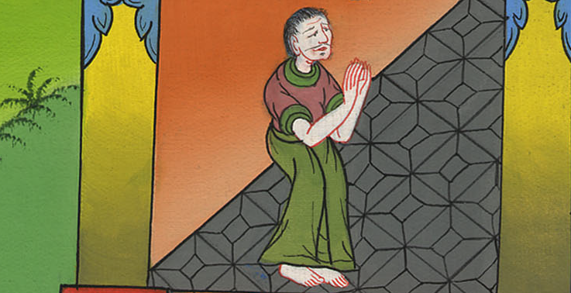
2 Samuel 9:3

Slide 9
4The king said to him, “Where is he?”
Ziba said to the king, “Behold, he is in the house of Machir the son of Ammiel, in Lo Debar.”
5Then King David sent and brought him out of the house of Machir the son of Ammiel, from Lo Debar.
John

Slide 10
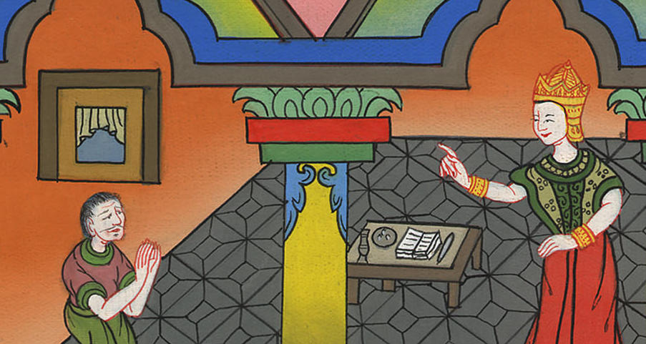
2 Samuel 9:4

Slide 11
6Mephibosheth, the son of Jonathan, the son of Saul, came to David, fell on his face, and showed respect. David said, “Mephibosheth?”
He answered, “Behold, your servant!”
John

Slide 12
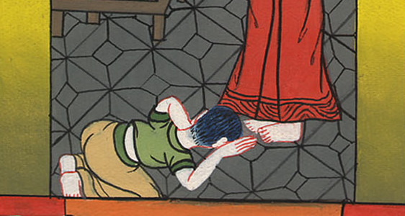
2 Samuel 9:6

Slide 13
7David said to him, “Don’t be afraid, for I will surely show you kindness for Jonathan your father’s sake, and will restore to you all the land of Saul your father. You will eat bread at my table continually.”
John

Slide 14
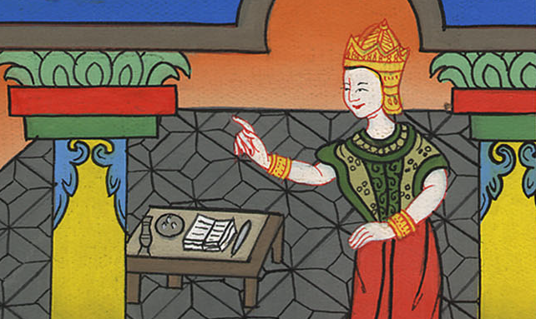
2 Samuel 9:7

Slide 15
(David gave him everything Saul had owned, and servants. He treated him like one of his own sons.) 13So Mephibosheth lived in Jerusalem, for he ate continually at the king’s table. He was lame in both his feet.
John

Slide 16
2 Samuel 9:13

