Slide 1
19-4
This work is licensed under a Creative Commons Attribution-Sharealike 4.0 International License.
Please add this statement to all the videos you create.
English Bible quotes are from the World English Bible US, which is in the public domain.
Notes:
ch19 David
1. Two Kings - 2 Samuel 2:4; 2:8-9; 3:1; 4:5 - 5:4 (Top)
2. Return of the ark to the city of David - 2 Sam 6:1-23 (Right Center)
3. David's reception of Mephibosheth - 2 Sam 9 (Right Bottom)
4. David, Bath-sheba and Uriah - 2 Sam 11 (Center Bottom)
5. Nathan confronts David - 2 Sam 12:1-14 (Left Bottom)
6. Solomon is born - 2 Sam 12:15-25 (Left Center)

Slide 2
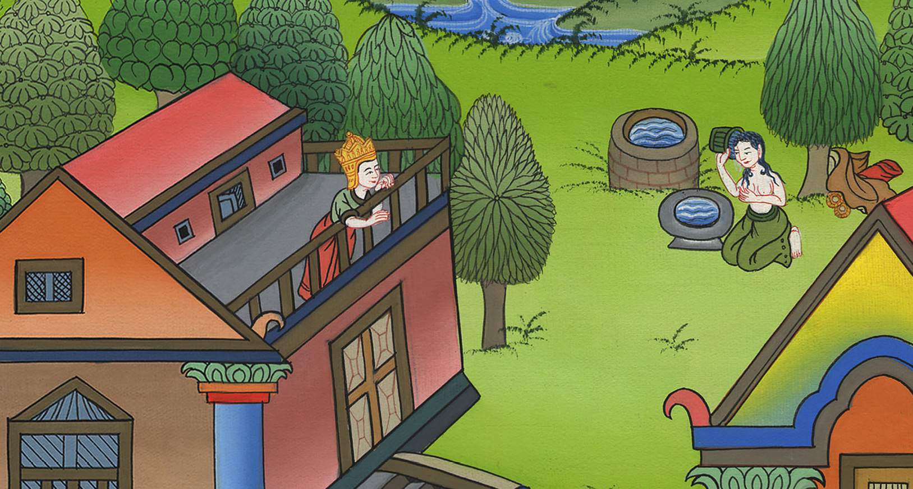
David, Bathsheba and Uriah –
2 Samuel 11

Slide 3
4. David, Bathsheba and Uriah - 2 Samuel 11 (Center Bottom)
John

Slide 4
David, Bathsheba and Uriah –
2 Samuel 11

Slide 5
2 Samuel11:1At the return of the year, at the time when kings go out, David sent Joab and his servants with him, and all Israel; and they destroyed the children of Ammon and besieged Rabbah. But David stayed at Jerusalem.
John

Slide 6
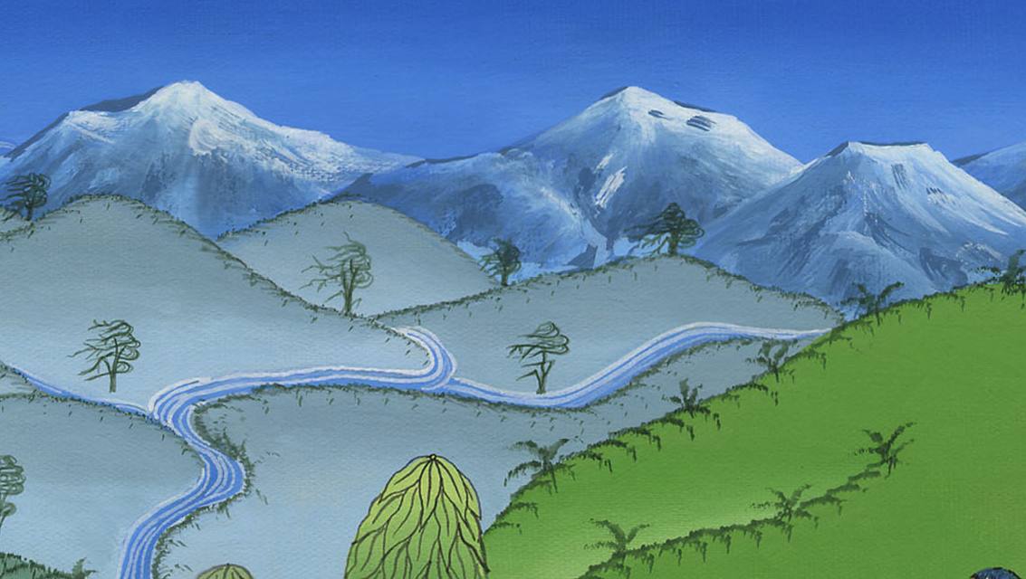
2 Samuel 11:1

Slide 7
2At evening, David arose from his bed and walked on the roof of the king’s house. From the roof, he saw a woman bathing, and the woman was very beautiful to look at.
John

Slide 8
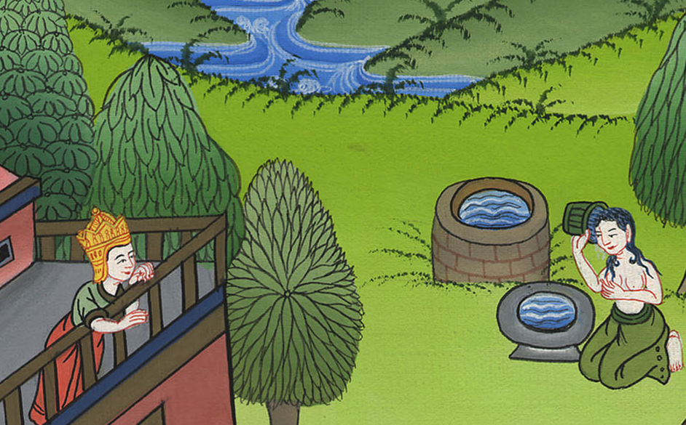
2 Samuel 11:2

Slide 9
3David sent and inquired after the woman. One said, “Isn’t this Bathsheba, the daughter of Eliam, Uriah the Hittite’s wife?”
John

Slide 10
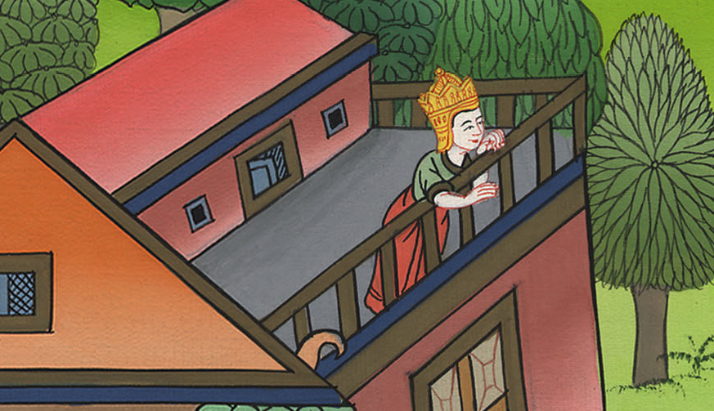
2 Samuel 11:3

Slide 11
4David sent messengers, and took her; and she came in to him, and he lay with her (for she was purified from her uncleanness); and she returned to her house.
John

Slide 12
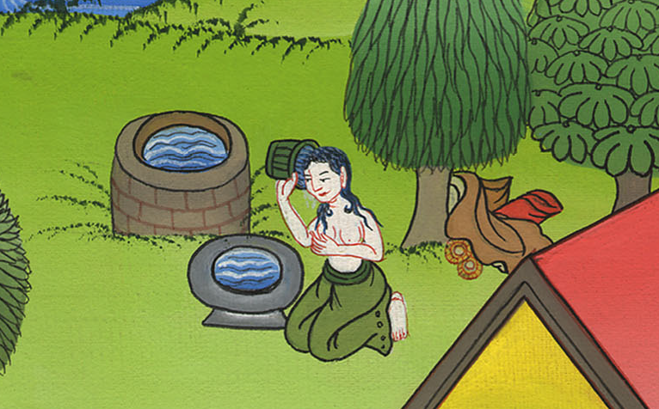
2 Samuel 11:4

Slide 13
5The woman conceived; and she sent and told David, and said, “I am with child.”
John

Slide 14
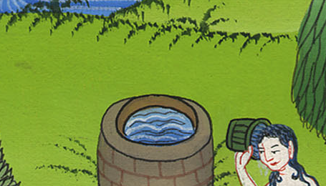
2 Samuel 11:5

Slide 15
6David sent to Joab, “Send me Uriah the Hittite.” Joab sent Uriah to David.
John

Slide 16
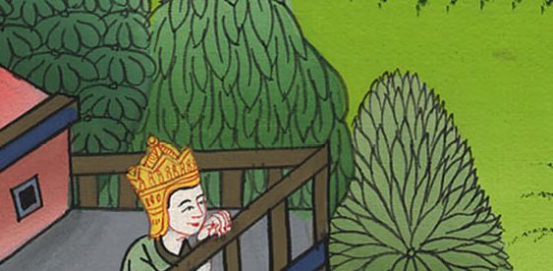
2 Samuel 11:6

Slide 17
7When Uriah had come to him, David asked him how Joab did, and how the people fared, and how the war prospered.
John

Slide 18
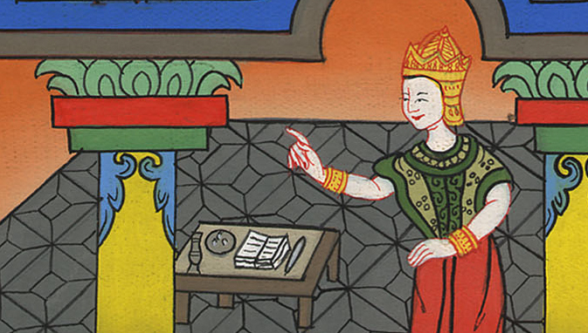
2 Samuel 11:7

Slide 19
8David said to Uriah, “Go down to your house and wash your feet.” Uriah departed out of the king’s house, and a gift from the king was sent after him.
John

Slide 20
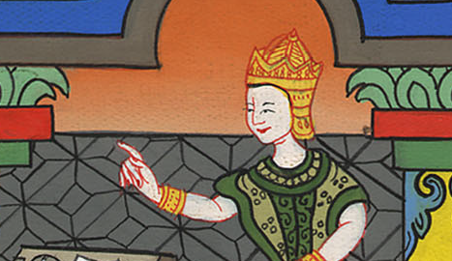
2 Samuel 11:8

Slide 21
9But Uriah slept at the door of the king’s house with all the servants of his lord, and didn’t go down to his house.
John

Slide 22
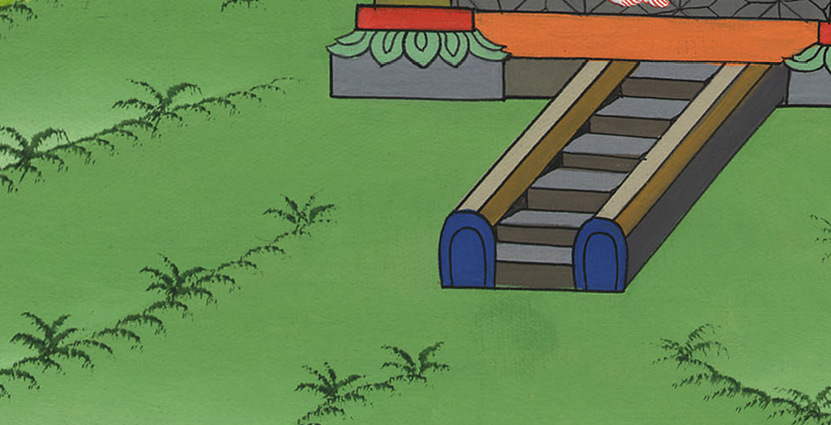
2 Samuel 11:9

Slide 23
10When they had told David, saying, “Uriah didn’t go down to his house,” David said to Uriah, “Haven’t you come from a journey? Why didn’t you go down to your house?”
John

Slide 24
2 Samuel 11:10

Slide 25
11Uriah said to David, “The ark, Israel, and Judah, are staying in tents; and my lord Joab and the servants of my lord are encamped in the open field. Shall I then go into my house to eat and to drink, and to lie with my wife? As you live, and as your soul lives, I will not do this thing!”
John

Slide 26
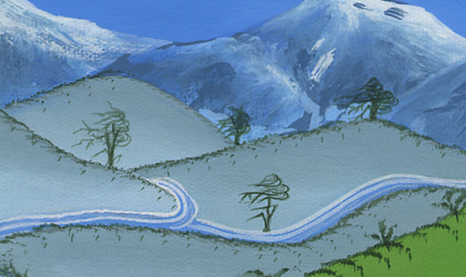
2 Samuel 11:11

Slide 27
The second night Uriah again slept outside, even though David made him drunk with wine.
John

Slide 29
14In the morning, David wrote a letter to Joab and sent it by the hand of Uriah. 15He wrote in the letter, saying, “Send Uriah to the forefront of the hottest battle, and retreat from him, that he may be struck and die.”
John

Slide 30
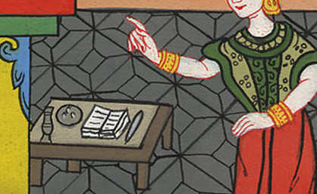
2 Samuel 11:14

Slide 31
16When Joab kept watch on the city, he assigned Uriah to the place where he knew that valiant men were. 17The men of the city went out and fought with Joab. Some of the people fell, even of David’s servants; and Uriah the Hittite died also.
John

Slide 32
2 Samuel 11:16

Slide 33
26When Uriah’s wife heard that Uriah her husband was dead, she mourned for her husband.
John

Slide 34
2 Samuel 11:26

Slide 35
27When the mourning was past, David sent and took her home to his house, and she became his wife and bore him a son. But the thing that David had done displeased Yahweh.
John

Slide 36
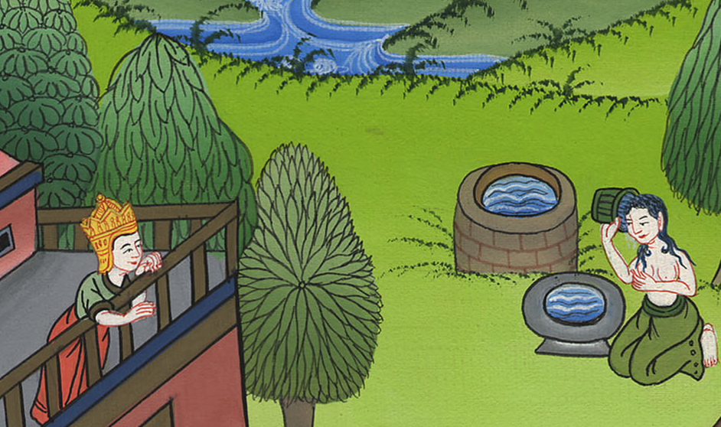
2 Samuel 11:27

