Slide 1
19-5
This work is licensed under a Creative Commons Attribution-Sharealike 4.0 International License.
Please add this statement to all the videos you create.
English Bible quotes are from the World English Bible US, which is in the public domain.
Notes:
Ch
19 David
1. Two Kings - 2 Samuel 2:4; 2:8-9; 3:1; 4:5 - 5:4 (Top)
2. Return of the ark to the city of David - 2 Sam 6:1-23 (Right Center)
3. David's reception of Mephibosheth - 2 Sam 9 (Right Bottom)
4. David, Bath-sheba and Uriah - 2 Sam 11 (Center Bottom)
5. Nathan confronts David - 2 Sam 12:1-14 (Left Bottom)
6. Solomon is born - 2 Sam 12:15-25 (Left Center)

Slide 2
Nathan confronts David –
2 Samuel 12:1-14

Slide 3
5. Nathan confronts David - 2 Samuel 12:1-14 (Left Bottom)
John

Slide 4
Nathan confronts David –
2 Samuel 12:1-14

Slide 5
2Samuel12:1Yahweh sent Nathan to David. He came to him, and said to him, “There were two men in one city: the one rich, and the other poor.
John

Slide 6
2 Samuel 12:1

Slide 7
2The rich man had very many flocks and herds,
John

Slide 8
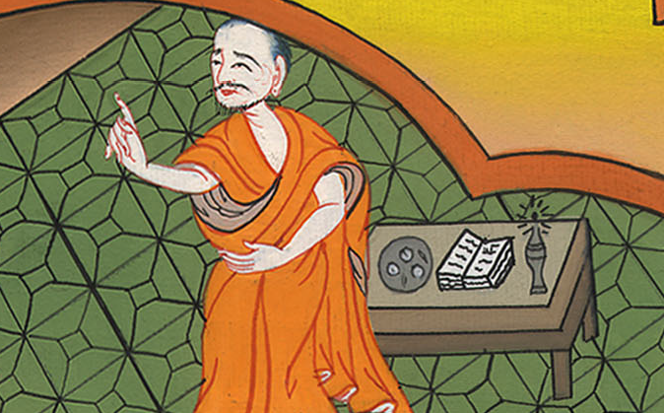
2 Samuel 12:2

Slide 9
3but the poor man had nothing, except one little ewe lamb, which he had bought and raised. It grew up together with him and with his children. It ate of his own food, drank of his own cup, and lay in his bosom, and was like a daughter to him.
John

Slide 10
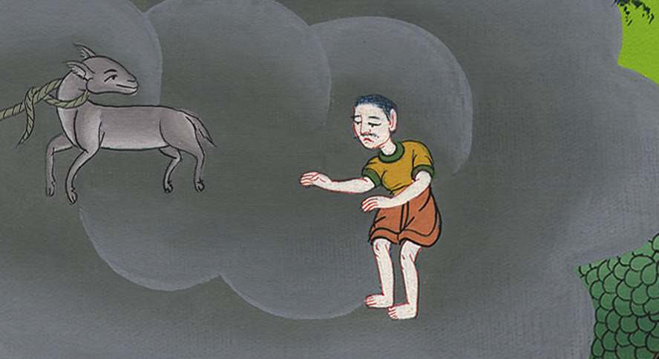
2 Samuel 12:3

Slide 11
4A traveler came to the rich man, and he didn’t want to take of his own flock and of his own herd to prepare for the wayfaring man who had come to him, but took the poor man’s lamb and prepared it for the man who had come to him.”
John

Slide 12
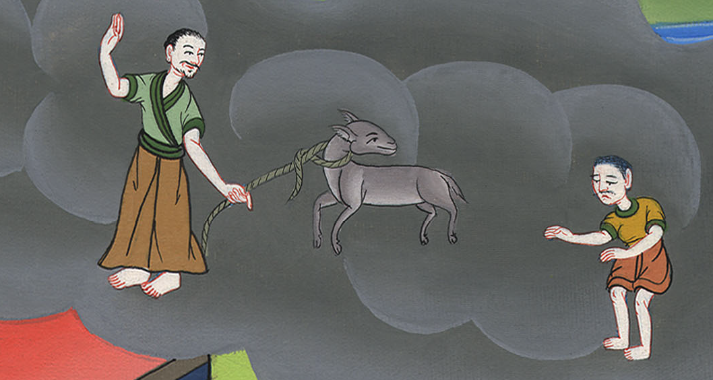
2 Samuel 12:4

Slide 13
5David’s anger burned hot against the man, and he said to Nathan, “As Yahweh lives, the man who has done this deserves to die!
John

Slide 14
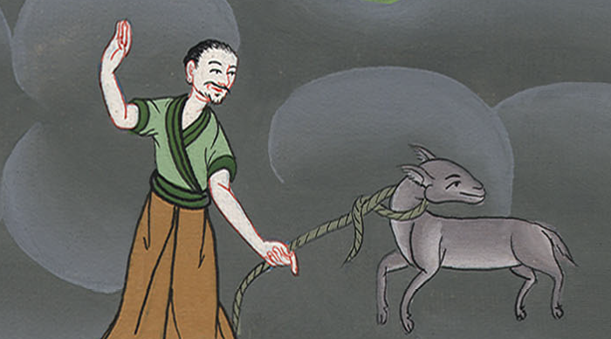
2 Samuel 12:5

Slide 15
6He must restore the lamb fourfold, because he did this thing and because he had no pity!
John

Slide 16
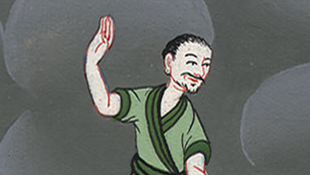
2 Samuel 12:6

Slide 17
7Nathan said to David, “You are the man! This is what Yahweh, the God of Israel, says: ‘I anointed you king over Israel, and I delivered you out of the hand of Saul.
John

Slide 18
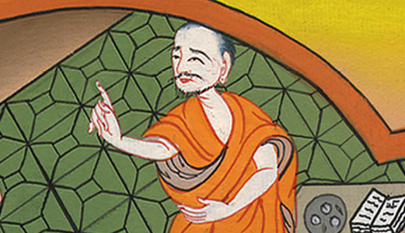
2 Samuel 12:7

Slide 19
8I gave you your master’s house and your master’s wives into your bosom, and gave you the house of Israel and of Judah; and if that would have been too little, I would have added to you many more such things.
John

Slide 20
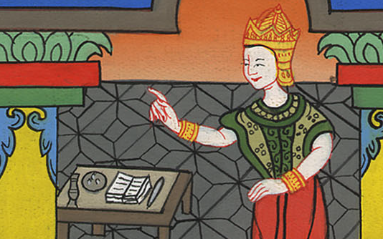
2 Samuel 12:8

Slide 21
9Why have you despised Yahweh’s word, to do that which is evil in his sight? You have struck Uriah the Hittite with the sword, have taken his wife to be your wife, and have slain him with the sword of the children of Ammon.
John

Slide 22
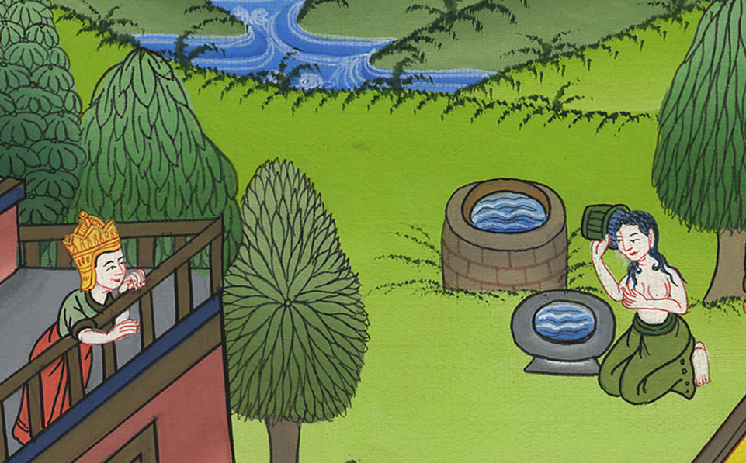
2 Samuel 12:9

Slide 23
10Now therefore the sword will never depart from your house, because you have despised me and have taken Uriah the Hittite’s wife to be your wife.’
John

Slide 24
2 Samuel 12:10

Slide 25
11“This is what Yahweh says: ‘Behold, I will raise up evil against you out of your own house; and I will take your wives before your eyes and give them to your neighbor, and he will lie with your wives in the sight of this sun.
John

Slide 26
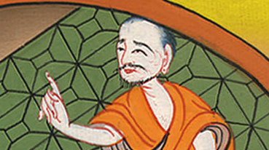
2 Samuel 12:11

Slide 27
13David said to Nathan, “I have sinned against Yahweh.”
Nathan said to David, “Yahweh also has put away your sin. You will not die.
John

Slide 28
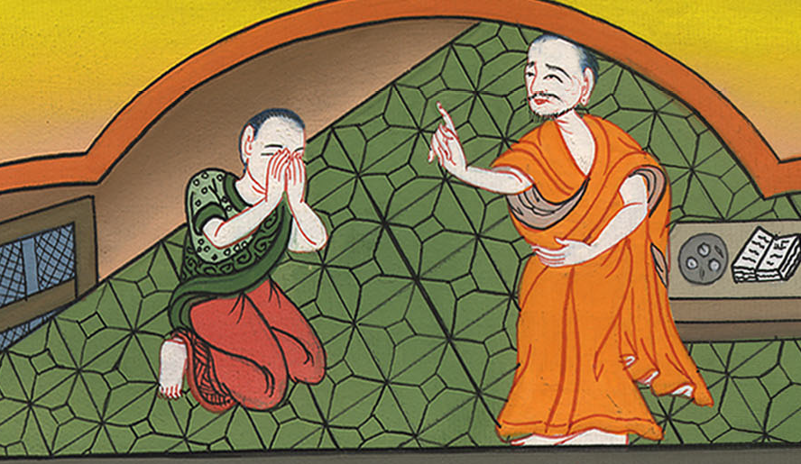
2 Samuel 12:13

Slide 29
14However, because by this deed you have given great occasion to Yahweh’s enemies to blaspheme, the child also who is born to you will surely die.”
John

Slide 30
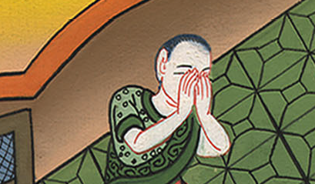
2 Samuel 12:14

Slide 31
15Then Nathan departed to his house.
John

Slide 32
2 Samuel 12:15

