Slide 1
19-6
This work is licensed under a Creative Commons Attribution-Sharealike 4.0 International License.
Please add this statement to all the videos you create.
English Bible quotes are from the World English Bible US, which is in the public domain.
Notes:
Ch
19 David
1. Two Kings - 2 Samuel 2:4; 2:8-9; 3:1; 4:5 - 5:4 (Top)
2. Return of the ark to the city of David - 2 Sam 6:1-23 (Right Center)
3. David's reception of Mephibosheth - 2 Sam 9 (Right Bottom)
4. David, Bath-sheba and Uriah - 2 Sam 11 (Center Bottom)
5. Nathan confronts David - 2 Sam 12:1-14 (Left Bottom)
6. Solomon is born - 2 Sam 12:15-25 (Left Center)

Slide 2
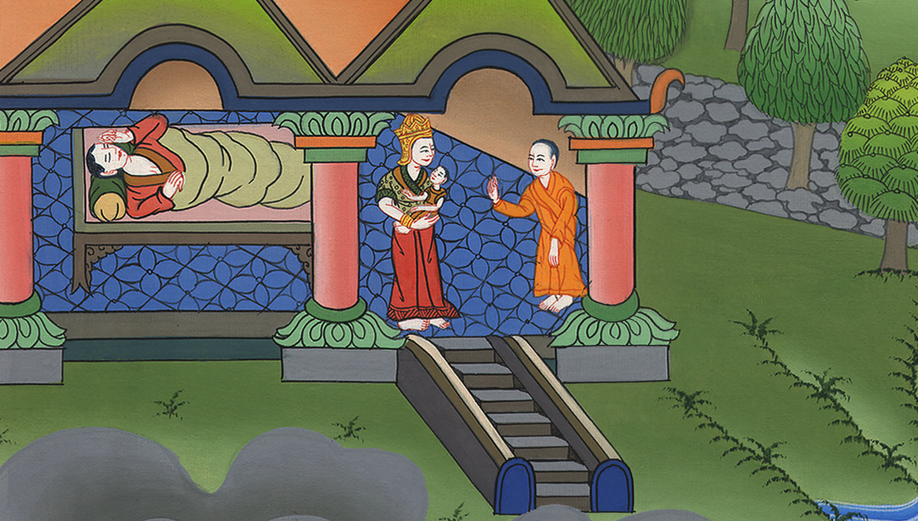
Solomon is born –
2 Samuel 12:15-25

Slide 3
6. Solomon is born - 2 Samuel 12:15-25 (Left Center)
John

Slide 4
Solomon is born –
2 Samuel 12:15-25

Slide 5
15Then Nathan departed to his house.
Yahweh struck the child that Uriah’s wife bore to David, and he was very sick.
John

Slide 6
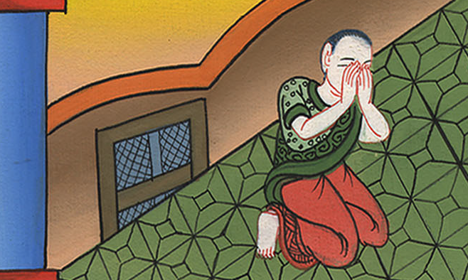
2 Samuel 12:15

Slide 7
16David therefore begged God for the child; and David fasted, and went in and lay all night on the ground.
John

Slide 8
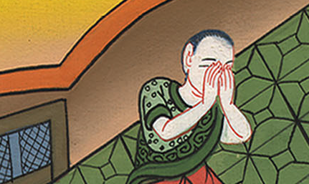
2 Samuel 12:16

Slide 9
17The elders of his house arose beside him, to raise him up from the earth; but he would not, and he didn’t eat bread with them.
John

Slide 10
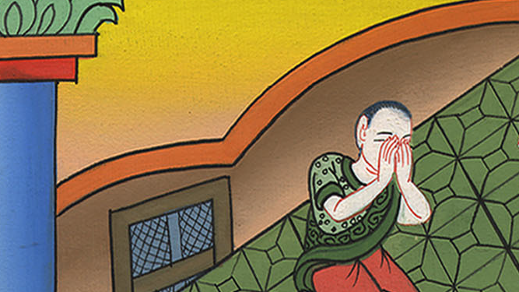
2 Samuel 12:17

Slide 11
18On the seventh day, the child died. David’s servants were afraid to tell him that the child was dead, for they said, “Behold, while the child was yet alive, we spoke to him and he didn’t listen to our voice. How will he then harm himself if we tell him that the child is dead?”
John

Slide 12
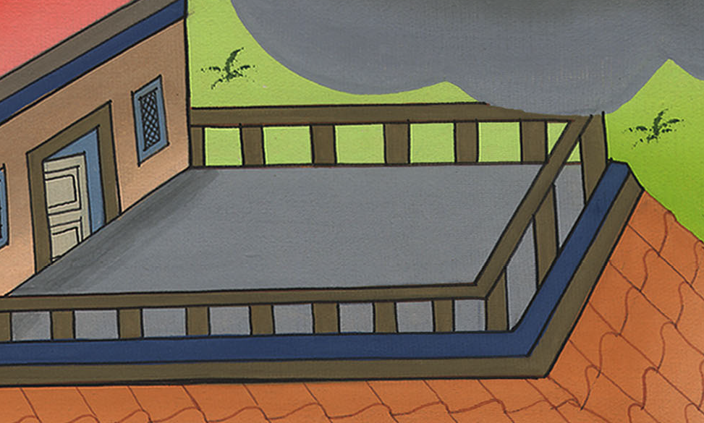
2 Samuel 12:18

Slide 13
19But when David saw that his servants were whispering together, David perceived that the child was dead; and David said to his servants, “Is the child dead?”
They said, “He is dead.”
John

Slide 14
2 Samuel 12:19

Slide 15
20Then David arose from the earth, and washed and anointed himself, and changed his clothing; and he came into Yahweh’s house, and worshiped. Then he came to his own house; and when he requested, they set bread before him and he ate.
John

Slide 16
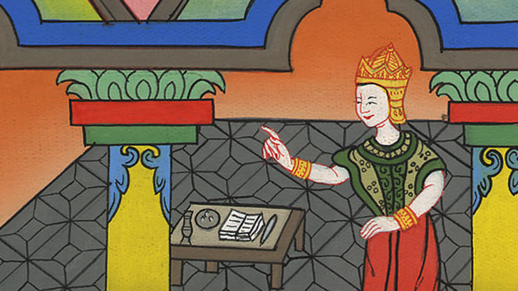
2 Samuel 12:20

Slide 17
21Then his servants said to him, “What is this that you have done? You fasted and wept for the child while he was alive, but when the child was dead, you rose up and ate bread.”
John

Slide 18
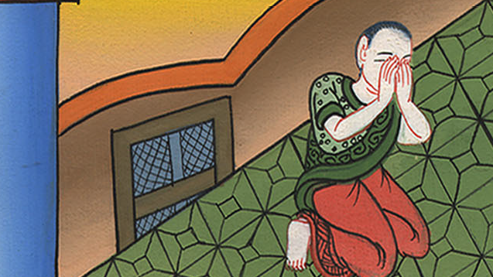
2 Samuel 12:21

Slide 19
22He said, “While the child was yet alive, I fasted and wept; for I said, ‘Who knows whether Yahweh will not be gracious to me, that the child may live?’
John

Slide 20
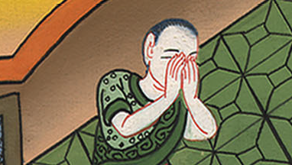
2 Samuel 12:22

Slide 21
23But now he is dead. Why should I fast? Can I bring him back again? I will go to him, but he will not return to me.”
John

Slide 22
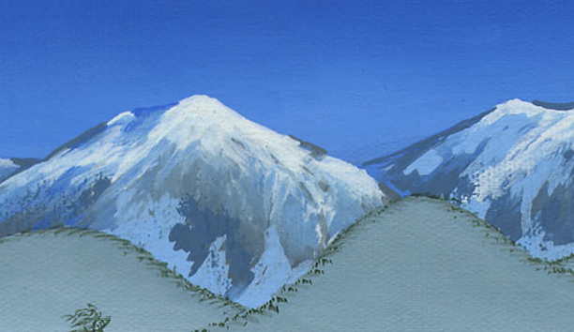
2 Samuel 12:23

Slide 23
24David comforted Bathsheba his wife, and went in to her, and lay with her. She bore a son, and he called his name Solomon. Yahweh loved him;
John

Slide 24
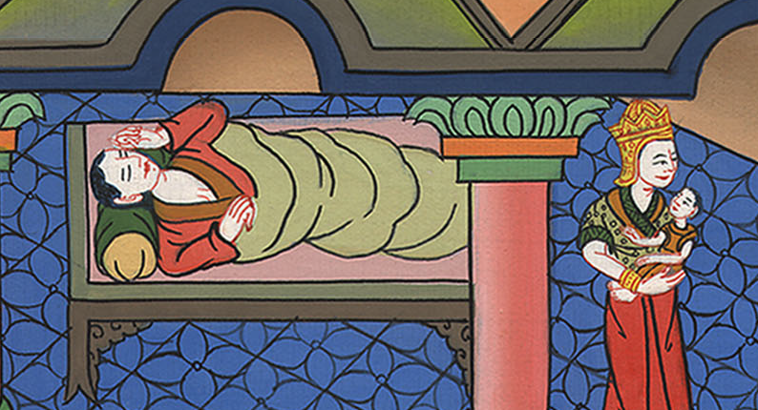
2 Samuel 12:24

Slide 25
25and he sent by the hand of Nathan the prophet, and he named him Jedidiah, for Yahweh’s sake. (Which means beloved friend of God)
John

Slide 26
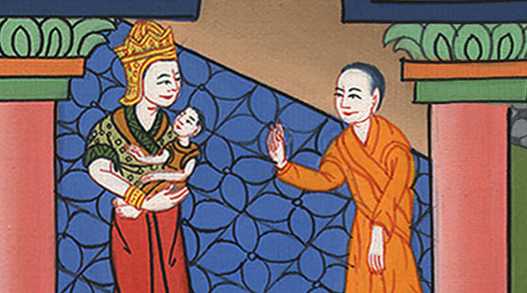
2 Samuel 12:25

