Slide 1
20-2
This work is licensed under a Creative Commons Attribution-ShareAlike 4.0 International License.
Please add this statement to all the videos you create.
English Bible quotes are from the World English Bible US, which is in the public domain.
Notes:
Ch
20 Solomon
1. David chooses Solomon - 1 Kings 1:5-53 (Left Top)
2. Solomon asks God for wisdom - 1 Kings 3:4-15 (Right Top)
3. Two women and one child - 1 Kings 3:16-28; 4:29-34 (Right Bottom)
4. Dedication of the temple - 1 Kings 6:1-14; 8:1-14, 54; 9:1-9 (Center)
5. Queen of Sheba visits Solomon -1 Kings 10:1-9 (Left Bottom)

Slide 2
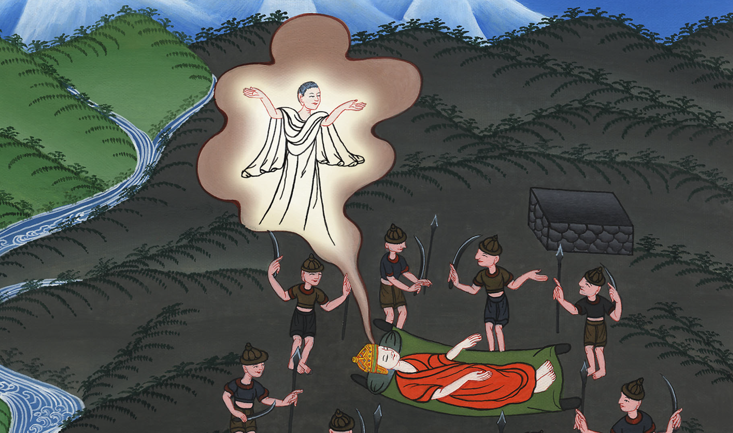
Solomon asks God for wisdom –
1 Kings 3:4-15

Slide 3
Solomon asks God for wisdom - 1 Kings 3:4-15

Slide 4
Solomon asks God for wisdom –
1 Kings 3:4-15

Slide 5
4The king went to Gibeon to sacrifice there, for that was the great high place. Solomon offered a thousand burnt offerings on that altar

Slide 6
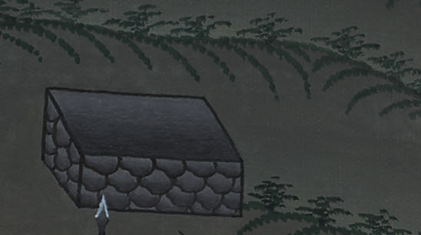
1 Kings 3:4

Slide 7
5In Gibeon, Yahweh appeared to Solomon in a dream by night; and God said, “Ask for what I should give you.”

Slide 8
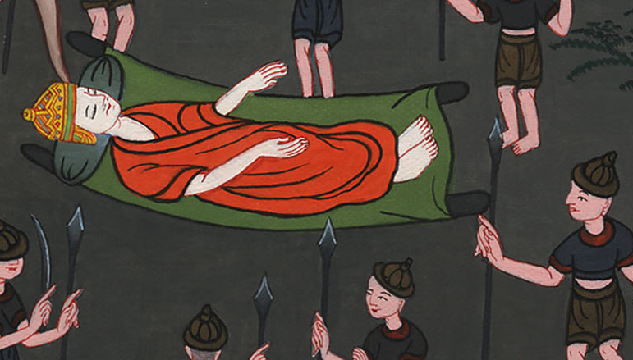
1 Kings 3:5

Slide 9
6Solomon said, “You have shown to your servant David my father great loving kindness, because he walked before you in truth, in righteousness, and in uprightness of heart with you. You have kept for him this great loving kindness, that you have given him a son to sit on his throne, as it is today.

Slide 10
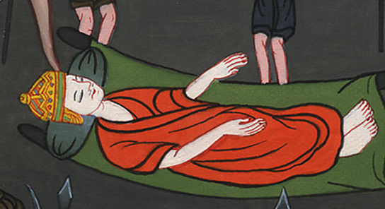
1 Kings 3:6

Slide 11
7Now, Yahweh my God, you have made your servant king instead of David my father. I am just a little child. I don’t know how to go out or come in.

Slide 12
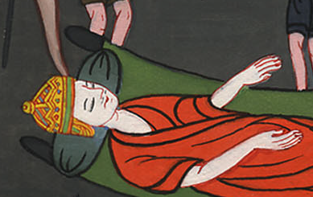
1 Kings 3:7

Slide 13
8Your servant is among your people which you have chosen, a great people, that can’t be numbered or counted for multitude.

Slide 14
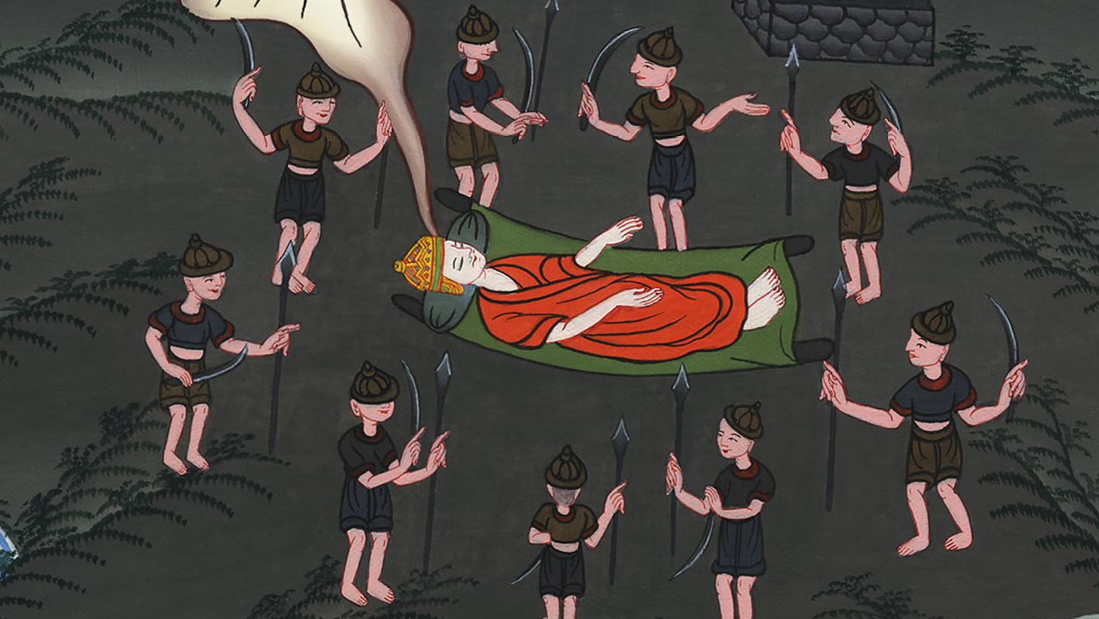
1 Kings 3:8

Slide 15
9Give your servant therefore an understanding heart to judge your people, that I may discern between good and evil; for who is able to judge this great people of yours?”

Slide 16
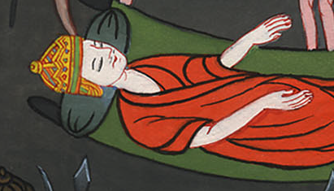
1 Kings 3:9

Slide 17
10This request pleased the Lord, that Solomon had asked this thing. 11God said to him, “Because you have asked this thing, and have not asked for yourself long life, nor have you asked for riches for yourself, nor have you asked for the life of your enemies, but have asked for yourself understanding to discern justice,

Slide 18
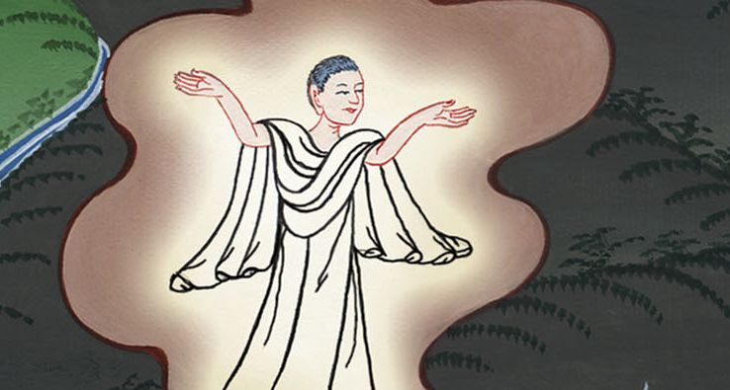
1 Kings 3:10

Slide 19
12behold, I have done according to your word. Behold, I have given you a wise and understanding heart, so that there has been no one like you before you, and after you none will arise like you.

Slide 20
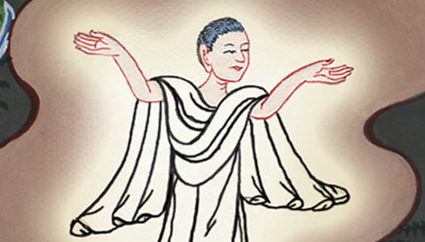
1 Kings 3:12

Slide 21
13I have also given you that which you have not asked, both riches and honor, so that there will not be any among the kings like you for all your days.

Slide 22
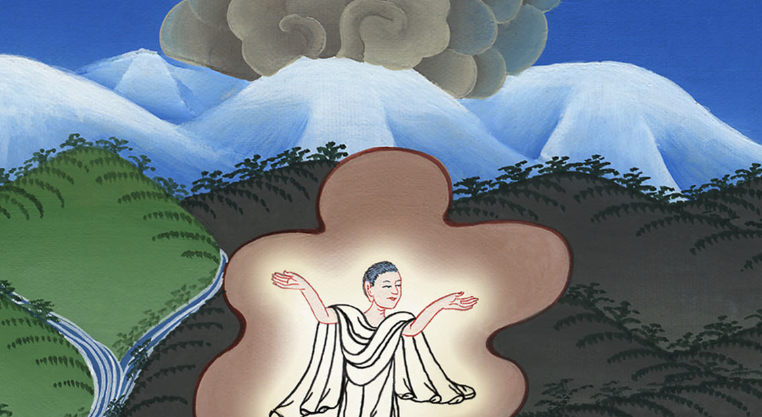
1 Kings 3:13

Slide 23
14If you will walk in my ways, to keep my statutes and my commandments, as your father David walked, then I will lengthen your days.”

Slide 24
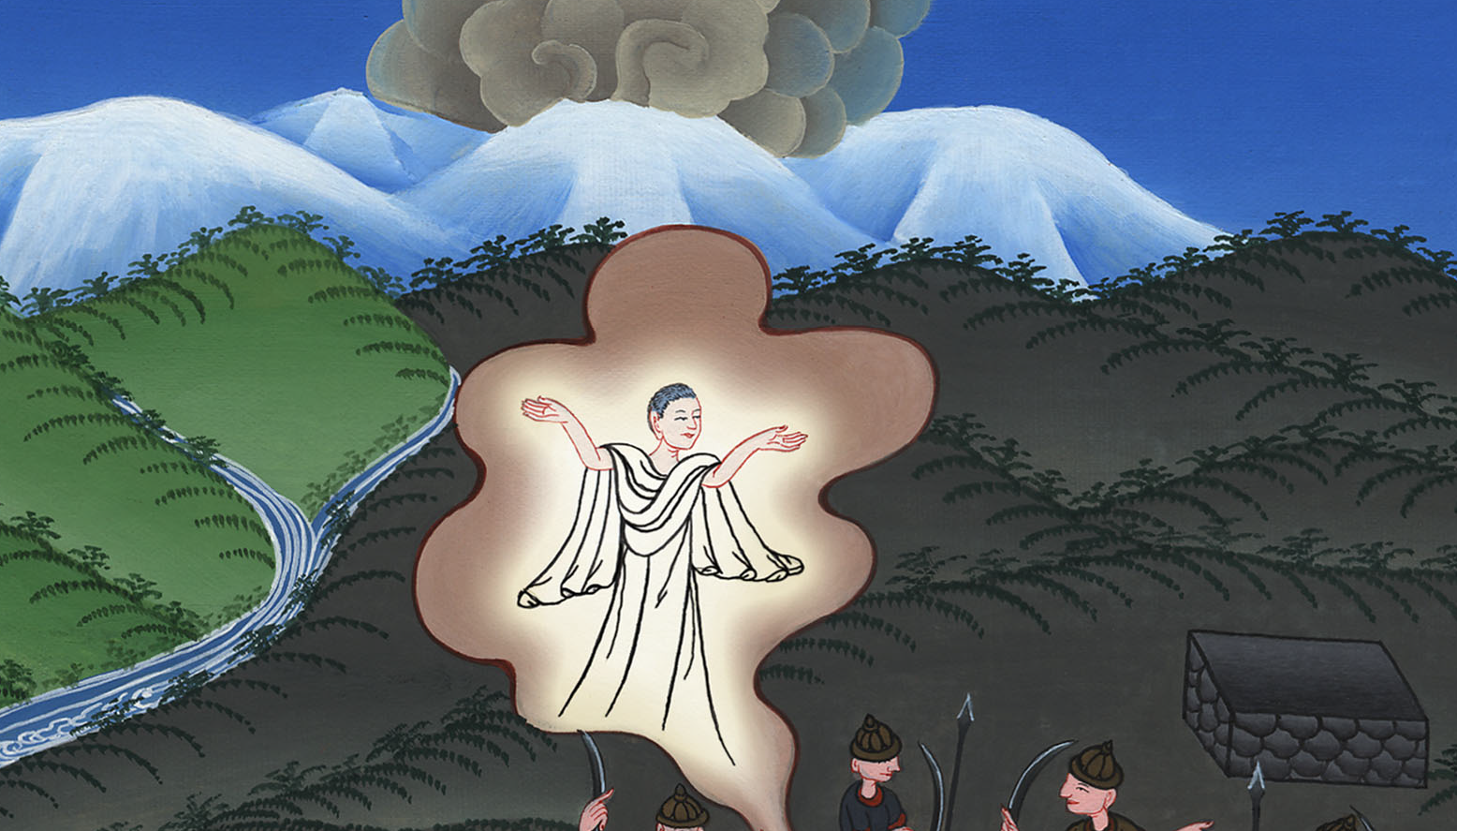
1 Kings 3:14

Slide 25
15Solomon awoke; and behold, it was a dream. Then he came to Jerusalem and stood before the ark of Yahweh’s covenant, and offered up burnt offerings, offered peace offerings, and made a feast for all his servants.

Slide 26
1 Kings 3:15

