Slide 1
20-3
This work is licensed under a Creative Commons Attribution-ShareAlike 4.0 International License.
Please add this statement to all the videos you create.
English Bible quotes are from the World English Bible US, which is in the public domain.
Notes:
Ch
20 Solomon
1. David chooses Solomon - 1 Kings 1:5-53 (Left Top)
2. Solomon asks God for wisdom - 1 Kings 3:4-15 (Right Top)
3. Two women and one child - 1 Kings 3:16-28; 4:29-34 (Right Bottom)
4. Dedication of the temple - 1 Kings 6:1-14; 8:1-14, 54; 9:1-9 (Center)
5. Queen of Sheba visits Solomon -1 Kings 10:1-9 (Left Bottom)

Slide 2
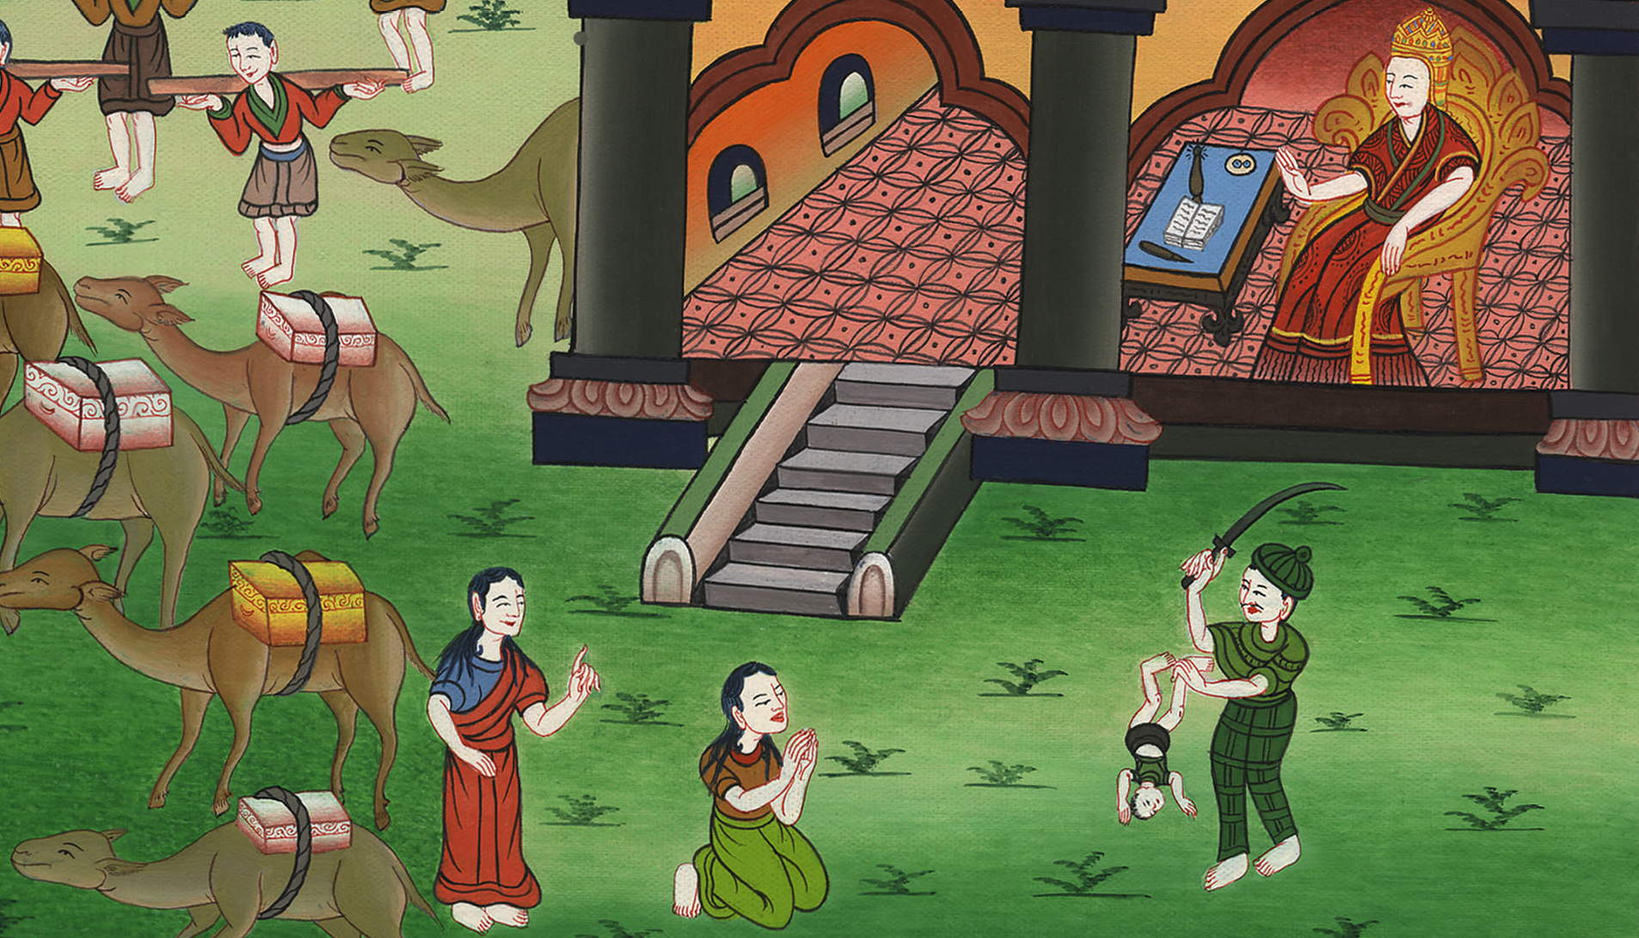
Two women and one child –
1 Kings 3:16-28; 4:29-3

Slide 3
Two women and one child - 1 Kings 3:16-28; 4:29-3

Slide 4
Two women and one child –
1 Kings 3:16-28; 4:29-3

Slide 5
16Then two women who were prostitutes came to the king, and stood before him.

Slide 6
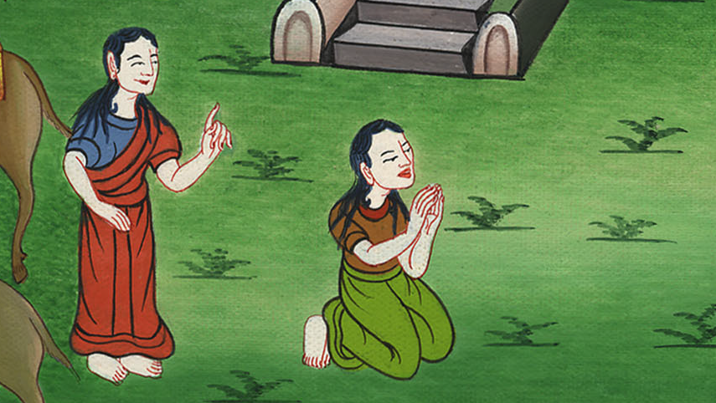
1 Kings 3:16

Slide 7
17The one woman said, “Oh, my lord, I and this woman dwell in one house. I delivered a child with her in the house.

Slide 8
1 Kings 3:17

Slide 9
18The third day after I delivered, this woman delivered also. We were together. There was no stranger with us in the house, just us two in the house.

Slide 10
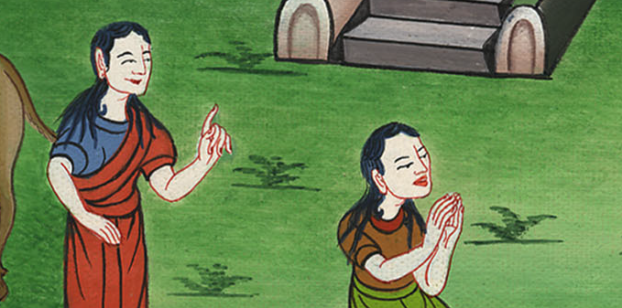
1 Kings 3:18

Slide 11
19This woman’s child died in the night, because she lay on it.

Slide 12
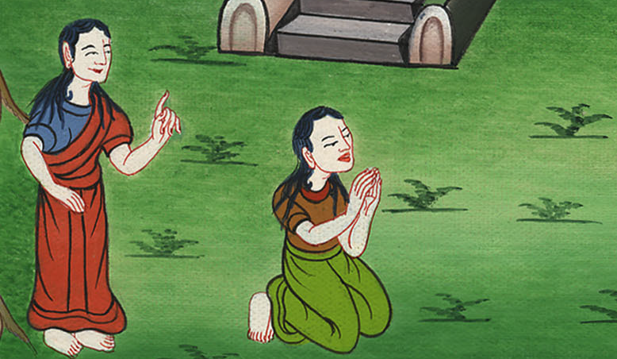
1 Kings 3:19

Slide 13
20She arose at midnight, and took my son from beside me while your servant slept, and laid it in her bosom, and laid her dead child in my bosom.

Slide 14
1 Kings 3:20

Slide 15
21When I rose in the morning to nurse my child, behold, he was dead; but when I had looked at him in the morning, behold, it was not my son whom I bore.”

Slide 16
1 Kings 3:21

Slide 17
22The other woman said, “No! But the living one is my son, and the dead one is your son.”
The first one said, “No! But the dead one is your son, and the living one is my son.” They argued like this before the king

Slide 18
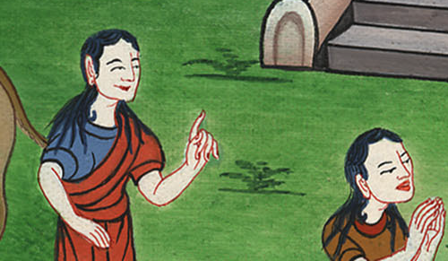
1 Kings 3:22

Slide 19
23Then the king said, “One says, ‘This is my son who lives, and your son is the dead;’ and the other says, ‘No! But your son is the dead one, and my son is the living one.’”

Slide 20
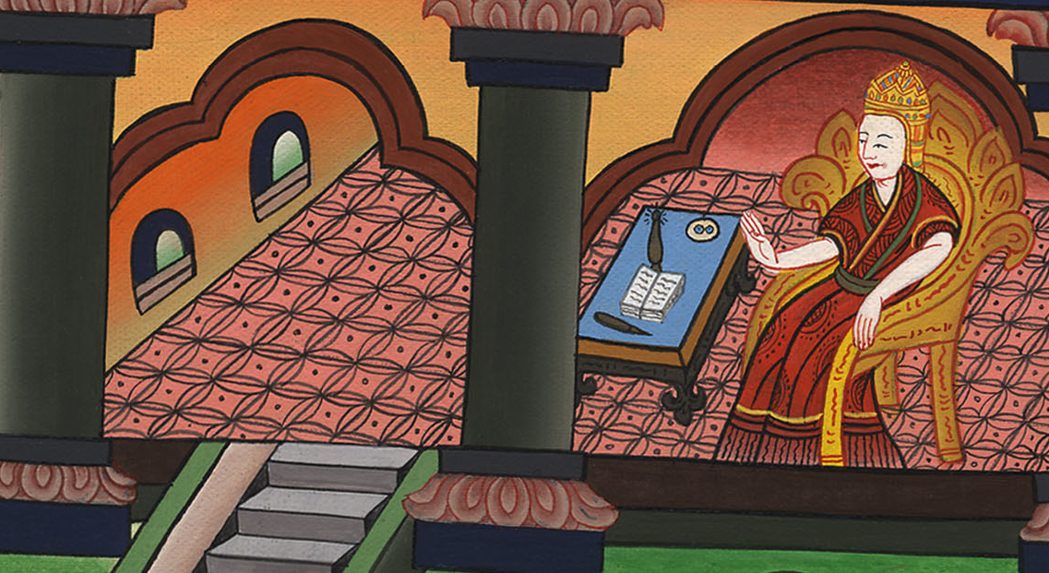
1 Kings 3:23

Slide 21
24The king said, “Get me a sword.” So they brought a sword before the king.
25The king said, “Divide the living child in two, and give half to the one, and half to the other.”

Slide 22
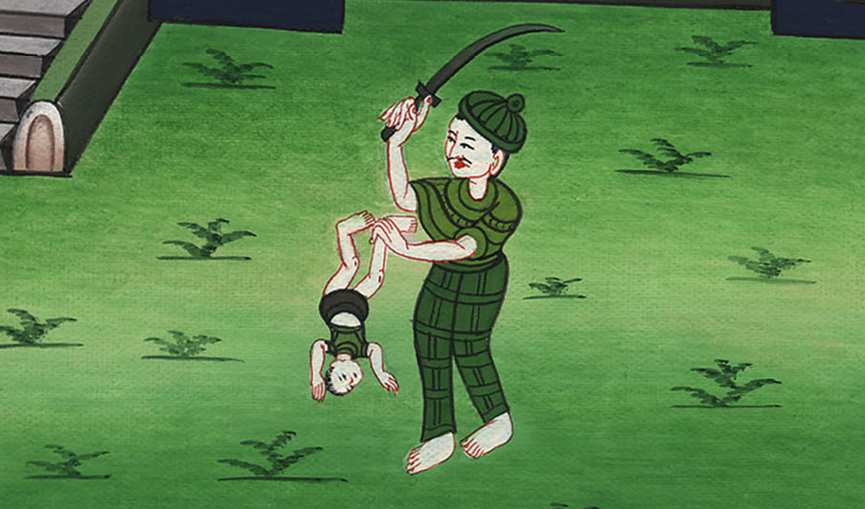
1 Kings 3:24-25

Slide 23
26Then the woman whose the living child was spoke to the king, for her heart yearned over her son, and she said, “Oh, my lord, give her the living child, and in no way kill him!”

Slide 24
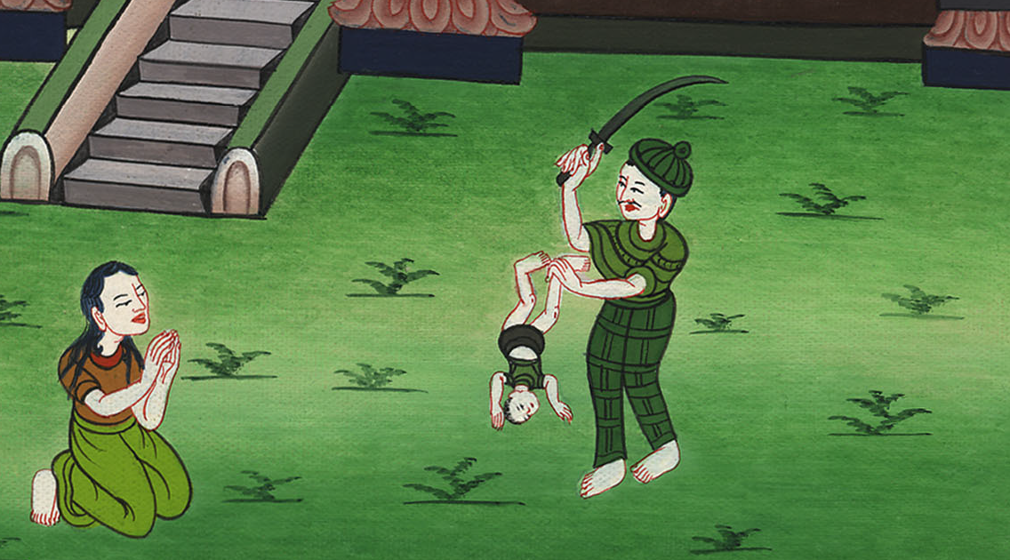
1 Kings 3:26

Slide 25
But the other said, “He shall be neither mine nor yours. Divide him.”

Slide 26
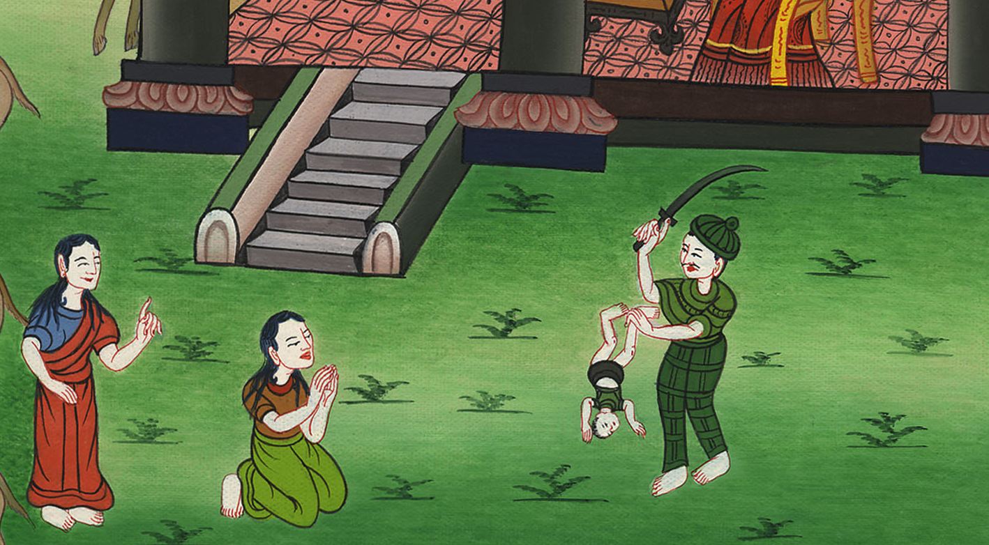
1 Kings 3:26

Slide 27
27Then the king answered, “Give the first woman the living child, and definitely do not kill him. She is his mother.”

Slide 28
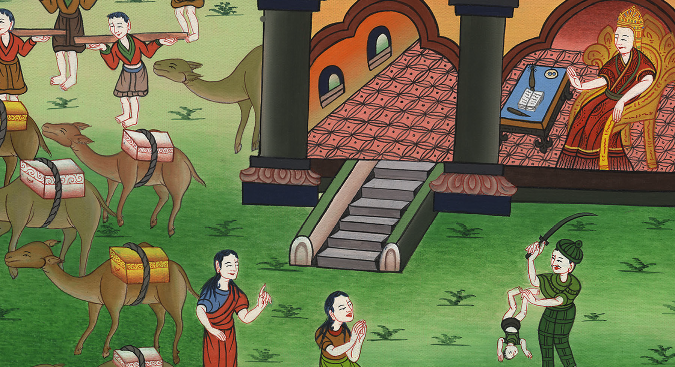
1 Kings ། 3:27

Slide 29
28All Israel heard of the judgment which the king had judged; and they feared the king, for they saw that the wisdom of God was in him to do justice.

Slide 30
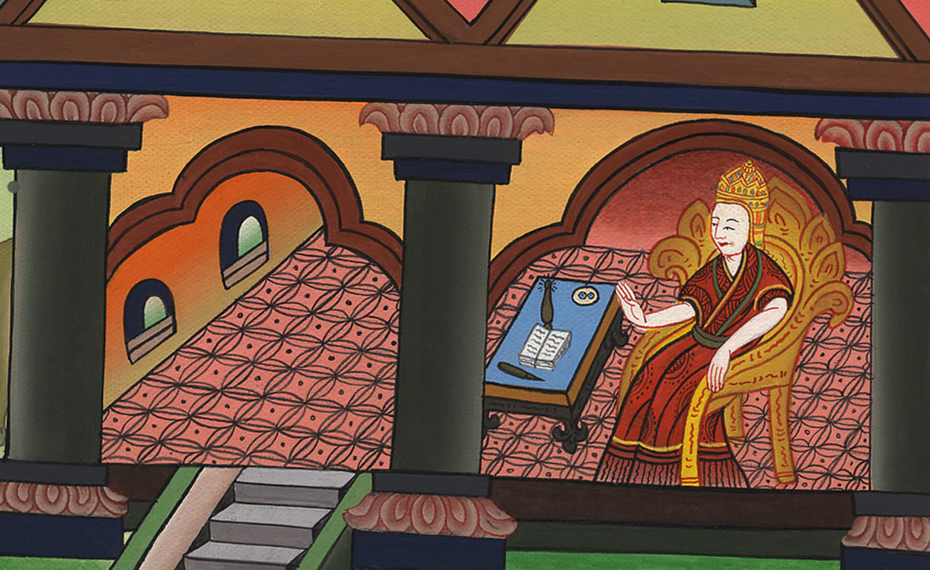
1 Kings 3:28

Slide 31
4:29God gave Solomon abundant wisdom, understanding, and breadth of mind like the sand that is on the seashore.

Slide 32
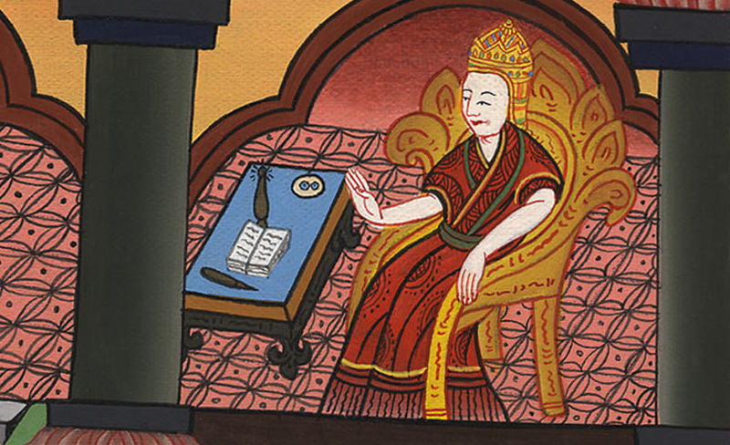
1 Kings 4:29

Slide 33
31For he was wiser than all men…and his fame was in all the nations all around. 32He spoke three thousand proverbs, and his songs numbered one thousand five.

Slide 34
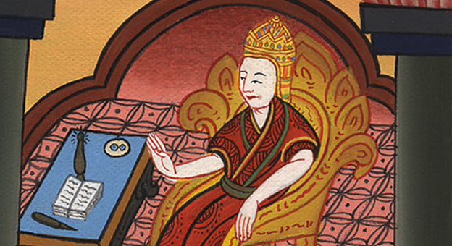
1 Kings 4:31-32

Slide 35
33He spoke of trees, from the cedar that is in Lebanon even to the hyssop that grows out of the wall; he also spoke of animals, of birds, of creeping things, and of fish.

Slide 36
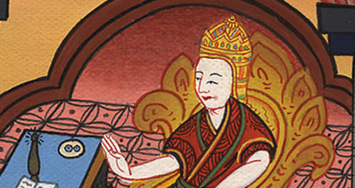
1 Kings 4:33

Slide 37
34People of all nations came to hear the wisdom of Solomon, sent by all kings of the earth who had heard of his wisdom.

Slide 38
1 Kings 4:34

