Slide 1
20-4
This work is licensed under a Creative Commons Attribution-ShareAlike 4.0 International License.
Please add this statement to all the videos you create.
English Bible quotes are from the World English Bible US, which is in the public domain.
Notes:
Ch
20 Solomon
1. David chooses Solomon - 1 Kings 1:5-53 (Left Top)
2. Solomon asks God for wisdom - 1 Kings 3:4-15 (Right Top)
3. Two women and one child - 1 Kings 3:16-28; 4:29-34 (Right Bottom)
4. Dedication of the temple - 1 Kings 6:1-14; 8:1-14, 54; 9:1-9 (Center)
5. Queen of Sheba visits Solomon -1 Kings 10:1-9 (Left Bottom)

Slide 2
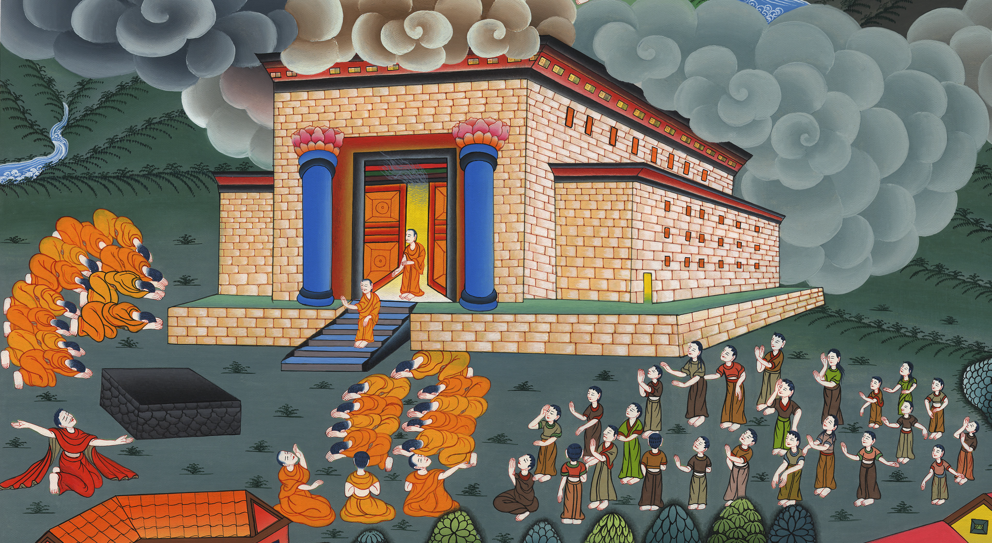
Dedication of the temple –
1 Kings 6:1-14; 8:1-14, 54; 9:1-9

Slide 3
Dedication of the temple - 1 Kings 6:1-14; 8:1-14, 54; 9:1-9

Slide 4
Dedication of the temple –
1 Kings 6:1-14; 8:1-14, 54; 9:1-9

Slide 5
1In the four hundred and eightieth year after the children of Israel had come out of the land of Egypt, … he began to build Yahweh’s house.

Slide 6
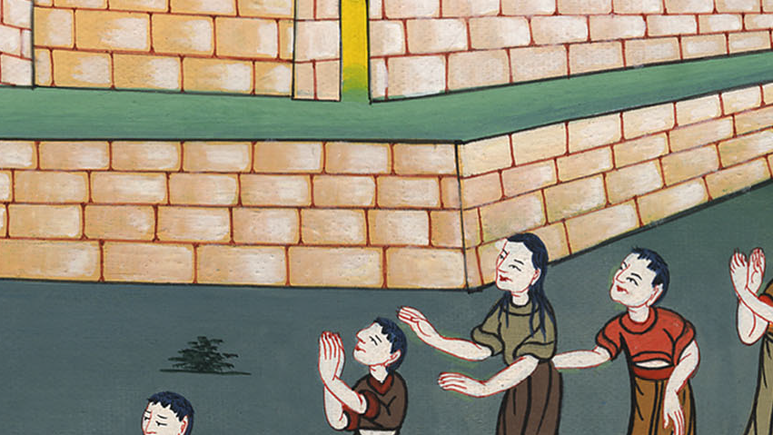
1 Kings 6:1

Slide 7
2The house which King Solomon built for Yahweh had a length of sixty cubits, and its width twenty, and its height thirty cubits.

Slide 8
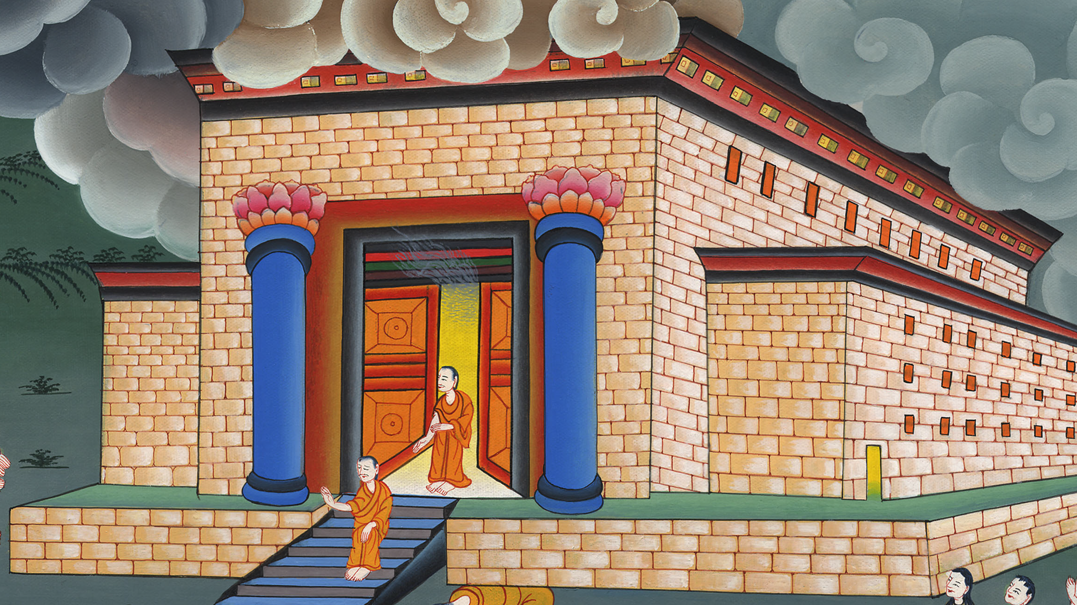
1 Kings 6:2

Slide 9
3The porch in front of the temple of the house had a length of twenty cubits, which was along the width of the house. Ten cubits was its width in front of the house. 4He made windows of fixed lattice work for the house. 5Against the wall of the house, he built floors all around, against the walls of the house all around, both of the temple and of the inner sanctuary; and he made side rooms all around.

Slide 10
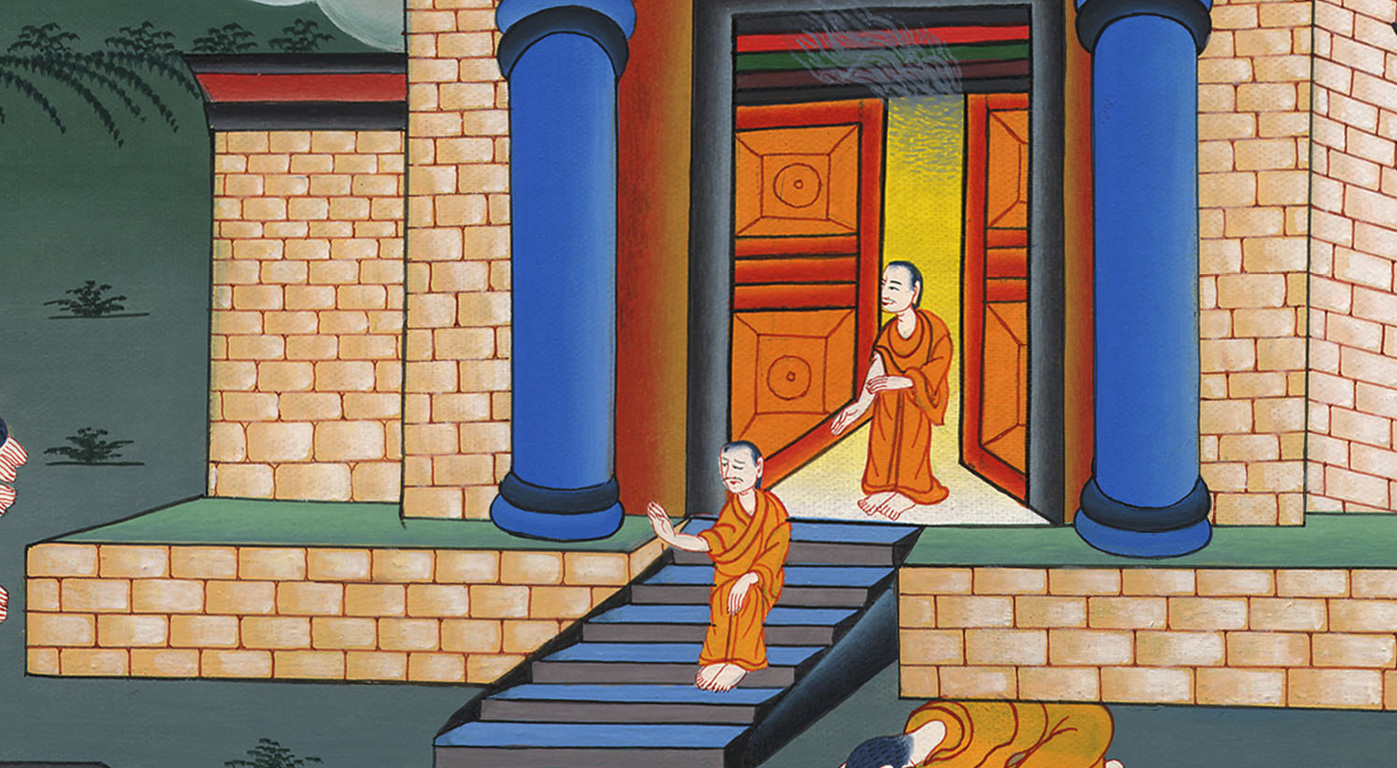
1 Kings 6:3

Slide 11
7The house, when it was under construction, was built of stone prepared at the quarry; and no hammer or ax or any tool of iron was heard in the house while it was under construction.

Slide 12
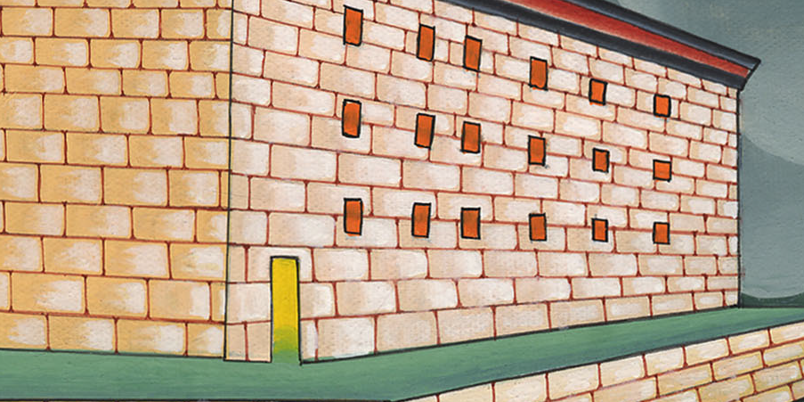
1 Kings 6:7

Slide 13
9So he built the house and finished it; and he covered the house with beams and planks of cedar.

Slide 14
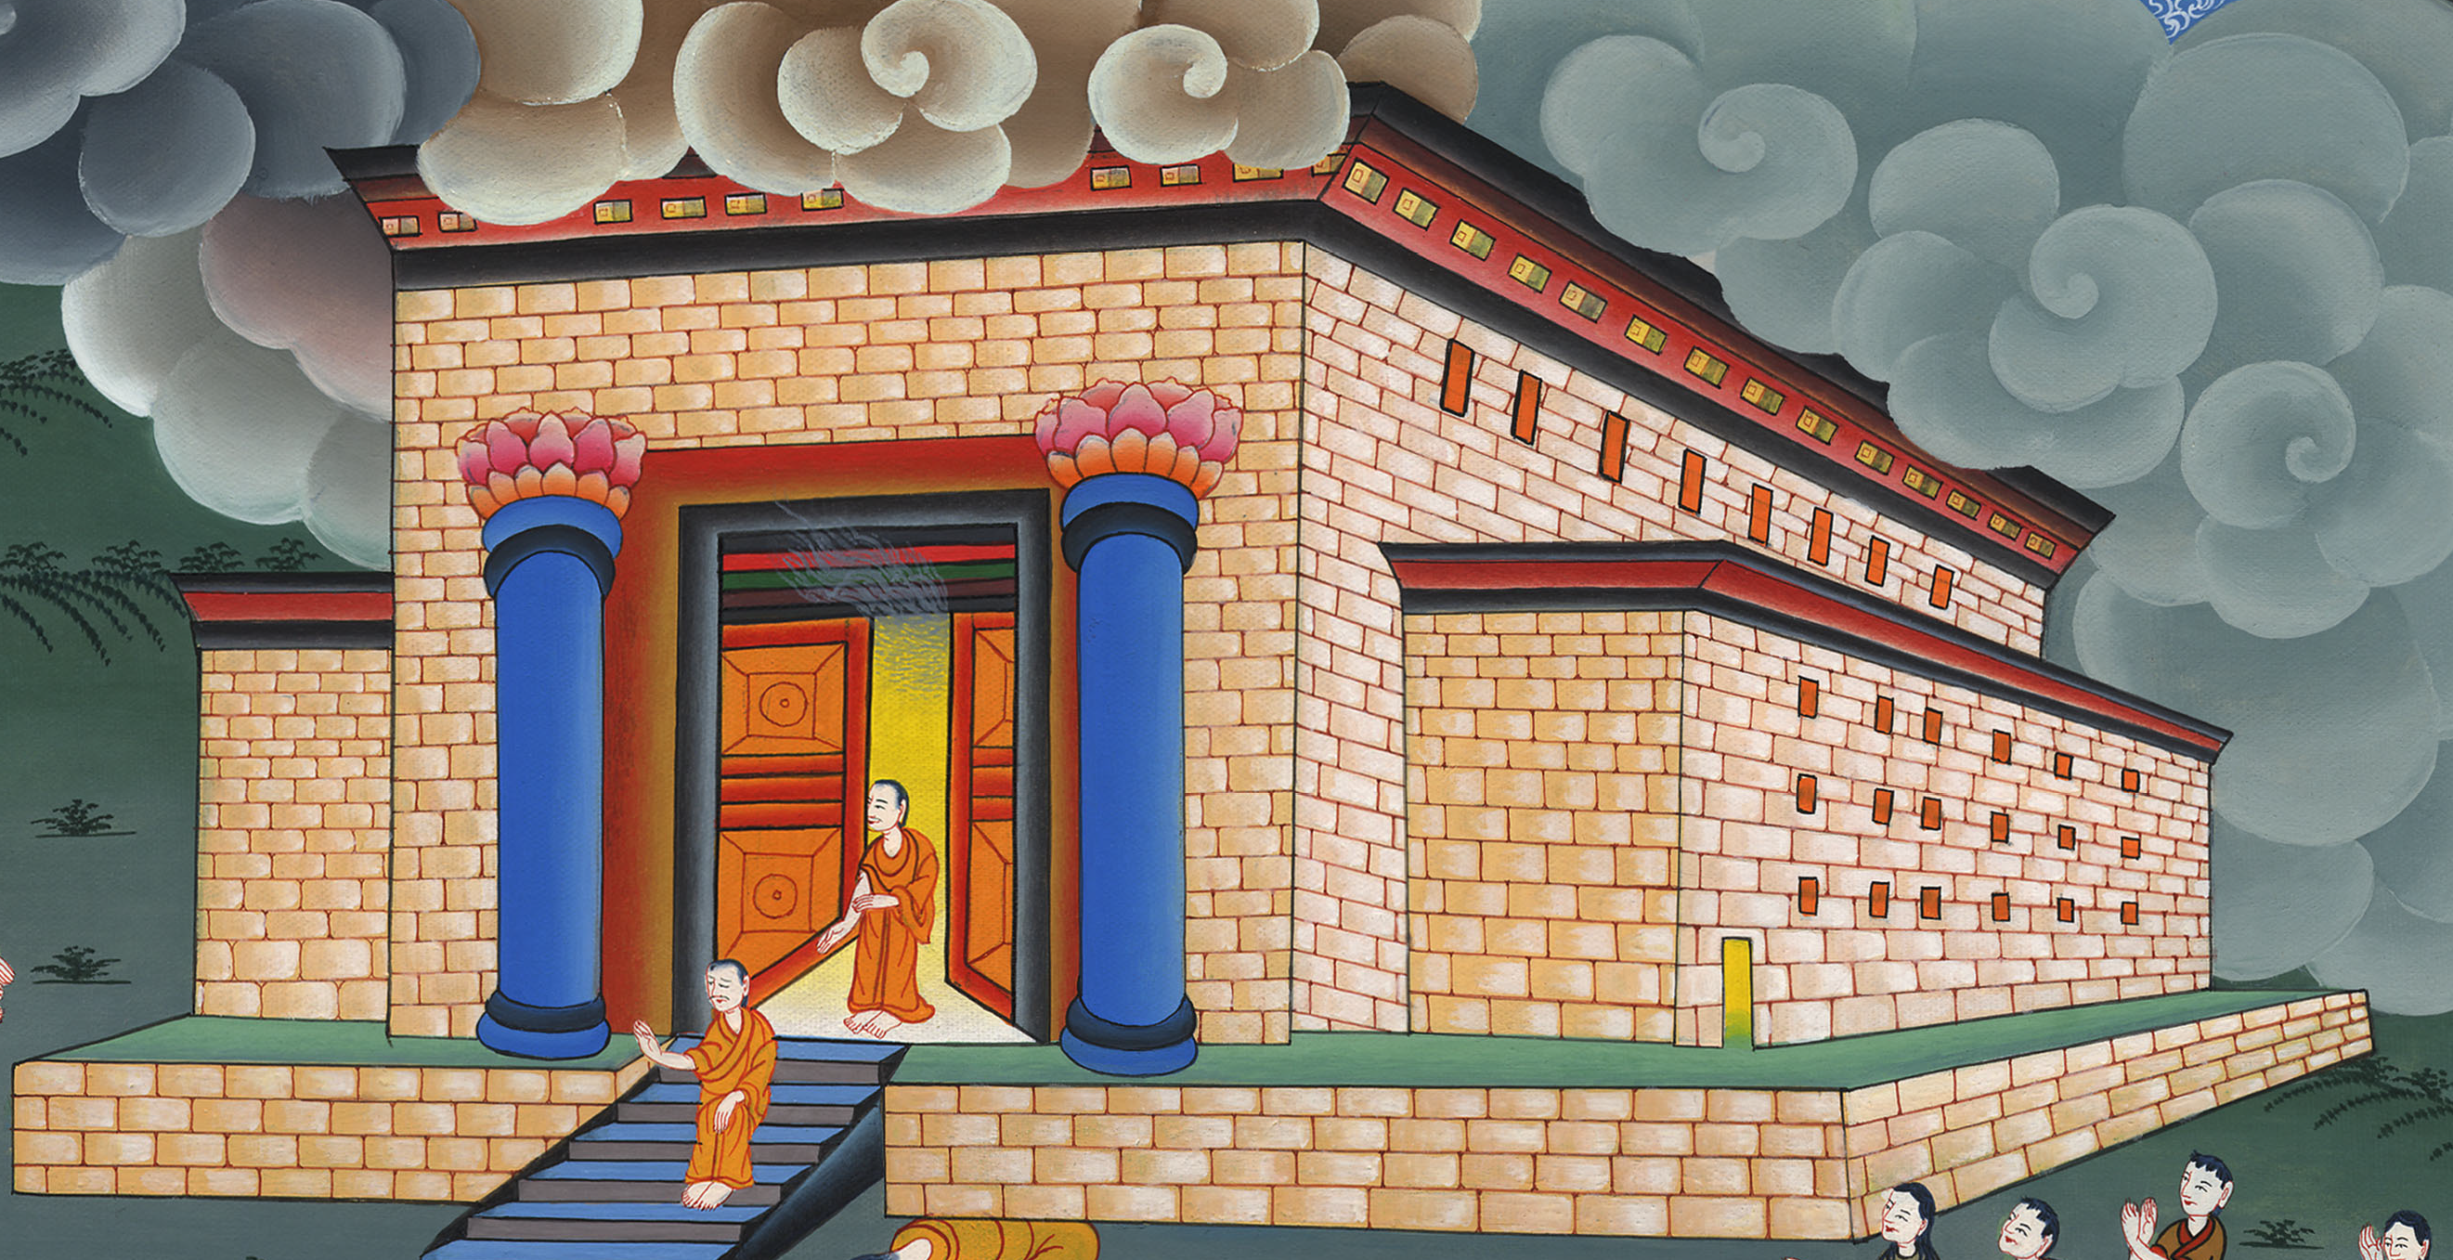
1 Kings 6:9

Slide 15
19He prepared an inner sanctuary in the middle of the house within, to set the ark of Yahweh’s covenant there.

Slide 16
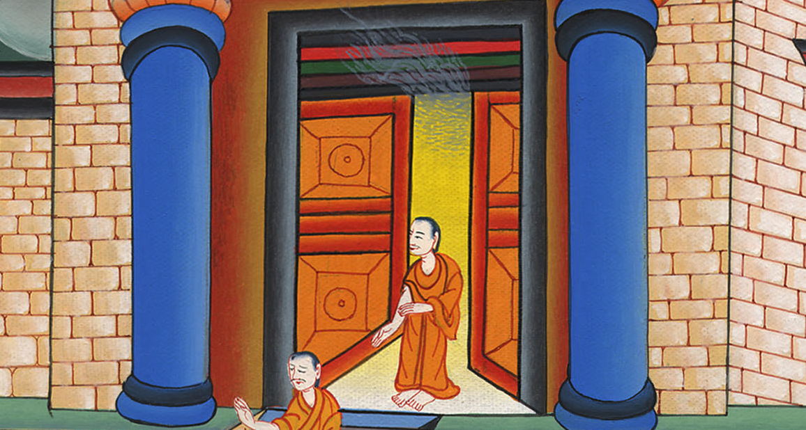
1 Kings 6:19

Slide 17
22He overlaid the whole house with gold, until all the house was finished. He also overlaid the whole altar that belonged to the inner sanctuary with gold.

Slide 18
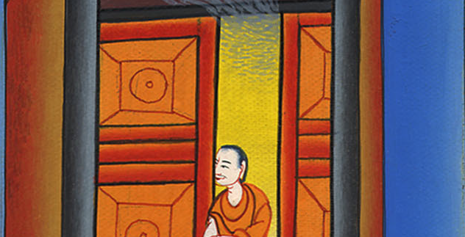
1 Kings 6:22

Slide 19
1Then Solomon assembled the elders of Israel with all the heads of the tribes, the princes of the fathers’ households of the children of Israel, to King Solomon in Jerusalem, to bring up the ark of Yahweh’s covenant out of David’s city, which is Zion.

Slide 20
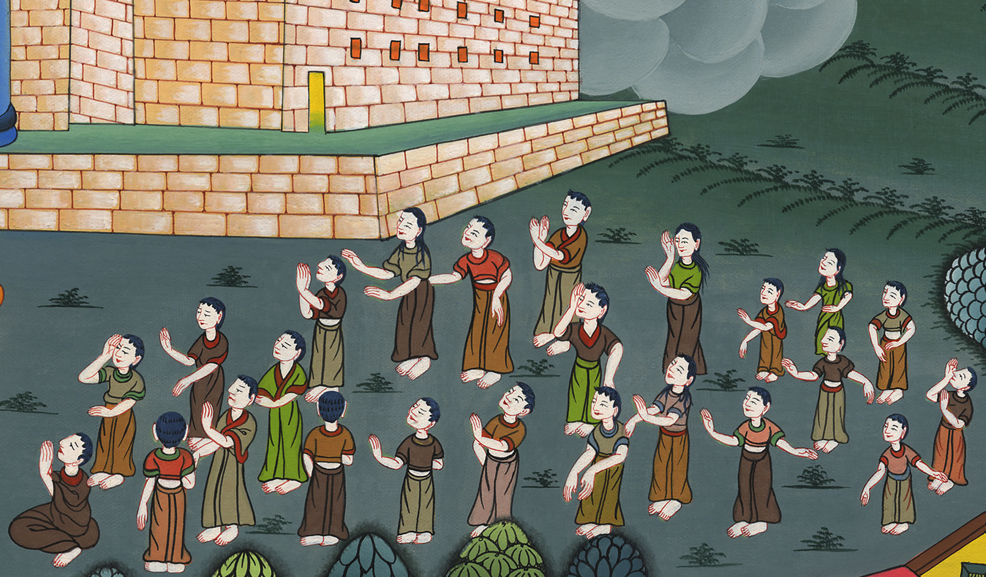
1 Kings 8:1

Slide 21
6The priests brought in the ark of Yahweh’s covenant to its place, into the inner sanctuary of the house, to the most holy place, even under the cherubim’s wings.

Slide 22
1 Kings 8:6

Slide 23
10It came to pass, when the priests had come out of the holy place, that the cloud filled Yahweh’s house, 11so that the priests could not stand to minister by reason of the cloud; for Yahweh’s glory filled Yahweh’s house.

Slide 24
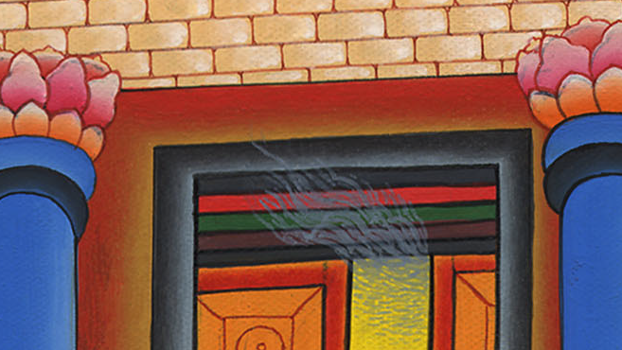
1 Kings 8:10,11

Slide 25
22Solomon stood before Yahweh’s altar in the presence of all the assembly of Israel, and spread out his hands toward heaven;

Slide 26
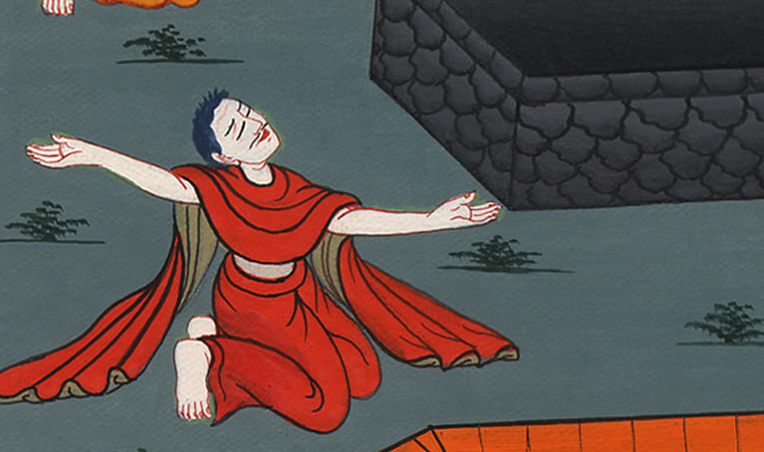
1 Kings 8:22

Slide 27
12Then Solomon said, “Yahweh has said that he would dwell in the thick darkness. 13I have surely built you a house of habitation, a place for you to dwell in forever.”

Slide 28
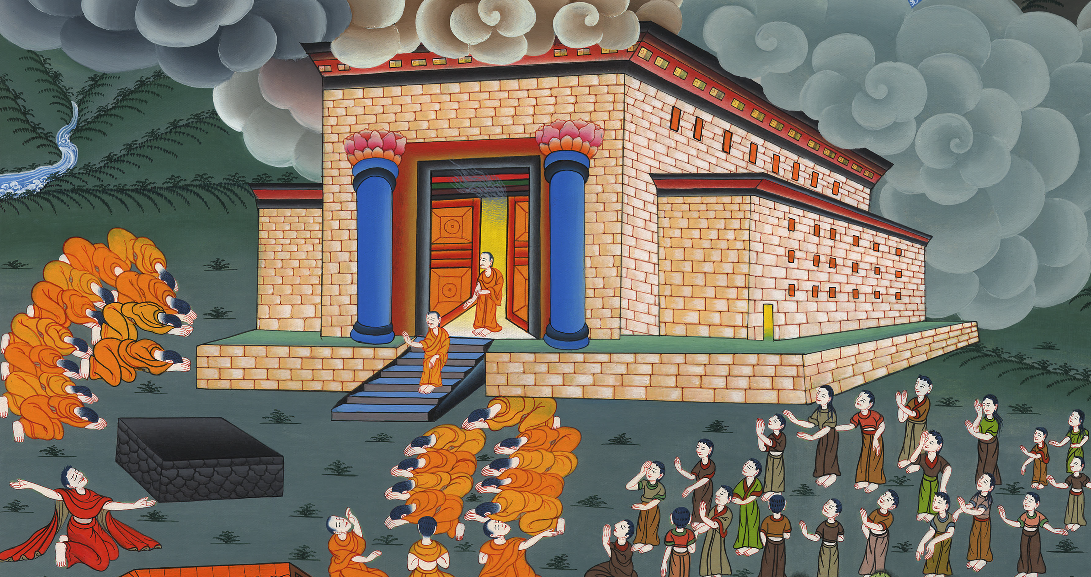
1 Kings 8:12,13

Slide 29
27But will God in very deed dwell on the earth? Behold, heaven and the heaven of heavens can’t contain you; how much less this house that I have built!

Slide 30
1 Kings 8:27

Slide 31
54It was so, that when Solomon had finished praying all this prayer and supplication to Yahweh, he arose from before Yahweh’s altar, from kneeling on his knees with his hands spread out toward heaven.

Slide 32
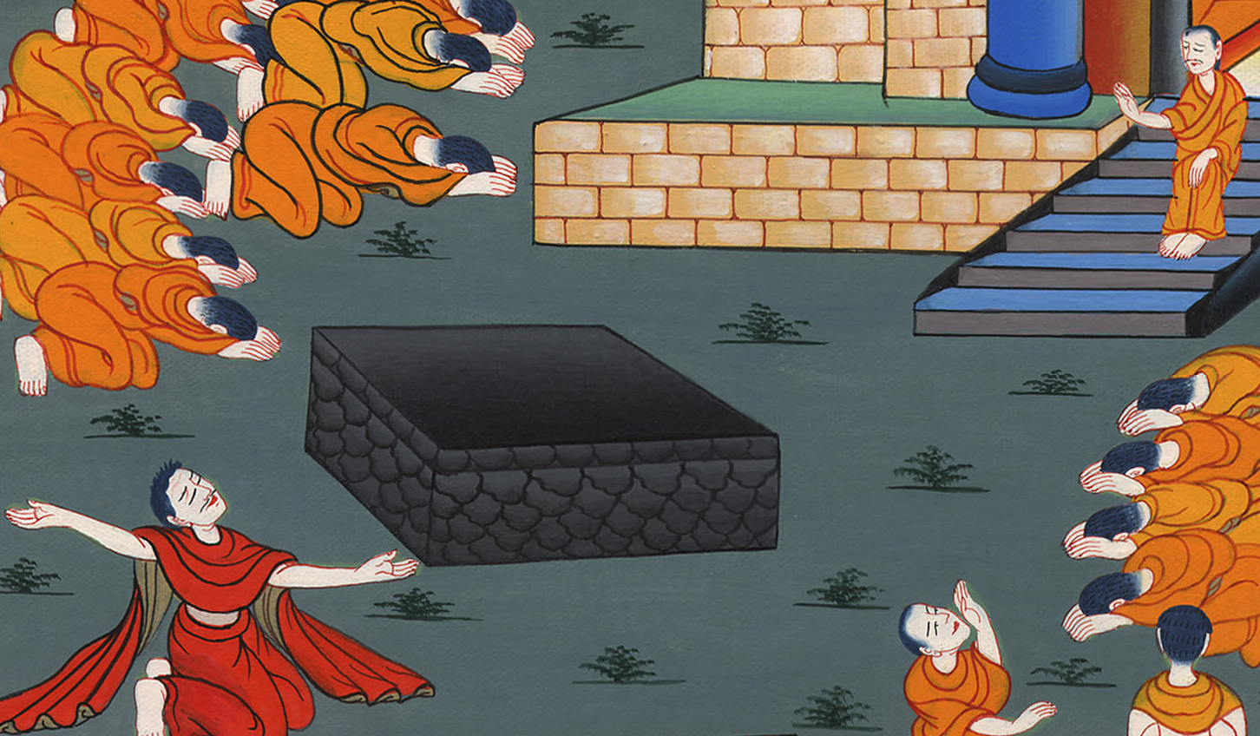
1 Kings 8:54

