Slide 1
20-5
This work is licensed under a Creative Commons Attribution-ShareAlike 4.0 International License.
Please add this statement to all the videos you create.
English Bible quotes are from the World English Bible US, which is in the public domain.
Notes:
Ch
20 Solomon
1. David chooses Solomon - 1 Kings 1:5-53 (Left Top)
2. Solomon asks God for wisdom - 1 Kings 3:4-15 (Right Top)
3. Two women and one child - 1 Kings 3:16-28; 4:29-34 (Right Bottom)
4. Dedication of the temple - 1 Kings 6:1-14; 8:1-14, 54; 9:1-9 (Center)
5. Queen of Sheba visits Solomon -1 Kings 10:1-9 (Left Bottom)

Slide 2
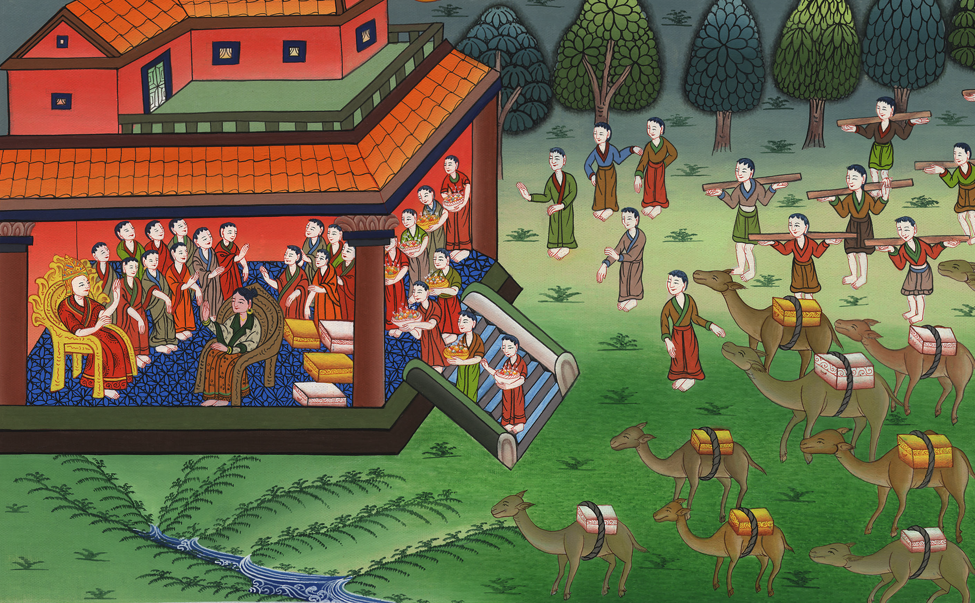
Queen of Sheba visits Solomon –
1 Kings 10:1-9

Slide 3
Queen of Sheba visits Solomon -1 Kings 10:1-9

Slide 4
Queen of Sheba visits Solomon –
1 Kings 10:1-9

Slide 5
1When the queen of Sheba heard of the fame of Solomon concerning Yahweh’s name, she came to test him with hard questions.

Slide 6
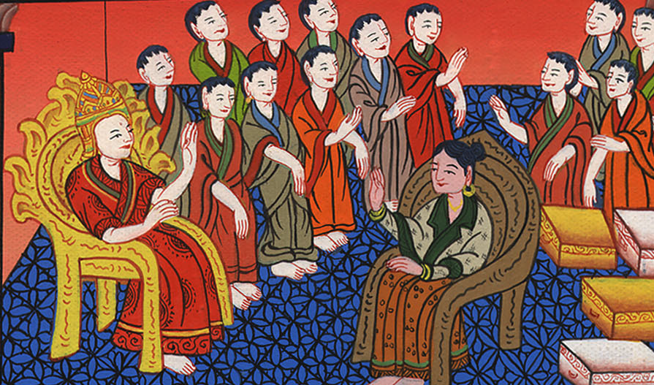
1 Kings 10:1

Slide 7
2She came to Jerusalem with a very great caravan, with camels that bore spices, very much gold, and precious stones; and when she had come to Solomon, she talked with him about all that was in her heart.

Slide 8
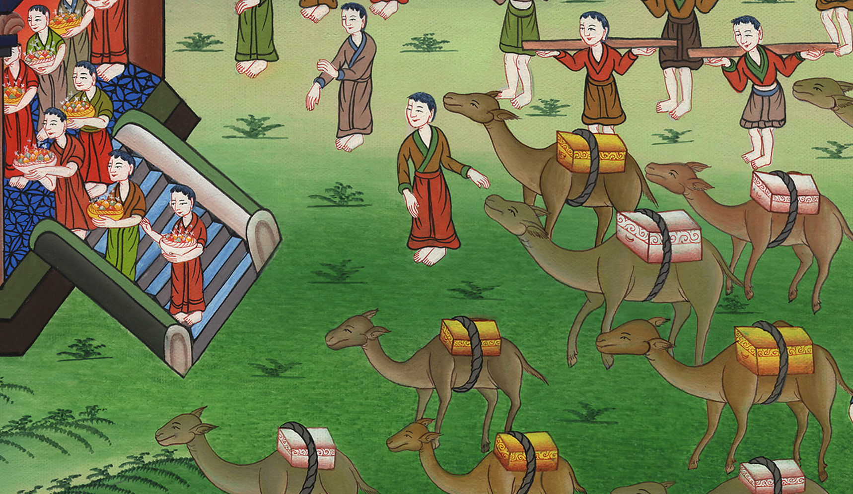
1 Kings 10:2

Slide 9
3Solomon answered all her questions. There wasn’t anything hidden from the king which he didn’t tell her. 4When the queen of Sheba had seen all the wisdom of Solomon, the house that he had built,

Slide 10
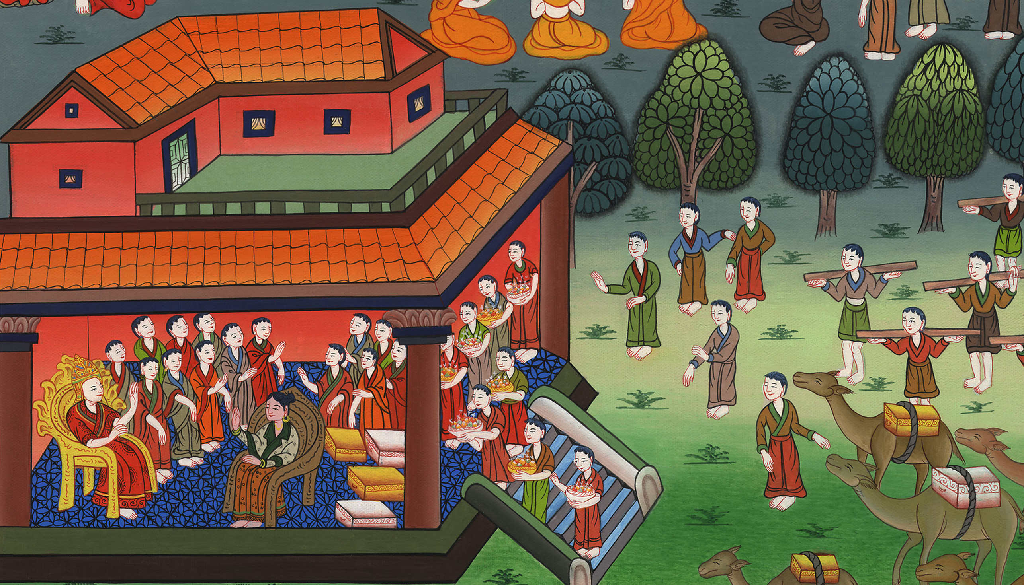
1 Kings 10:3,4

Slide 11
5the food of his table, the sitting of his servants, the attendance of his officials, their clothing, his cup bearers, and his ascent by which he went up to Yahweh’s house, there was no more spirit in her.

Slide 12
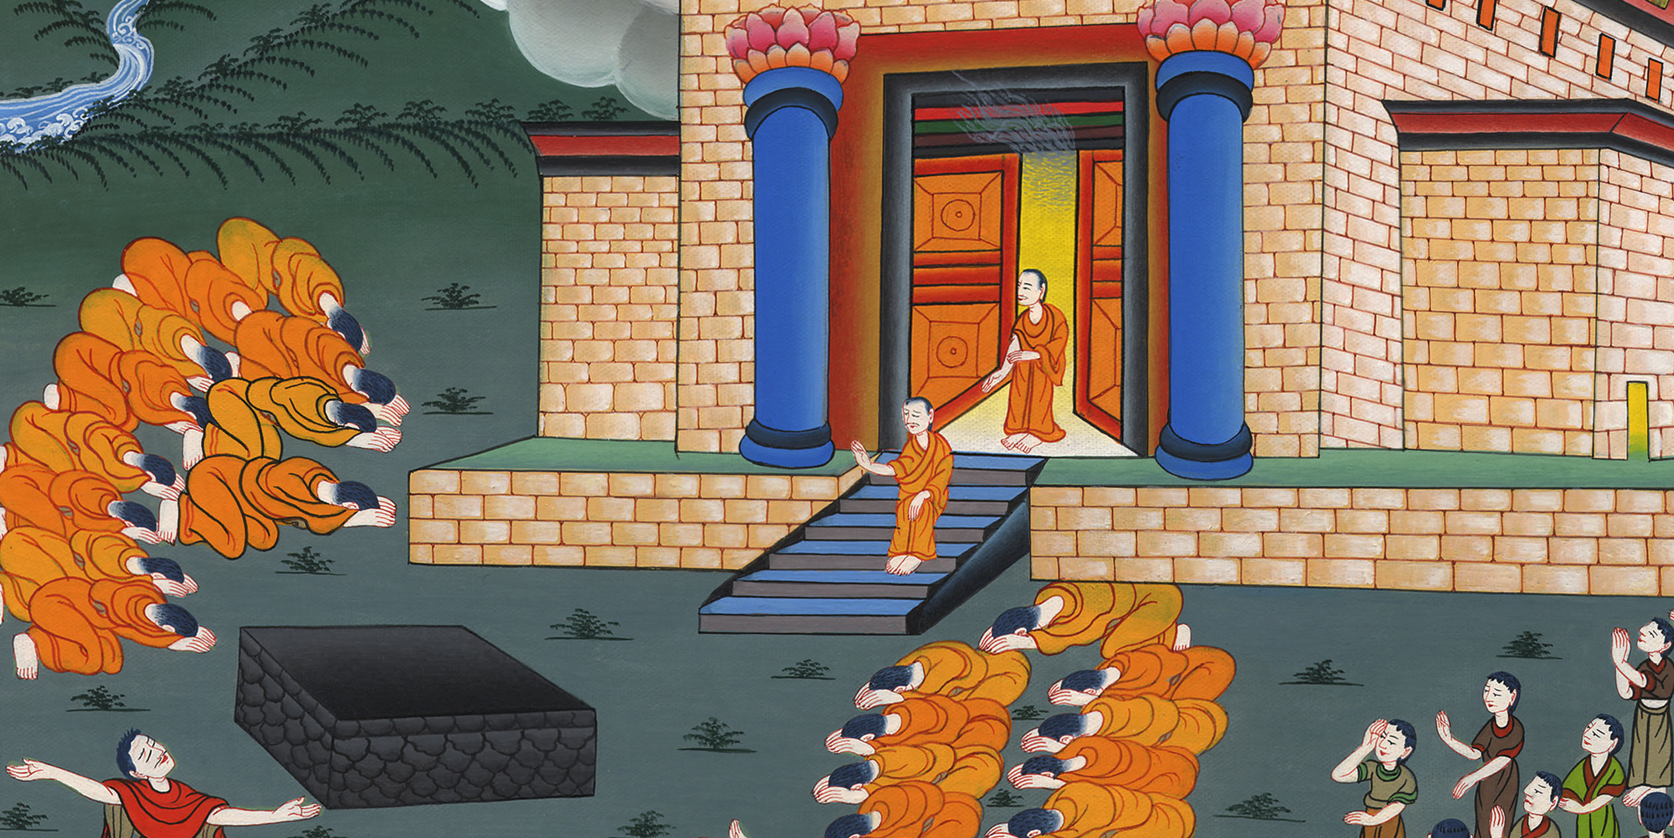
1 Kings 10:5

Slide 13
6She said to the king, “It was a true report that I heard in my own land of your acts and of your wisdom.

Slide 14
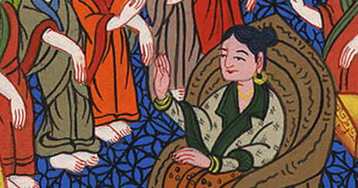
1 Kings 10:6

Slide 15
7However, I didn’t believe the words until I came and my eyes had seen it. Behold, not even half was told me! Your wisdom and prosperity exceed the fame which I heard.

Slide 16
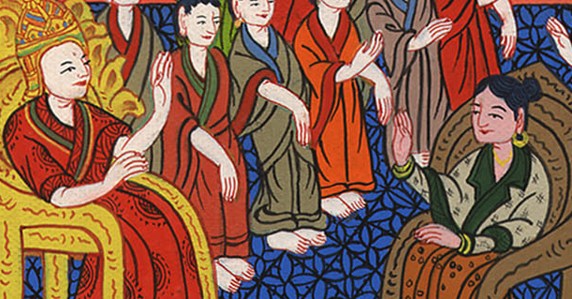
1 Kings 10:7

Slide 17
8Happy are your men, happy are these your servants who stand continually before you, who hear your wisdom.

Slide 18
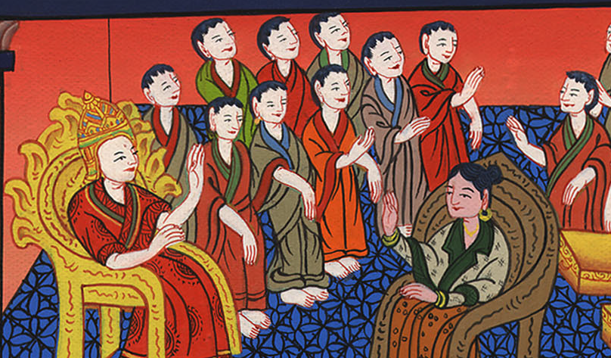
1 Kings 10:8

Slide 19
9Blessed is Yahweh your God, who delighted in you, to set you on the throne of Israel

Slide 20
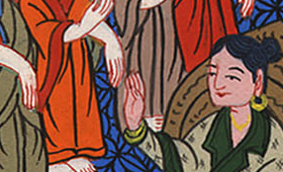
1 Kings 10:9

Slide 21
. Because Yahweh loved Israel forever, therefore he made you king, to do justice and righteousness.”

Slide 22
1 Kings 10:9

