Slide 1
21-1
This work is licensed under a Creative Commons Attribution-ShareAlike 4.0 International License.
Please add this statement to all the videos you create.
English Bible quotes are from the World English Bible US, which is in the public domain.
Notes:
21 Elijah
1. Elijah comes to Ahab - 1 Kings 16:28 – 17:1 (Left Top)
2. Ravens feed Elijah – 1 Kings 17:2-7 (Center Top)
3. Elijah and the widow – 1 Kings 17:8-24 (Right Top)
4. Mt. Carmel – 1 Kings 18:17-40 (Right Center)
5. Rain comes – 1 kings 18:41-46 (Right Bottom)
6. Elisha called – 1 Kings 19:19-21 (Left Bottom)
7. Elijah taken up to Heaven - 2 Kings 2:1-13 (Left Center)

Slide 2
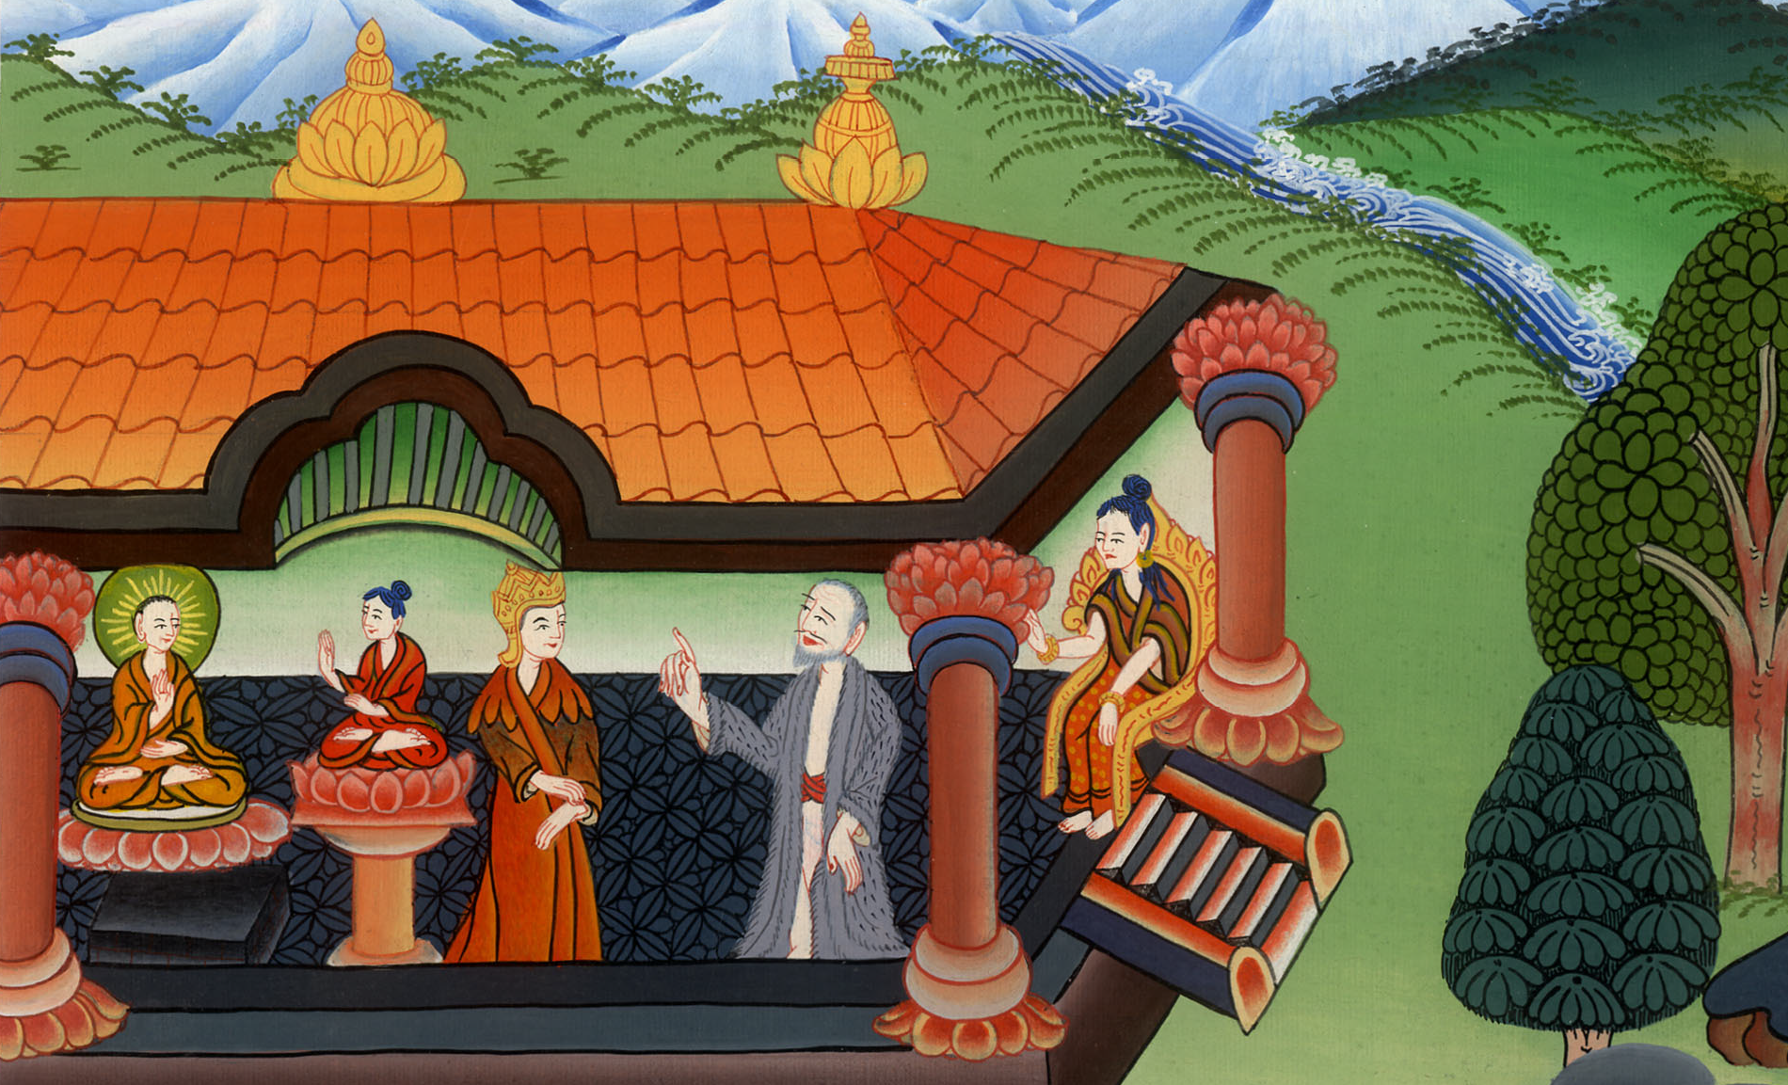
Elijah comes to Ahab –
1 Kings 16:28-17:1

Slide 3
Elijah comes to Ahab – 1 Kings 16:28 - 17:1

Slide 4
Elijah comes to Ahab –
1 Kings 16:28-17:1

Slide 5
( After Solomon died, Ahab was the 8th king of Israel.)
30Ahab the son of Omri did that which was evil in Yahweh’s sight above all that were before him.

Slide 6
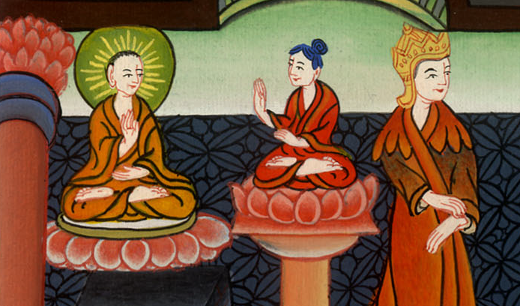
1 Kings 16:30

Slide 7
Ahab served Baal and worshiped him. 32He raised up an altar for Baal in the house of Baal, which he had built in Samaria.

Slide 8
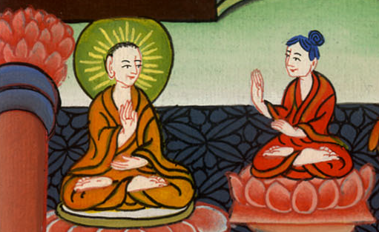
1 Kings 16:32

Slide 9
33Ahab made the Asherah; and Ahab did more yet to provoke Yahweh, the God of Israel, to anger than all the kings of Israel who were before him.

Slide 10
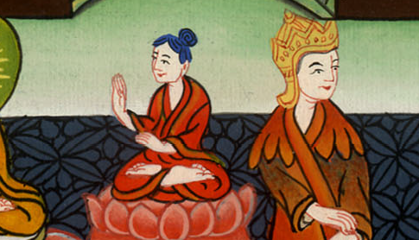
1 Kings 16:33

Slide 11
17:1Elijah the Tishbite, who was one of the settlers of Gilead, said to Ahab, “As Yahweh, the God of Israel, lives, before whom I stand,

Slide 12
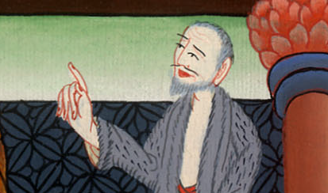
1 Kings 17:1

Slide 13
there shall not be dew nor rain these years, but according to my word.”

Slide 14
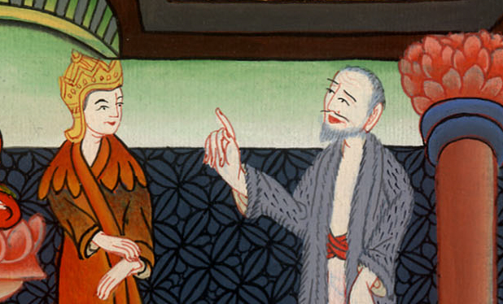
1 Kings 17:1

