Slide 1
21-2
This work is licensed under a Creative Commons Attribution-ShareAlike 4.0 International License.
Please add this statement to all the videos you create.
English Bible quotes are from the World English Bible US, which is in the public domain.
Notes:
21 Elijah
1. Elijah comes to Ahab - 1 Kings 16:28 – 17:1 (Left Top)
2. Ravens feed Elijah – 1 Kings 17:2-7 (Center Top)
3. Elijah and the widow – 1 Kings 17:8-24 (Right Top)
4. Mt. Carmel – 1 Kings 18:17-40 (Right Center)
5. Rain comes – 1 kings 18:41-46 (Right Bottom)
6. Elisha called – 1 Kings 19:19-21 (Left Bottom)
7. Elijah taken up to Heaven - 2 Kings 2:1-13 (Left Center)

Slide 2
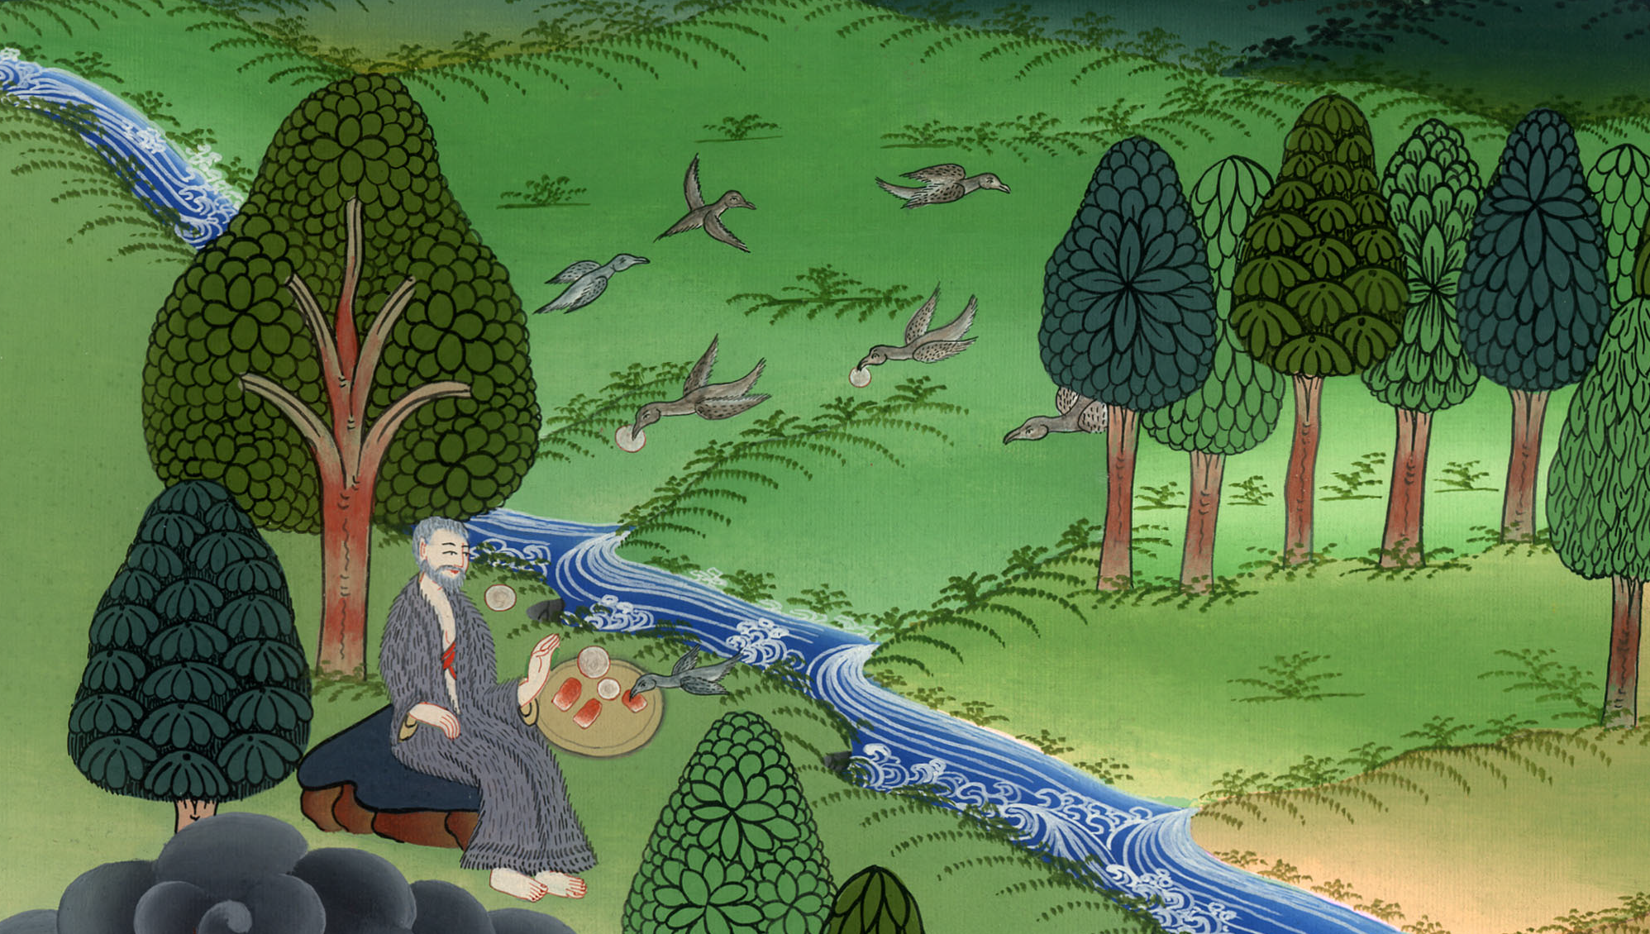
Ravens feed Elijah – 1 Kings 17:2-7

Slide 3
Ravens feed Elijah – 1 Kings 17:2-7

Slide 4
Ravens feed Elijah – 1 Kings 17:2-7

Slide 5
Elijah told king Ahab that there would be no rain.
2Then Yahweh’s word came to him, saying, 3“Go away from here, turn eastward, and hide yourself by the brook Cherith, that is before the Jordan.

Slide 6
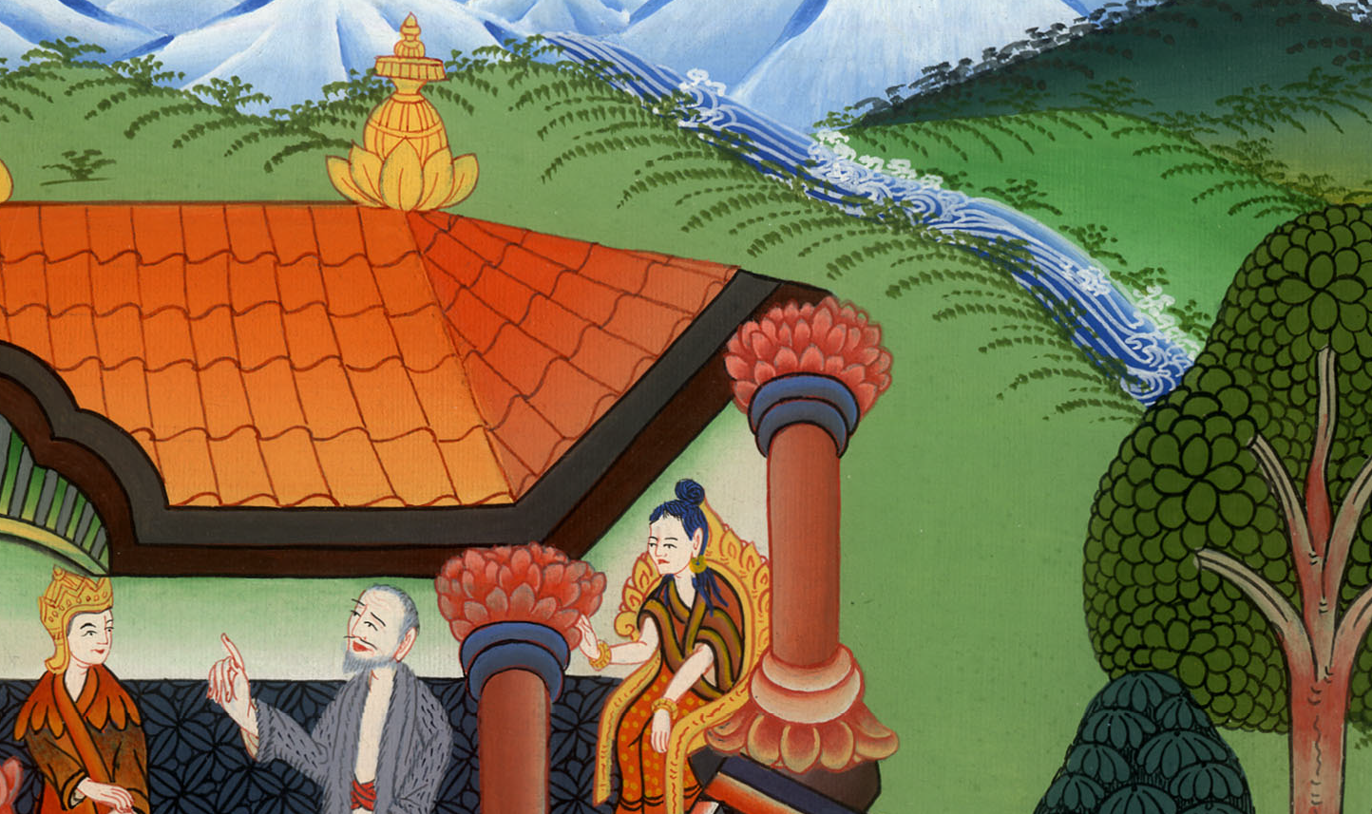
1 Kings 17:1,2,3

Slide 7
4You shall drink from the brook. I have commanded the ravens to feed you there.”

Slide 8
1 Kings 17:4

Slide 9
5So he went and did according to Yahweh’s word, for he went and lived by the brook Cherith that is before the Jordan.

Slide 10
1 Kings 17:5

Slide 11
6The ravens brought him bread and meat in the morning, and bread and meat in the evening; and he drank from the brook.

Slide 12
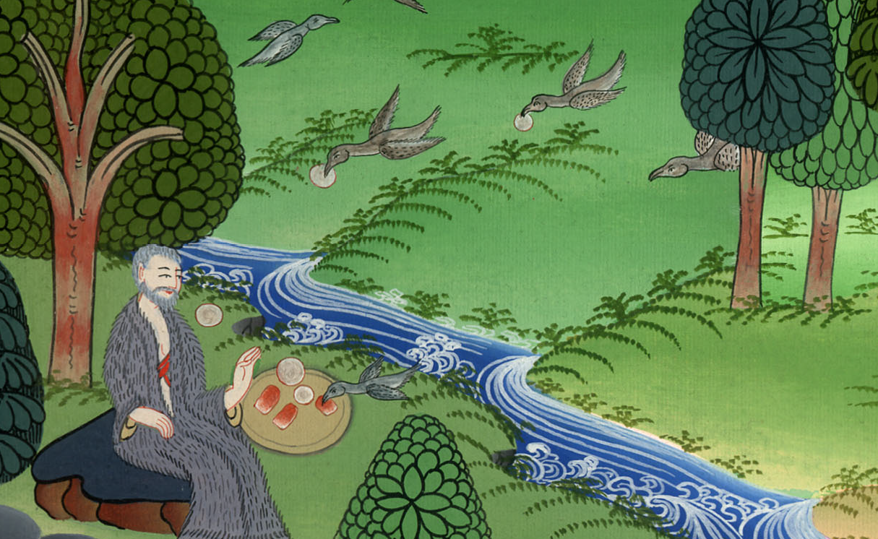
1 Kings 17:6

Slide 13
7After a while, the brook dried up, because there was no rain in the land.

Slide 14
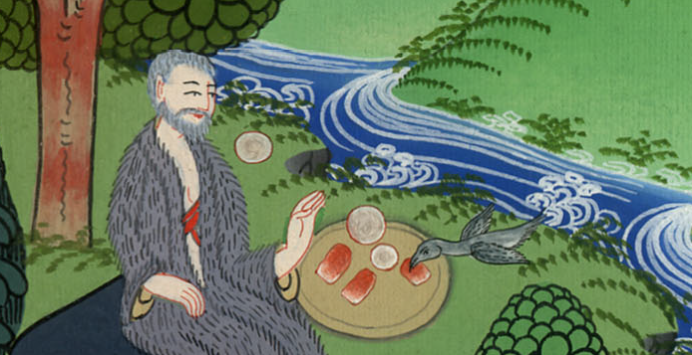
1 Kings 17:7

