Slide 1
21-3
This work is licensed under a Creative Commons Attribution-ShareAlike 4.0 International License.
Please add this statement to all the videos you create.
English Bible quotes are from the World English Bible US, which is in the public domain.
Notes:
21 Elijah
1. Elijah comes to Ahab - 1 Kings 16:28 – 17:1 (Left Top)
2. Ravens feed Elijah – 1 Kings 17:2-7 (Center Top)
3. Elijah and the widow – 1 Kings 17:8-24 (Right Top)
4. Mt. Carmel – 1 Kings 18:17-40 (Right Center)
5. Rain comes – 1 kings 18:41-46 (Right Bottom)
6. Elisha called – 1 Kings 19:19-21 (Left Bottom)
7. Elijah taken up to Heaven - 2 Kings 2:1-13 (Left Center)

Slide 2
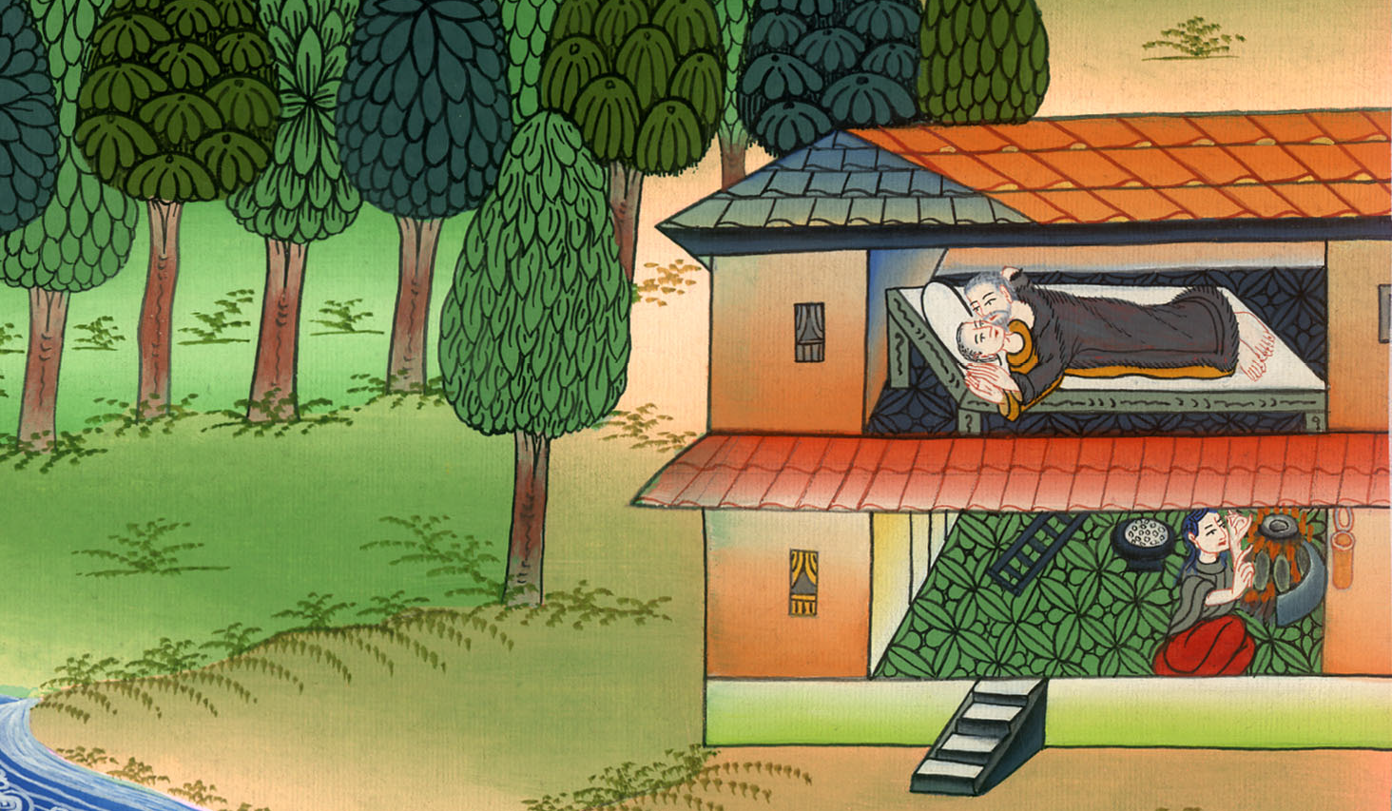
Elijah and the
widow –
1 Kings 17:8-24

Slide 3
Elijah and the widow – 1 Kings 17:8-24

Slide 4
Elijah and the
widow –
1 Kings 17:8-24

Slide 5
7After a while, the brook dried up, because there was no rain in the land.

Slide 6
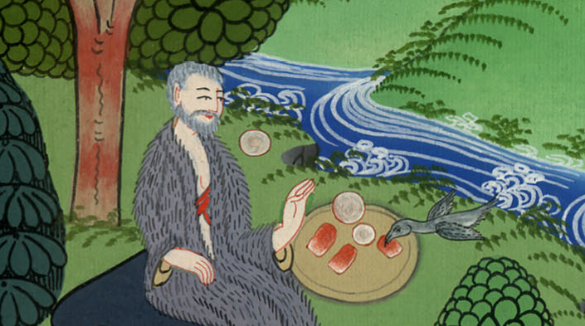
1 Kings 17:7

Slide 7
8Yahweh’s word came to him, saying, 9“Arise, go to Zarephath, which belongs to Sidon, and stay there. Behold, I have commanded a widow there to sustain you.”

Slide 8
1 Kings 17:8,9

Slide 9
10So he arose and went to Zarephath; and when he came to the gate of the city, behold, a widow was there gathering sticks. He called to her and said, “Please get me a little water in a jar, that I may drink.”

Slide 10
1 Kings 17:10

Slide 11
11As she was going to get it, he called to her and said, “Please bring me a morsel of bread in your hand.”

Slide 12
1 Kings 17:11

Slide 13
12She said, “As Yahweh your God lives, I don’t have anything baked, but only a handful of meal in a jar and a little oil in a jar.

Slide 14
1 Kings 17:12

Slide 15
Behold, I am gathering two sticks, that I may go in and bake it for me and my son, that we may eat it, and die.”

Slide 16
1 Kings 17:12

Slide 17
13Elijah said to her, “Don’t be afraid. Go and do as you have said; but make me a little cake from it first, and bring it out to me, and afterward make some for you and for your son.

Slide 18
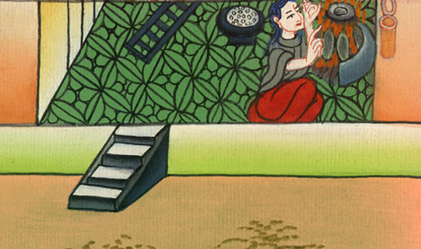
1 Kings 17:13

Slide 19
14For Yahweh, the God of Israel, says, ‘The jar of meal will not run out, and the jar of oil will not fail, until the day that Yahweh sends rain on the earth.’”

Slide 20
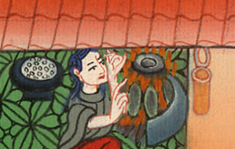
1 Kings 17:14

Slide 21
15She went and did according to the saying of Elijah; and she, he, and her household ate many days.

Slide 22
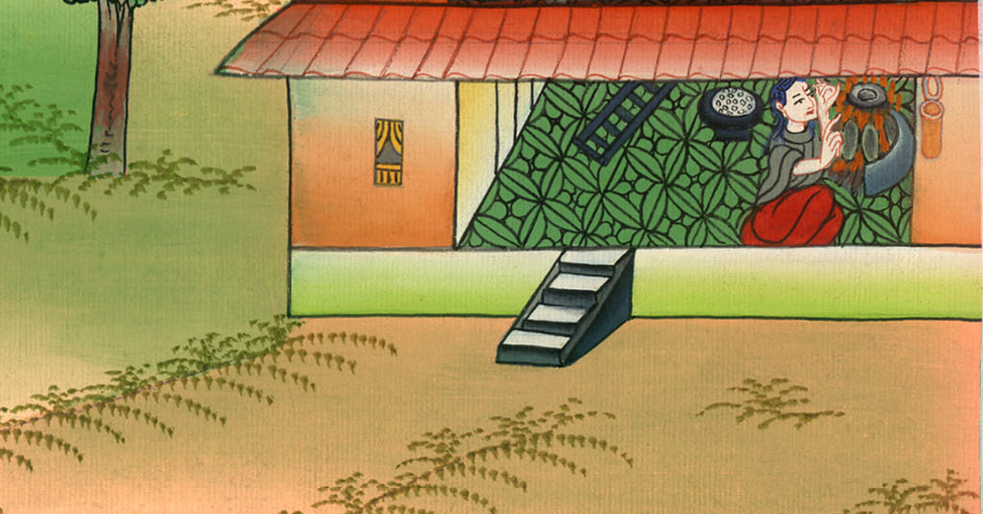
1 Kings 17:15

Slide 23
16The jar of meal didn’t run out and the jar of oil didn’t fail, according to Yahweh’s word, which he spoke by Elijah.

Slide 24
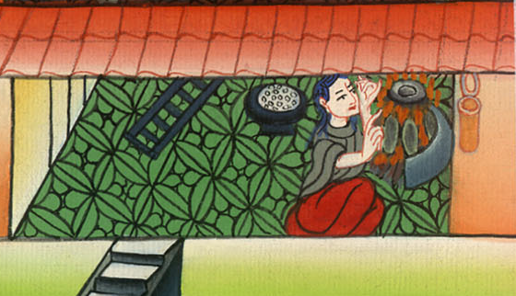
1 Kings 17:16

Slide 25
17After these things, the son of the woman, the mistress of the house, became sick; and his sickness was so severe that there was no breath left in him.

Slide 26
1 Kings 17:17

Slide 27
18She said to Elijah, “What have I to do with you, you man of God? You have come to me to bring my sin to memory, and to kill my son!”

Slide 28
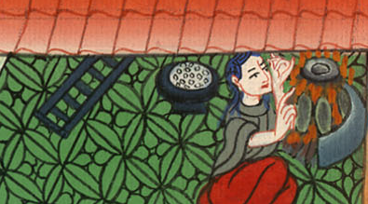
1 Kings 17:18

Slide 29
19He said to her, “Give me your son.” He took him out of her bosom, and carried him up into the room where he stayed, and laid him on his own bed.

Slide 30
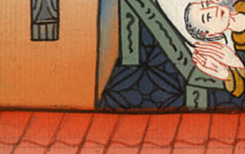
1 Kings 17:19

Slide 31
20He cried to Yahweh and said, “Yahweh my God, have you also brought evil on the widow with whom I am staying, by killing her son?”

Slide 32
1 Kings 17:20

Slide 33
21He stretched himself on the child three times, and cried to Yahweh and said, “Yahweh my God, please let this child’s soul come into him again.”

Slide 34
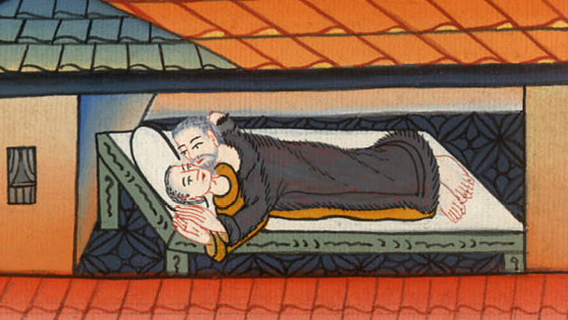
1 Kings 17:21

Slide 35
22Yahweh listened to the voice of Elijah; and the soul of the child came into him again, and he revived.

Slide 36
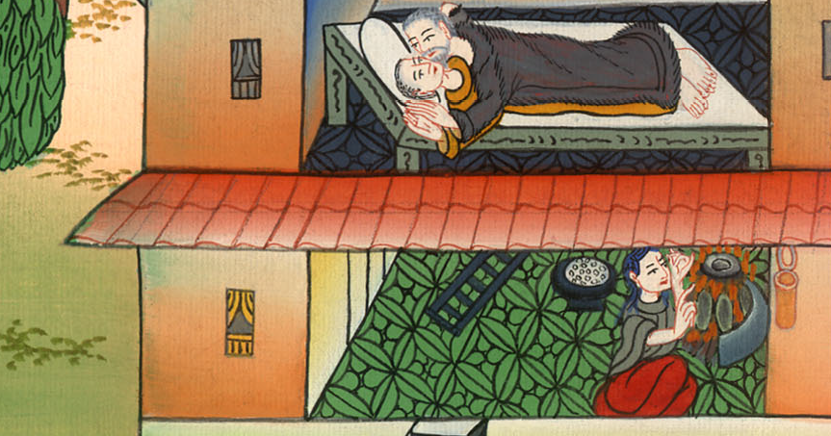
1 Kings 17:22

Slide 37
23Elijah took the child and brought him down out of the room into the house, and delivered him to his mother; and Elijah said, “Behold, your son lives.”

Slide 38
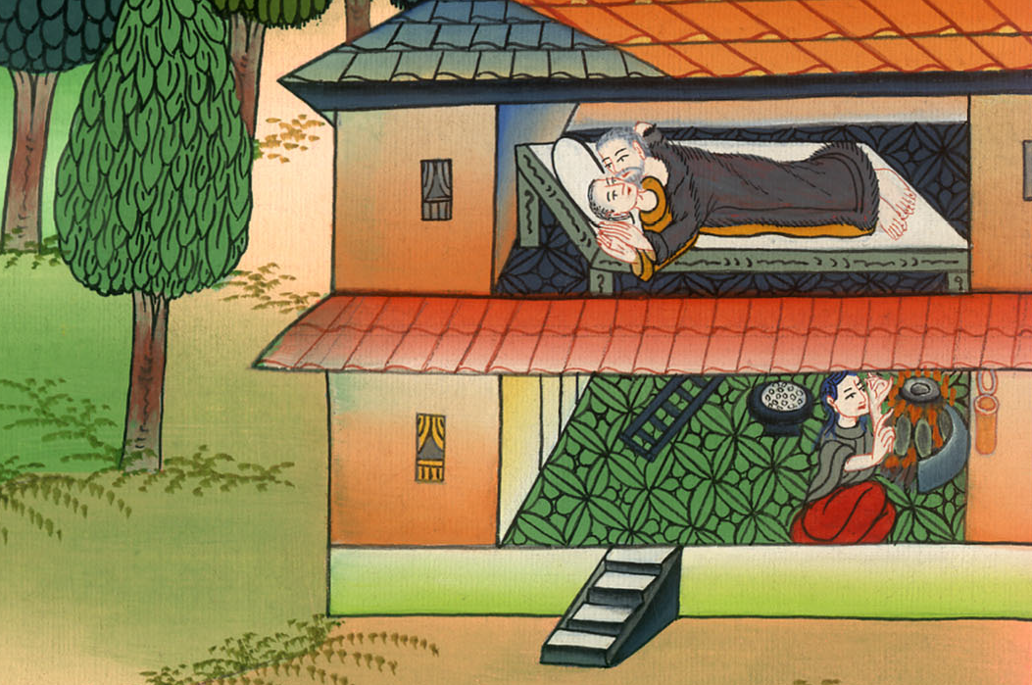
1 Kings 17:23

Slide 39
24The woman said to Elijah, “Now I know that you are a man of God, and that Yahweh’s word in your mouth is truth.”

Slide 40
1 Kings 17:24

