Slide 1
21-4
This work is licensed under a Creative Commons Attribution-ShareAlike 4.0 International License.
Please add this statement to all the videos you create.
English Bible quotes are from the World English Bible US, which is in the public domain.
Notes:
Ch
21 Elijah
1. Elijah comes to Ahab - 1 Kings 16:28 – 17:1 (Left Top)
2. Ravens feed Elijah – 1 Kings 17:2-7 (Center Top)
3. Elijah and the widow – 1 Kings 17:8-24 (Right Top)
4. Mt. Carmel – 1 Kings 18:17-40 (Right Center)
5. Rain comes – 1 kings 18:41-46 (Right Bottom)
6. Elisha called – 1 Kings 19:19-21 (Left Bottom)
7. Elijah taken up to Heaven - 2 Kings 2:1-13 (Left Center)

Slide 2
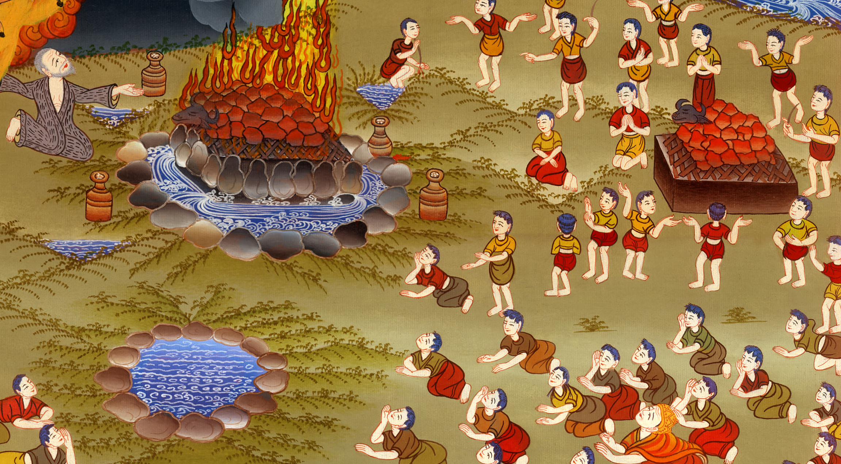
Mount Carmel –
1 Kings 18:17-40

Slide 3
Mount Carmel – 1 Kings 18:17-40

Slide 4
Mount Carmel –
1 Kings 18:17-40

Slide 5
Ahab went to meet Elijah.
17When Ahab saw Elijah, Ahab said to him, “Is that you, you troubler of Israel?”

Slide 6
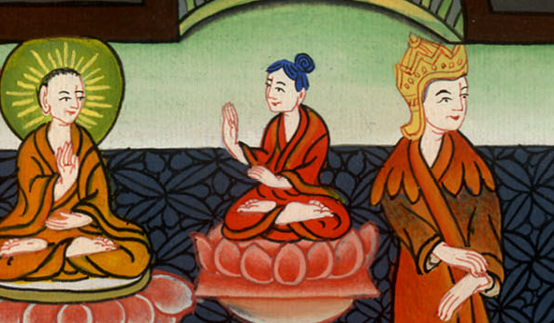
1 Kings 18:17

Slide 7
18He answered, “I have not troubled Israel, but you and your father’s house, in that you have forsaken Yahweh’s commandments and you have followed the Baals.

Slide 8
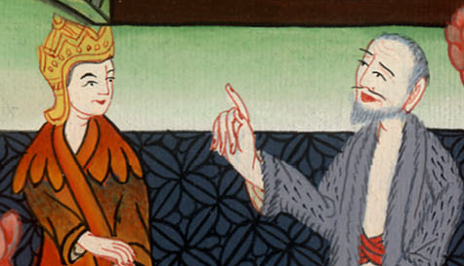
1 Kings 18:18

Slide 9
19Now therefore send, and gather to me all Israel to Mount Carmel, and four hundred fifty of the prophets of Baal, and four hundred of the prophets of the Asherah, who eat at Jezebel’s table.”

Slide 10
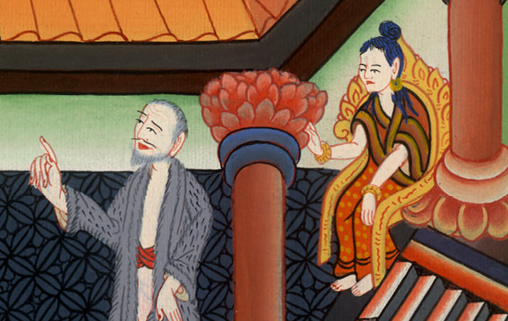
1 Kings 18:19

Slide 11
20So Ahab sent to all the children of Israel, and gathered the prophets together to Mount Carmel.

Slide 12
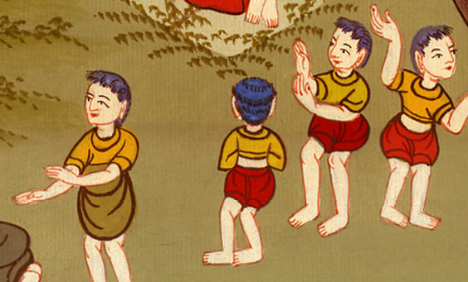
1 Kings 18:20

Slide 13
21Elijah came near to all the people, and said, “How long will you waver between the two sides? If Yahweh is God, follow him; but if Baal, then follow him.”
The people didn’t say a word.

Slide 14
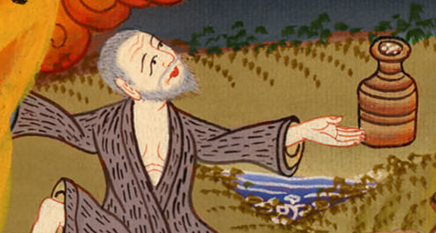
1 Kings 18:21

Slide 15
22Then Elijah said to the people, “I, even I only, am left as a prophet of Yahweh; but Baal’s prophets are four hundred fifty men.

Slide 16
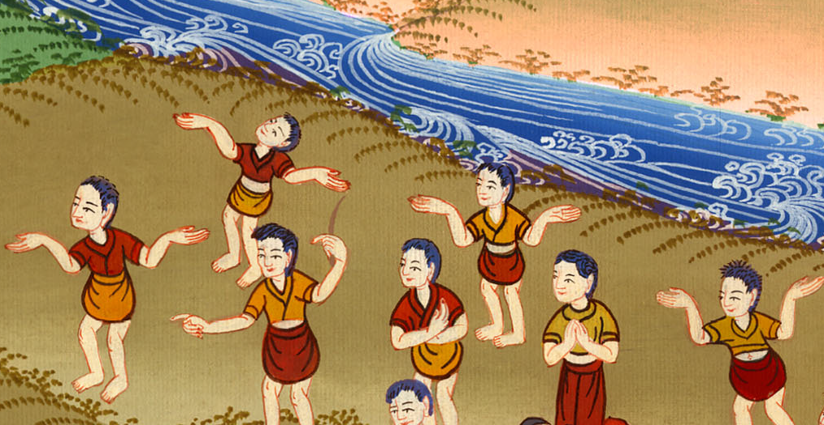
1 Kings 18:22

Slide 17
23Let them therefore give us two bulls; and let them choose one bull for themselves, and cut it in pieces, and lay it on the wood, and put no fire under; and I will dress the other bull, and lay it on the wood, and put no fire under it.

Slide 18
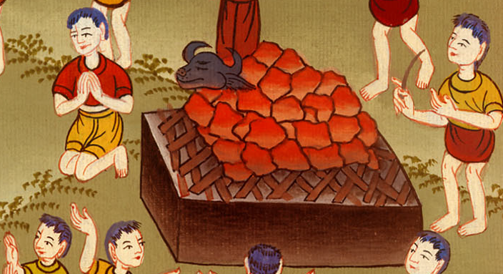
1 Kings 18:23

Slide 19
24You call on the name of your god, and I will call on Yahweh’s name. The God who answers by fire, let him be God.”
All the people answered, “What you say is good.”

Slide 20
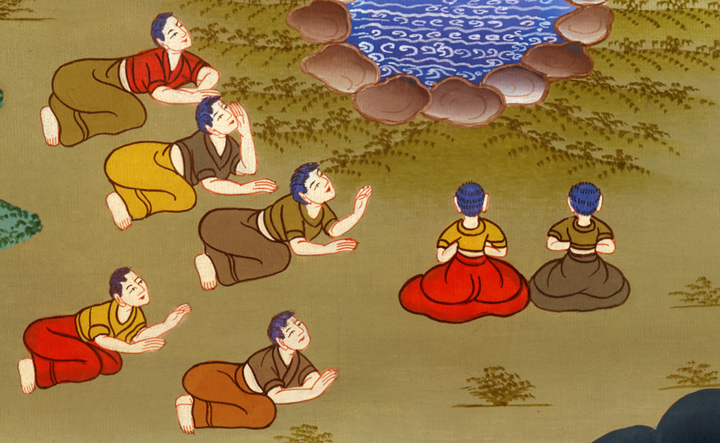
1 Kings 18:24

Slide 21
26They took the bull which was given them, and they dressed it, and called on the name of Baal from morning even until noon, saying, “Baal, hear us!” But there was no voice, and nobody answered. They leaped about the altar which was made.

Slide 22
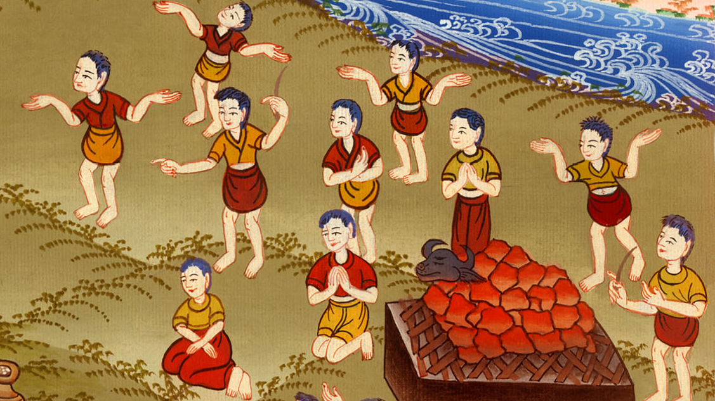
1 Kings 18:26

Slide 23
27At noon, Elijah mocked them, and said, “Cry aloud, for he is a god. Either he is deep in thought, or he has gone somewhere, or he is on a journey, or perhaps he sleeps and must be awakened.”

Slide 24
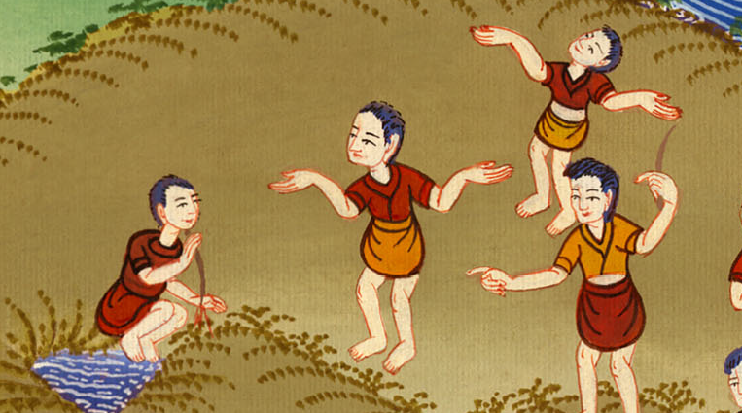
1 Kings 18:27

Slide 25
28They cried aloud, and cut themselves in their way with knives and lances until the blood gushed out on them.

Slide 26
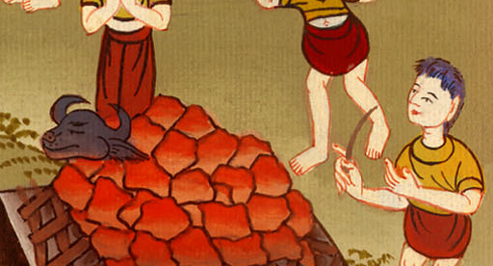
1 Kings 18:28

Slide 27
29When midday was past, they prophesied until the time of the evening offering; but there was no voice, no answer, and nobody paid attention.

Slide 28
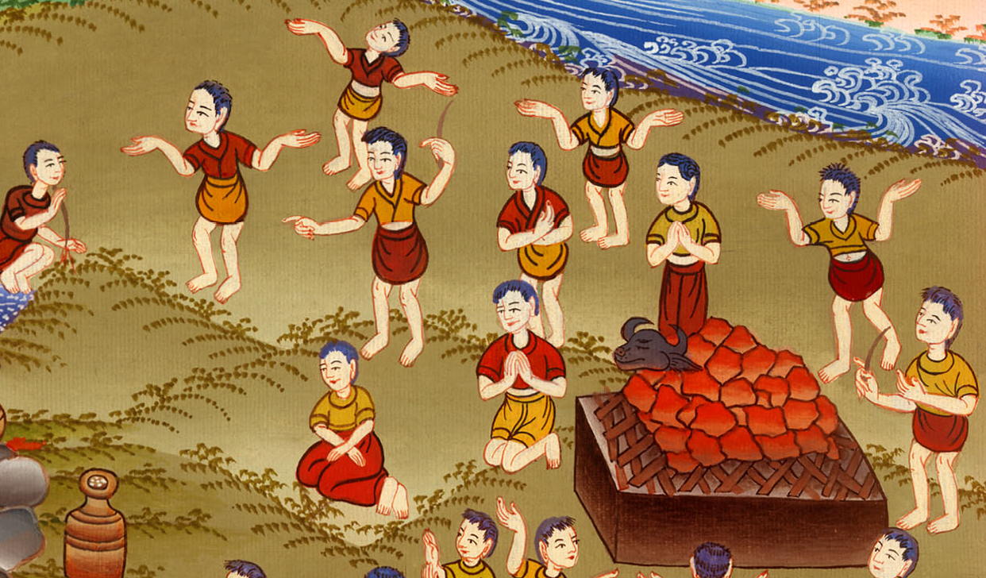
1 Kings 18:29

Slide 29
30Elijah said to all the people, “Come near to me!”; and all the people came near to him. He repaired Yahweh’s altar that had been thrown down.

Slide 30
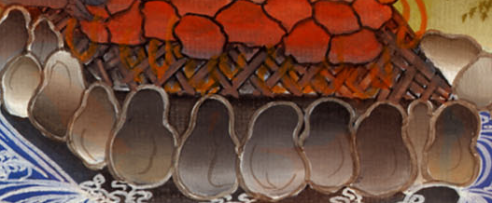
1 Kings 18:30

Slide 31
32With the [12] stones he built an altar in Yahweh’s name. He made a trench around the altar

Slide 32
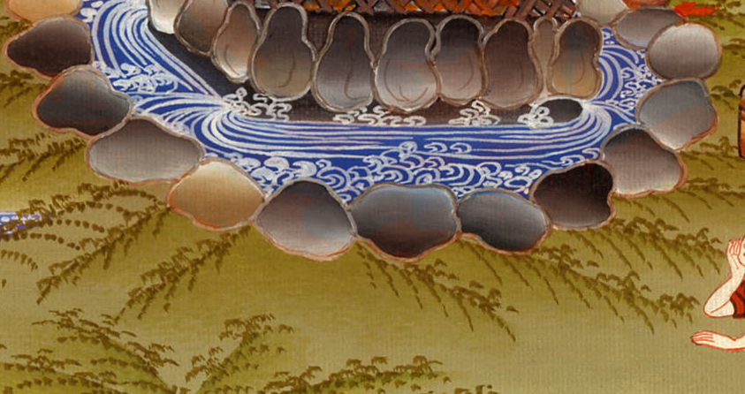
1 Kings 18:32

Slide 33
33He put the wood in order, and cut the bull in pieces and laid it on the wood. He said, “Fill four jars with water, and pour it on the burnt offering and on the wood.”

Slide 34
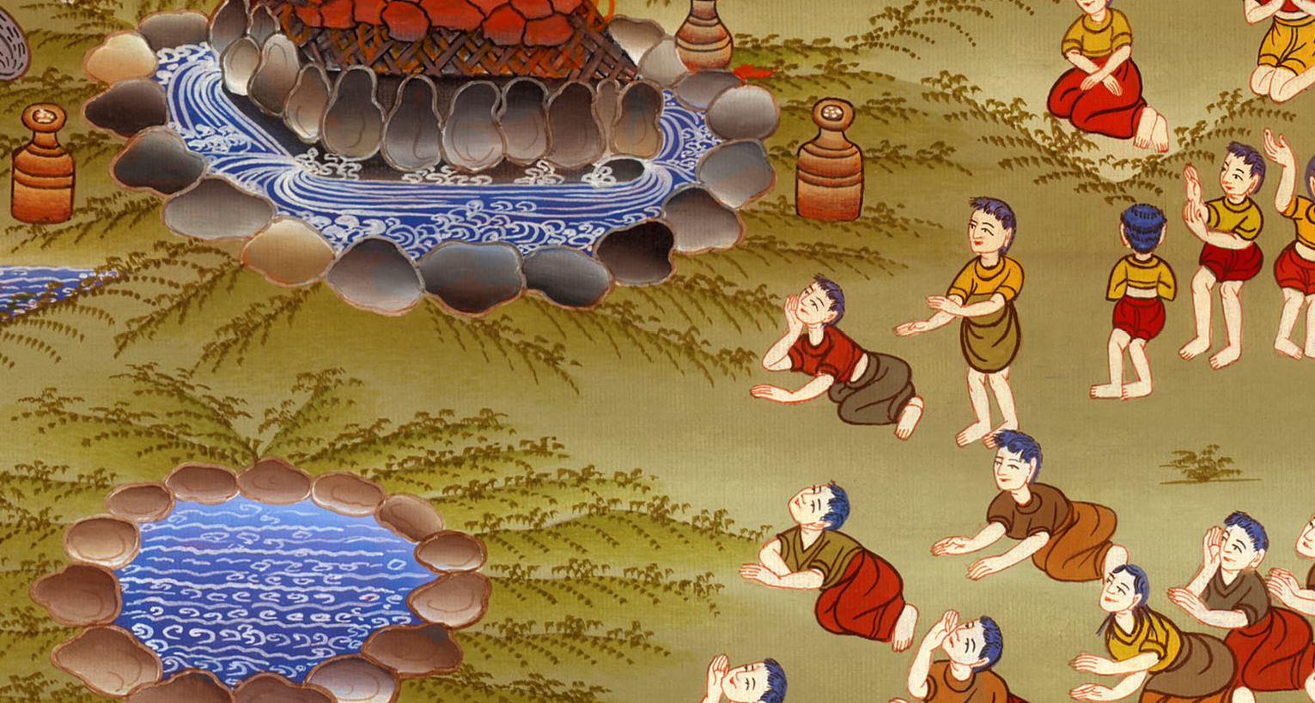
1 Kings 18:33

Slide 35
34He said, “Do it a second time;” and they did it the second time. He said, “Do it a third time;” and they did it the third time. 35The water ran around the altar; and he also filled the trench with water.

Slide 36
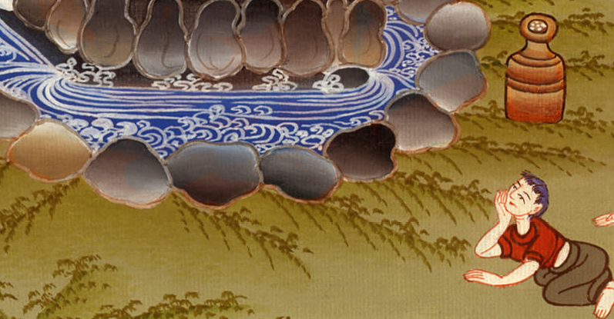
1 Kings 18:34,35

Slide 37
36At the time of the evening offering, Elijah the prophet came near and said, “Yahweh, the God of Abraham, of Isaac, and of Israel, let it be known today that you are God in Israel and that I am your servant, and that I have done all these things at your word.

Slide 38
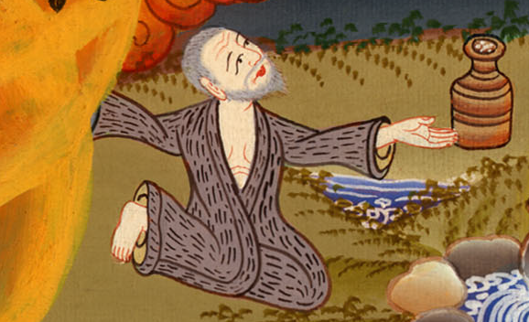
1 Kings 18:36

Slide 39
37Hear me, Yahweh, hear me, that this people may know that you, Yahweh, are God, and that you have turned their heart back again.”

Slide 40
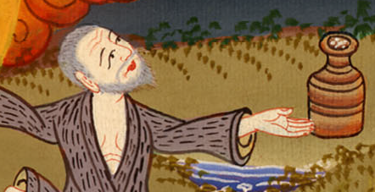
1 Kings 18:37

Slide 41
38Then Yahweh’s fire fell and consumed the burnt offering, the wood, the stones, and the dust; and it licked up the water that was in the trench.

Slide 42
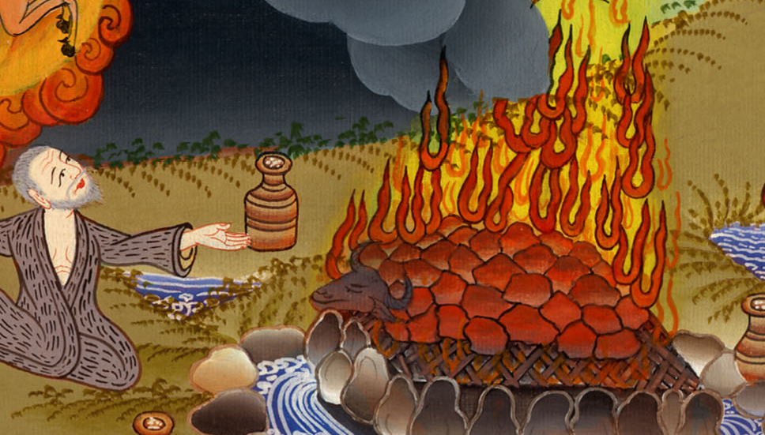
1 Kings 18:38

Slide 43
39When all the people saw it, they fell on their faces. They said, “Yahweh, he is God! Yahweh, he is God!”

Slide 44
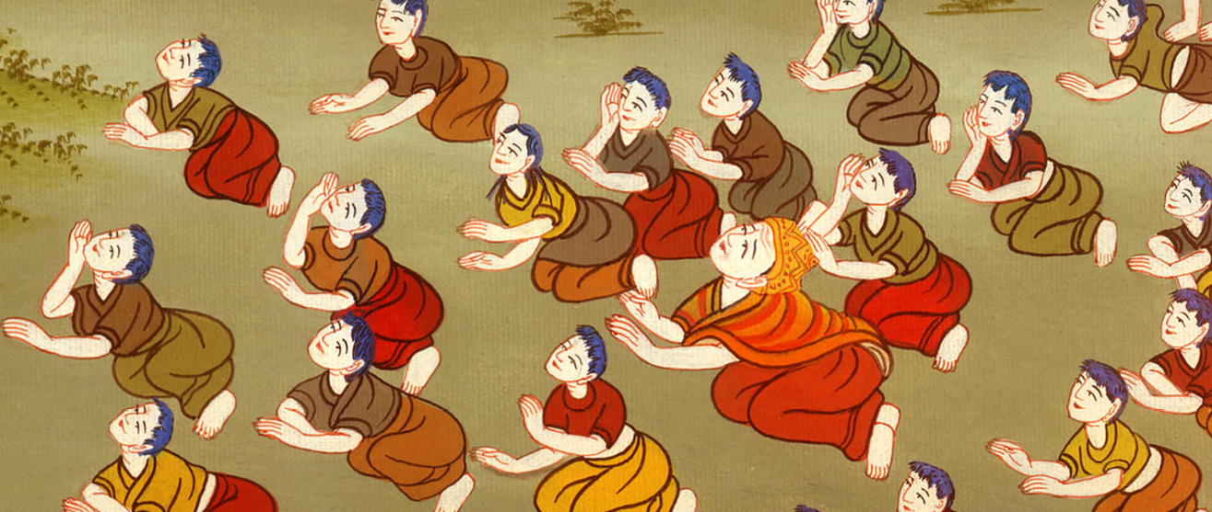
1 Kings 18:39

Slide 45
40Elijah said to them, “Seize the prophets of Baal! Don’t let one of them escape!”
They seized them; and Elijah brought them down to the brook Kishon, and killed them there.

Slide 46
1 Kings 18:40

