Slide 1
21-5
This work is licensed under a Creative Commons Attribution-ShareAlike 4.0 International License.
Please add this statement to all the videos you create.
English Bible quotes are from the World English Bible US, which is in the public domain.
Notes:
ch21 Elijah
1. Elijah comes to Ahab - 1 Kings 16:28 – 17:1 (Left Top)
2. Ravens feed Elijah – 1 Kings 17:2-7 (Center Top)
3. Elijah and the widow – 1 Kings 17:8-24 (Right Top)
4. Mt. Carmel – 1 Kings 18:17-40 (Right Center)
5. Rain comes – 1 kings 18:41-46 (Right Bottom)
6. Elisha called – 1 Kings 19:19-21 (Left Bottom)
7. Elijah taken up to Heaven - 2 Kings 2:1-13 (Left Center)

Slide 2
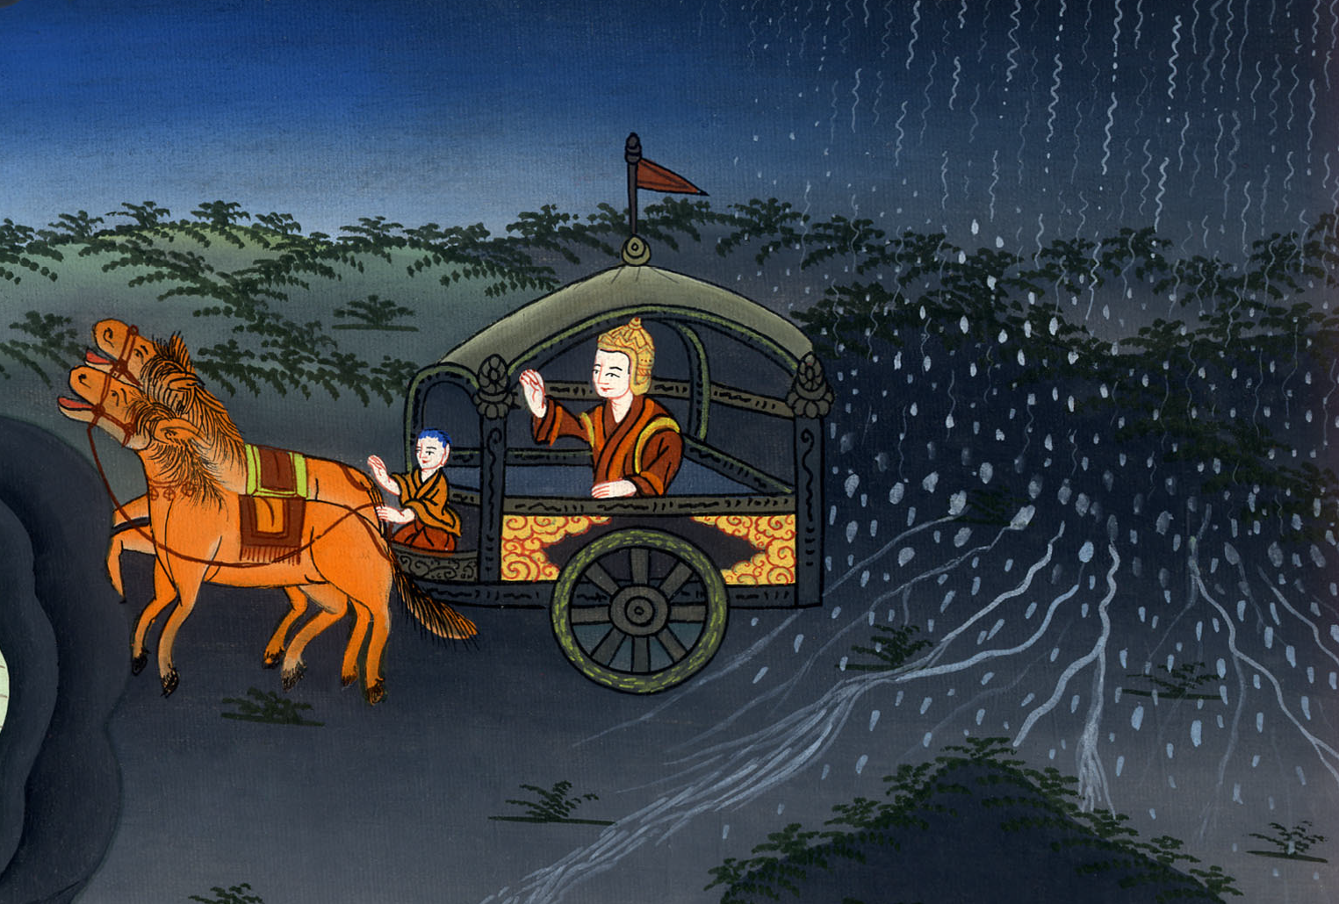
Rain comes –
1 Kings 18: 41-46

Slide 3
Rain comes –
1 Kings 18:41-46

Slide 4
Rain comes –
1 Kings 18: 41-46

Slide 5
41Elijah said to Ahab, “Get up, eat and drink; for there is the sound of abundance of rain.”

Slide 6
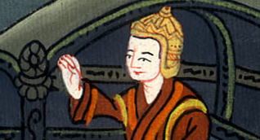
1 Kings 18:41

Slide 7
42So Ahab went up to eat and to drink. Elijah went up to the top of Carmel; and he bowed himself down on the earth, and put his face between his knees.

Slide 8
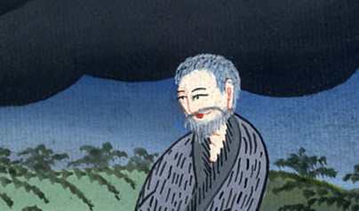
1 Kings 18:42

Slide 9
43He said to his servant, “Go up now and look toward the sea.”
He went up and looked, then said, “There is nothing.”
He said, “Go again” seven times.

Slide 10
1 Kings 18:43

Slide 11
44On the seventh time, he said, “Behold, a small cloud, like a man’s hand, is rising out of the sea.”
He said, “Go up, tell Ahab, ‘Get ready and go down, so that the rain doesn’t stop you.’”

Slide 12
1 Kings 18:44

Slide 13
45In a little while, the sky grew black with clouds and wind, and there was a great rain. Ahab rode, and went to Jezreel.

Slide 14
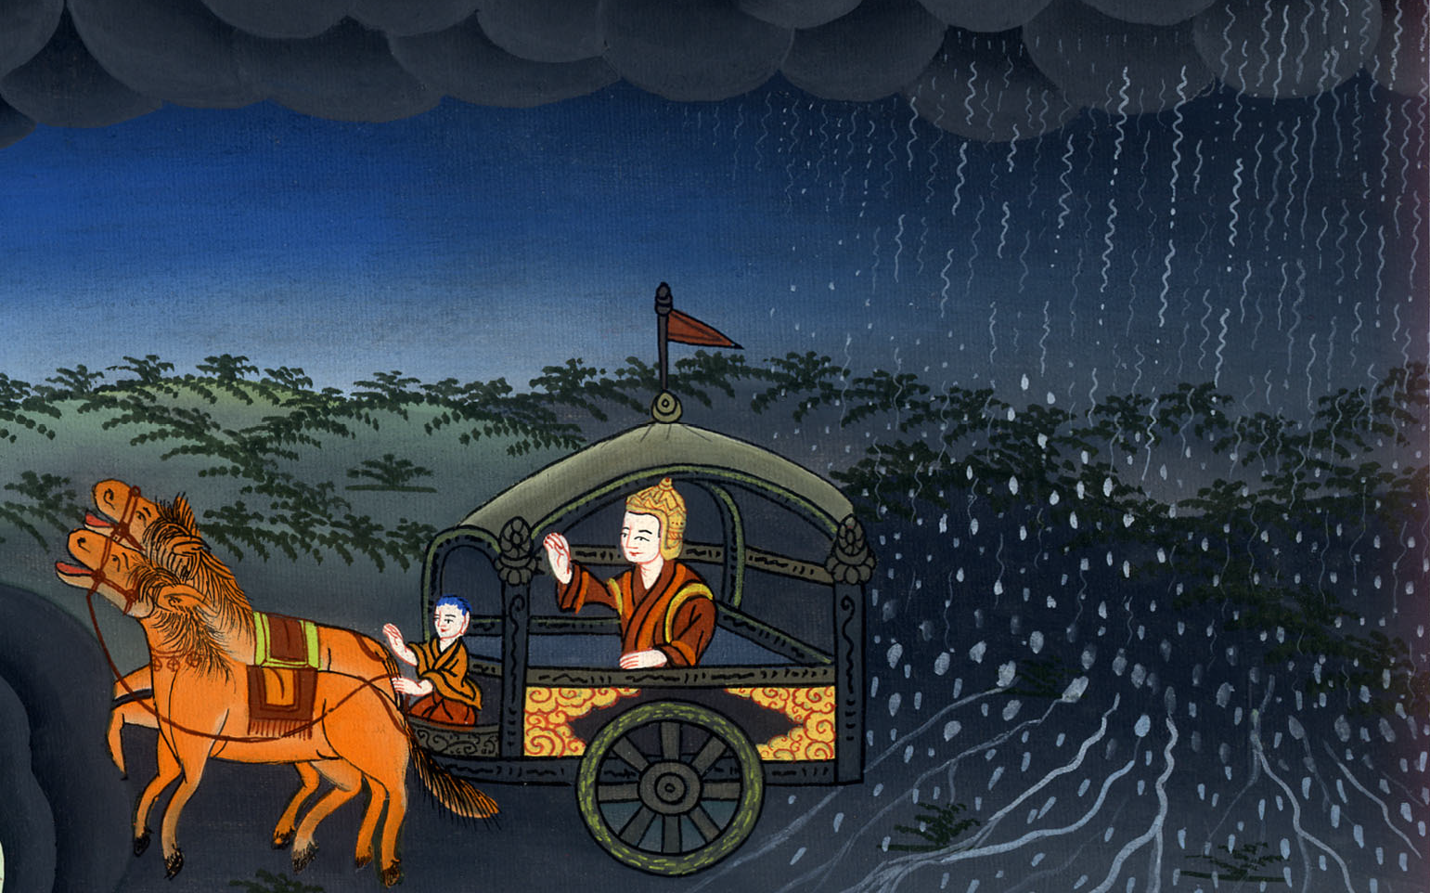
1 Kings 18:45

Slide 15
46Yahweh’s hand was on Elijah; and he tucked his cloak into his belt and ran before Ahab to the entrance of Jezreel.

Slide 16
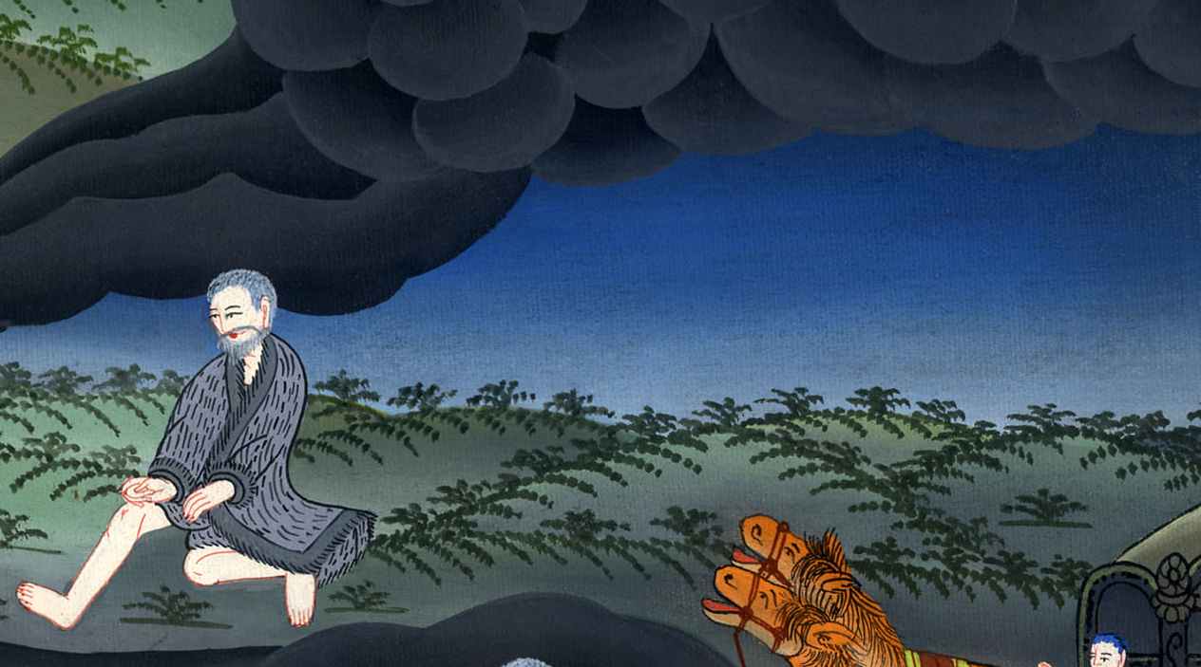
1 Kings 18:46

