Slide 1
21-6
This work is licensed under a Creative Commons Attribution-ShareAlike 4.0 International License.
Please add this statement to all the videos you create.
English Bible quotes are from the World English Bible US, which is in the public domain.
Notes:
Ch, change title and add pics chanage list
21 Elijah
1. Elijah comes to Ahab - 1 Kings 16:28 – 17:1 (Left Top)
2. Ravens feed Elijah – 1 Kings 17:2-7 (Center Top)
3. Elijah and the widow – 1 Kings 17:8-24 (Right Top)
4. Mt. Carmel – 1 Kings 18:17-40 (Right Center)
5. Rain comes – 1 kings 18:41-46 (Right Bottom)
6. Elisha called – 1 Kings 19:19-21 (Left Bottom)
7. Elijah taken up to Heaven - 2 Kings 2:1-13 (Left Center)

Slide 2
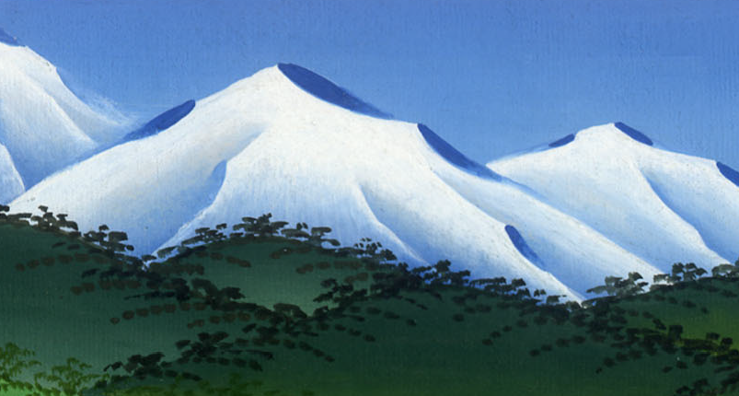
Elijah Runs Away to Mount Horeb –
1 Kings 19:1-8

Slide 3
Elijah Runs Away to Mount Horeb – 1 Kings 19:1-8

Slide 4
Elijah Runs Away to Mount Horeb –
1 Kings 19:1-8

Slide 5
1Ahab told Jezebel all that Elijah had done, and how he had killed all the prophets with the sword.

Slide 6
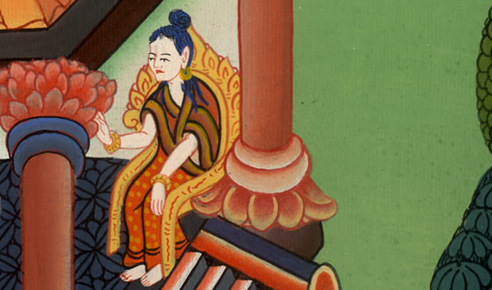
1 Kings 19:1

Slide 7
2Then Jezebel sent a messenger to Elijah, saying, “So let the gods do to me, and more also, if I don’t make your life as the life of one of them by tomorrow about this time!”

Slide 8
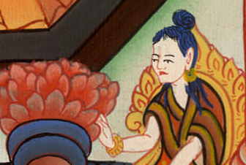
1 Kings 19:2

Slide 9
3When he saw that, he arose and ran for his life, and came to Beersheba, which belongs to Judah, and left his servant there.

Slide 10
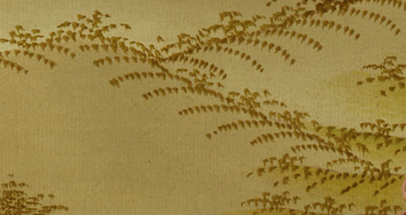
1 Kings 19:3

Slide 11
4But he himself went a day’s journey into the wilderness, and came and sat down under a juniper tree. Then he requested for himself that he might die, and said, “It is enough. Now, O Yahweh, take away my life; for I am not better than my fathers.”

Slide 12
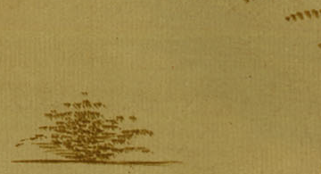
1 Kings 19:4

Slide 13
5He lay down and slept under a juniper tree; and behold, an angel touched him, and said to him, “Arise and eat!”

Slide 14
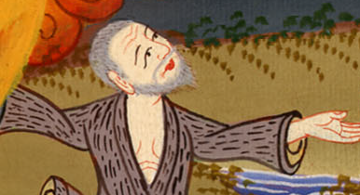
1 Kings 19:5

Slide 15
6He looked, and behold, there was at his head a cake baked on the coals, and a jar of water. He ate and drank, and lay down again.

Slide 16
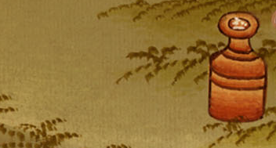
1 Kings 19:6

Slide 17
7Yahweh’s angel came again the second time, and touched him, and said, “Arise and eat, because the journey is too great for you.”

Slide 18
1 Kings 19:7

Slide 19
8He arose, and ate and drank, and went in the strength of that food forty days and forty nights to Horeb, God’s Mountain.

Slide 20
1 Kings 19:8

