Slide 1
21-7
This work is licensed under a Creative Commons Attribution-ShareAlike 4.0 International License.
Please add this statement to all the videos you create.
English Bible quotes are from the World English Bible US, which is in the public domain.
Notes:
ch
21 Elijah
1. Elijah comes to Ahab - 1 Kings 16:28 – 17:1 (Left Top)
2. Ravens feed Elijah – 1 Kings 17:2-7 (Center Top)
3. Elijah and the widow – 1 Kings 17:8-24 (Right Top)
4. Mt. Carmel – 1 Kings 18:17-40 (Right Center)
5. Rain comes – 1 kings 18:41-46 (Right Bottom)
6. Elisha called – 1 Kings 19:19-21 (Left Bottom)
7. Elijah taken up to Heaven - 2 Kings 2:1-13 (Left Center)

Slide 2
A still small voice –
1 Kings 19:8-21

Slide 3
A still small voice –
1 Kings 19:8-21

Slide 4
A still small voice –
1 Kings 19:8-21

Slide 5
(Elijah travelled to Horeb), God’s Mountain. 9He came to a cave there, and camped there; and behold, Yahweh’s word came to him, and he said to him, “What are you doing here, Elijah?”

Slide 6
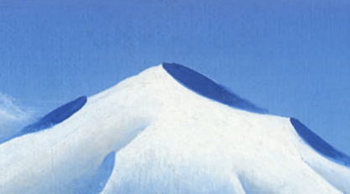
1 Kings 19:8,9

Slide 7
10He said, “I have been very jealous for Yahweh, the God of Armies; for the children of Israel have forsaken your covenant, thrown down your altars, and killed your prophets with the sword. I, even I only, am left; and they seek my life, to take it away.”

Slide 8
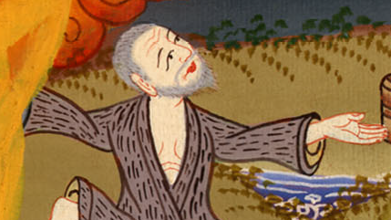
1 Kings 19:10

Slide 9
11He said, “Go out and stand on the mountain before Yahweh.”

Slide 10
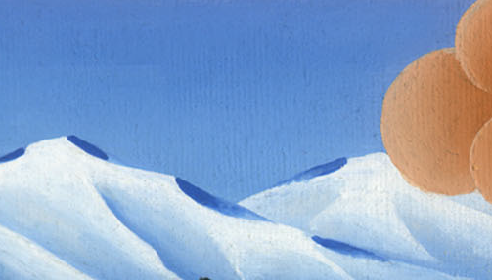
1 Kings 19:11

Slide 11
Behold, Yahweh passed by, and a great and strong wind tore the mountains and broke in pieces the rocks before Yahweh; but Yahweh was not in the wind.

Slide 12
1 Kings 19:11

Slide 13
After the wind there was an earthquake; but Yahweh was not in the earthquake.

Slide 14
1 Kings 19:11

Slide 15
12After the earthquake a fire passed; but Yahweh was not in the fire.

Slide 16
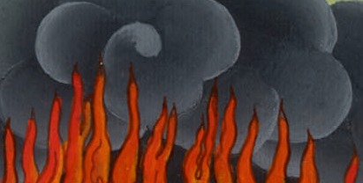
1 Kings 19:12

Slide 17
After the fire, there was a still small voice.

Slide 18
1 Kings 19:12

Slide 19
13When Elijah heard it, he wrapped his face in his mantle, went out, and stood in the entrance of the cave. Behold, a voice came to him, and said, “What are you doing here, Elijah?”

Slide 20
1 Kings 19:13

Slide 21
14He said, “I have been very jealous for Yahweh, the God of Armies; for the children of Israel have forsaken your covenant, thrown down your altars, and killed your prophets with the sword. I, even I only, am left; and they seek my life, to take it away.”

Slide 22
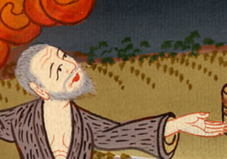
1 Kings 19:14

Slide 23
15Yahweh said to him, “Go, return on your way to the wilderness of Damascus. When you arrive, anoint Hazael to be king over Syria.

Slide 24
1 Kings 19:15

Slide 25
16Anoint Jehu the son of Nimshi to be king over Israel; and anoint Elisha the son of Shaphat of Abel Meholah to be prophet in your place.

Slide 26
1 Kings 19:16

Slide 27
19So he departed from there and found Elisha the son of Shaphat, who was plowing with twelve yoke of oxen before him, and he with the twelfth. Elijah went over to him and put his mantle on him.

Slide 28
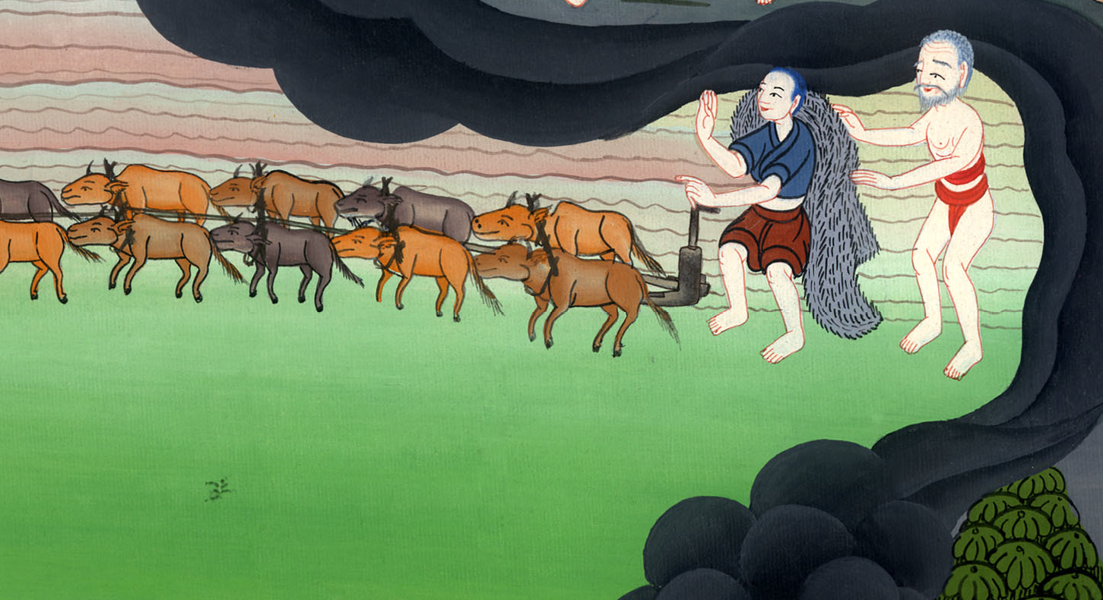
1 Kings 19:19

Slide 29
20Elisha left the oxen and ran after Elijah, and said, “Let me please kiss my father and my mother, and then I will follow you.”
He said to him, “Go back again; for what have I done to you?

Slide 30
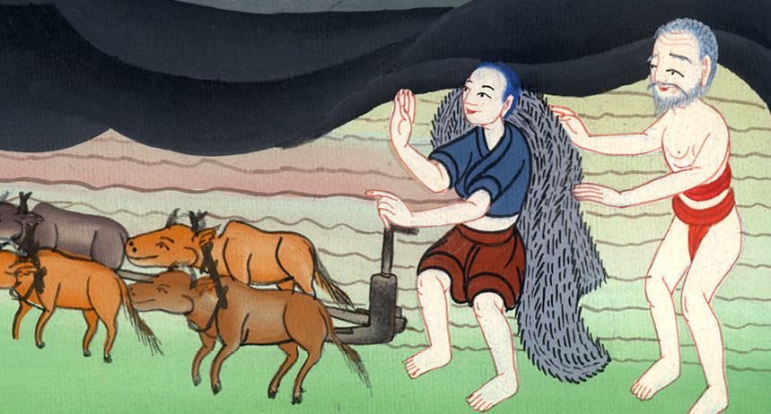
1 Kings 19:20

Slide 31
21He returned from following him, and took the yoke of oxen, killed them, and boiled their meat with the oxen’s equipment, and gave to the people; and they ate. Then he arose, and went after Elijah, and served him.

Slide 32
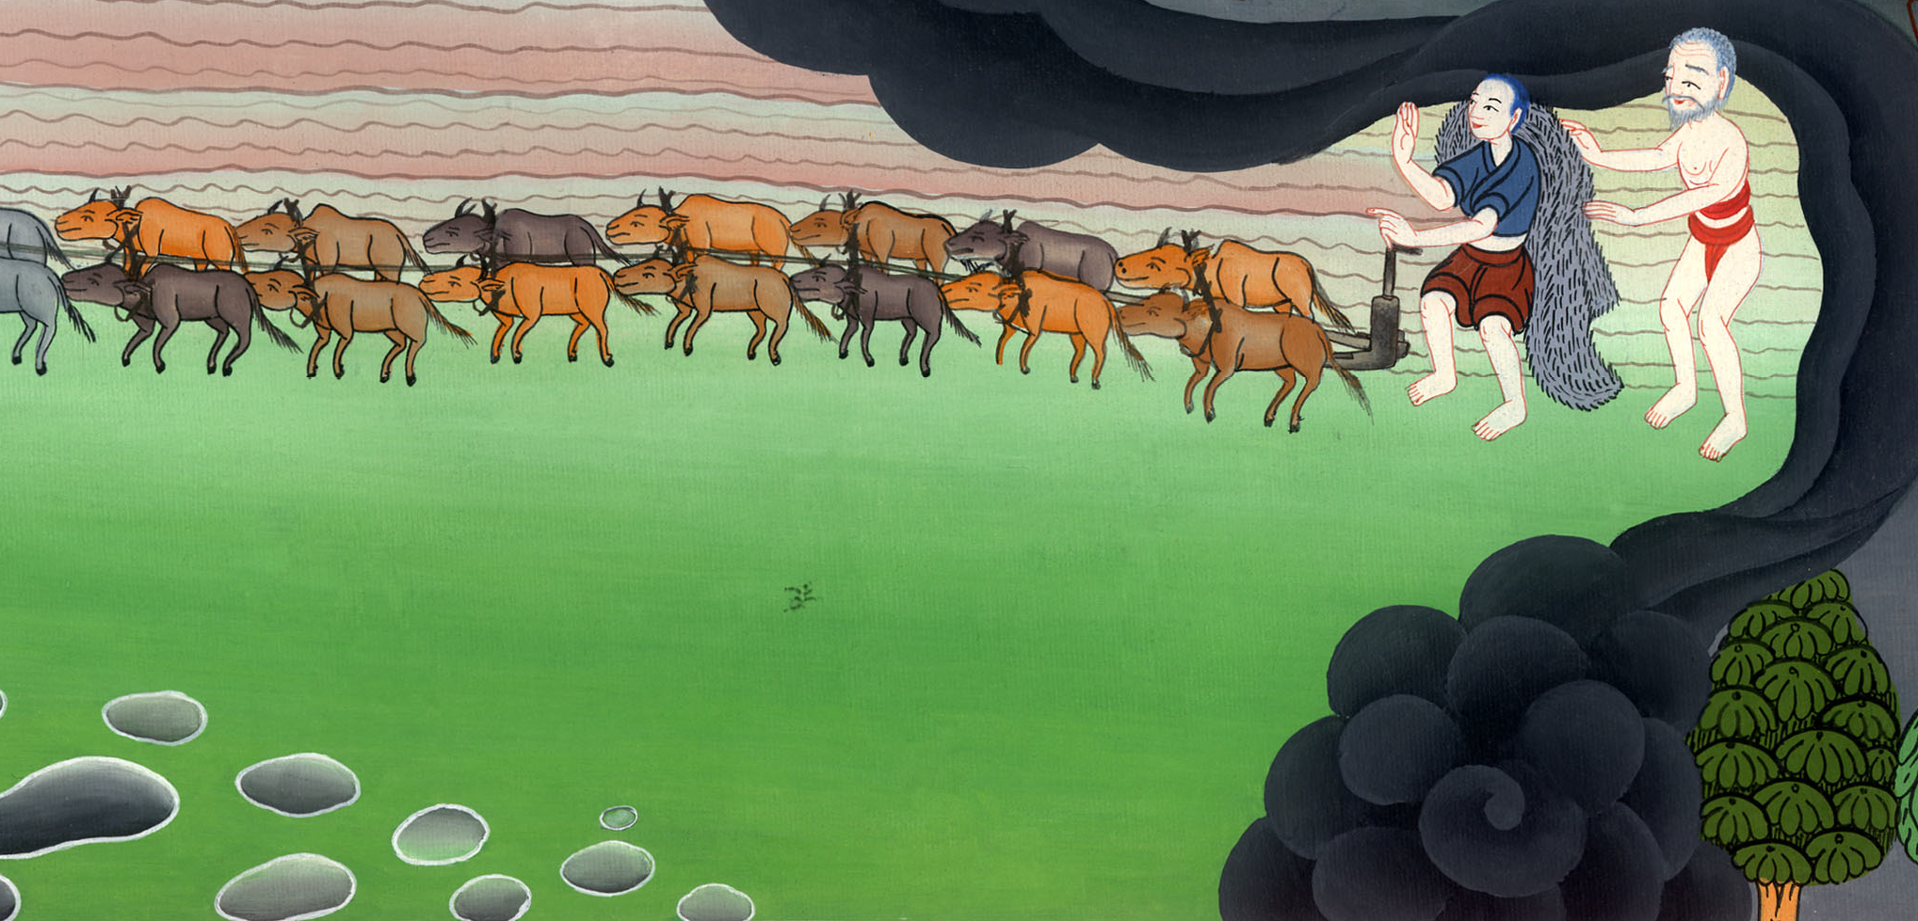
1 Kings 19:21

