Slide 1
21-8
This work is licensed under a Creative Commons Attribution-ShareAlike 4.0 International License.
Please add this statement to all the videos you create.
English Bible quotes are from the World English Bible US, which is in the public domain.
Notes:
Ch
21 Elijah
1. Elijah comes to Ahab - 1 Kings 16:28 – 17:1 (Left Top)
2. Ravens feed Elijah – 1 Kings 17:2-7 (Center Top)
3. Elijah and the widow – 1 Kings 17:8-24 (Right Top)
4. Mt. Carmel – 1 Kings 18:17-40 (Right Center)
5. Rain comes – 1 kings 18:41-46 (Right Bottom)
6. Elisha called – 1 Kings 19:19-21 (Left Bottom)
7. Elijah taken up to Heaven - 2 Kings 2:1-13 (Left Center)

Slide 2
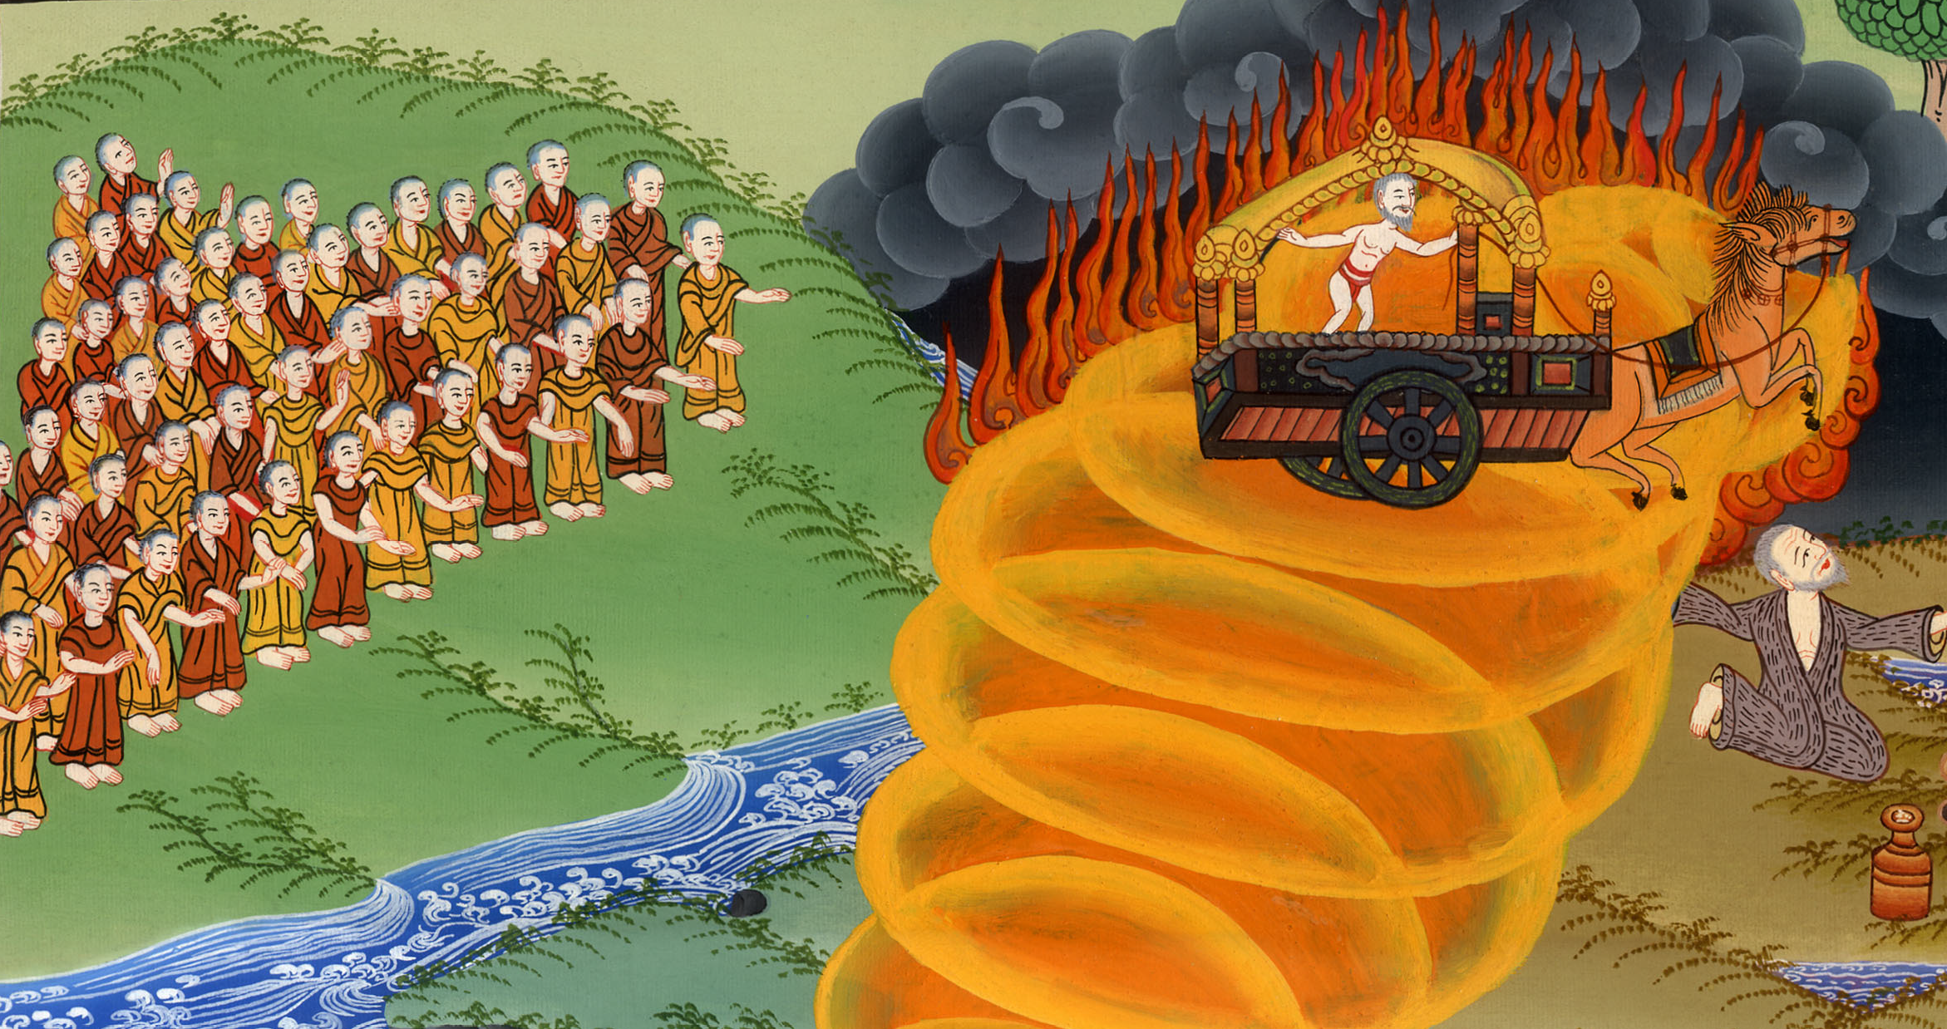
Elijah taken up to Heaven –
2 Kings 2:1-13

Slide 3
Elijah taken up to Heaven –
2 Kings 2:1-13

Slide 4
Elijah taken up to Heaven –
2 Kings 2:1-13

Slide 5
1When Yahweh was about to take Elijah up by a whirlwind into heaven, Elijah went with Elisha from Gilgal.

Slide 6
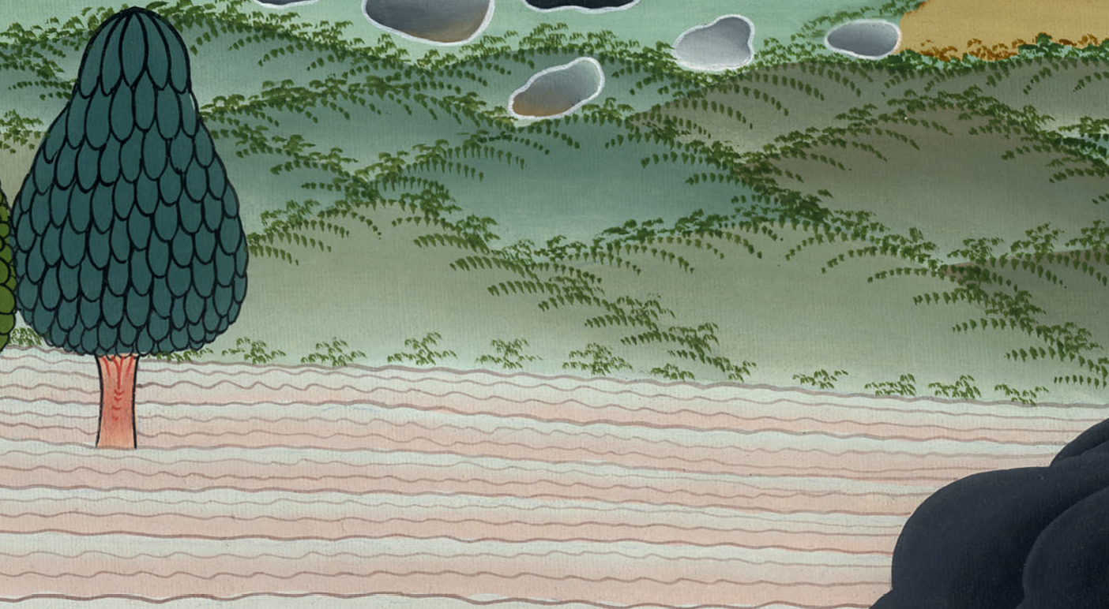
2 Kings 2:1

Slide 7
2Elijah said to Elisha, “Please wait here, for Yahweh has sent me as far as Bethel.”
Elisha said, “As Yahweh lives, and as your soul lives, I will not leave you.” So they went down to Bethel.

Slide 8
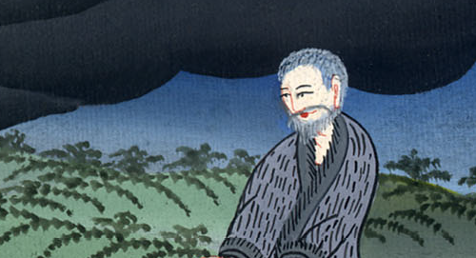
2 Kings 2:2

Slide 9
3The sons of the prophets who were at Bethel came out to Elisha, and said to him, “Do you know that Yahweh will take away your master from over you today?”
He said, “Yes, I know it. Hold your peace.”

Slide 10
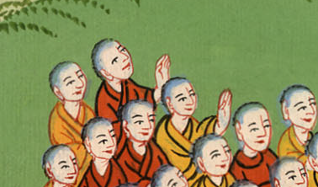
2 Kings 2:3

Slide 11
4Elijah said to him, “Elisha, please wait here, for Yahweh has sent me to Jericho.”
He said, “As Yahweh lives, and as your soul lives, I will not leave you.” So they came to Jericho.

Slide 12
2 Kings 2:4

Slide 13
5The sons of the prophets who were at Jericho came near to Elisha, and said to him, “Do you know that Yahweh will take away your master from over you today?”
He answered, “Yes, I know it. Hold your peace.”

Slide 14
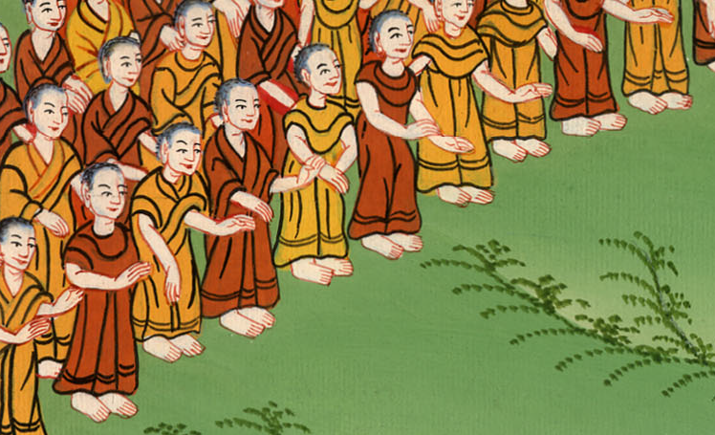
2 Kings 2:5

Slide 15
6Elijah said to him, “Please wait here, for Yahweh has sent me to the Jordan.”
He said, “As Yahweh lives, and as your soul lives, I will not leave you.” Then they both went on.

Slide 16
2 Kings 2:6

Slide 17
7Fifty men of the sons of the prophets went and stood opposite them at a distance; and they both stood by the Jordan.

Slide 18
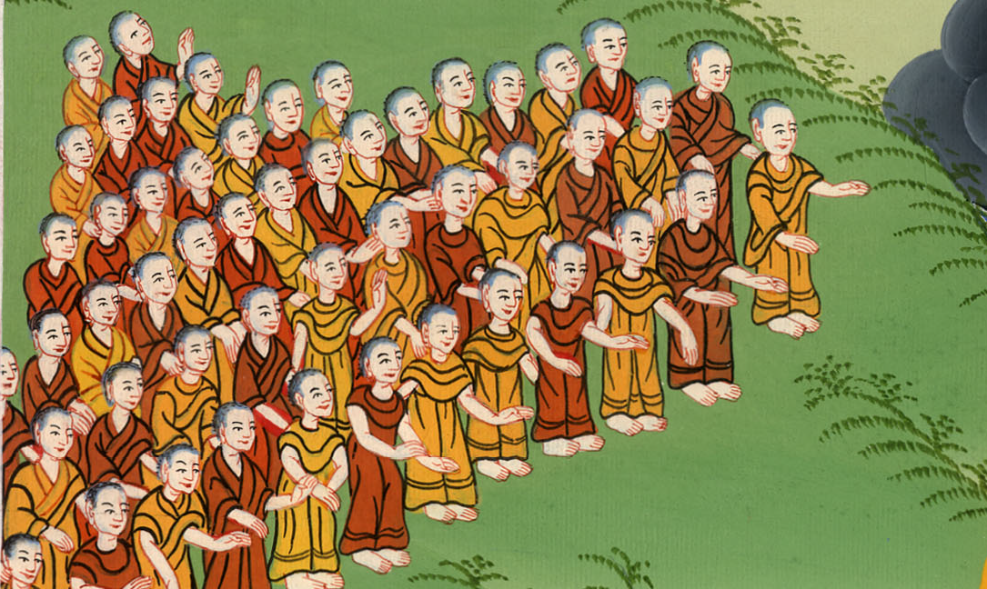
2 Kings 2:7

Slide 19
8Elijah took his mantle, and rolled it up, and struck the waters; and they were divided here and there, so that they both went over on dry ground.

Slide 20
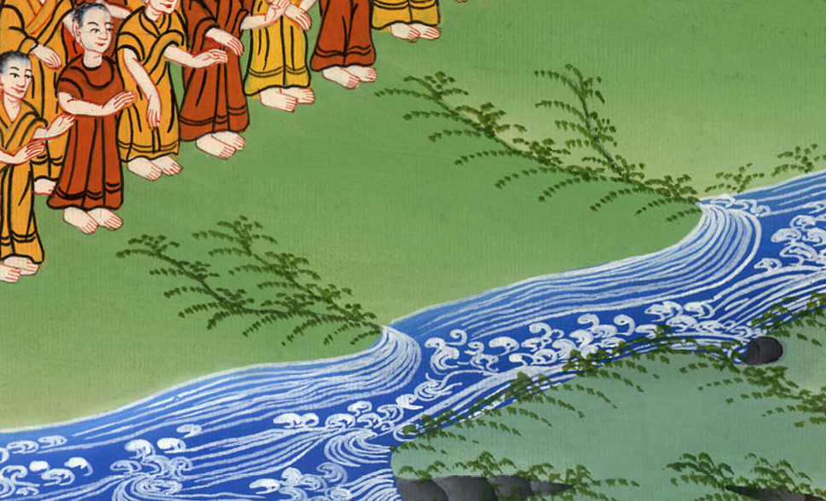
2 Kings 2:8

Slide 21
9When they had gone over, Elijah said to Elisha, “Ask what I shall do for you, before I am taken from you.”
Elisha said, “Please let a double portion of your spirit be on me.”

Slide 22
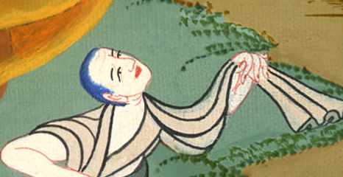
2 Kings 2:9

Slide 23
10He said, “You have asked a hard thing. If you see me when I am taken from you, it will be so for you; but if not, it will not be so.”

Slide 24
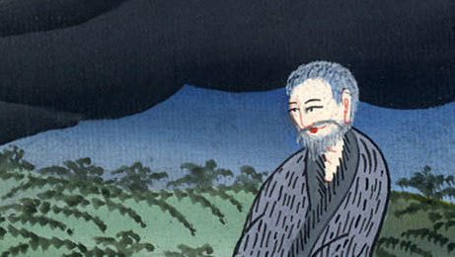
2 Kings 2:10

Slide 25
11As they continued on and talked, behold, a chariot of fire and horses of fire separated them; and Elijah went up by a whirlwind into heaven.

Slide 26
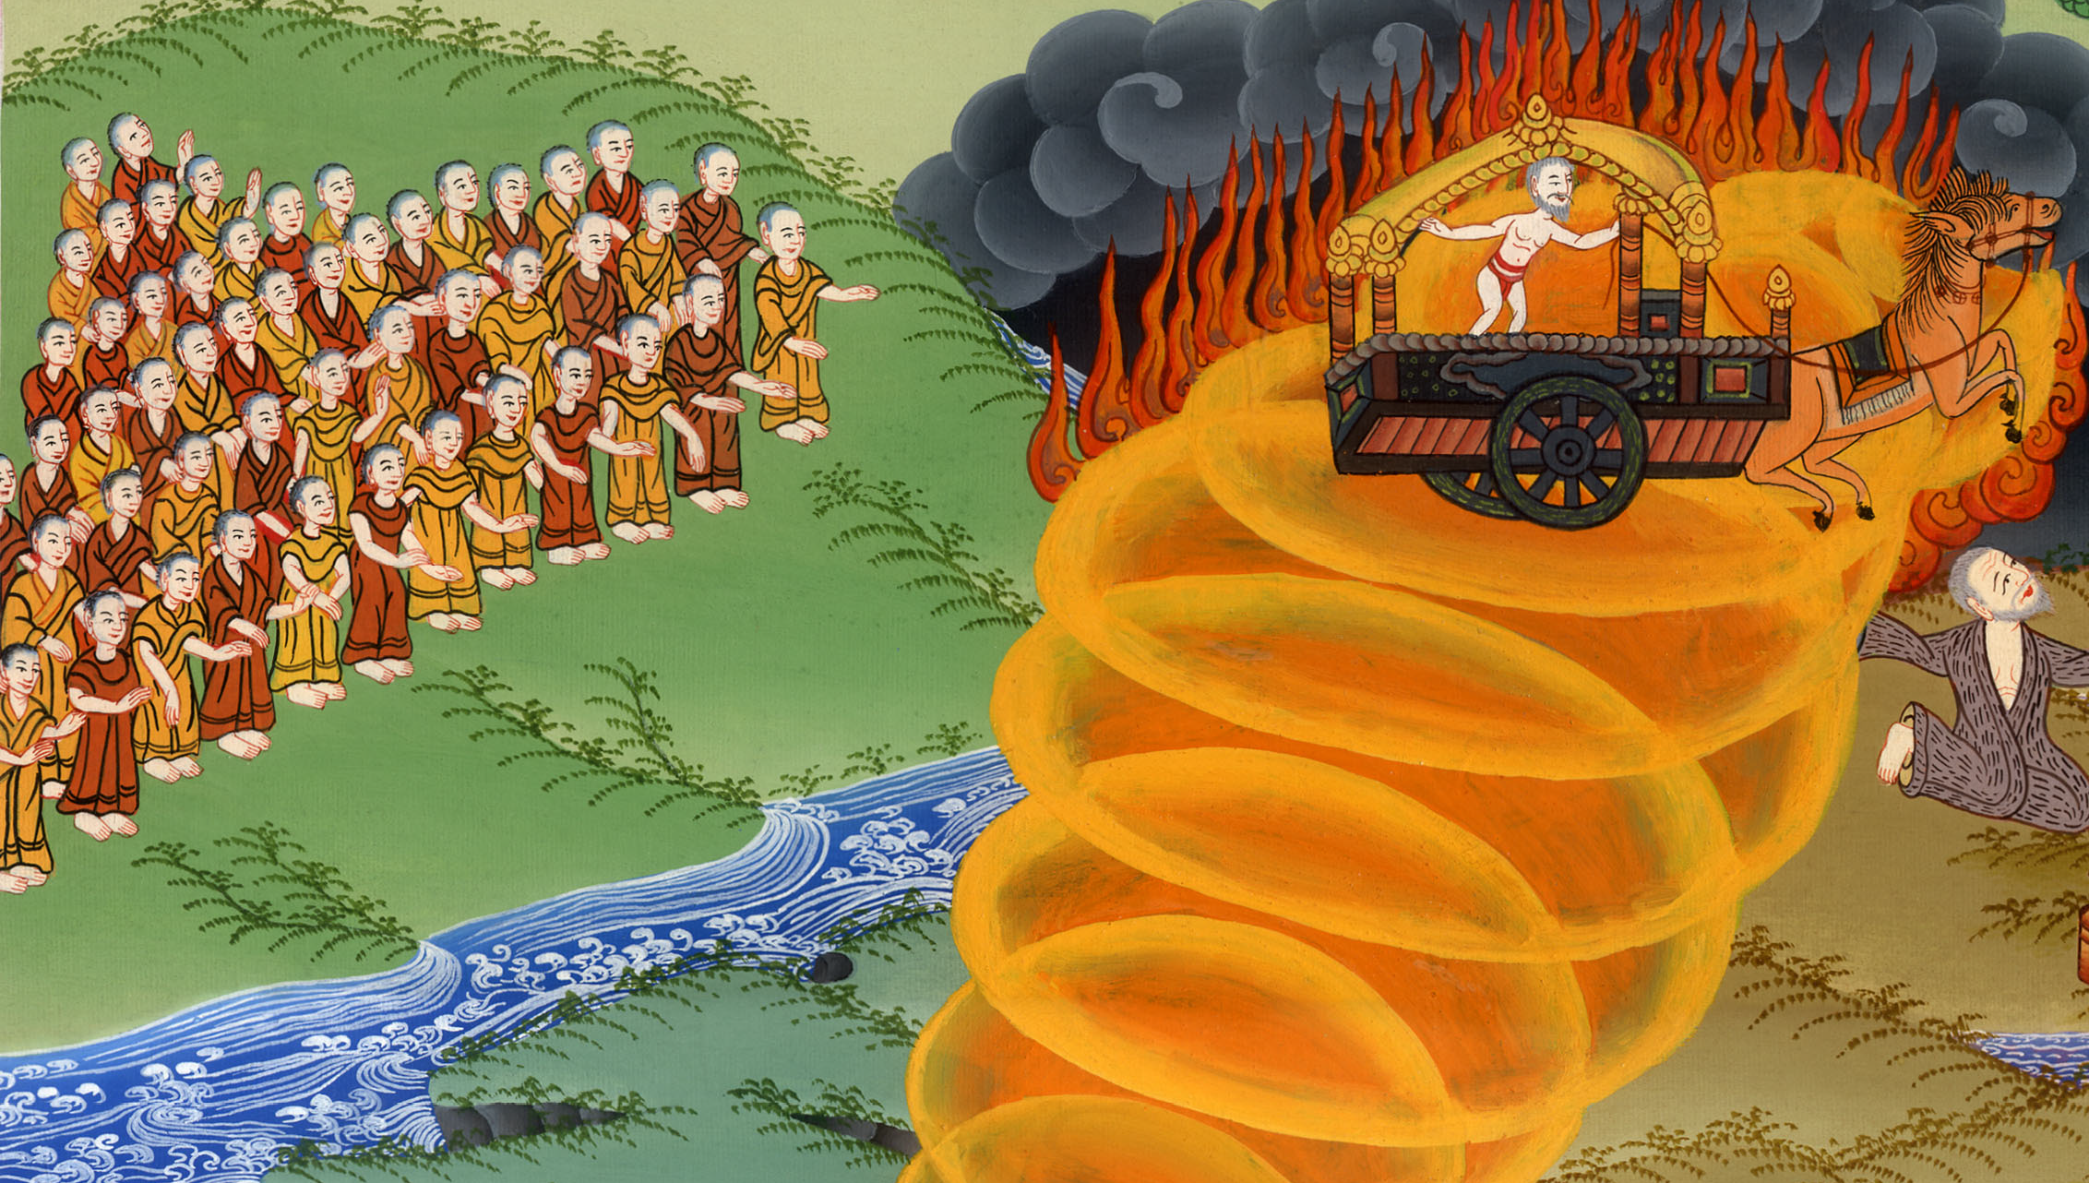
2 Kings 2:11

Slide 27
12Elisha saw it, and he cried, “My father, my father, the chariots of Israel and its horsemen!”
He saw him no more. Then he took hold of his own clothes and tore them in two pieces.

Slide 28
2 Kings 2:12

Slide 29
13He also took up Elijah’s mantle that fell from him, and went back and stood by the bank of the Jordan.

Slide 30
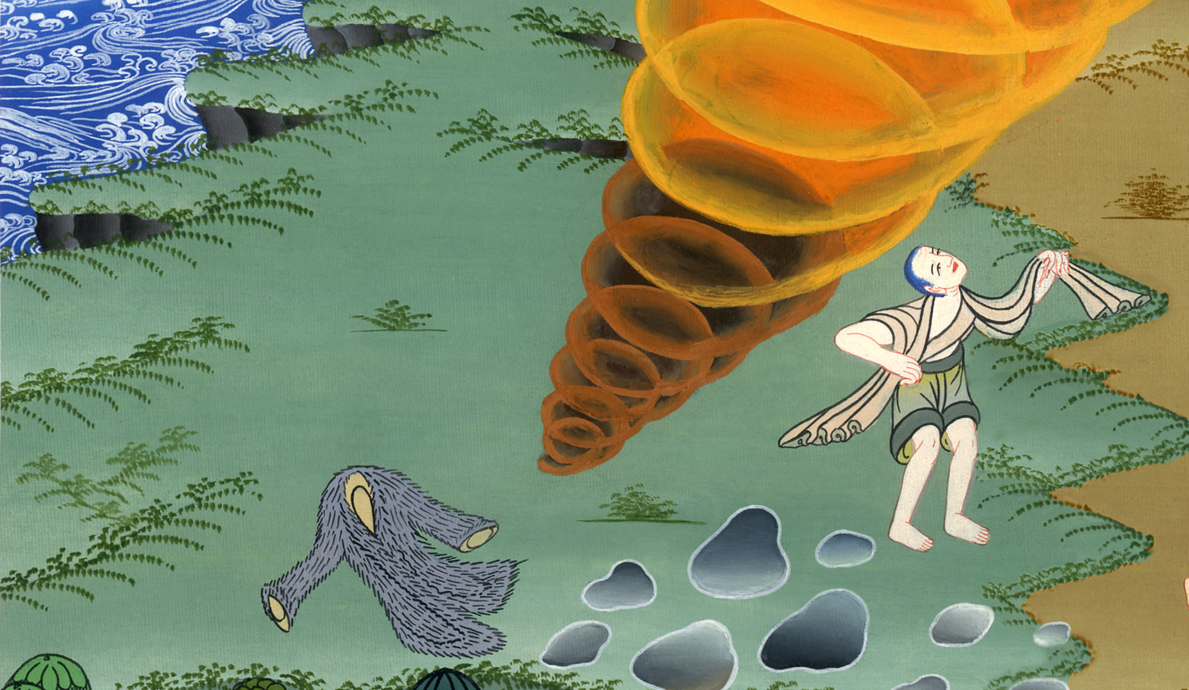
2 Kings 2:13

Slide 31
14He took Elijah’s mantle that fell from him, and struck the waters, and said, “Where is Yahweh, the God of Elijah?” When he also had struck the waters, they were divided apart, and Elisha went over.

Slide 32
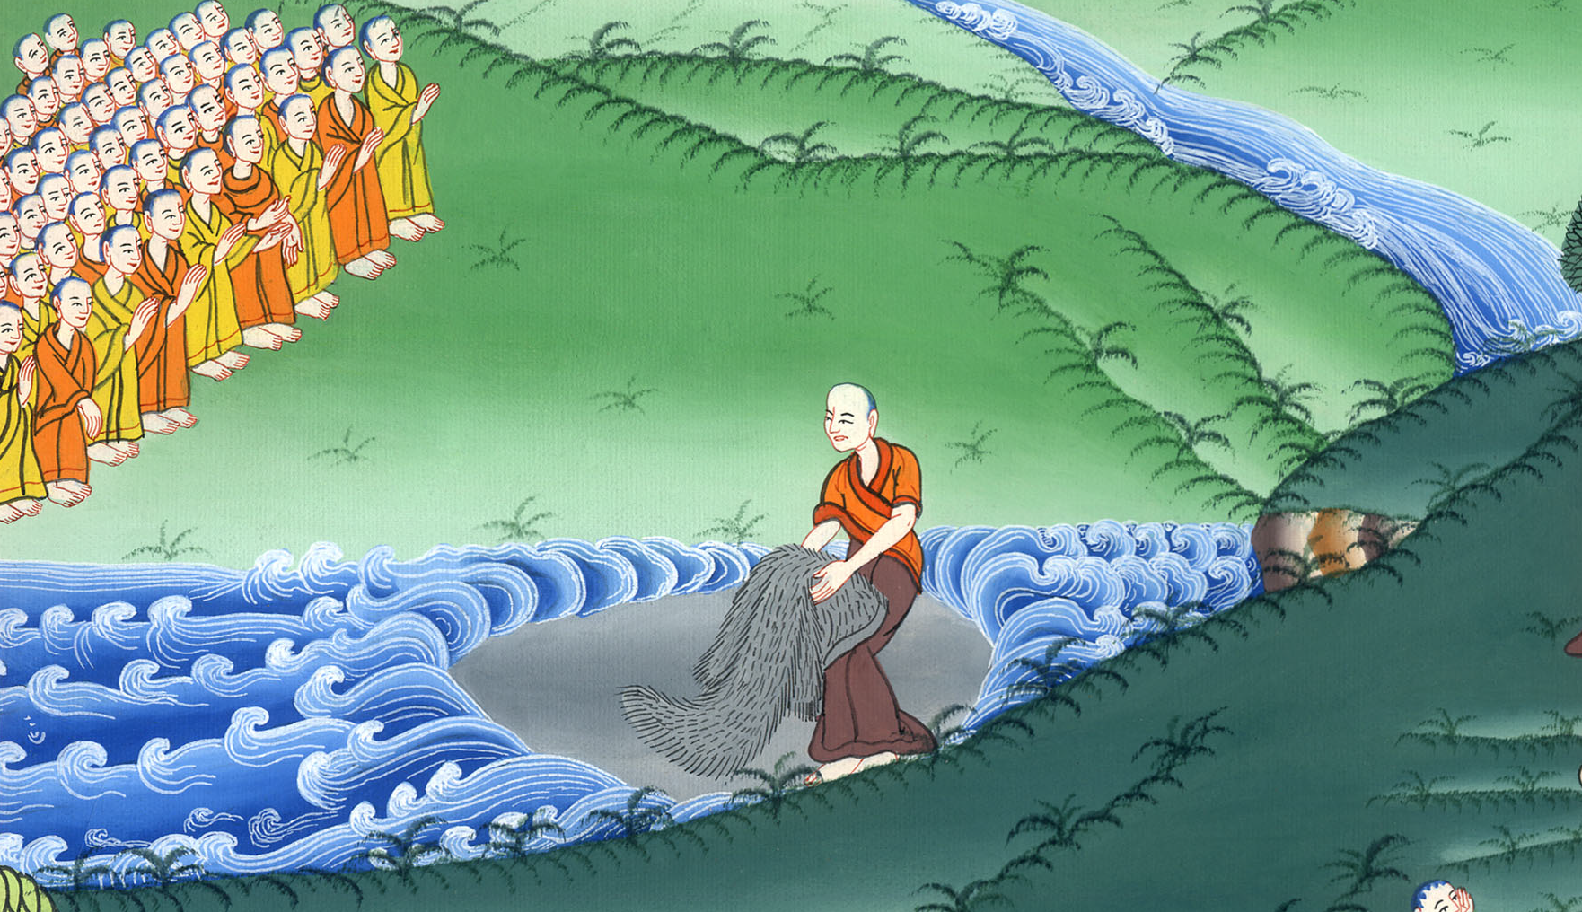
2 Kings 2:14

Slide 33
15When the sons of the prophets who were at Jericho facing him saw him, they said, “The spirit of Elijah rests on Elisha.” They came to meet him, and bowed themselves to the ground before him.

Slide 34
2 Kings 2:15

