Slide 1
22-1
This work is licensed under a Creative Commons Attribution-ShareAlike 4.0 International License.
Please add this statement to all the videos you create.
English Bible quotes are from the World English Bible US, which is in the public domain.
Notes:
Ch
22 Elisha
1. Elisha purifies water in Jericho - 2:19-25 4. Purifies stew and multiplies loaves - 4:38-44 (Right Bottom)
2. Oil for a widow 2 Kings 4:1-44
3. Naaman & Gehazi - 5:1-27 (Center Bottom)
4. Floating axe head - 6:1-7 (Left Bottom)
5. Army of God - 6:8-23 (Center)

Slide 2
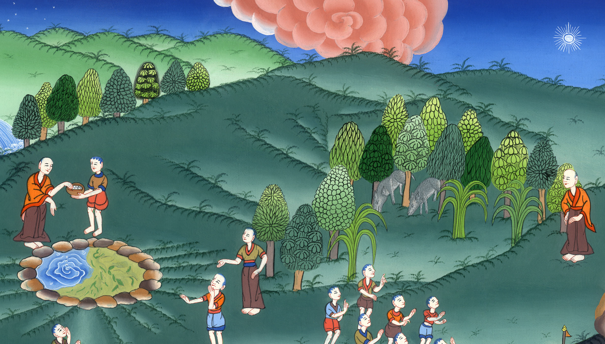
Elisha purifies water in Jericho –
2 Kings 2:19-25

Slide 3
Elisha purifies water in Jericho –
2 Kings 2:19-25

Slide 4
Elisha purifies water in Jericho –
2 Kings 2:19-25

Slide 5
19The men of the city [Jericho] said to Elisha, “Behold, please, the situation of this city is pleasant, as my lord sees; but the water is bad, and the land is barren.”

Slide 6
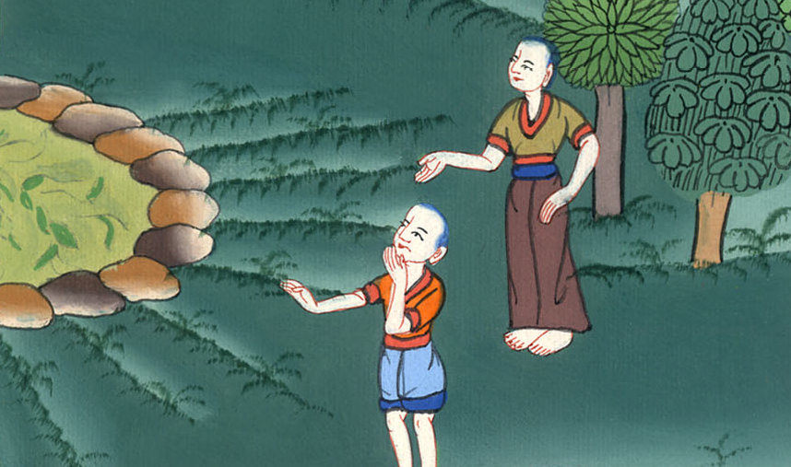
2 Kings 2:19

Slide 7
20He said, “Bring me a new jar, and put salt in it.” Then they brought it to him.

Slide 8
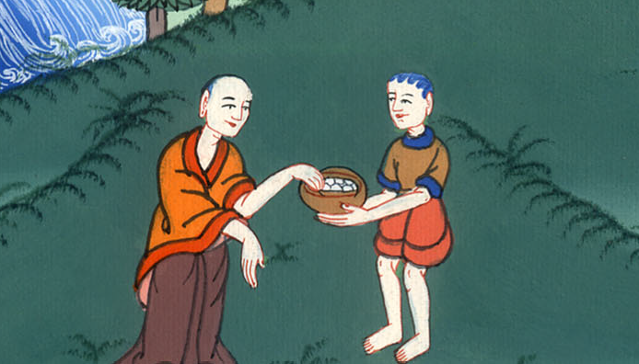
2 Kings 2:20

Slide 9
21He went out to the spring of the waters, and threw salt into it, and said, “Yahweh says, ‘I have healed these waters. There shall not be from there any more death or barren wasteland.’”

Slide 10
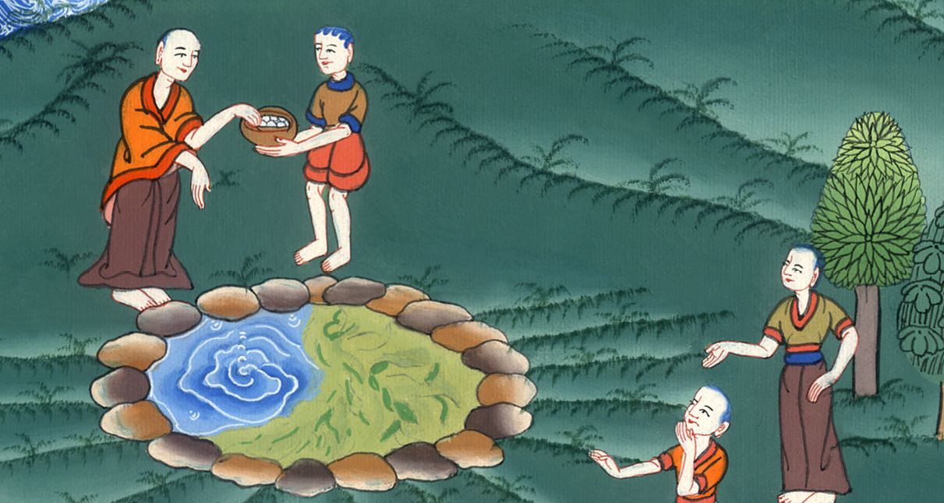
2 Kings 2:21

Slide 11
22So the waters were healed to this day, according to Elisha’s word which he spoke.

Slide 12
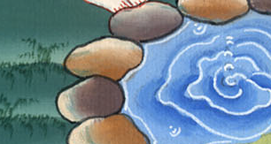
2 Kings 2:22

Slide 13
23He went up from there to Bethel. As he was going up by the way, some youths came out of the city and mocked him, and said to him, “Go up, you baldy! Go up, you baldy!”

Slide 14
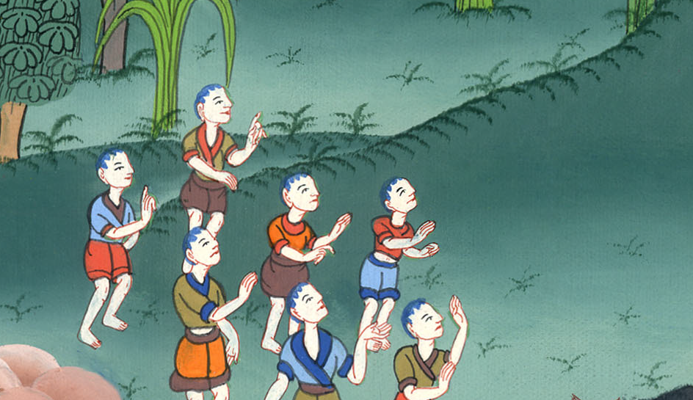
2 Kings ། 2:23

Slide 15
24He looked behind him and saw them, and cursed them in Yahweh’s name. Then two female bears came out of the woods and mauled forty-two of those youths.

Slide 16
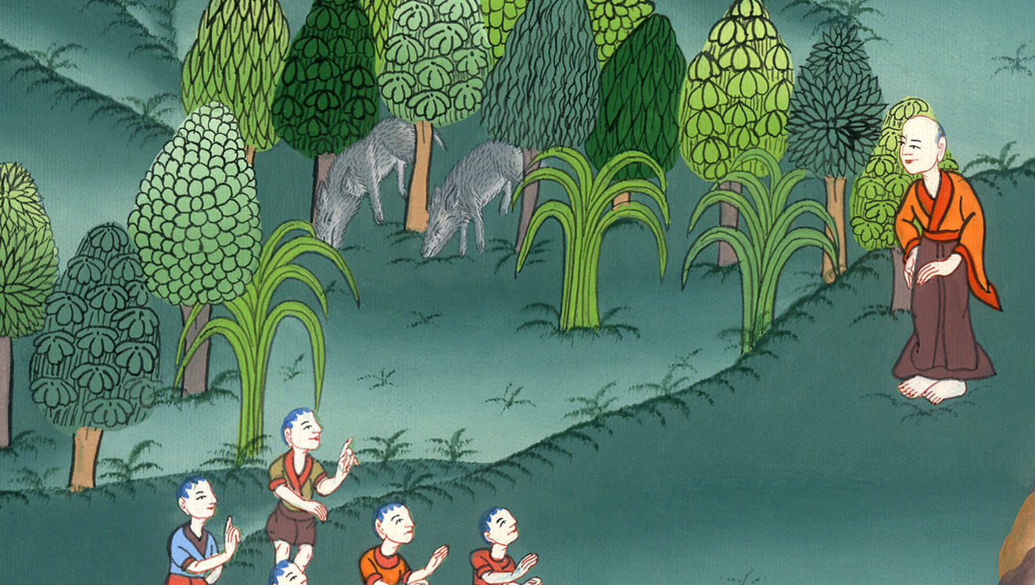
2 Kings 2:24

Slide 17
25He went from there to Mount Carmel, and from there he returned to Samaria.

Slide 18
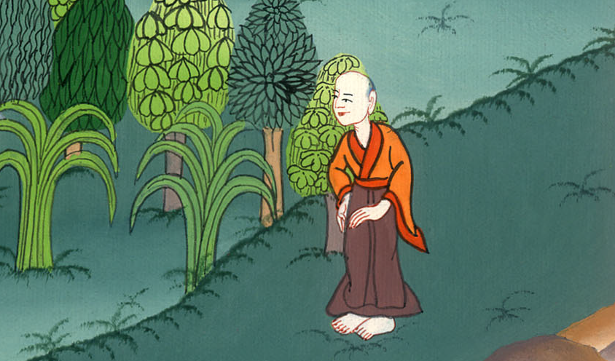
2 Kings 2:25

