Slide 1
22-2
This work is licensed under a Creative Commons Attribution-ShareAlike 4.0 International License.
Please add this statement to all the videos you create.
English Bible quotes are from the World English Bible US, which is in the public domain.
Notes:
Ch
22 Elisha
1. Elisha crosses the Jordan - 2 Kings 2:13-18 (Left Top)
2. Purifies water in Jericho - 2:19-22 (Center Top)
3. “Go up Baldhead” - 2:23-25 (Right Top)
4. Purifies stew and multiplies loaves - 4:38-44 (Right Bottom)
5. Naaman & Gehazi - 5:1-27 (Center Bottom)
6. Floating axe head - 6:1-7 (Left Bottom)
7. Army of God - 6:8-23 (Center)

Slide 2
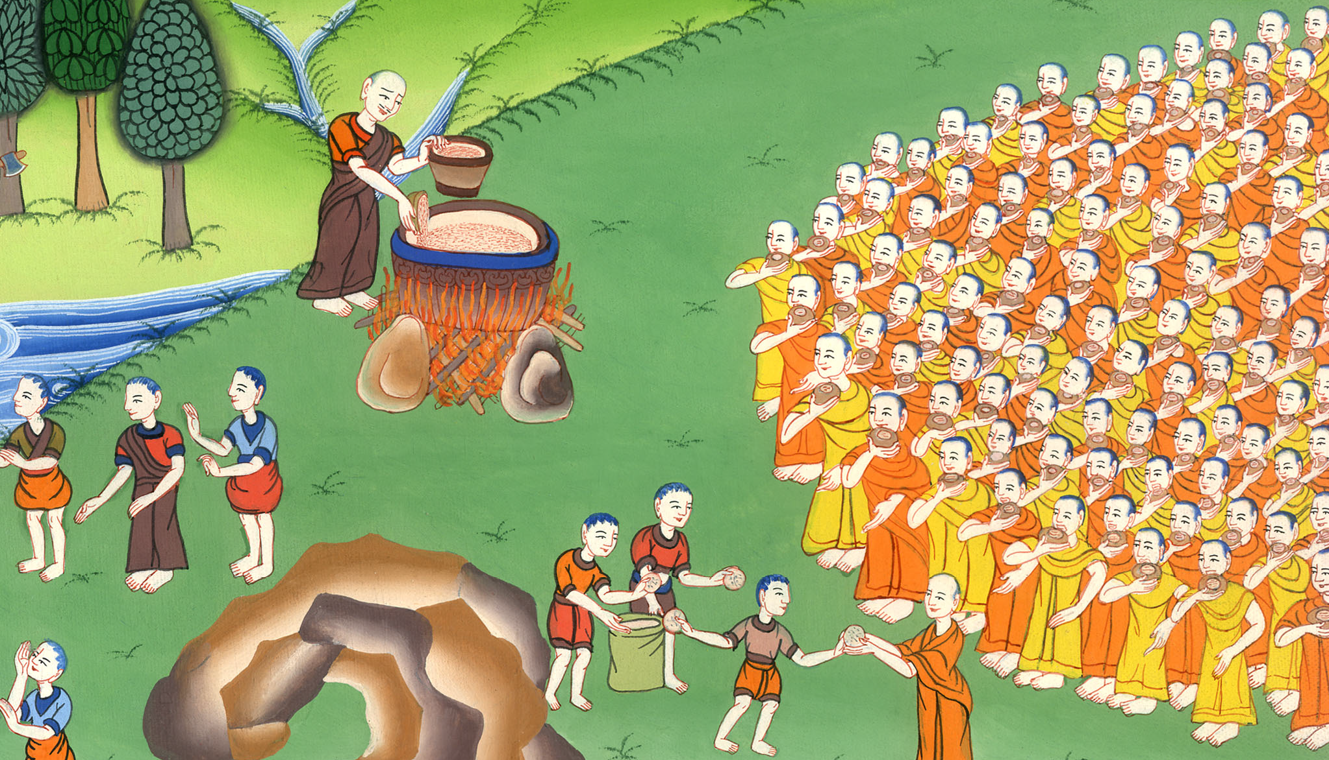
Elisha provides olive oil for a widow –
2 Kings 4:1-44

Slide 3
Elisha provides olive oil for a widow – 2 Kings 4:1-44

Slide 4
Elisha provides olive oil for a widow –
2 Kings 4:1-44

Slide 5
1Now a certain woman of the wives of the sons of the prophets cried out to Elisha, saying, “Your servant my husband is dead.

Slide 6
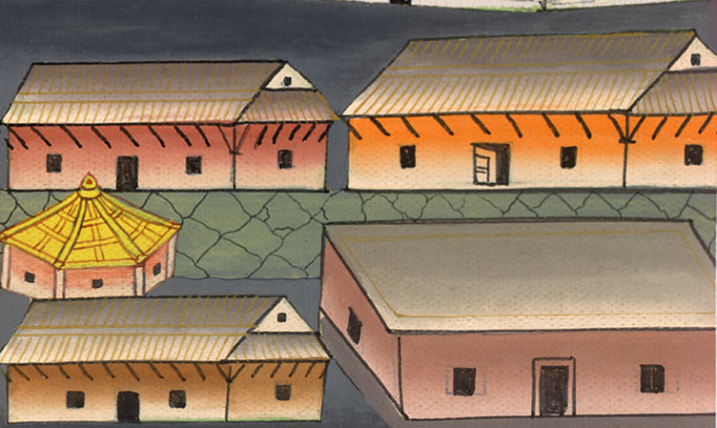
2 Kings 4:1

Slide 7
You know that your servant feared Yahweh. Now the creditor has come to take for himself my two children to be slaves.”

Slide 8
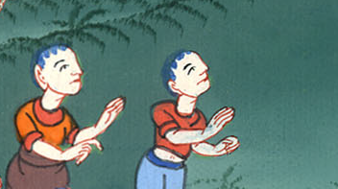
2 Kings 4:1

Slide 9
2Elisha said to her, “What should I do for you? Tell me, what do you have in the house?”
She said, “Your servant has nothing in the house, except a pot of oil.”

Slide 10
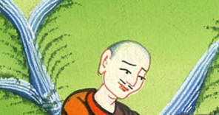
2 Kings 4:2

Slide 11
3Then he said, “Go, borrow empty containers from all your neighbors. Don’t borrow just a few containers.

Slide 12
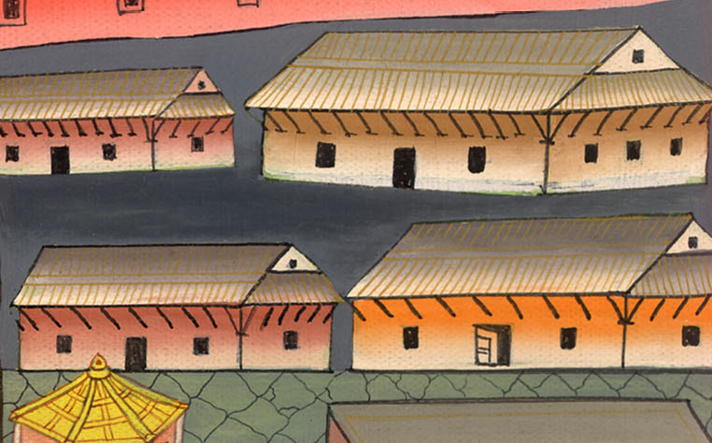
2 Kings 4:3

Slide 13
4Go in and shut the door on you and on your sons, and pour oil into all those containers; and set aside those which are full.”

Slide 14
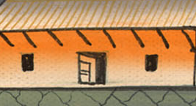
2 Kings 4:4

Slide 15
5So she went from him, and shut the door on herself and on her sons. They brought the containers to her, and she poured oil.

Slide 16
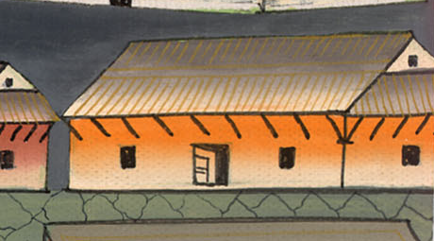
2 Kings 4:5

Slide 17
6When the containers were full, she said to her son, “Bring me another container.”
He said to her, “There isn’t another container.” Then the oil stopped flowing.

Slide 18
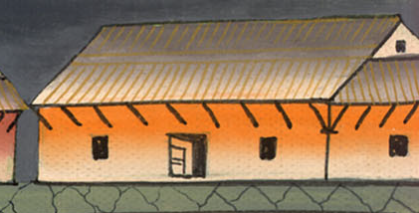
2 Kings 4:6

Slide 19
7Then she came and told the man of God. He said, “Go, sell the oil, and pay your debt; and you and your sons live on the rest.”

Slide 20
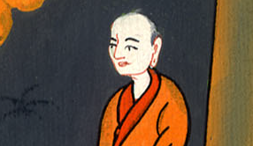
2 Kings 4:7

Slide 21
38Elisha came again to Gilgal. There was a famine in the land; and the sons of the prophets were sitting before him; and he said to his servant, “Get the large pot, and boil stew for the sons of the prophets.”

Slide 22
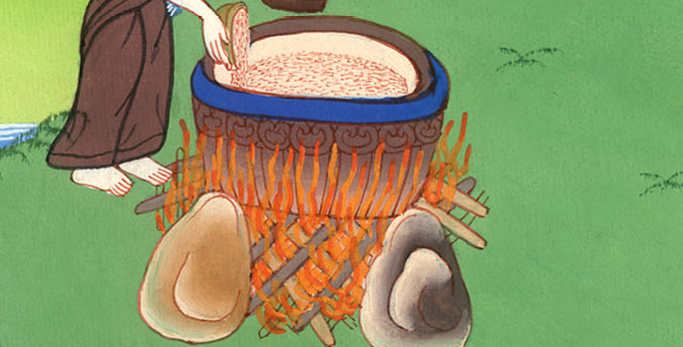
2 Kings 4:38

Slide 23
39One went out into the field to gather herbs, and found a wild vine, and gathered a lap full of wild gourds from it, and came and cut them up into the pot of stew; for they didn’t recognize them.

Slide 24
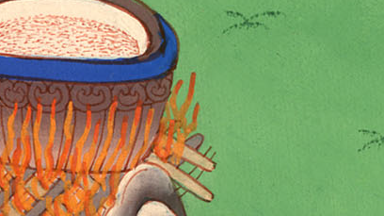
2 Kings 4:39

Slide 25
40So they poured out for the men to eat. As they were eating some of the stew, they cried out and said, “Man of God, there is death in the pot!” And they could not eat it.

Slide 26
2 Kings 4:40

Slide 27
41But he said, “Then bring meal.” He threw it into the pot; and he said, “Serve it to the people, that they may eat.” And there was nothing harmful in the pot.

Slide 28
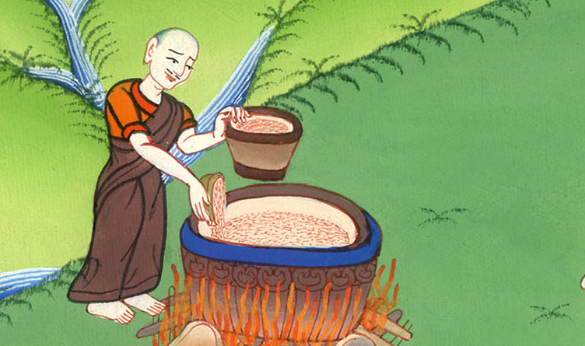
2 Kings 4:41

Slide 29
2A man from Baal Shalishah came, and brought the man of God some bread of the first fruits: twenty loaves of barley and fresh ears of grain in his sack. Elisha said, “Give to the people, that they may eat.”

Slide 30
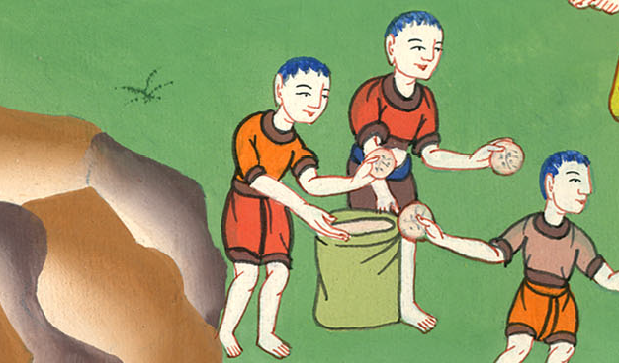
2 Kings 4:42

Slide 31
43His servant said, “What, should I set this before a hundred men?”
But he said, “Give it to the people, that they may eat; for Yahweh says, ‘They will eat, and will have some left over.’”

Slide 32
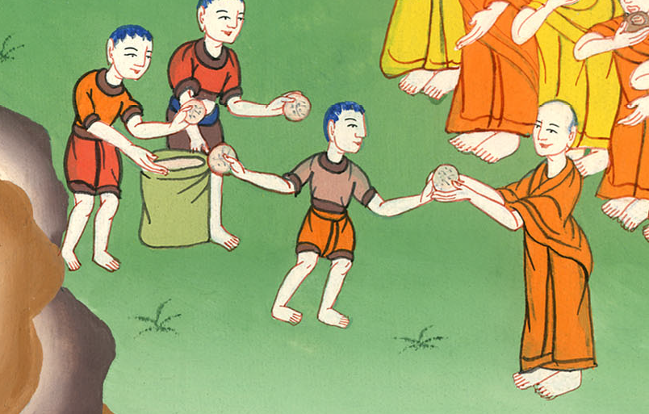
2 Kings 4:43

Slide 33
44So he set it before them and they ate and had some left over, according to Yahweh’s word.

Slide 34
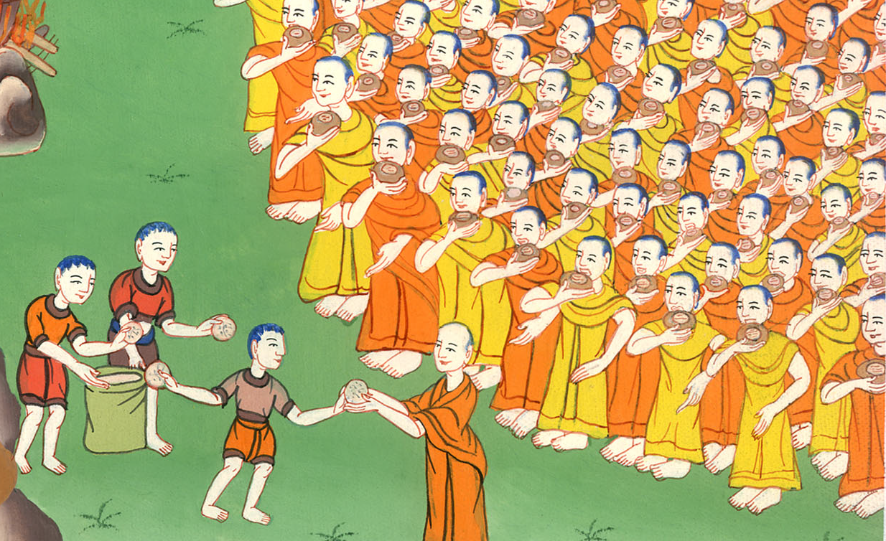
2 Kings 4:44

