Slide 1
22-3
This work is licensed under a Creative Commons Attribution-ShareAlike 4.0 International License.
Please add this statement to all the videos you create.
English Bible quotes are from the World English Bible US, which is in the public domain.
Notes:
Ch
22 Elisha
1. Elisha crosses the Jordan - 2 Kings 2:13-18 (Left Top)
2. Purifies water in Jericho - 2:19-22 (Center Top)
3. “Go up Baldhead” - 2:23-25 (Right Top)
4. Purifies stew and multiplies loaves - 4:38-44 (Right Bottom)
5. Naaman & Gehazi - 5:1-27 (Center Bottom)
6. Floating axe head - 6:1-7 (Left Bottom)
7. Army of God - 6:8-23 (Center)

Slide 2
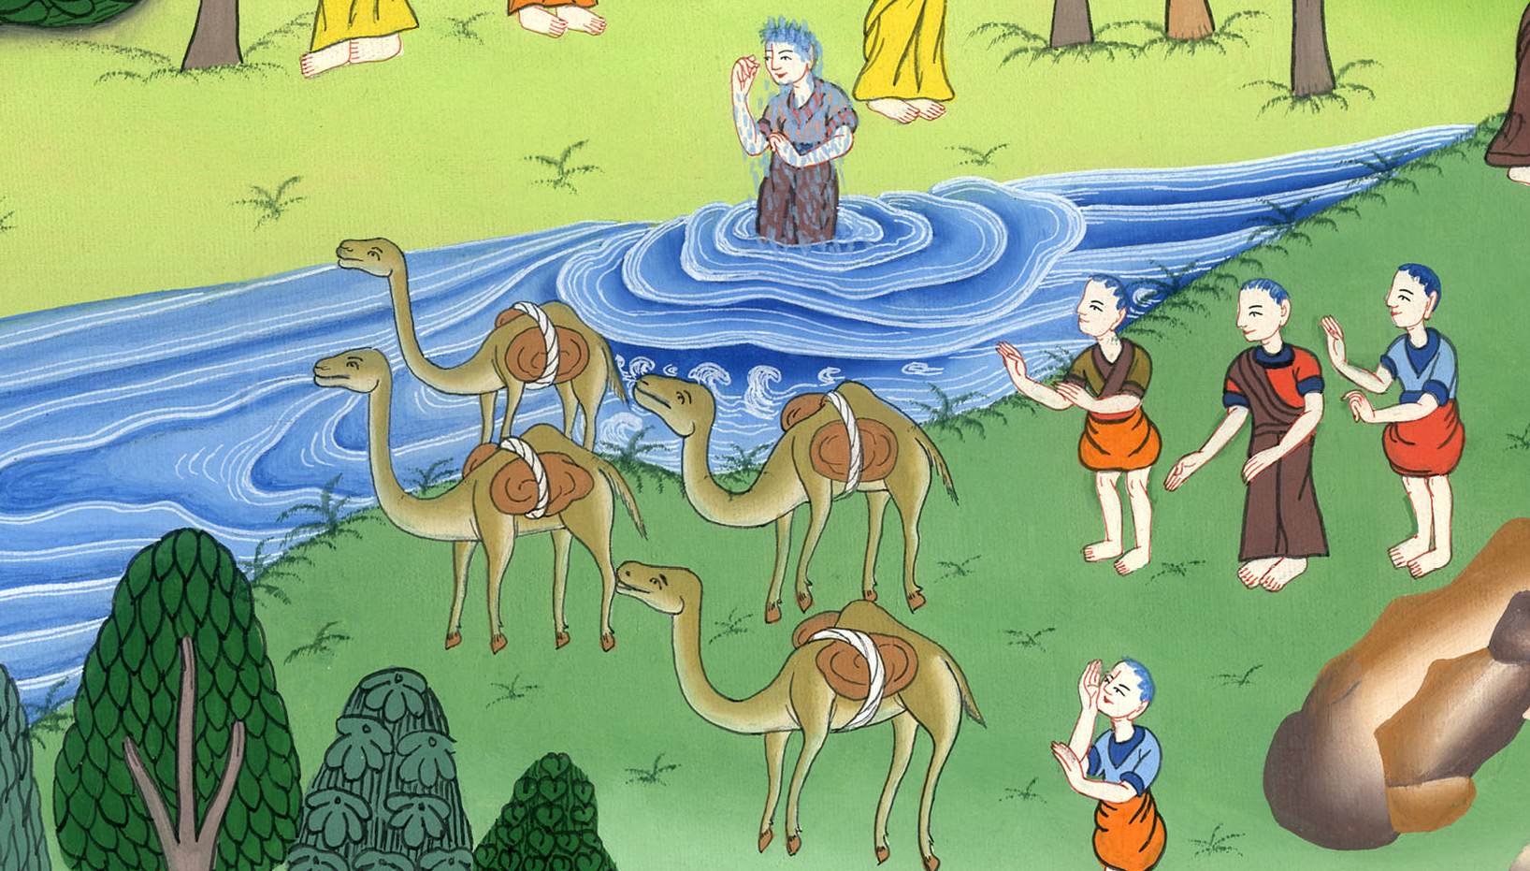
Naaman and Gehazi –
2 Kings 5:1-27

Slide 3
Naaman and Gehazi – 2 Kings 5:1-27

Slide 4
Naaman and Gehazi –
2 Kings 5:1-27

Slide 5
1Now Naaman, captain of the army of the king of Syria, was a great man with his master, and honorable, because by him Yahweh had given victory to Syria; he was also a mighty man of valor, but he was a leper.

Slide 6
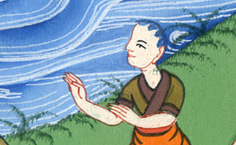
2 Kings 5:1

Slide 7
2The Syrians had gone out in bands, and had brought away captive out of the land of Israel a little girl, and she waited on Naaman’s wife.

Slide 8
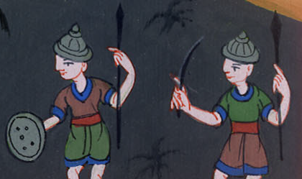
2 Kings 5:2

Slide 9
3She said to her mistress, “I wish that my lord were with the prophet who is in Samaria! Then he would heal him of his leprosy.”

Slide 10
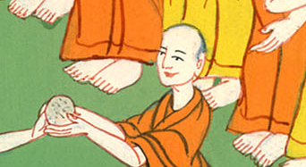
2 Kings 5:3

Slide 11
9So Naaman came with his horses and with his chariots, and stood at the door of the house of Elisha.

Slide 12
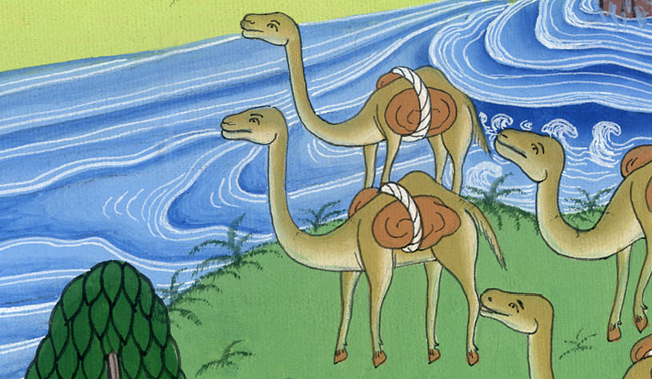
2 Kings 5:9

Slide 13
10Elisha sent a messenger to him, saying, “Go and wash in the Jordan seven times, and your flesh shall come again to you, and you shall be clean.”

Slide 14
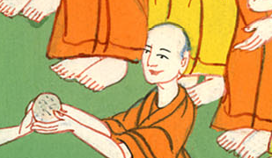
2 Kings 5:10

Slide 15
11But Naaman was angry, and went away and said, “Behold, I thought, ‘He will surely come out to me, and stand, and call on the name of Yahweh his God, and wave his hand over the place, and heal the leper.’

Slide 16
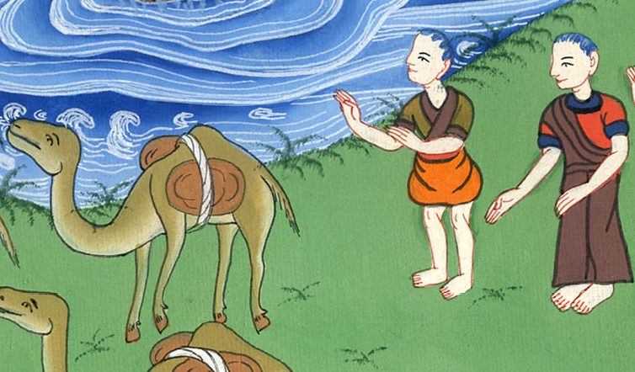
2 Kings 5:11

Slide 17
13His servants came near and spoke to him, and said, “My father, if the prophet had asked you do some great thing, wouldn’t you have done it? How much rather then, when he says to you, ‘Wash, and be clean?’”

Slide 18
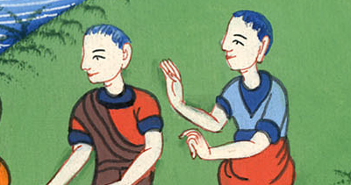
2 Kings 5:13

Slide 19
14Then went he down and dipped himself seven times in the Jordan, according to the saying of the man of God; and his flesh was restored like the flesh of a little child, and he was clean.

Slide 20
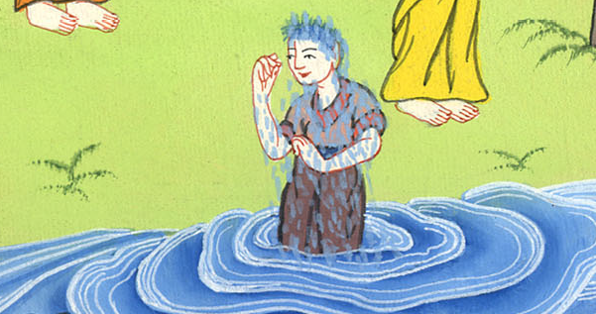
2 Kings 5:14

Slide 21
15He returned to the man of God, he and all his company, and came, and stood before him; and he said, “See now, I know that there is no God in all the earth, but in Israel. Now therefore, please take a gift from your servant.”

Slide 22
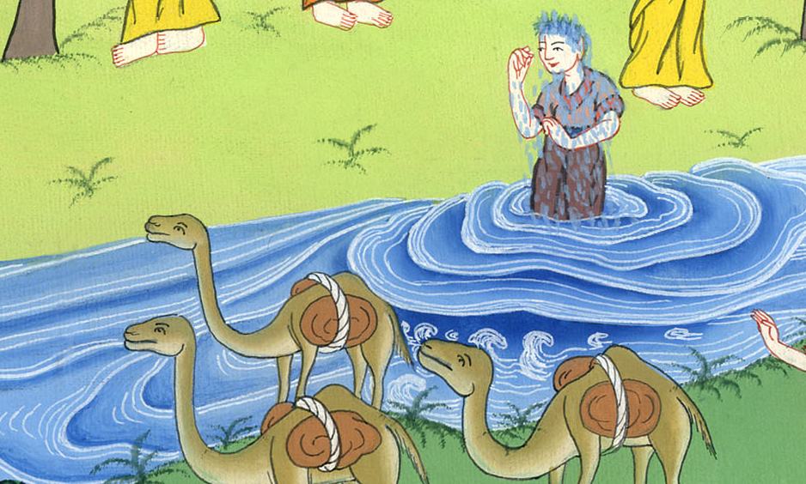
2 Kings 5:15

Slide 23
16But he said, “As Yahweh lives, before whom I stand, I will receive none.”
He urged him to take it; but he refused.

Slide 24
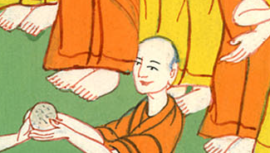
2 Kings 5:16

Slide 25
20But Gehazi the servant of Elisha the man of God, said, “Behold, my master has spared this Naaman the Syrian, in not receiving at his hands that which he brought. As Yahweh lives, I will run after him, and take something from him.”

Slide 26
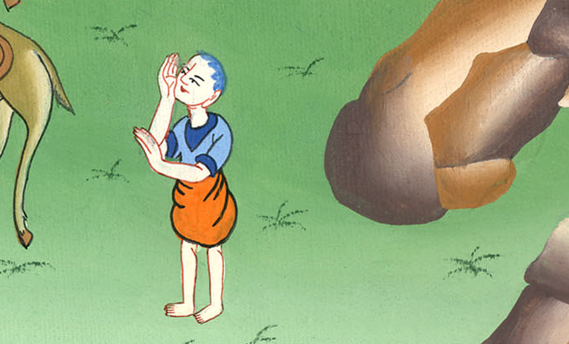
2 Kings 5:20

Slide 27
(Gehazi went after Naaman who asked him, “Is all well?”) 22He said, “All is well. My master has sent me, saying, ‘Behold, even now two young men of the sons of the prophets have come to me from the hill country of Ephraim. Please give them a talent of silver and two changes of clothing.’”

Slide 28
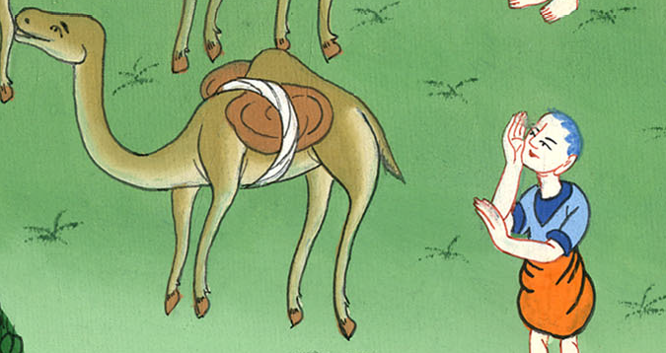
2 Kings 5:21,22

Slide 29
25But he went in, and stood before his master. Elisha said to him, “Where did you come from, Gehazi?”
He said, “Your servant went nowhere.”

Slide 30
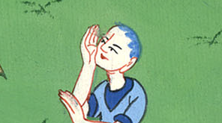
2 Kings 5:25

Slide 31
But Elisha said to him, “I know what you did”)
27Therefore the leprosy of Naaman will cling to you and to your offspring forever.”
He went out from his presence a leper, as white as snow.

Slide 32
2 Kings 5:27

