Slide 1
22-4
This work is licensed under a Creative Commons Attribution-ShareAlike 4.0 International License.
Please add this statement to all the videos you create.
English Bible quotes are from the World English Bible US, which is in the public domain.
Notes:
Ch
22 Elisha
1. Elisha crosses the Jordan - 2 Kings 2:13-18 (Left Top)
2. Purifies water in Jericho - 2:19-22 (Center Top)
3. “Go up Baldhead” - 2:23-25 (Right Top)
4. Purifies stew and multiplies loaves - 4:38-44 (Right Bottom)
5. Naaman & Gehazi - 5:1-27 (Center Bottom)
6. Floating axe head - 6:1-7 (Left Bottom)
7. Army of God - 6:8-23 (Center)

Slide 2
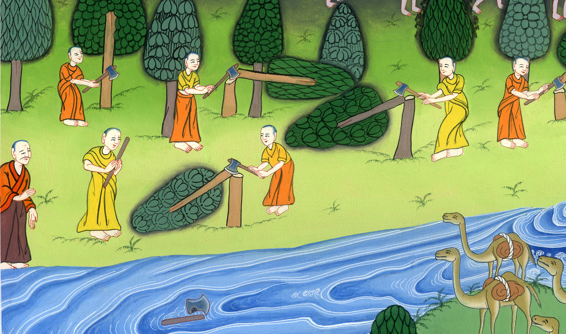
Floating axe head – 2 Kings 6:1-7

Slide 3
Floating axe head – 2 Kings 6:1-7

Slide 4
Floating axe head – 2 Kings 6:1-7

Slide 5
1The sons of the prophets said to Elisha, “See now, the place where we live and meet with you is too small for us.

Slide 6
2 Kings 6:1

Slide 7
2Please let us go to the Jordan, and each man take a beam from there, and let’s make us a place there, where we may live.”
He answered, “Go!”

Slide 8
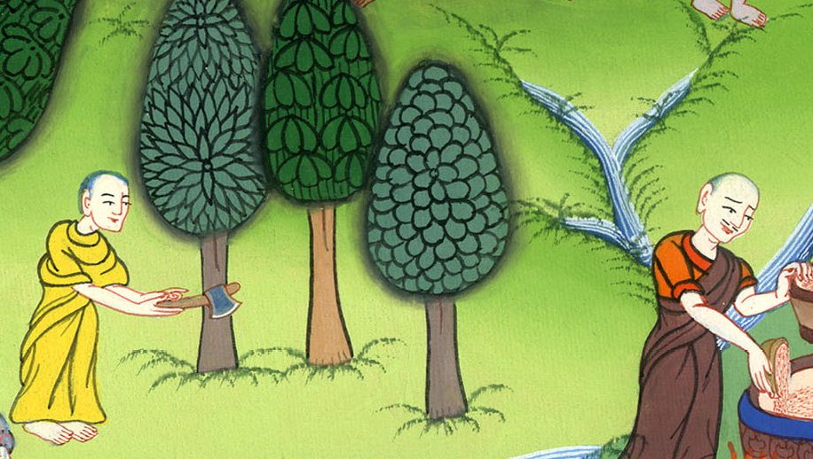
2 Kings 6:2

Slide 9
3One said, “Please be pleased to go with your servants.”
He answered, “I will go.”

Slide 10
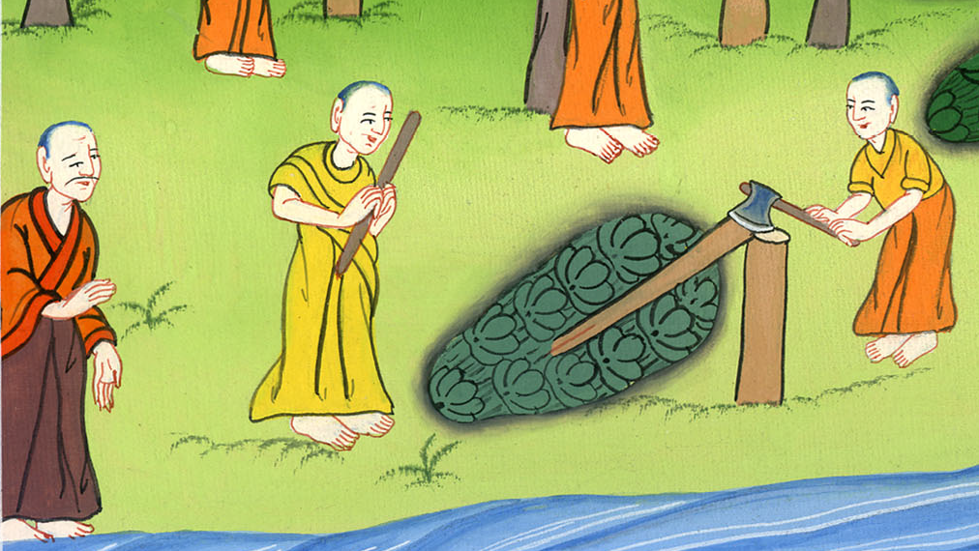
2 Kings 6:3

Slide 11
4So he went with them. When they came to the Jordan, they cut down wood.

Slide 12
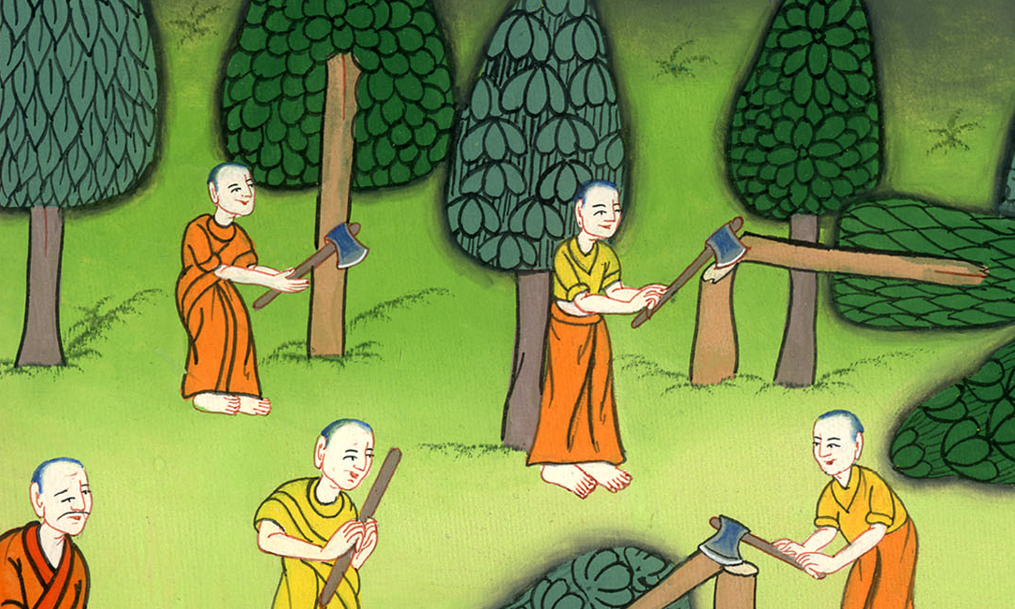
2 Kings 6:4

Slide 13
5But as one was cutting down a tree, the ax head fell into the water. Then he cried out and said, “Alas, my master! For it was borrowed.”

Slide 14
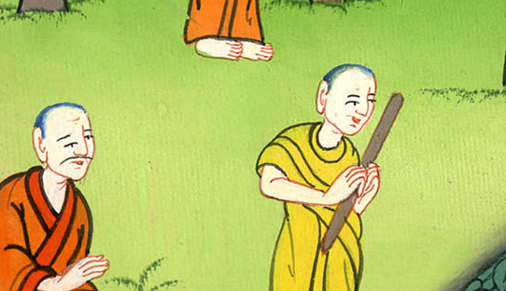
2 Kings 6:5

Slide 15
6The man of God asked, “Where did it fall?” He showed him the place. He cut down a stick, threw it in there, and made the iron float.

Slide 16
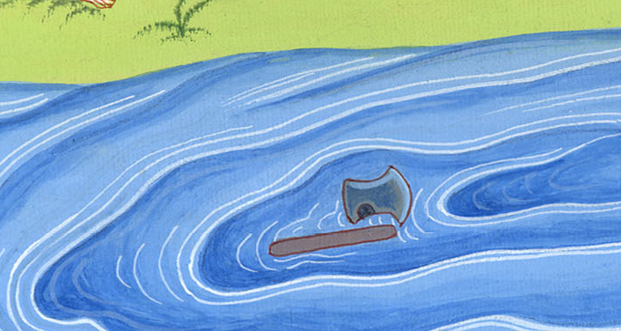
2 Kings 6:6

Slide 17
7He said, “Take it.” So he put out his hand and took it.

Slide 18
2 Kings 6:7

