Slide 1
22-5
This work is licensed under a Creative Commons Attribution-ShareAlike 4.0 International License.
Please add this statement to all the videos you create.
English Bible quotes are from the World English Bible US, which is in the public domain.
Notes:
Ch
22 Elisha
1. Elisha crosses the Jordan - 2 Kings 2:13-18 (Left Top)
2. Purifies water in Jericho - 2:19-22 (Center Top)
3. “Go up Baldhead” - 2:23-25 (Right Top)
4. Purifies stew and multiplies loaves - 4:38-44 (Right Bottom)
5. Naaman & Gehazi - 5:1-27 (Center Bottom)
6. Floating axe head - 6:1-7 (Left Bottom)
7. Army of God - 6:8-23 (Center)

Slide 2
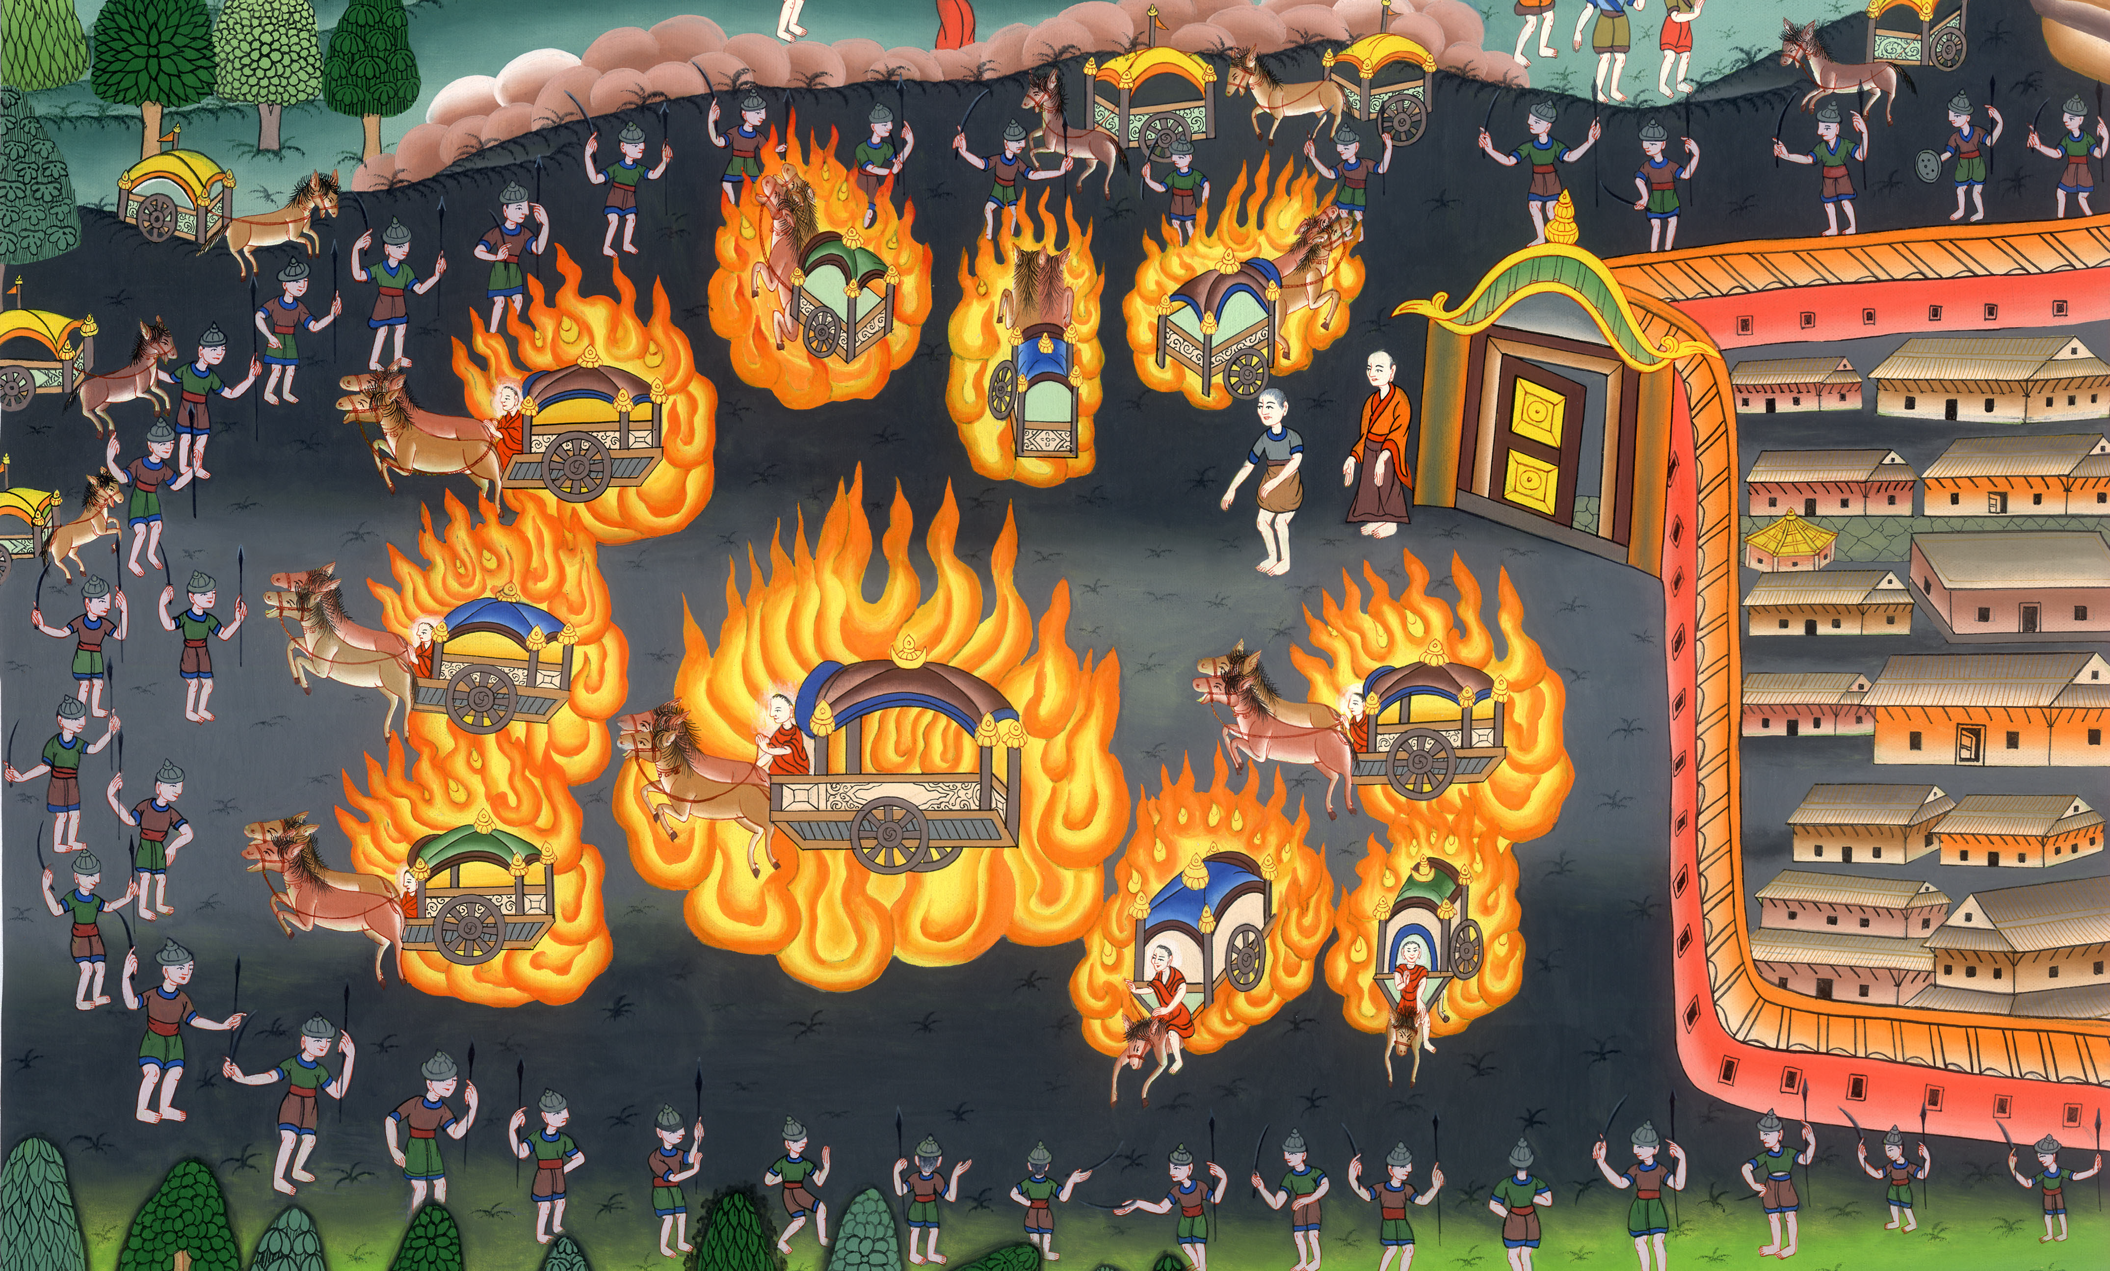
Army of God –
2 Kings 6:8-23

Slide 3
Army of God –
2 Kings 6:8-23

Slide 4
Army of God –
2 Kings 6:8-23

Slide 5
8Now the king of Syria was at war against Israel; and he took counsel with his servants, saying, “My camp will be in such and such a place.”

Slide 6
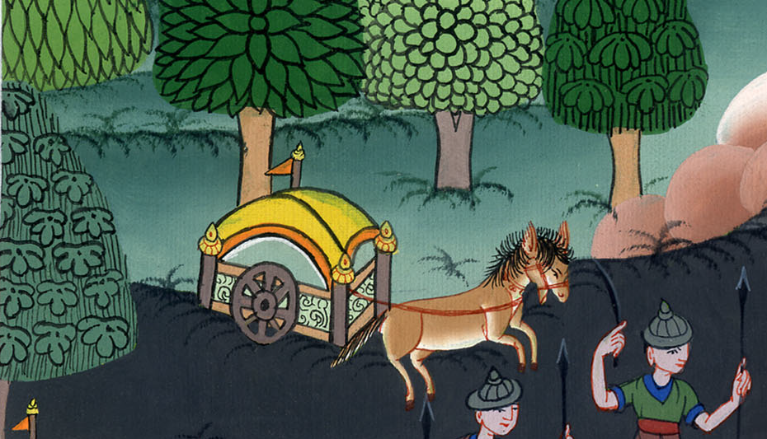
2 Kings 6:8

Slide 7
9The man of God sent to the king of Israel, saying, “Beware that you not pass this place, for the Syrians are coming down there.”

Slide 8
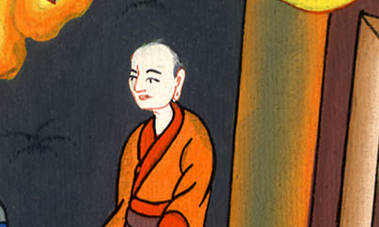
2 Kings 6:9

Slide 9
10The king of Israel sent to the place which the man of God told him and warned him of; and he saved himself there, not once or twice.

Slide 10
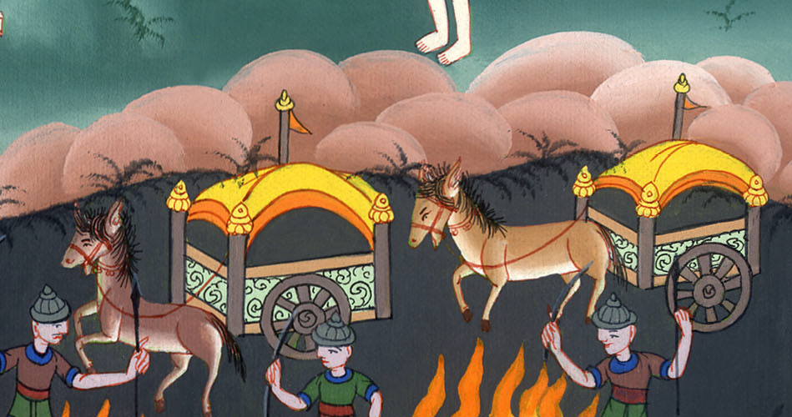
2 Kings 6:10

Slide 11
11The king of Syria’s heart was very troubled about this. He called his servants, and said to them, “Won’t you show me which of us is for the king of Israel?”

Slide 12
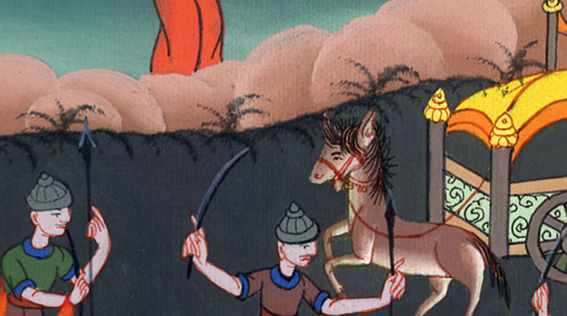
2 Kings 6:11

Slide 13
12One of his servants said, “No, my lord, O king; but Elisha, the prophet who is in Israel, tells the king of Israel the words that you speak in your bedroom.”

Slide 14
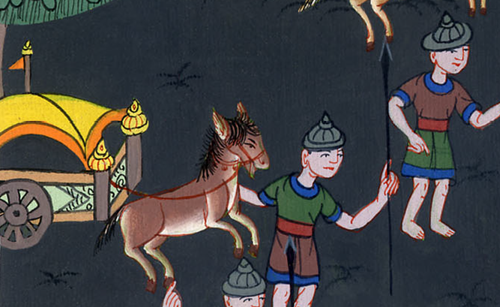
2 Kings 6:12

Slide 15
13He said, “Go and see where he is, that I may send and get him.”
He was told, “Behold, he is in Dothan.”

Slide 16
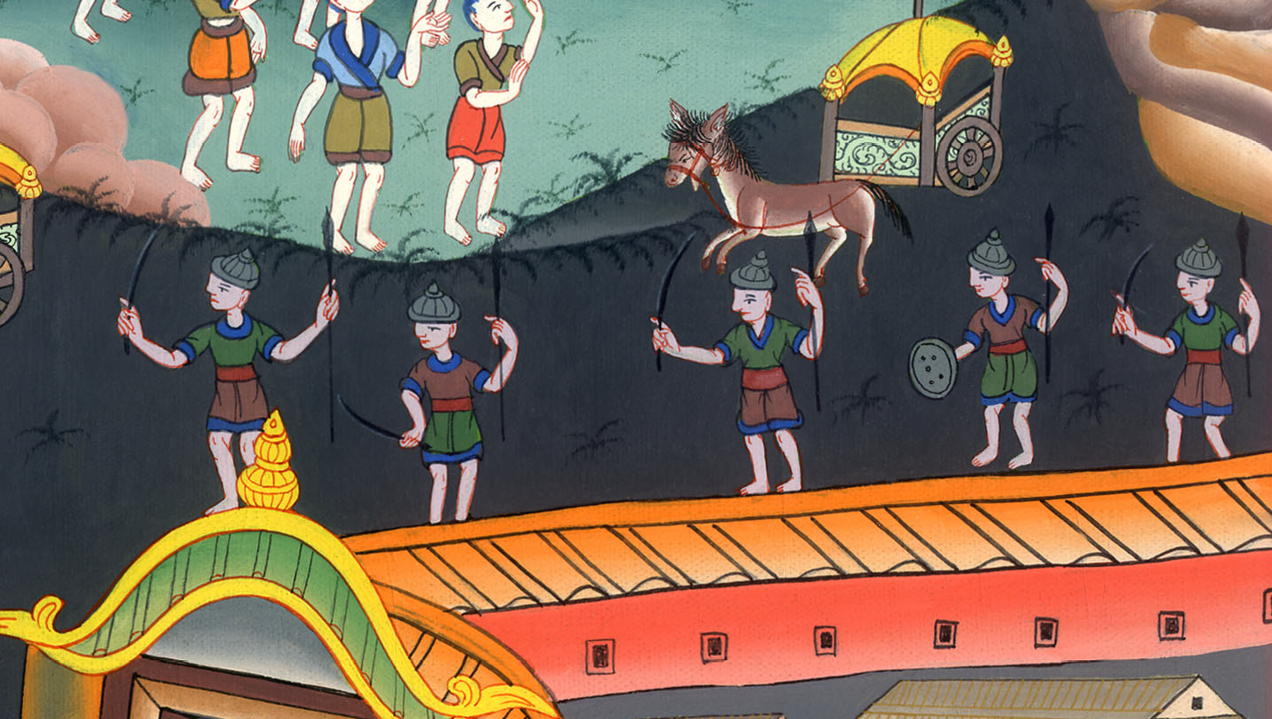
2 Kings 6:13

Slide 17
14Therefore he sent horses, chariots, and a great army there. They came by night and surrounded the city.

Slide 18
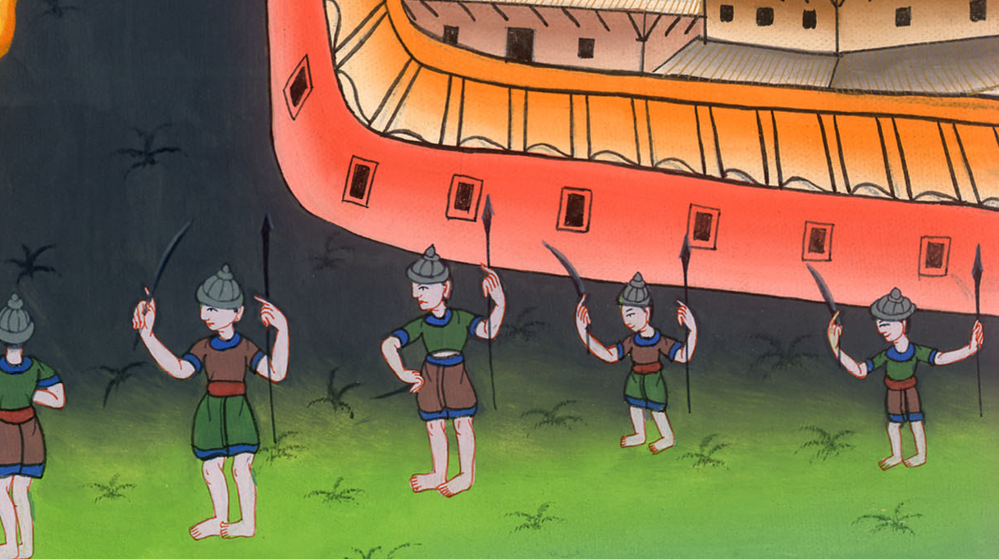
2 Kings 6:14

Slide 19
15When the servant of the man of God had risen early and gone out, behold, an army with horses and chariots was around the city. His servant said to him, “Alas, my master! What shall we do?”

Slide 20
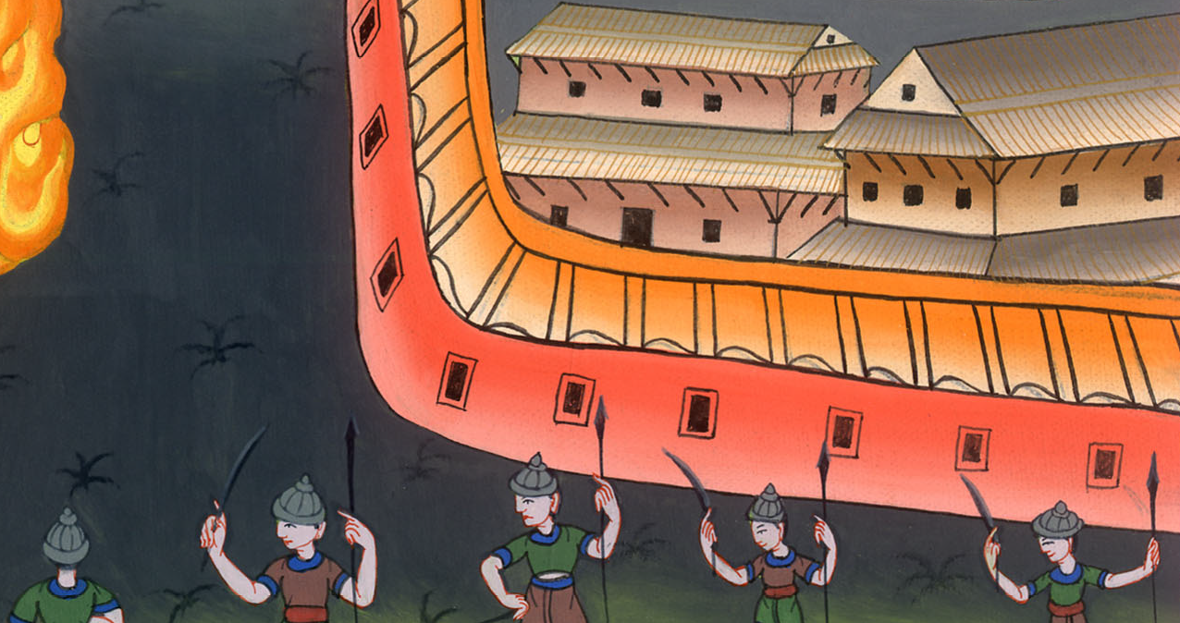
2 Kings 6:15

Slide 21
16He answered, “Don’t be afraid, for those who are with us are more than those who are with them.”

Slide 22
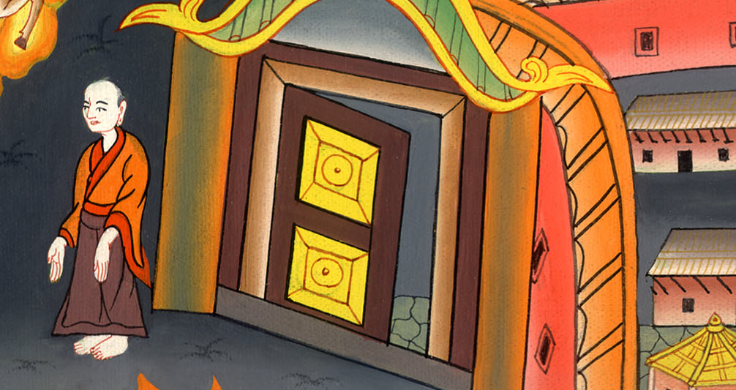
2 Kings 6:16

Slide 23
17Elisha prayed, and said, “Yahweh, please open his eyes, that he may see.” Yahweh opened the young man’s eyes, and he saw; and behold, the mountain was full of horses and chariots of fire around Elisha.

Slide 24
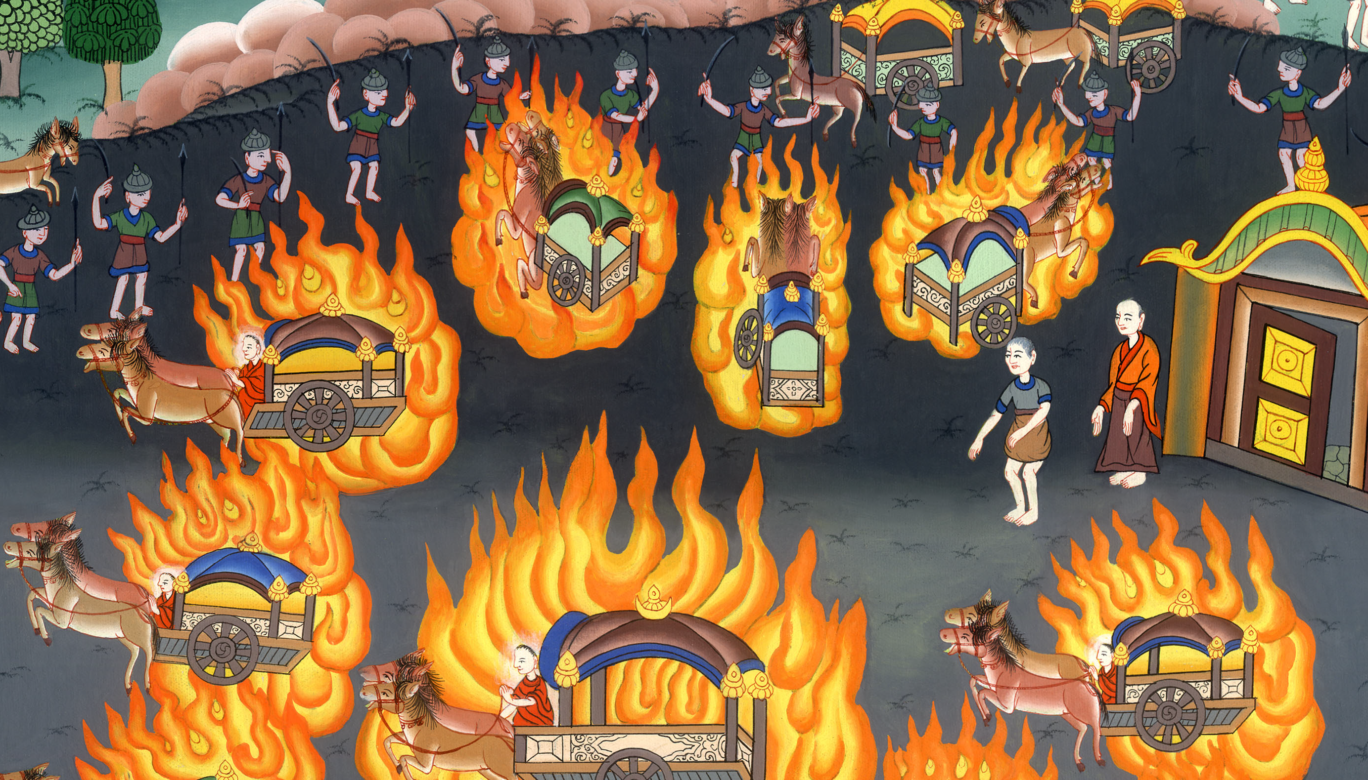
2 Kings 6:17

Slide 25
18When they came down to him, Elisha prayed to Yahweh, and said, “Please strike this people with blindness.” He struck them with blindness according to Elisha’s word.

Slide 26
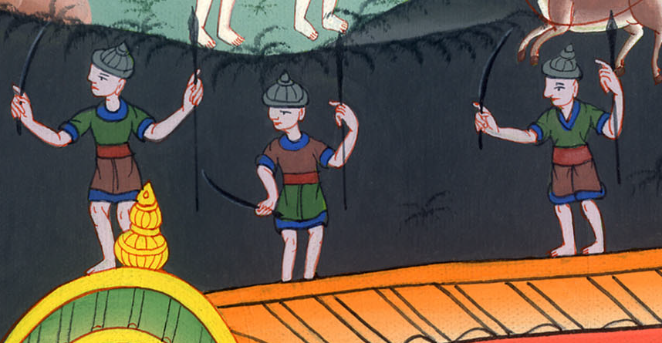
2 Kings 6:18

Slide 27
19Elisha said to them, “This is not the way, neither is this the city. Follow me, and I will bring you to the man whom you seek.” He led them to Samaria.

Slide 28
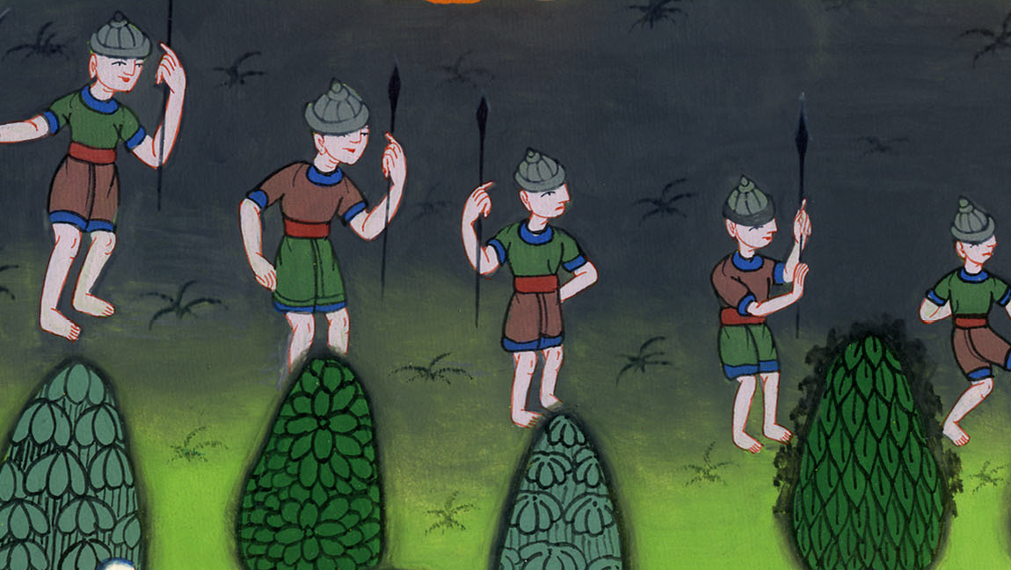
2 Kings 6:19

Slide 29
20When they had come into Samaria, Elisha said, “Yahweh, open these men’s eyes, that they may see.” Yahweh opened their eyes, and they saw; and behold, they were in the middle of Samaria.

Slide 30
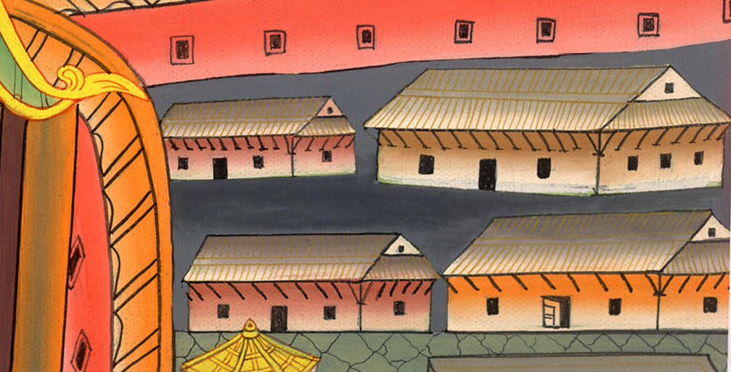
2 Kings 6:20

Slide 31
21The king of Israel said to Elisha, when he saw them, “My father, shall I strike them? Shall I strike them?”

Slide 32
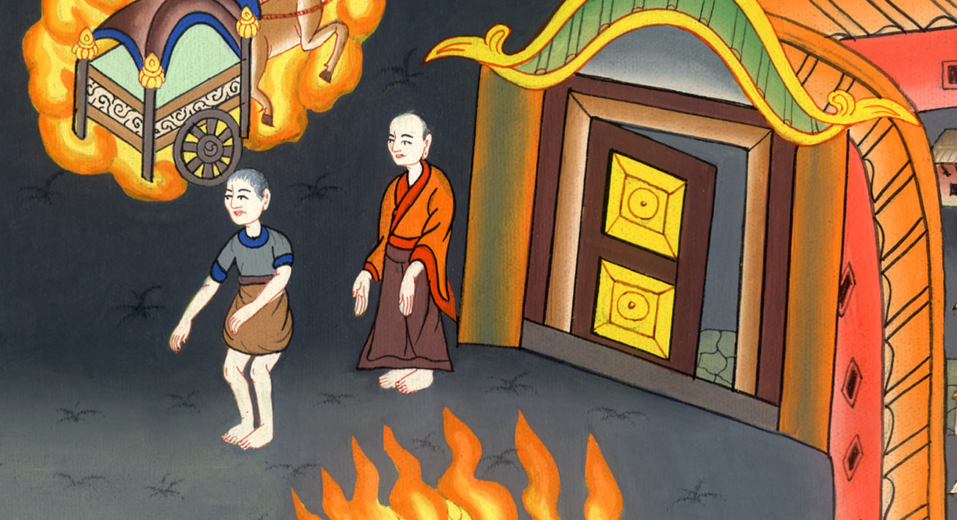
2 Kings 6:21

Slide 33
22He answered, “You shall not strike them. Would you strike those whom you have taken captive with your sword and with your bow? Set bread and water before them, that they may eat and drink, then go to their master.”

Slide 34
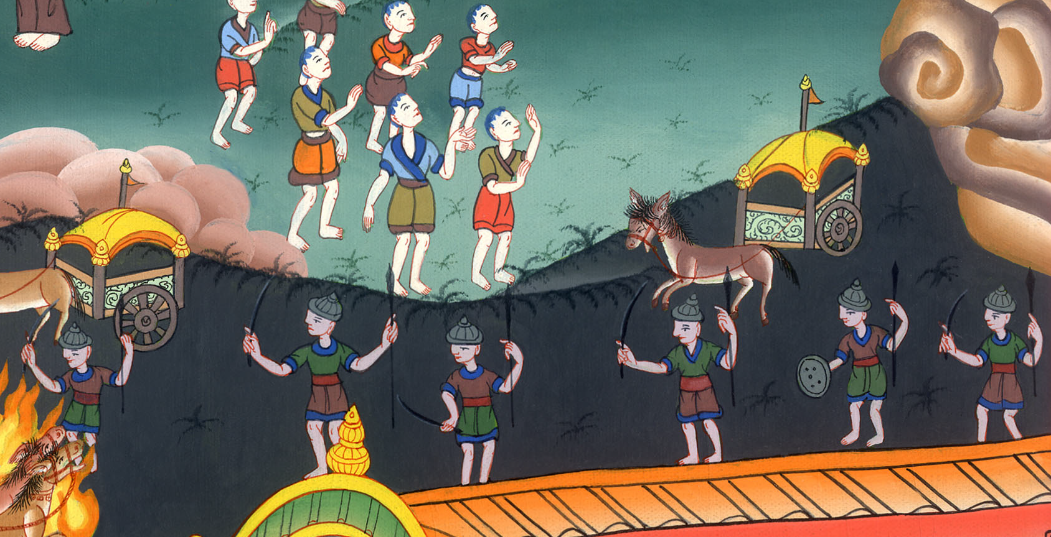
2 Kings 6:22

Slide 35
23He prepared a great feast for them. After they ate and drank, he sent them away and they went to their master. So the bands of Syria stopped raiding the land of Israel.

Slide 36
2 Kings 6:23

