Slide 1
23-1
This work is licensed under a Creative Commons Attribution-ShareAlike 4.0 International License.
Please add this statement to all the videos you create.
English Bible quotes are from the World English Bible US, which is in the public domain.
Notes:
Ch
23 Jonah
1. Jonah Disobedient - Jonah 1:1-3 (Left Top)
2. Jonah Punished - Jonah 1:4-16 (Right Top)
3. Jonah Miraculously Preserved - Jonah 1:17 - 2:10 (Right Center)
4. Jonah's Ministry in Nineveh - Jonah 3:1-10 (Bottom)
5. A Narrow Prophet versus the Merciful God - Jonah 3:10 - 4:11 (Left Center)

Slide 2
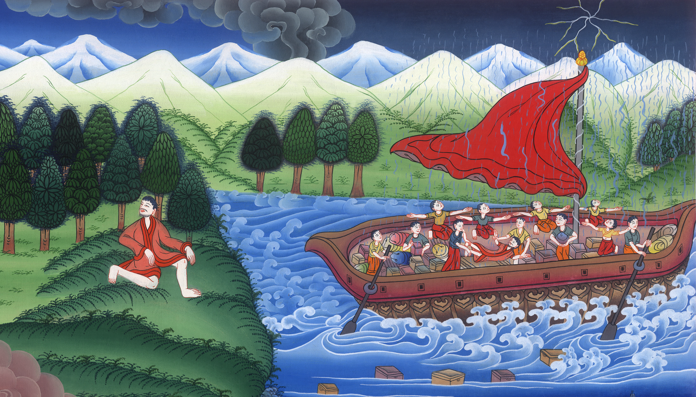
Jonah runs away from the Lord – Jonah 1:1-16

Slide 3
Jonah runs away from the Lord – Jonah 1:1-16

Slide 4
Jonah runs away from the Lord – Jonah 1:1-16

Slide 5
1Now Yahweh’s word came to Jonah the son of Amittai, saying, 2“Arise, go to Nineveh, that great city, and preach against it, for their wickedness has come up before me.”

Slide 6
Jonah 1:1,2

Slide 7
3But Jonah rose up to flee to Tarshish from the presence of Yahweh. He went down to Joppa

Slide 8
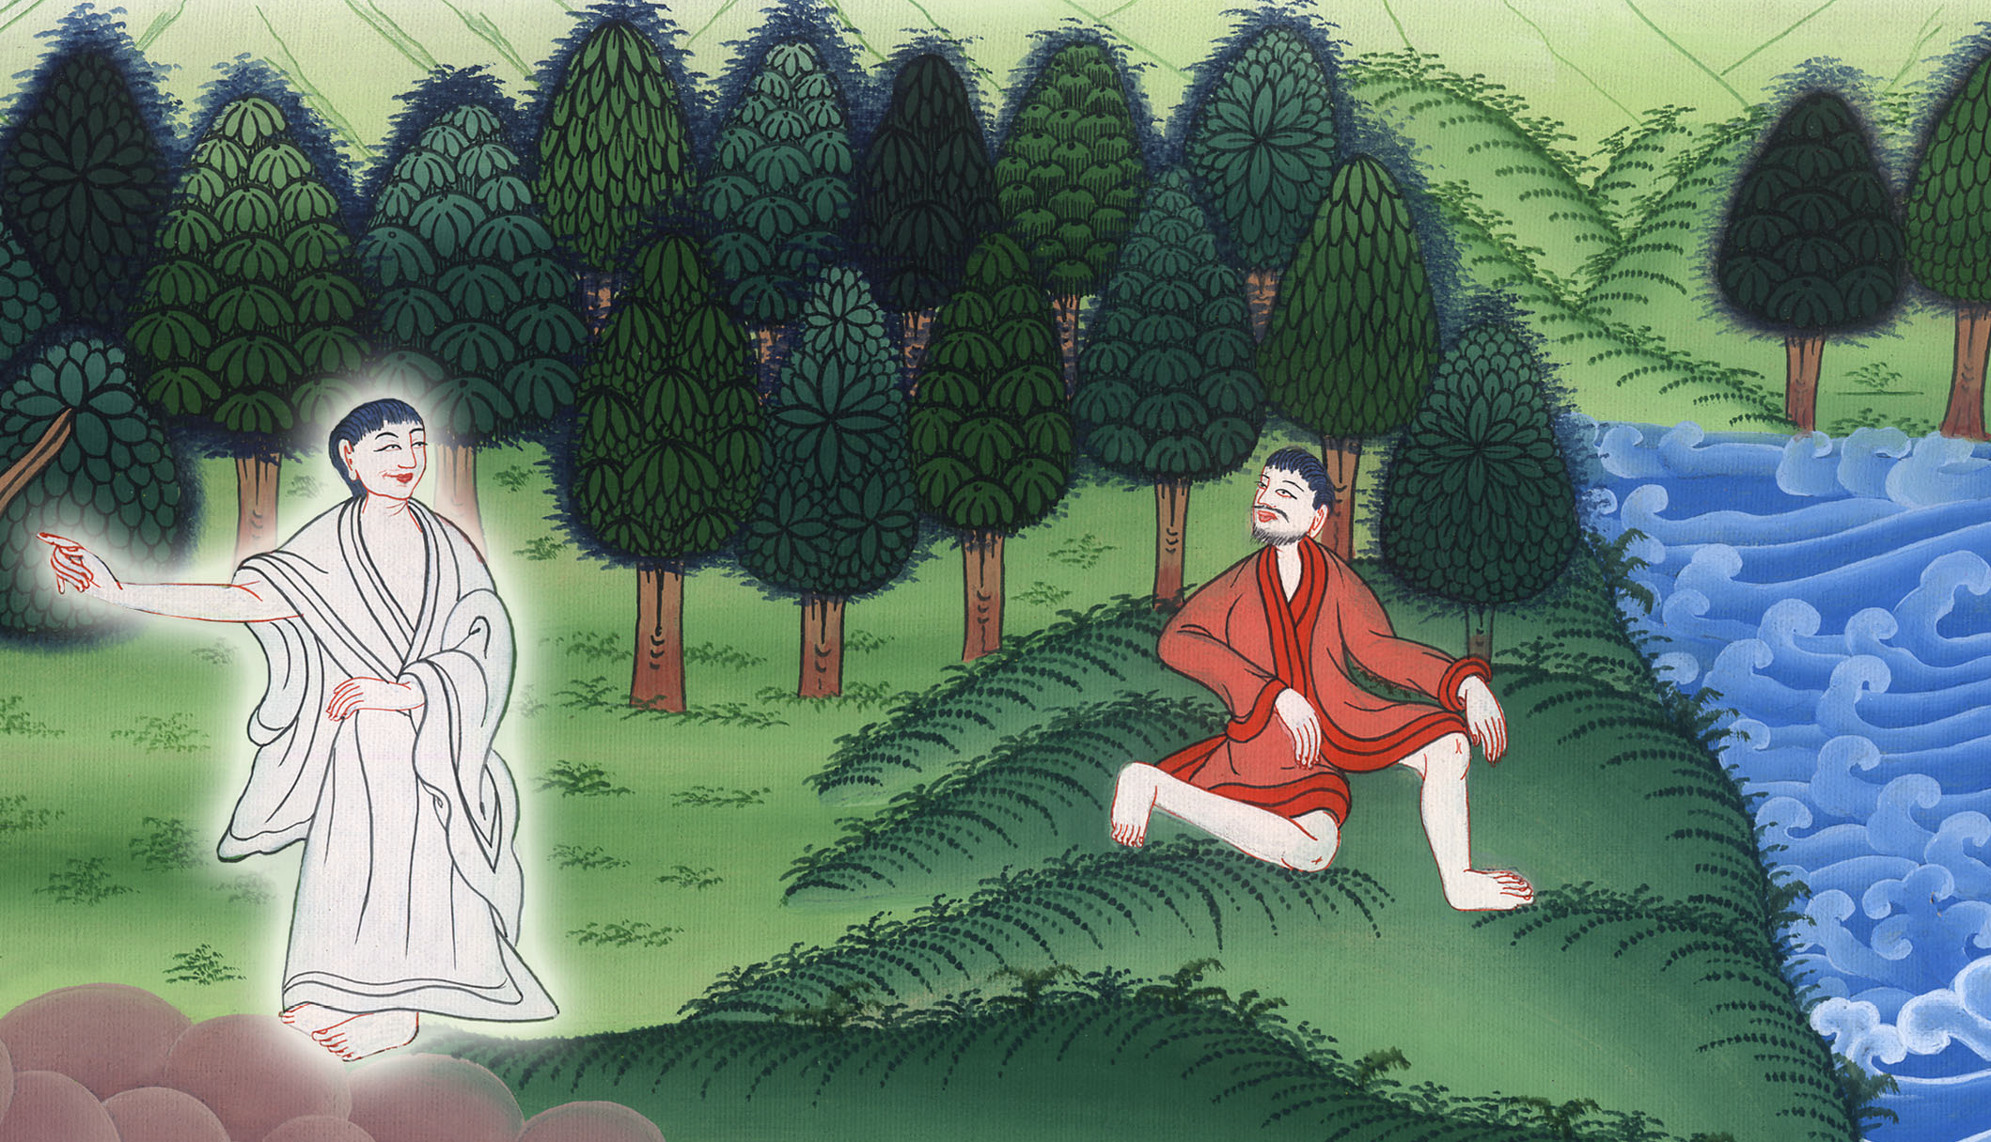
Jonah 1:3

Slide 9
and found a ship going to Tarshish; so he paid its fare, and went down into it, to go with them to Tarshish from the presence of Yahweh.

Slide 10
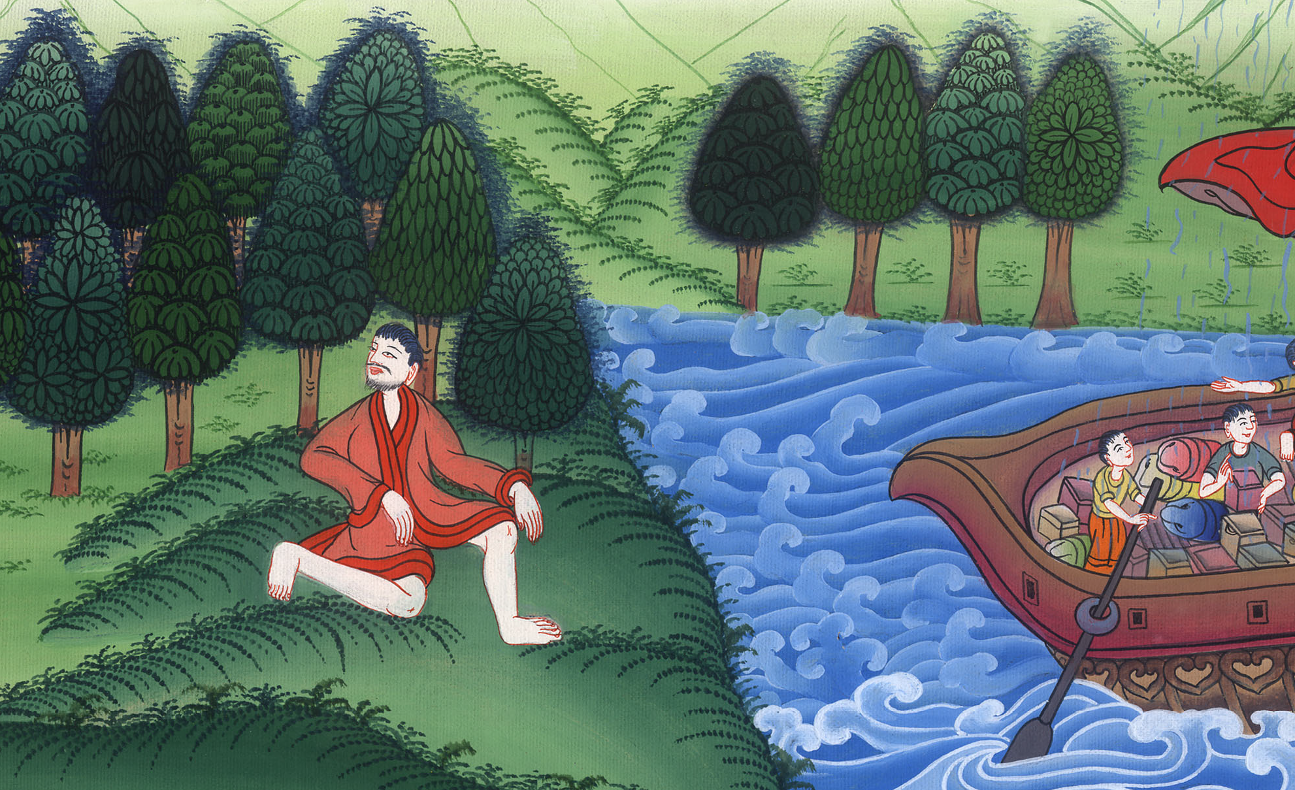
Jonah 1:3

Slide 11
4But Yahweh sent out a great wind on the sea, and there was a mighty storm on the sea, so that the ship was likely to break up.

Slide 12
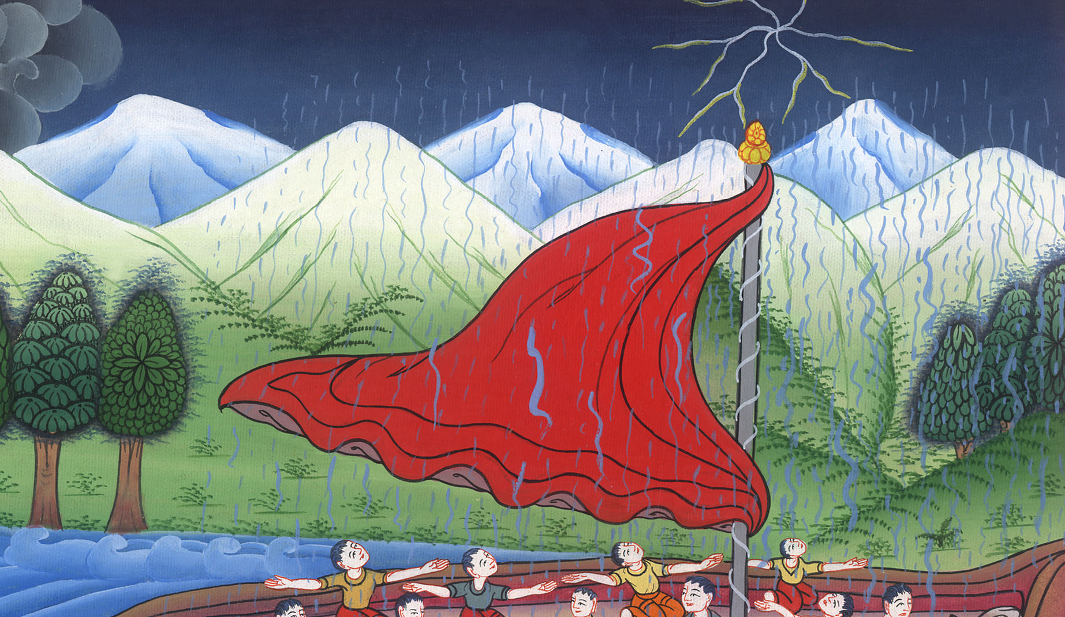
Jonah 1:4

Slide 13
5Then the mariners were afraid, and every man cried to his god. They threw the cargo that was in the ship into the sea to lighten the ship.

Slide 14
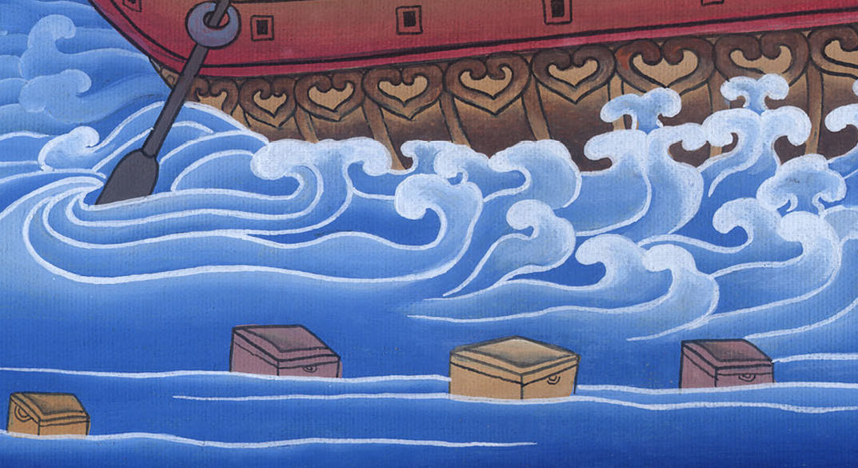
Jonah 1:5

Slide 15
But Jonah had gone down into the innermost parts of the ship and he was laying down, and was fast asleep.

Slide 16
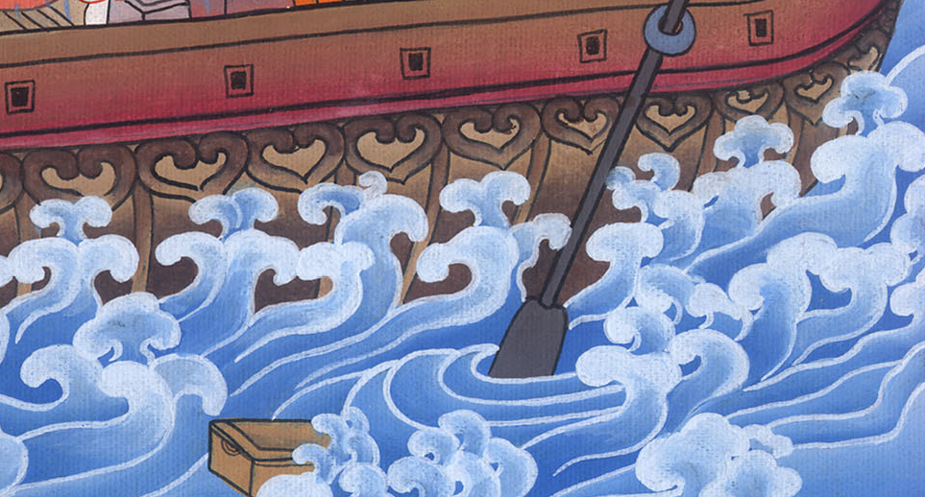
Jonah 1:5

Slide 17
6So the ship master came to him, and said to him, “What do you mean, sleeper? Arise, call on your God! Maybe your God will notice us, so that we won’t perish.”

Slide 18
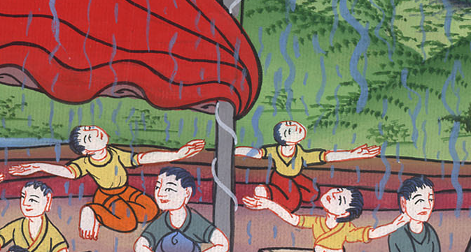
Jonah 1:6

Slide 19
7They all said to each other, “Come! Let’s cast lots, that we may know who is responsible for this evil that is on us.” So they cast lots, and the lot fell on Jonah.

Slide 20
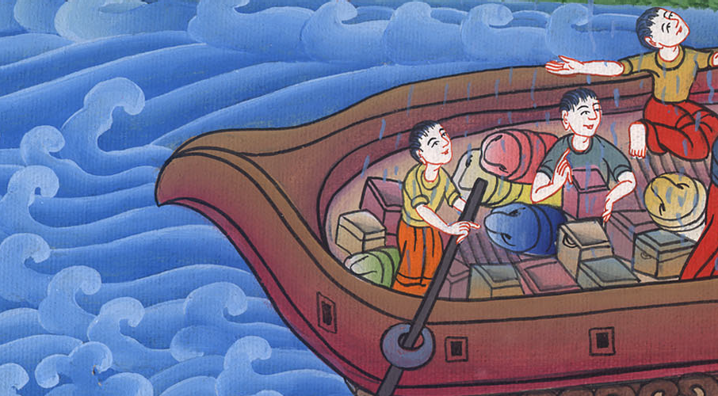
Jonah 1:7

Slide 21
8Then they asked him, “Tell us, please, for whose cause this evil is on us. What is your occupation? Where do you come from? What is your country? Of what people are you?”

Slide 22
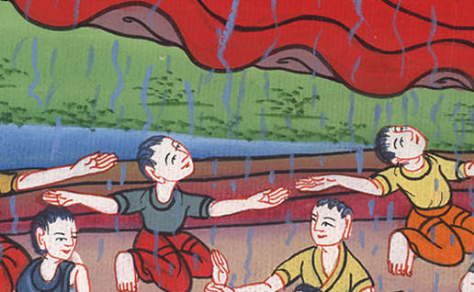
Jonah 1:8

Slide 23
9He said to them, “I am a Hebrew, and I fear Yahweh, the God of heaven, who has made the sea and the dry land.”

Slide 24
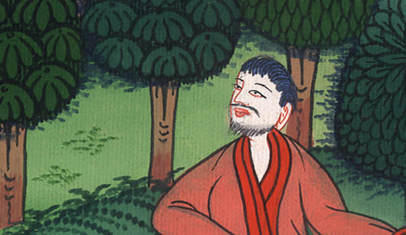
Jonah 1:9

Slide 25
10Then the men were exceedingly afraid, and said to him, “What have you done?” For the men knew that he was fleeing from the presence of Yahweh, because he had told them.

Slide 26
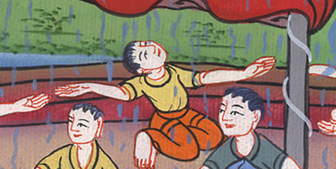
Jonah 1:10

Slide 27
11Then they said to him, “What shall we do to you, that the sea may be calm to us?” For the sea grew more and more stormy.

Slide 28
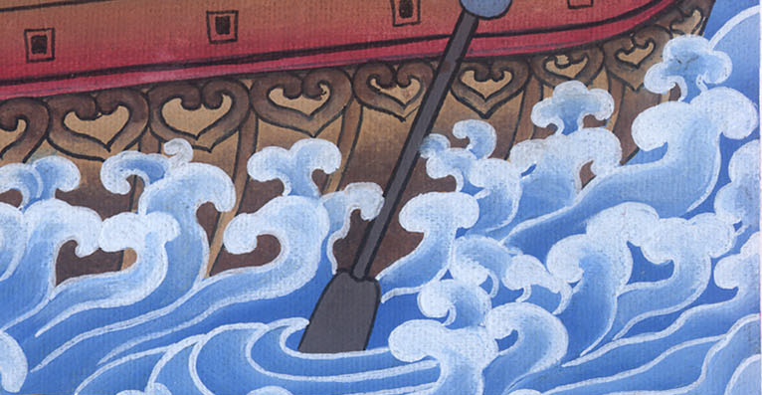
Jonah 1:11

Slide 29
12He said to them, “Take me up, and throw me into the sea. Then the sea will be calm for you; for I know that because of me this great storm is on you.”

Slide 30
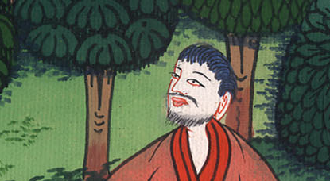
Jonah 1:12

Slide 31
13Nevertheless the men rowed hard to get them back to the land; but they could not, for the sea grew more and more stormy against them.

Slide 32
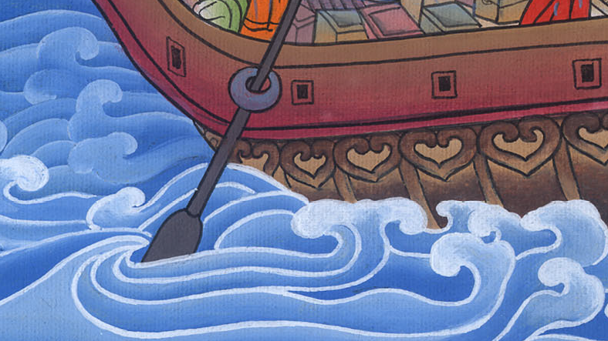
Jonah 1:13

Slide 33
14Therefore they cried to Yahweh, and said, “We beg you, Yahweh, we beg you, don’t let us die for this man’s life, and don’t lay on us innocent blood; for you, Yahweh, have done as it pleased you.”

Slide 34
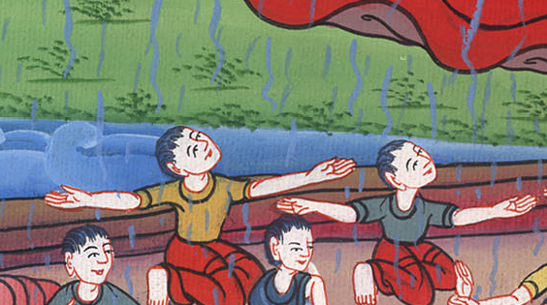
Jonah 1:14

Slide 35
15So they took up Jonah and threw him into the sea; and the sea ceased its raging.

Slide 36
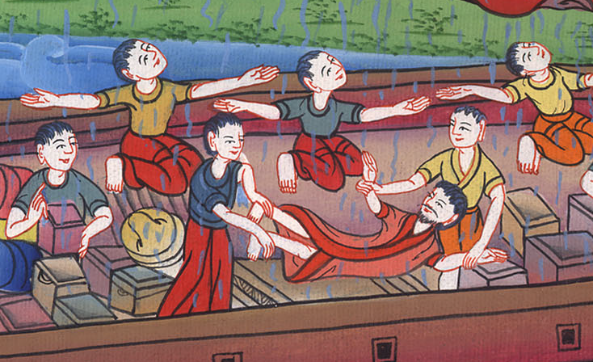
Jonah 1:15

Slide 37
16Then the men feared Yahweh exceedingly; and they offered a sacrifice to Yahweh and made vows.

Slide 38
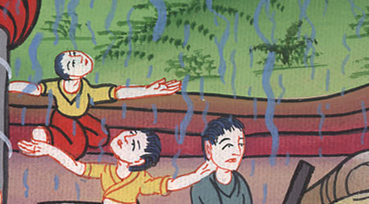
Jonah 1:16

