Slide 1
23-2
This work is licensed under a Creative Commons Attribution-ShareAlike 4.0 International License.
Please add this statement to all the videos you create.
English Bible quotes are from the World English Bible US, which is in the public domain.
Notes:
Ch
23 Jonah
1. Jonah Disobedient - Jonah 1:1-3 (Left Top)
2. Jonah Punished - Jonah 1:4-16 (Right Top)
3. Jonah Miraculously Preserved - Jonah 1:17 - 2:10 (Right Center)
4. Jonah's Ministry in Nineveh - Jonah 3:1-10 (Bottom)
5. A Narrow Prophet versus the Merciful God - Jonah 3:10 - 4:11 (Left Center)

Slide 2
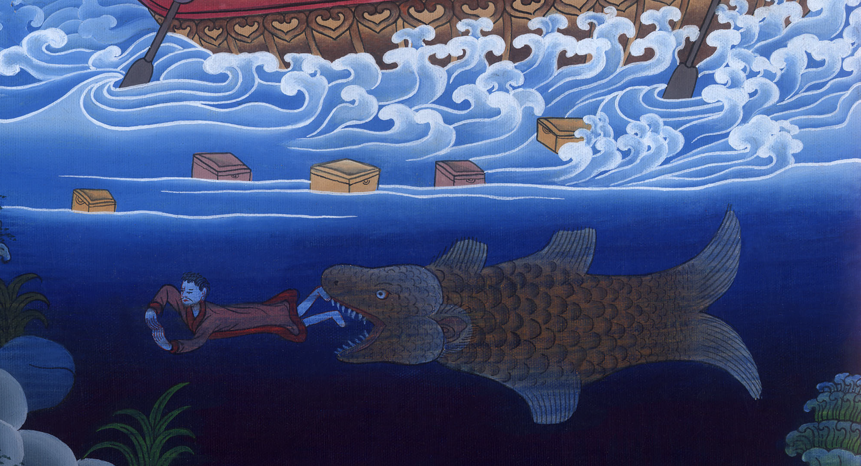
Jonah miraculously preserved –
Jonah 1:17-2:10

Slide 3
Jonah miraculously preserved –
Jonah 1:17-2:10

Slide 4
Jonah miraculously preserved –
Jonah 1:17-2:10

Slide 5
17Yahweh prepared a huge fish to swallow up Jonah, and Jonah was in the belly of the fish three days and three nights.

Slide 6
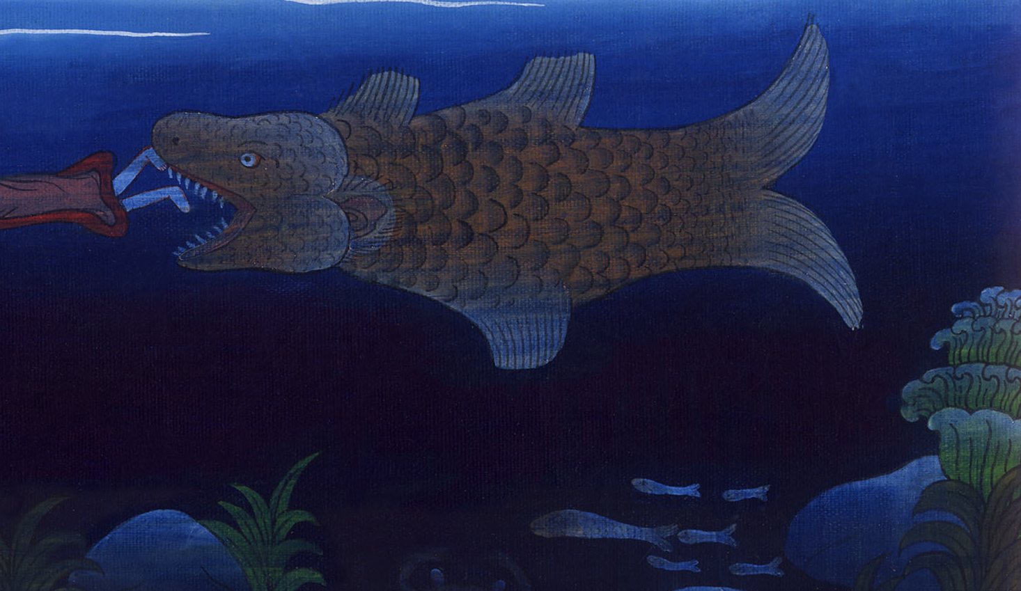
Jonah 1:17

Slide 7
1Then Jonah prayed to Yahweh, his God, out of the fish’s belly.

Slide 8
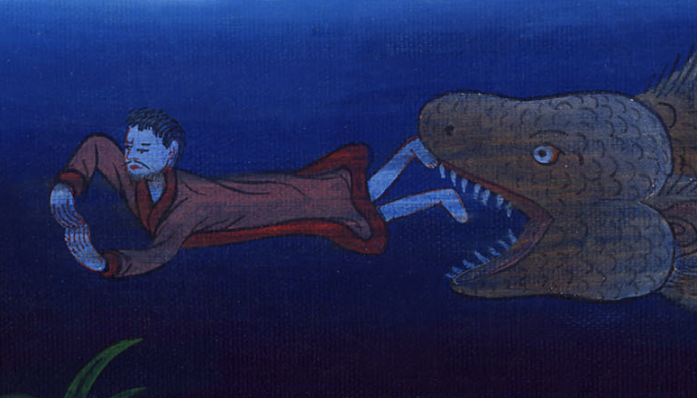
Jonah 2:1

Slide 9
2He said, “I called because of my affliction to Yahweh. He answered me. Out of the belly of Sheol I cried. You heard my voice.

Slide 10
Jonah 2:2

Slide 11
3For you threw me into the depths, in the heart of the seas. The flood was all around me. All your waves and your billows passed over me.

Slide 12
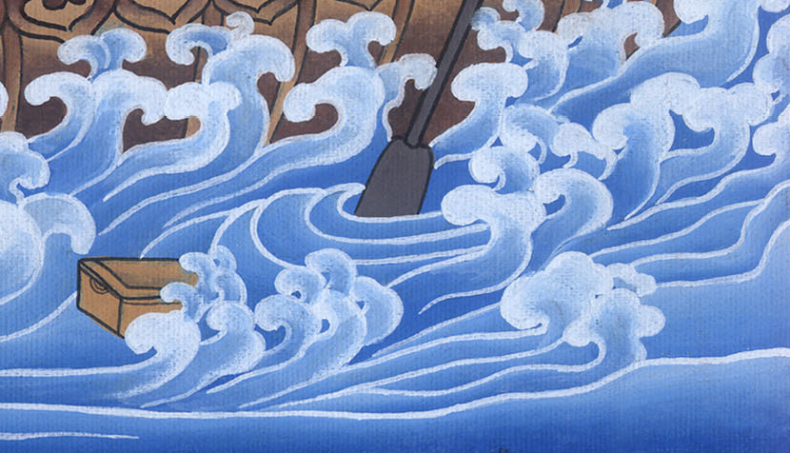
Jonah 2:3

Slide 13
4I said, ‘I have been banished from your sight; yet I will look again toward your holy temple.’

Slide 14
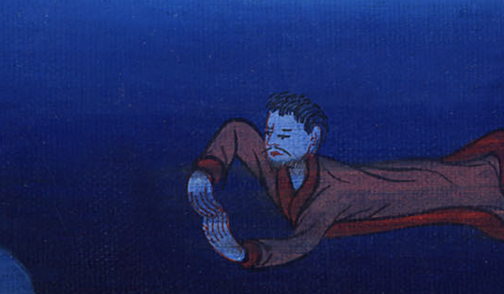
Jonah 2:4

Slide 15
5The waters surrounded me, even to the soul. The deep was around me. The weeds were wrapped around my head.

Slide 16
Jonah 2:5

Slide 17
6I went down to the bottoms of the mountains. The earth barred me in forever; yet you have brought my life up from the pit, Yahweh my God.

Slide 18
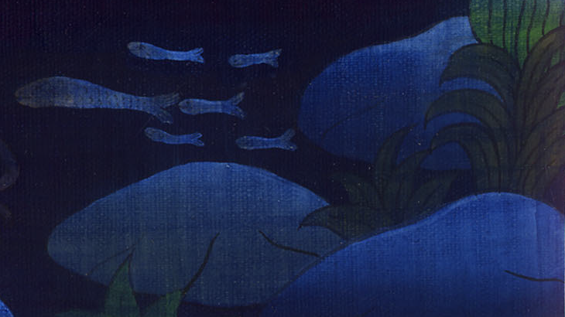
Jonah 2:6

Slide 19
7“When my soul fainted within me, I remembered Yahweh. My prayer came in to you, into your holy temple.

Slide 20
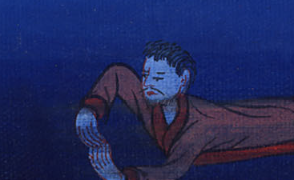
Jonah 2:7

Slide 21
8Those who regard vain idols forsake their own mercy.

Slide 22
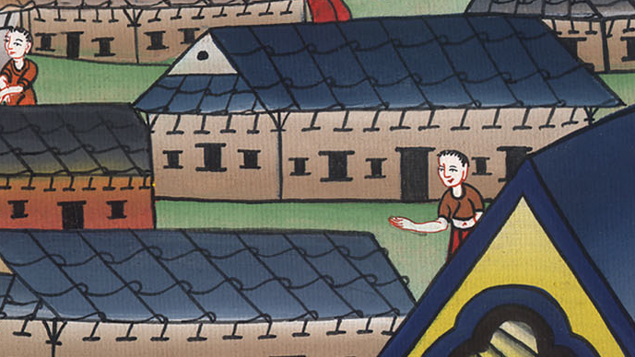
Jonah 2:8

Slide 23
9But I will sacrifice to you with the voice of thanksgiving. I will pay that which I have vowed. Salvation belongs to Yahweh.”

Slide 24
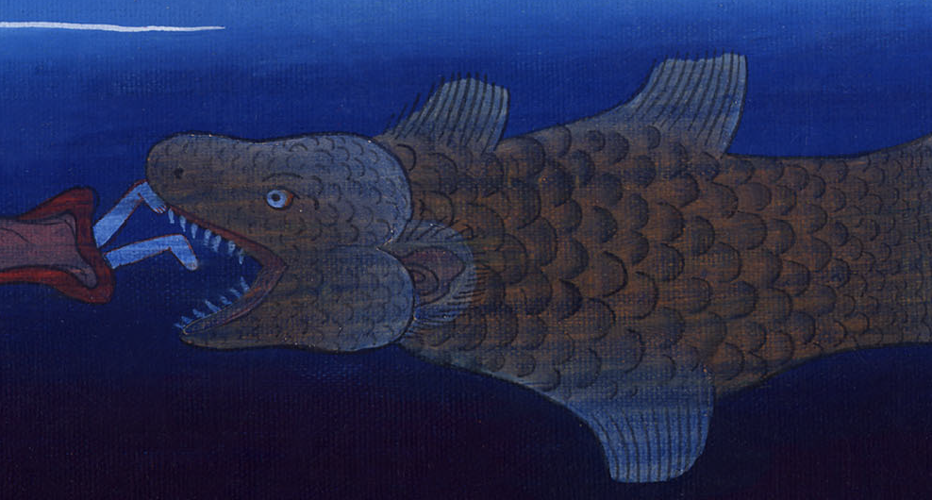
Jonah 2:9

Slide 25
10Then Yahweh spoke to the fish, and it vomited out Jonah on the dry land.

Slide 26
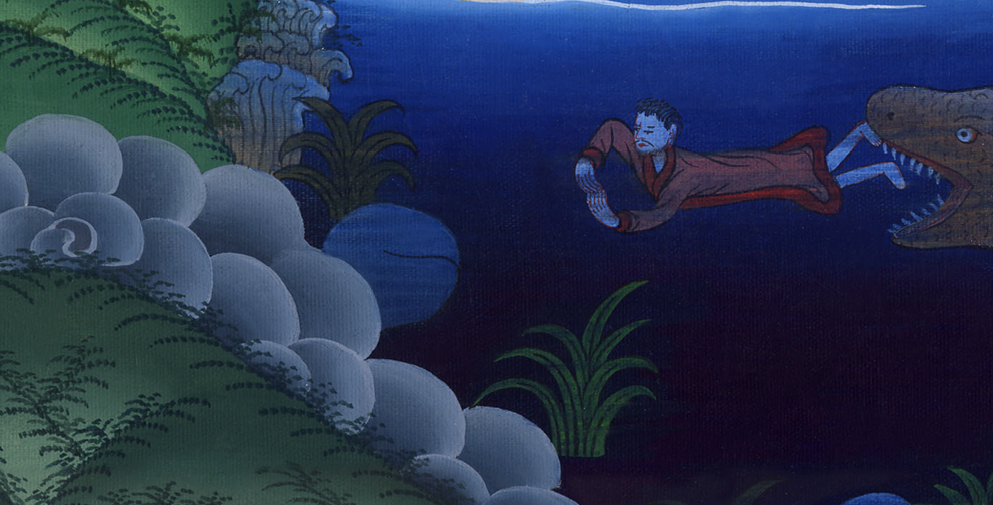
Jonah 2:10

