Slide 1
23-3
This work is licensed under a Creative Commons Attribution-ShareAlike 4.0 International License.
Please add this statement to all the videos you create.
English Bible quotes are from the World English Bible US, which is in the public domain.
Notes:
Ch
23 Jonah
1. Jonah Disobedient - Jonah 1:1-3 (Left Top)
2. Jonah Punished - Jonah 1:4-16 (Right Top)
3. Jonah Miraculously Preserved - Jonah 1:17 - 2:10 (Right Center)
4. Jonah's Ministry in Nineveh - Jonah 3:1-10 (Bottom)
5. A Narrow Prophet versus the Merciful God - Jonah 3:10 - 4:11 (Left Center)

Slide 2
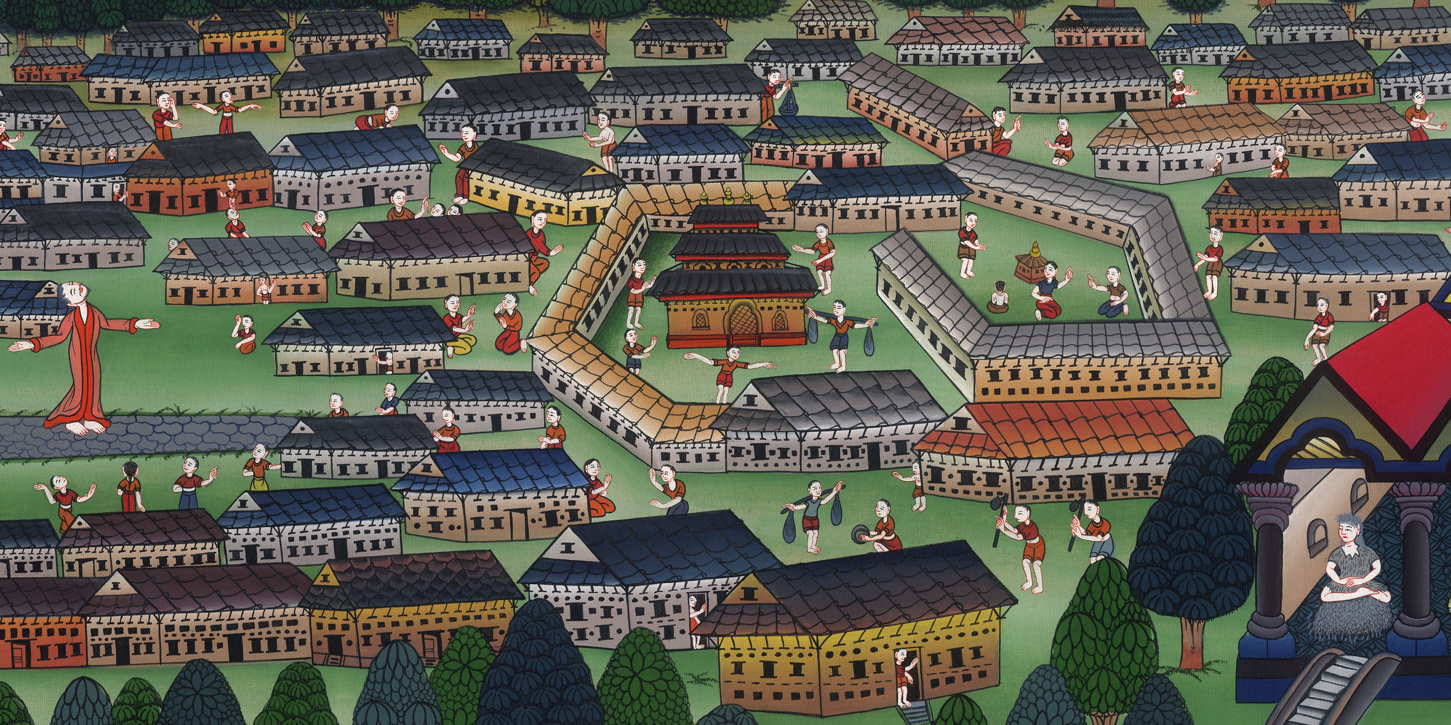
Jonah’s ministry in Nineveh –
Jonah 3:1-10

Slide 3
Jonah’s ministry in Nineveh - Jonah 3:1-10

Slide 4
Jonah’s ministry in Nineveh –
Jonah 3:1-10

Slide 5
1Yahweh’s word came to Jonah the second time, saying, 2“Arise, go to Nineveh, that great city, and preach to it the message that I give you.”

Slide 6
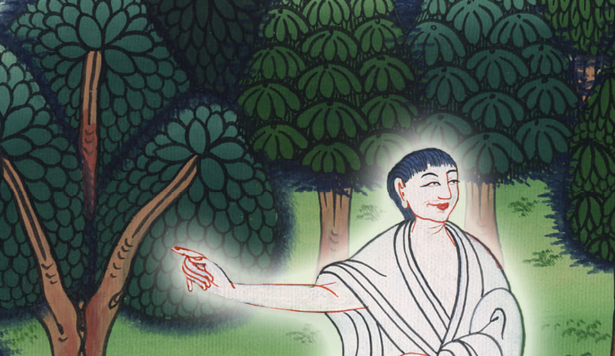
Jonah 3:1,2

Slide 7
3So Jonah arose, and went to Nineveh, according to Yahweh’s word. Now Nineveh was an exceedingly great city, three days’ journey across.

Slide 8
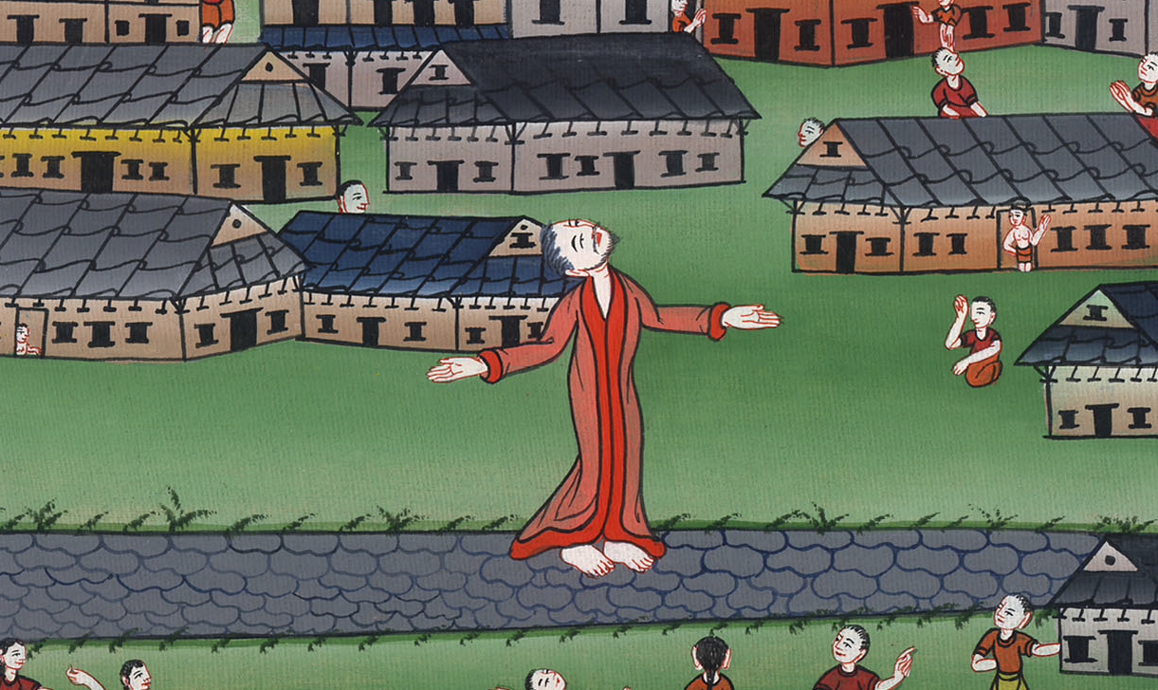
Jonah 3:3

Slide 9
4Jonah began to enter into the city a day’s journey, and he cried out, and said, “In forty days, Nineveh will be overthrown!”

Slide 10
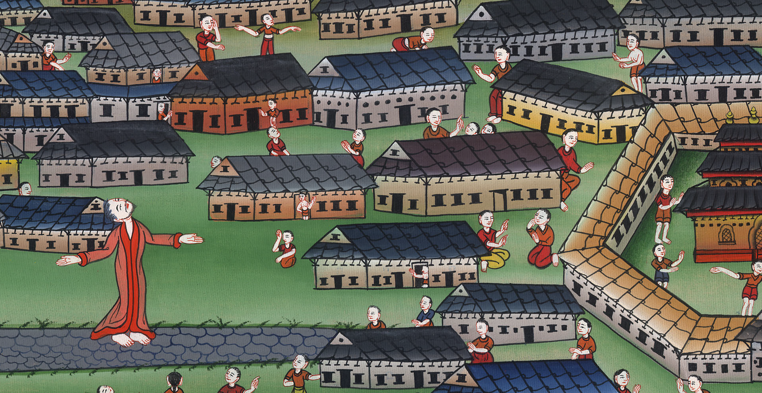
Jonah 3:4

Slide 11
5The people of Nineveh believed God; and they proclaimed a fast and put on sackcloth, from their greatest even to their least.

Slide 12
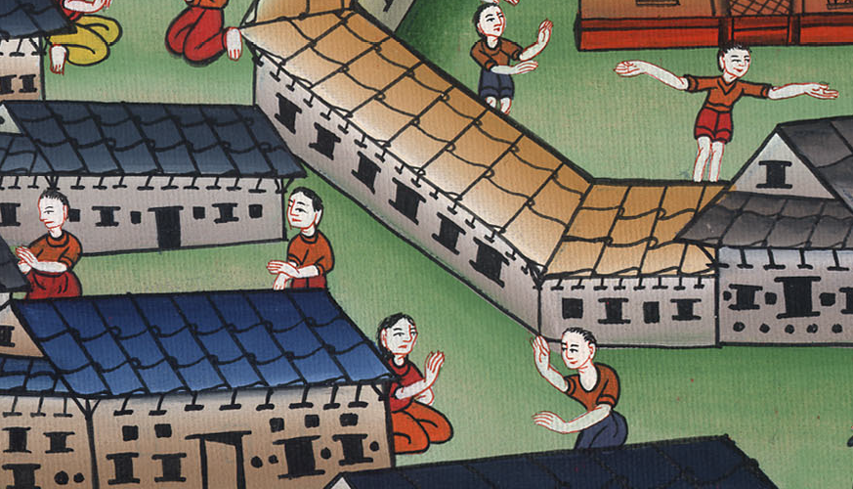
Jonah 3:5

Slide 13
6The news reached the king of Nineveh, and he arose from his throne, took off his royal robe, covered himself with sackcloth, and sat in ashes.

Slide 14
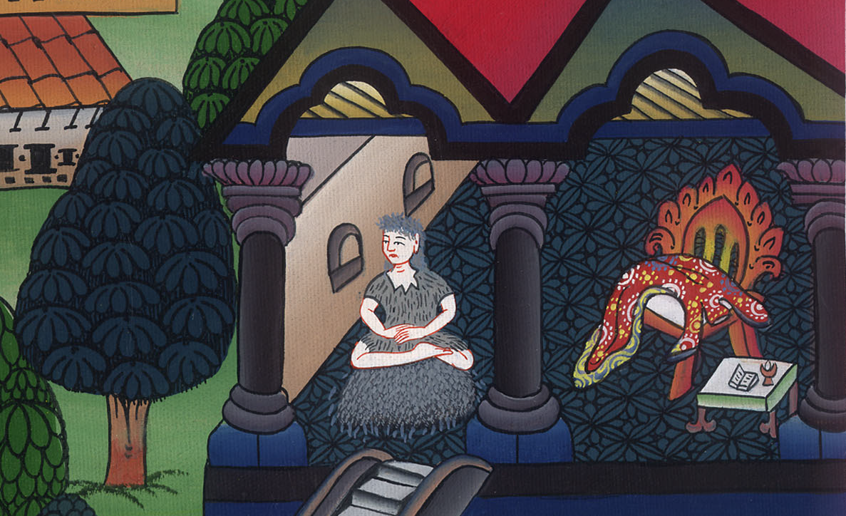
Jonah 3:6

Slide 15
7He made a proclamation and published through Nineveh by the decree of the king and his nobles, saying, “Let neither man nor animal, herd nor flock, taste anything; let them not feed, nor drink water;

Slide 16
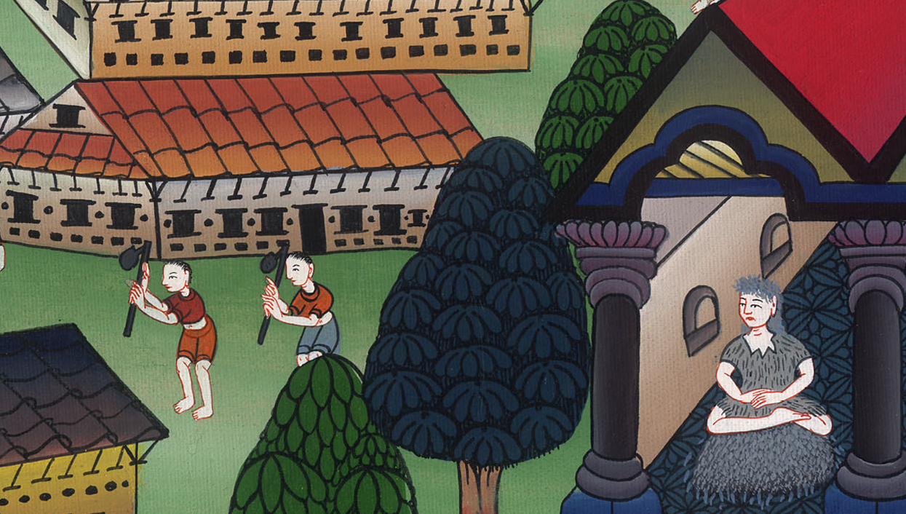
Jonah 3:7

Slide 17
8but let them be covered with sackcloth, both man and animal, and let them cry mightily to God. Yes, let them turn everyone from his evil way and from the violence that is in his hands.

Slide 18
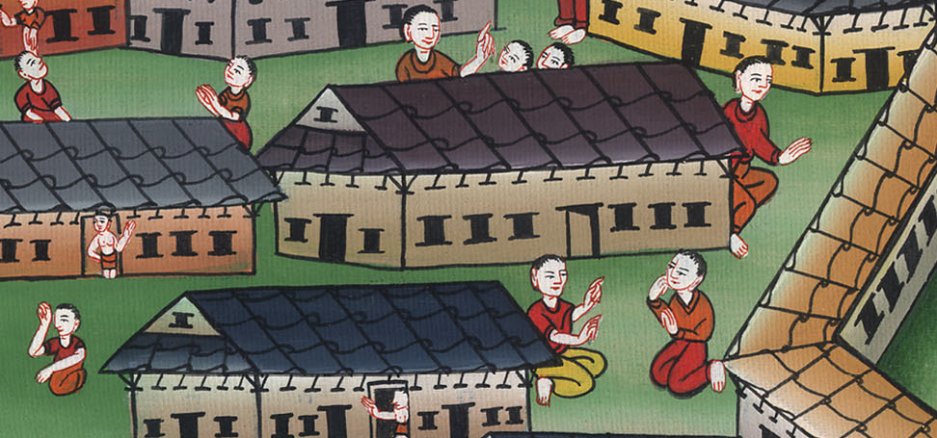
Jonah 3:8

Slide 19
9Who knows whether God will not turn and relent, and turn away from his fierce anger, so that we might not perish?”

Slide 20
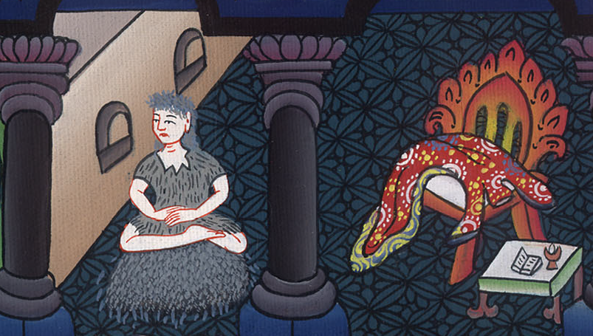
Jonah 3:9

Slide 21
10God saw their works, that they turned from their evil way. God relented of the disaster which he said he would do to them, and he didn’t do it.

Slide 22
Jonah 3:10

