Slide 1
24-2
This work is licensed under a Creative Commons Attribution-ShareAlike 4.0 International License.
Please add this statement to all the videos you create.
English Bible quotes are from the World English Bible US, which is in the public domain.
Notes:
Ch
24 Isaiah
1. Isaiah’s commission - Isaiah 6:1-8 (Center)
2. “Bring your worthless offerings no longer” - Isaiah 1:1-20 (Left Top)
3. “Those who fashion a graven image are all of them futile” - Isaiah 44:9-20
(Center Top)
4. “Comfort, oh comfort my people.” - Isaiah 40:1-31 (Right Top)
5. “The wolf will dwell with the lamb” - Isaiah 11:1-9, 12:1-6 (Right Center)
6. Immanuel - Isaiah 7:14, 9:1-7, 60:1-5, 61:1-3 (Right Bottom)
7. “Like a lamb that is led to slaughter” - Isaiah 53:1-12 (Center Bottom)
8. “The LORD of hosts will prepare a lavish banquet” - Isaiah 66:18-19, 25:6-9
(Left Bottom)
9. "Ho! Every one who thirsts, come to the waters” - Isaiah 55:1-13 (Left Center)

Slide 2
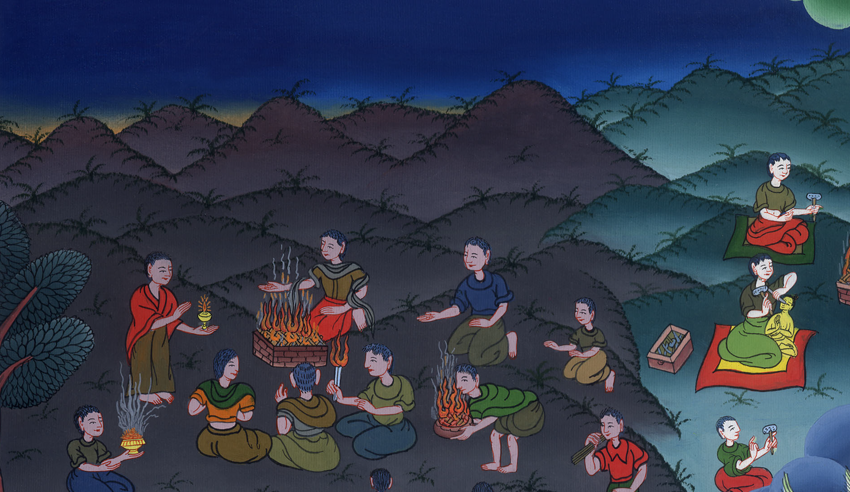
Bring your worthless
offerings no longer –
Isaiah 1:1-20

Slide 3
Bring your worthless offerings no longer - Isaiah 1:1-20

Slide 4
Bring your worthless
offerings no longer –
Isaiah 1:1-20

Slide 5
1The vision of Isaiah the son of Amoz, which he saw concerning Judah and Jerusalem, in the days of Uzziah, Jotham, Ahaz, and Hezekiah, kings of Judah.

Slide 6
Isaiah 1:1

Slide 7
2Hear, heavens,
and listen, earth; for Yahweh has spoken:
“I have nourished and brought up children
and they have rebelled against me.

Slide 8
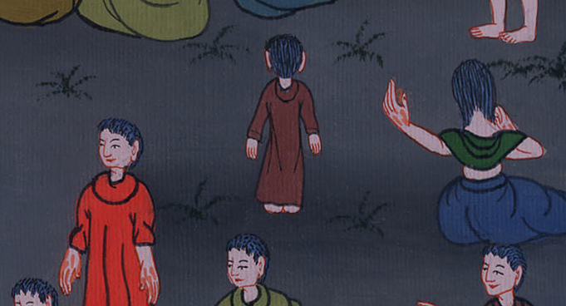
Isaiah 1:2

Slide 9
3The ox knows his owner,
and the donkey his master’s crib;
but Israel doesn’t know.
My people don’t consider.”

Slide 10
Isaiah 1:3

Slide 11
4Ah sinful nation,
a people loaded with iniquity,
offspring of evildoers,
children who deal corruptly!
They have forsaken Yahweh.
They have despised the Holy One of Israel.
They are estranged and backward.

Slide 12
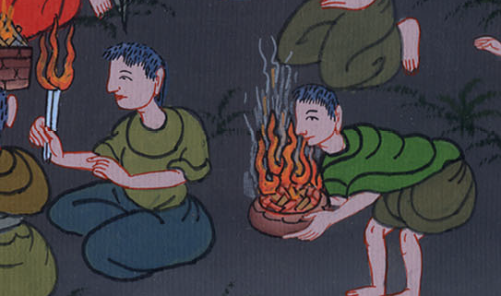
Isaiah 1:4

Slide 13
5Why should you be beaten more,
that you revolt more and more?
The whole head is sick,
and the whole heart faint.

Slide 14
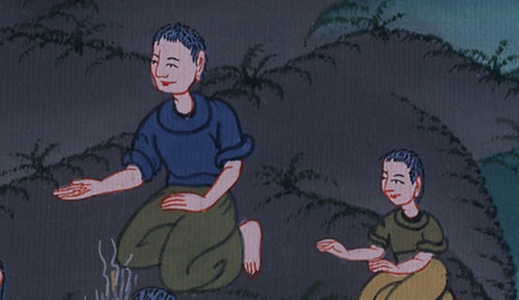
Isaiah 1:5

Slide 15
7Your country is desolate.
Your cities are burned with fire.
Strangers devour your land in your presence
and it is desolate,
as overthrown by strangers.

Slide 16
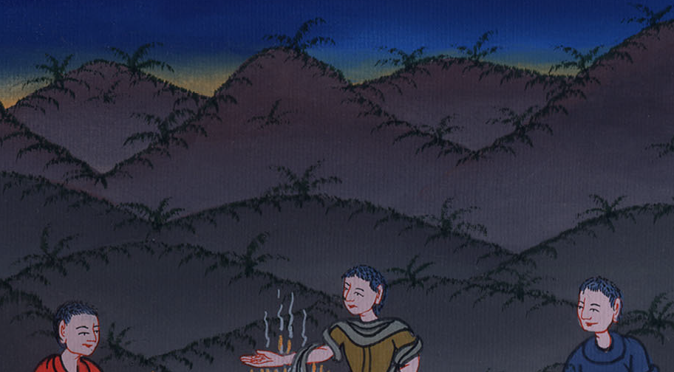
Isaiah 1:7

Slide 17
11“What are the multitude of your sacrifices to me?”, says Yahweh.
“I have had enough of the burnt offerings of rams
and the fat of fed animals.
I don’t delight in the blood of bulls,
or of lambs,
or of male goats.

Slide 18
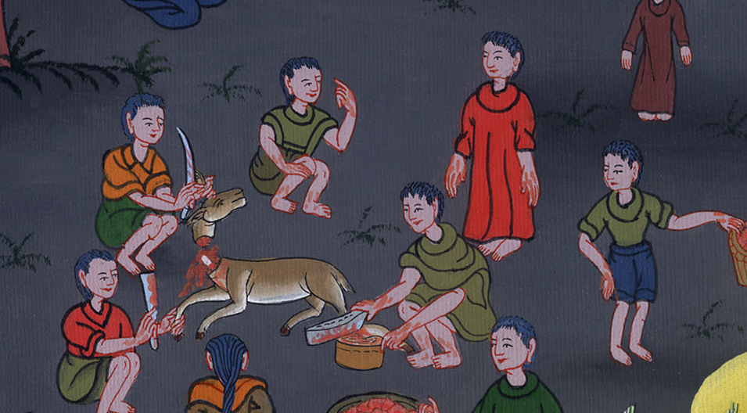
Isaiah 1:11

Slide 19
13Bring no more vain offerings.
Incense is an abomination to me.
New moons, Sabbaths, and convocations—
I can’t stand evil assemblies.

Slide 20
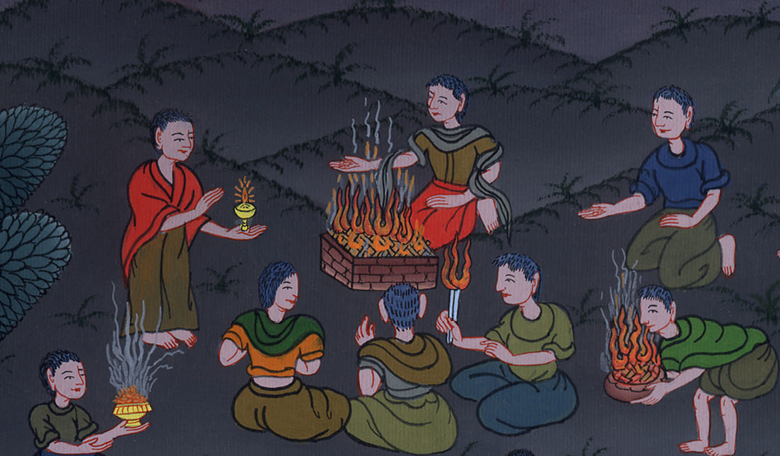
Isaiah 1:13

Slide 21
15When you spread out your hands, I will hide my eyes from you.
Yes, when you make many prayers, I will not hear.
Your hands are full of blood.

Slide 22
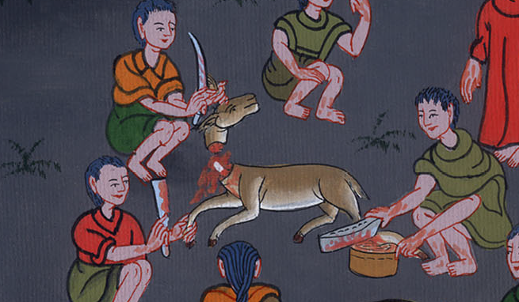
Isaiah 1:15

Slide 23
16Wash yourselves. Make yourself clean.
Put away the evil of your doings from before my eyes.
Cease to do evil.

Slide 24
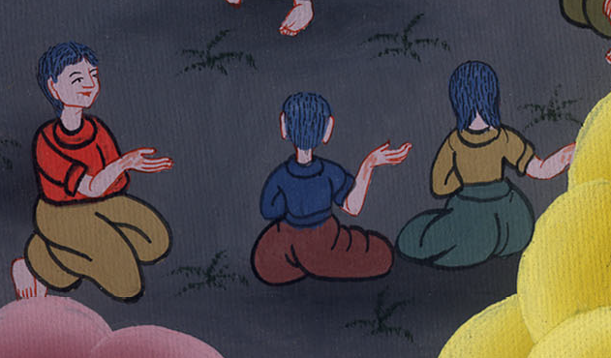
Isaiah 1:16

Slide 25
17Learn to do well.
Seek justice.
Relieve the oppressed.
Defend the fatherless.
Plead for the widow.”

Slide 26
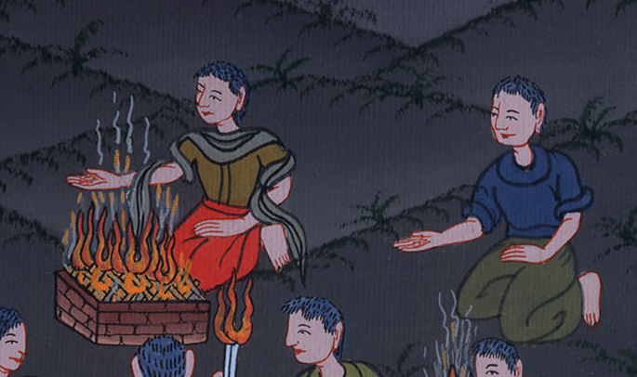
Isaiah 1:17

Slide 27
18“Come now, and let’s reason together,” says Yahweh:
“Though your sins are as scarlet, they shall be as white as snow.
Though they are red like crimson, they shall be as wool.

Slide 28
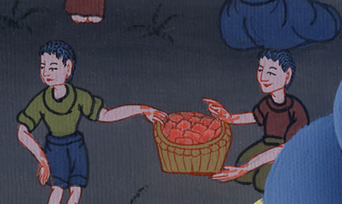
Isaiah 1:18

Slide 29
19If you are willing and obedient,
you will eat the good of the land;

Slide 30
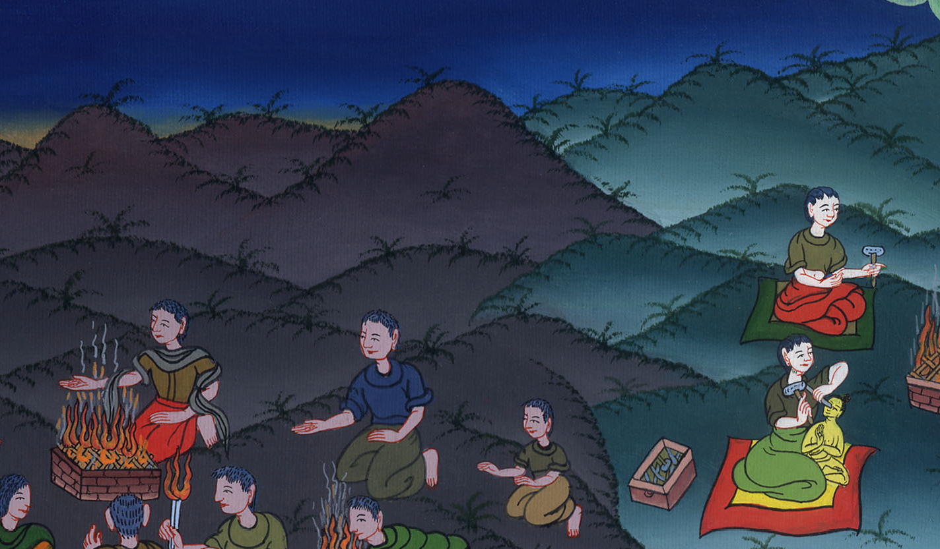
Isaiah 1:19

Slide 31
20but if you refuse and rebel, you will be devoured with the sword;
for Yahweh’s mouth has spoken it.”

Slide 32
Isaiah 1:20

