Slide 1
24-3
This work is licensed under a Creative Commons Attribution-ShareAlike 4.0 International License.
Please add this statement to all the videos you create.
English Bible quotes are from the World English Bible US, which is in the public domain.
Notes:
Ch
24 Isaiah
1. Isaiah’s commission - Isaiah 6:1-8 (Center)
2. “Bring your worthless offerings no longer” - Isaiah 1:1-20 (Left Top)
3. “Those who fashion a graven image are all of them futile” - Isaiah 44:9-20
(Center Top)
4. “Comfort, oh comfort my people.” - Isaiah 40:1-31 (Right Top)
5. “The wolf will dwell with the lamb” - Isaiah 11:1-9, 12:1-6 (Right Center)
6. Immanuel - Isaiah 7:14, 9:1-7, 60:1-5, 61:1-3 (Right Bottom)
7. “Like a lamb that is led to slaughter” - Isaiah 53:1-12 (Center Bottom)
8. “The LORD of hosts will prepare a lavish banquet” - Isaiah 66:18-19, 25:6-9
(Left Bottom)
9. "Ho! Every one who thirsts, come to the waters” - Isaiah 55:1-13 (Left Center)

Slide 2
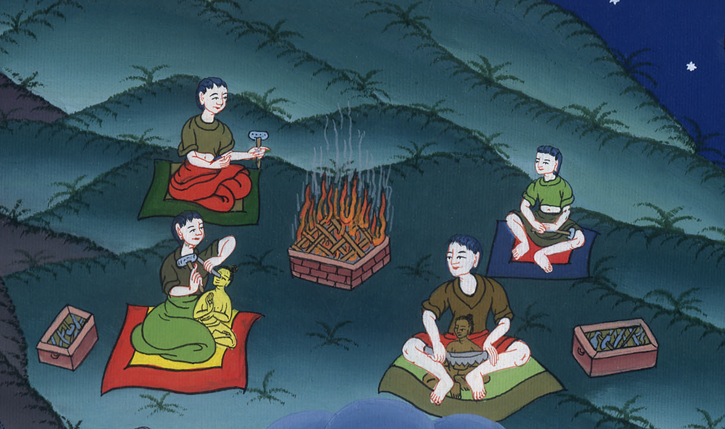
Worship the Lord, not false gods –
Isaiah 44:6-20

Slide 3
Worship the Lord, not false gods – Isaiah 44:6-20

Slide 4
Worship the Lord, not false gods –
Isaiah 44:6-20

Slide 5
6This is what Yahweh, the King of Israel,
and his Redeemer, Yahweh of Armies, says:
“I am the first, and I am the last;
and besides me there is no God.

Slide 6
Isaiah 44:6

Slide 7
9Everyone who makes a carved image is vain.
The things that they delight in will not profit.
Their own witnesses don’t see, nor know, that they may be disappointed.

Slide 8
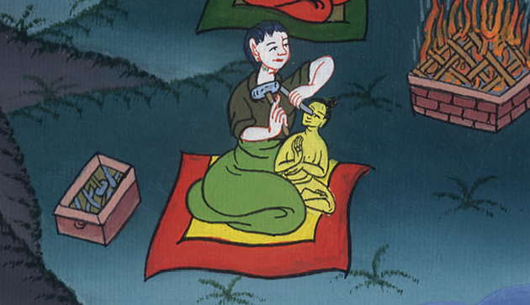
Isaiah 44:9

Slide 9
10Who has fashioned a god,
or molds an image that is profitable for nothing?

Slide 10
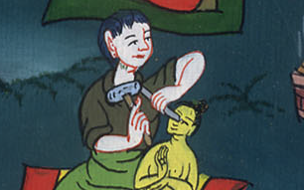
Isaiah 44:10

Slide 11
11Behold, all his fellows will be disappointed;
and the workmen are mere men.
Let them all be gathered together.
Let them stand up.
They will fear.
They will be put to shame together.

Slide 12
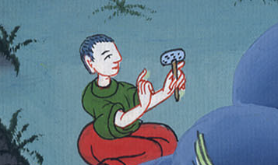
Isaiah 44:11

Slide 13
12The blacksmith takes an ax,
works in the coals,
fashions it with hammers,
and works it with his strong arm.
He is hungry,
and his strength fails;
he drinks no water,
and is faint.

Slide 14
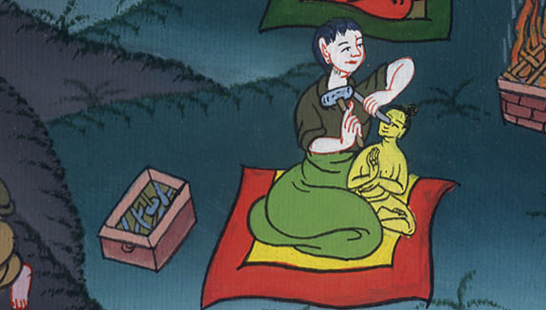
Isaiah 44:12

Slide 15
13The carpenter stretches out a line.
He marks it out with a pencil.
He shapes it with planes.
He marks it out with compasses,
and shapes it like the figure of a man,
with the beauty of a man,
to reside in a house.

Slide 16
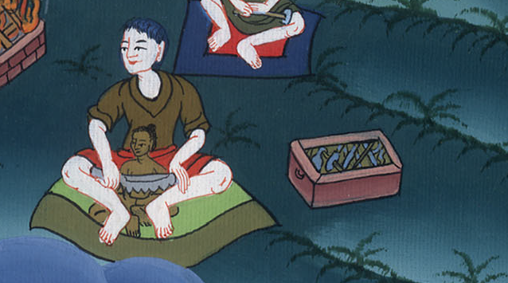
Isaiah 44:13

Slide 17
14He cuts down cedars for himself,
and takes the cypress and the oak,
and strengthens for himself one among the trees of the forest.
He plants a cypress tree,
and the rain nourishes it.

Slide 18
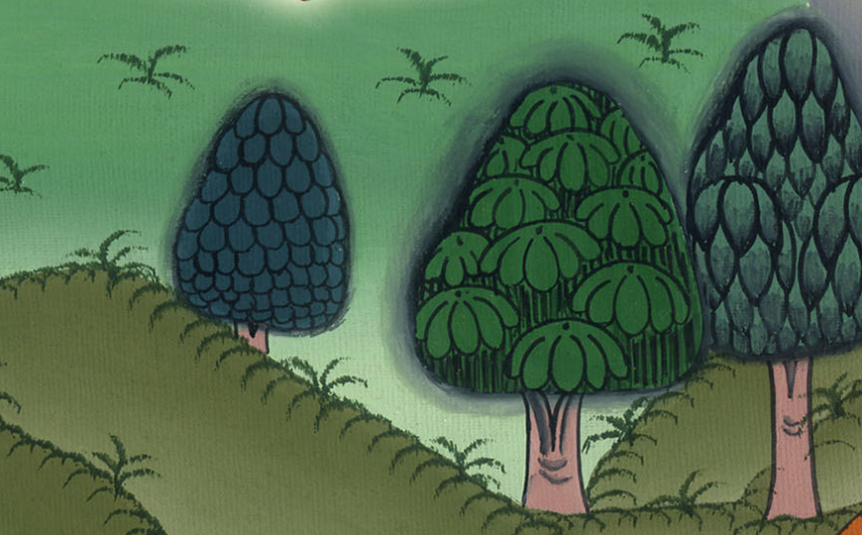
Isaiah 44:14

Slide 19
15Then it will be for a man to burn;
and he takes some of it and warms himself.
Yes, he burns it and bakes bread.
Yes, he makes a god and worships it;
he makes it a carved image, and falls down to it.

Slide 20
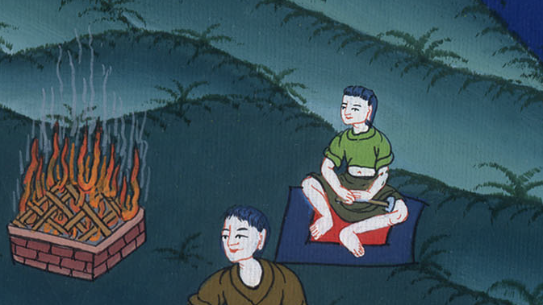
Isaiah 44:15

Slide 21
16He burns part of it in the fire.
With part of it, he eats meat.
He roasts a roast and is satisfied.
Yes, he warms himself
and says, “Aha! I am warm. I have seen the fire.”

Slide 22
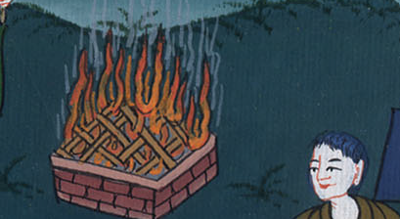
Isaiah 44:16

Slide 23
17The rest of it he makes into a god,
even his engraved image.
He bows down to it and worships,
and prays to it, and says, “Deliver me, for you are my god!”

Slide 24
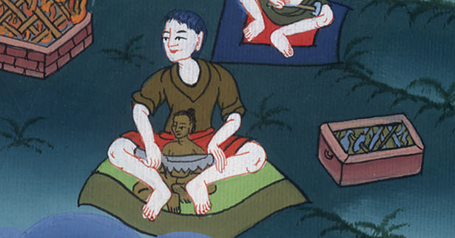
Isaiah 44:17

Slide 25
18They don’t know, neither do they consider,
for he has shut their eyes, that they can’t see,
and their hearts, that they can’t understand.

Slide 26
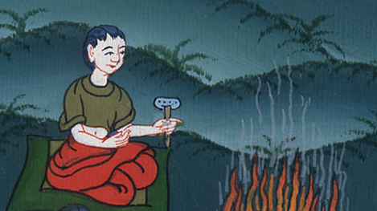
Isaiah 44:18

Slide 27
19No one thinks,
neither is there knowledge nor understanding to say,
“I have burned part of it in the fire.
Yes, I have also baked bread on its coals.
I have roasted meat and eaten it.
Shall I make the rest of it into an abomination?
Shall I bow down to a tree trunk?”

Slide 28
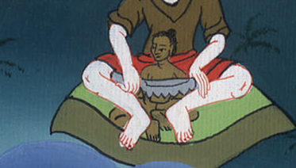
Isaiah 44:19

Slide 29
20He feeds on ashes.
A deceived heart has turned him aside;
and he can’t deliver his soul,
nor say, “Isn’t there a lie in my right hand?”

Slide 30
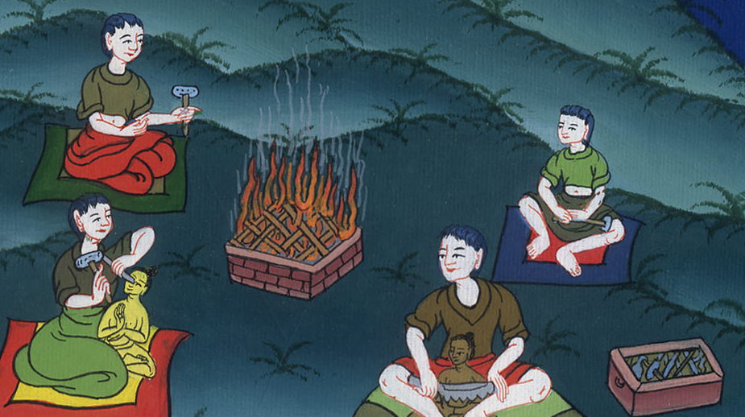
Isaiah 44:20

