Slide 1
24-4
This work is licensed under a Creative Commons Attribution-ShareAlike 4.0 International License.
Please add this statement to all the videos you create.
English Bible quotes are from the World English Bible US, which is in the public domain.
Notes:
Ch
24 Isaiah
1. Isaiah’s commission - Isaiah 6:1-8 (Center)
2. “Bring your worthless offerings no longer” - Isaiah 1:1-20 (Left Top)
3. “Those who fashion a graven image are all of them futile” - Isaiah 44:9-20
(Center Top)
4. “Comfort, oh comfort my people.” - Isaiah 40:1-31 (Right Top)
5. “The wolf will dwell with the lamb” - Isaiah 11:1-9, 12:1-6 (Right Center)
6. Immanuel - Isaiah 7:14, 9:1-7, 60:1-5, 61:1-3 (Right Bottom)
7. “Like a lamb that is led to slaughter” - Isaiah 53:1-12 (Center Bottom)
8. “The LORD of hosts will prepare a lavish banquet” - Isaiah 66:18-19, 25:6-9
(Left Bottom)
9. "Ho! Every one who thirsts, come to the waters” - Isaiah 55:1-13 (Left Center)

Slide 2
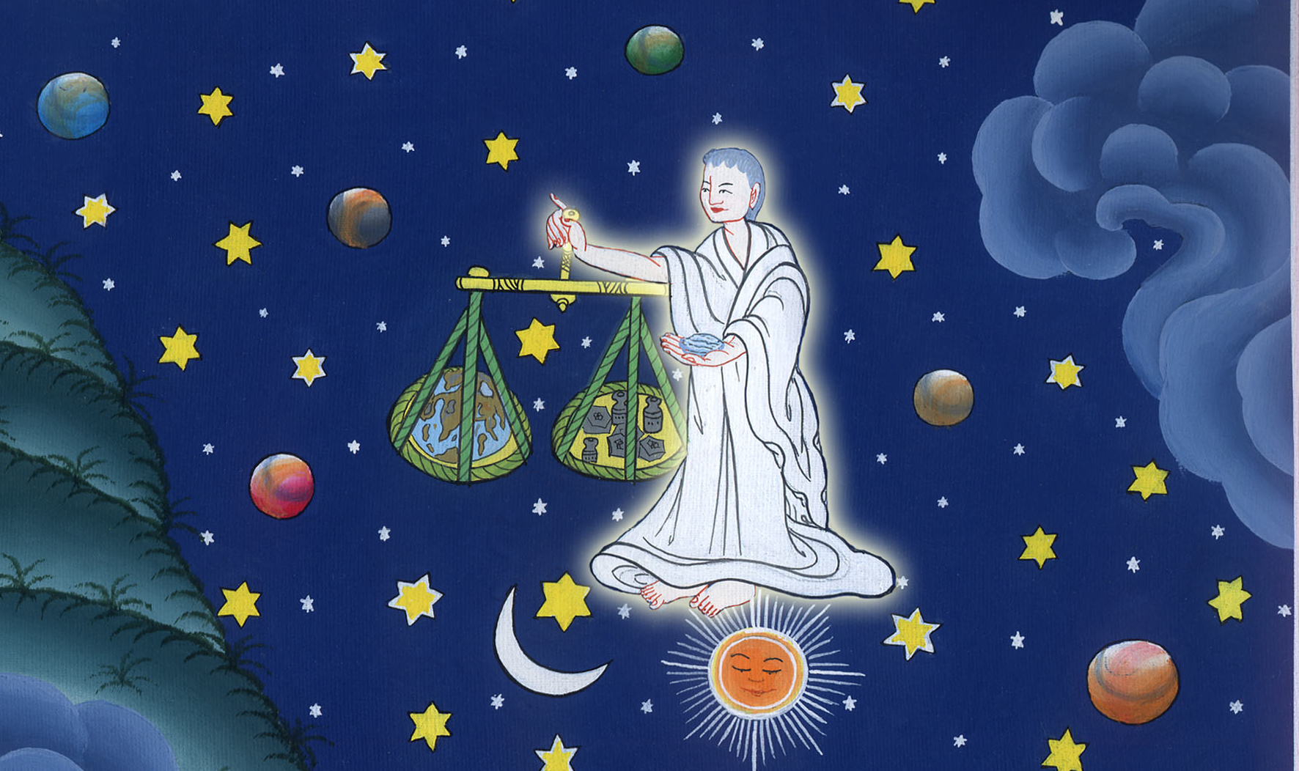
Comfort, oh comfort my people – Isaiah 40:1-31

Slide 3
Comfort, oh comfort my people – Isaiah 40:1-31

Slide 4
Comfort, oh comfort my people – Isaiah 40:1-31

Slide 5
1“Comfort, comfort my people,” says your God.

Slide 6
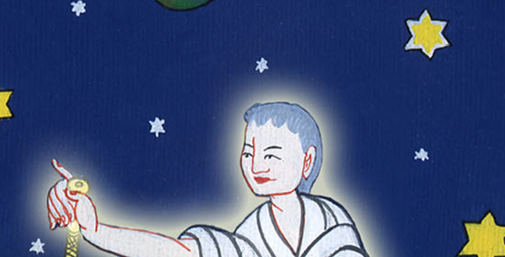
Isaiah 40:1

Slide 7
2“Speak comfortably to Jerusalem, and call out to her that her warfare is accomplished, that her iniquity is pardoned, that she has received of Yahweh’s hand double for all her sins.”

Slide 8
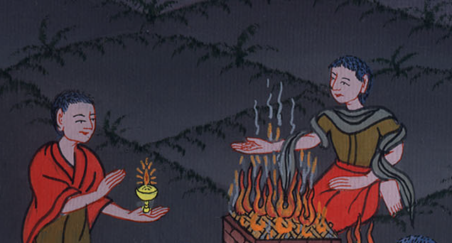
Isaiah 40:2

Slide 9
3The voice of one who calls out,
“Prepare the way of Yahweh in the wilderness!
Make a level highway in the desert for our God.

Slide 10
Isaiah 40:3

Slide 11
4Every valley shall be exalted,
and every mountain and hill shall be made low.
The uneven shall be made level,
and the rough places a plain.

Slide 12
Isaiah 40:4

Slide 13
5Yahweh’s glory shall be revealed,
and all flesh shall see it together;
for the mouth of Yahweh has spoken it.”

Slide 14
Isaiah 40:5

Slide 15
6The voice of one saying, “Cry out!”
One said, “What shall I cry?”
“All flesh is like grass,
and all its glory is like the flower of the field.

Slide 16
Isaiah 40:6

Slide 17
7The grass withers,
the flower fades,
because Yahweh’s breath blows on it.
Surely the people are like grass.
8The grass withers,
the flower fades;
but the word of our God stands forever.”

Slide 18
Isaiah 40:7-8

Slide 19
9You who tell good news to Zion, go up on a high mountain.
You who tell good news to Jerusalem, lift up your voice with strength!
Lift it up! Don’t be afraid!
Say to the cities of Judah, “Behold, your God!”

Slide 20
Isaiah 40:9

Slide 21
10Behold, the Lord Yahweh will come as a mighty one,
and his arm will rule for him.
Behold, his reward is with him,
and his recompense before him.

Slide 22
Isaiah 40:10

Slide 23
11He will feed his flock like a shepherd.
He will gather the lambs in his arm,
and carry them in his bosom.
He will gently lead those who have their young.

Slide 24
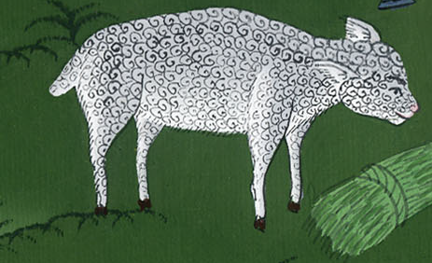
Isaiah 40:11

Slide 25
12Who has measured the waters in the hollow of his hand,
and marked off the sky with his span,
and calculated the dust of the earth in a measuring basket,
and weighed the mountains in scales,
and the hills in a balance?

Slide 26
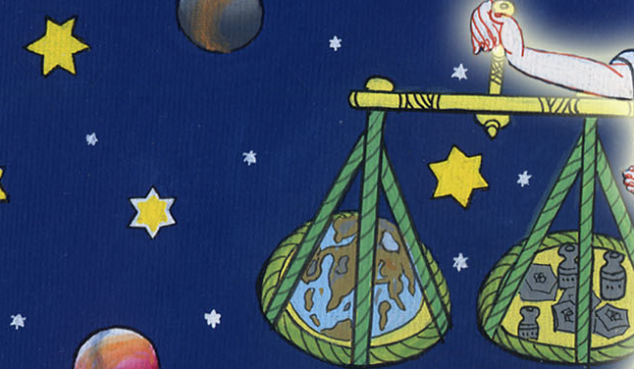
Isaiah 40:12

Slide 27
13Who has directed Yahweh’s Spirit,
or has taught him as his counselor?

Slide 28
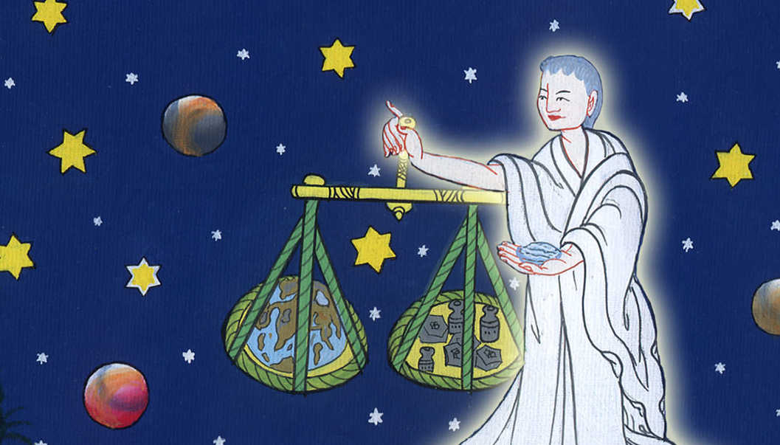
Isaiah 40:13

Slide 29
14Who did he take counsel with,
and who instructed him,
and taught him in the path of justice,
and taught him knowledge,
and showed him the way of understanding?

Slide 30
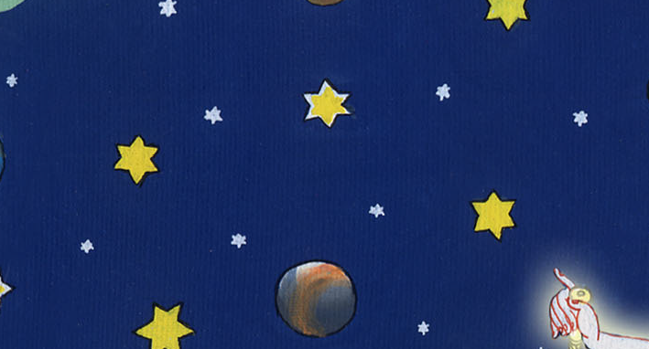
Isaiah 40:14

Slide 31
18To whom then will you liken God?
Or what likeness will you compare to him?

Slide 32
Isaiah 40:18

Slide 33
19A workman has cast an image,
and the goldsmith overlays it with gold,
and casts silver chains for it.

Slide 34
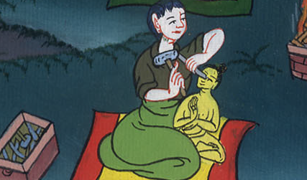
Isaiah 40:19

Slide 35
21Haven’t you known?
Haven’t you heard?
Haven’t you been told from the beginning?
Haven’t you understood from the foundations of the earth?

Slide 36
Isaiah 40:21

Slide 37
22It is he who sits above the circle of the earth,
and its inhabitants are like grasshoppers;
who stretches out the heavens like a curtain,
and spreads them out like a tent to dwell in,

Slide 38
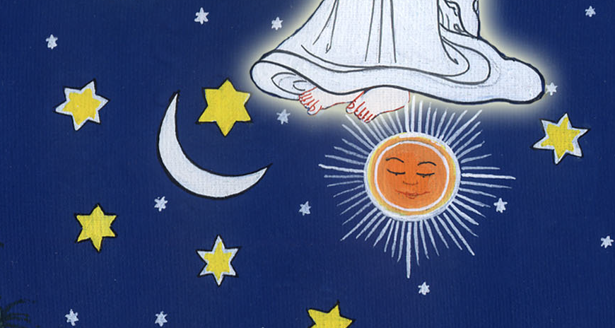
Isaiah 40:22

Slide 39
23who brings princes to nothing,
who makes the judges of the earth meaningless.

Slide 40
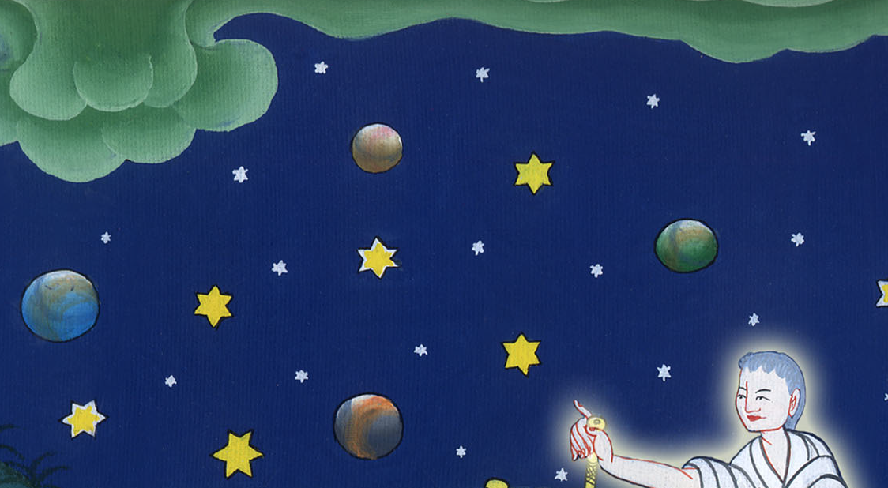
Isaiah 40:23

Slide 41
25“To whom then will you liken me?
Who is my equal?” says the Holy One.

Slide 42
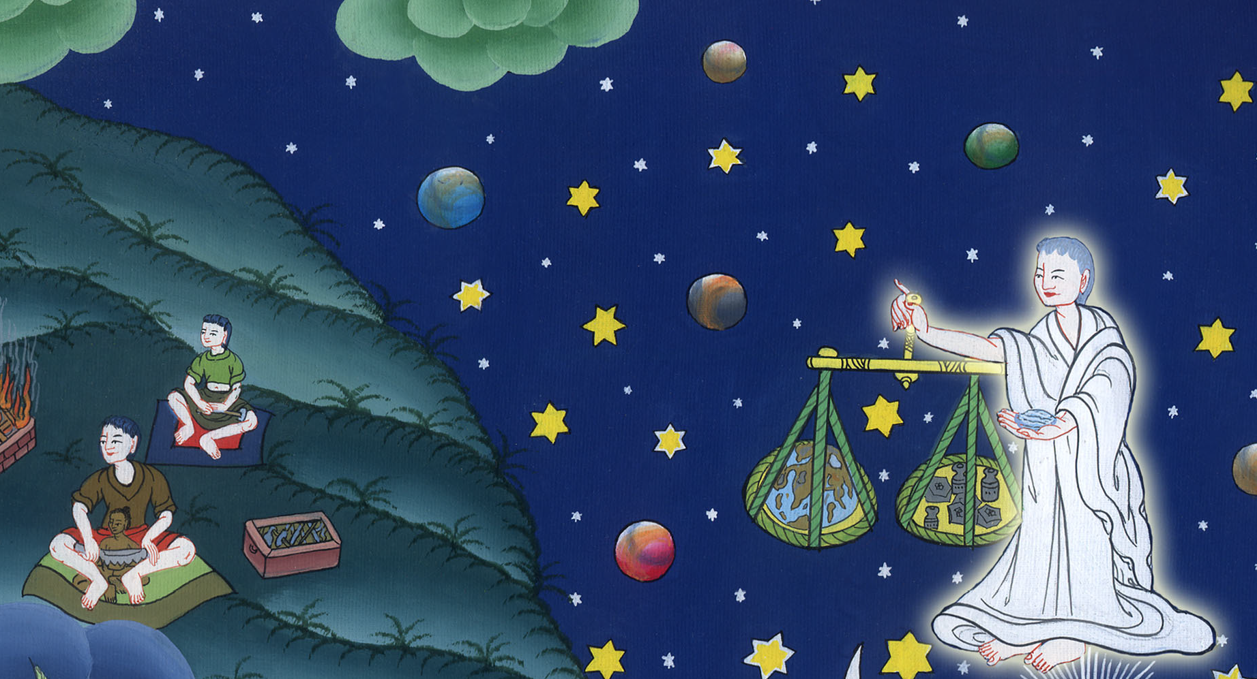
Isaiah 40:25

Slide 43
26Lift up your eyes on high,
and see who has created these,
who brings out their army by number.
He calls them all by name.
by the greatness of his might,
and because he is strong in power,
not one is lacking.

Slide 44
Isaiah 40:26

Slide 45
27Why do you say, Jacob,
and speak, Israel,
“My way is hidden from Yahweh,
and the justice due me is disregarded by my God?”

Slide 46
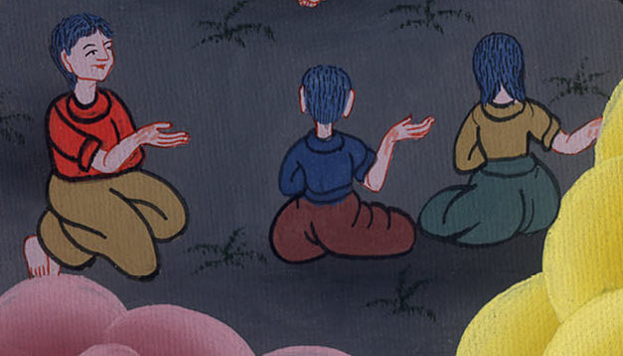
Isaiah 40:27

Slide 47
28Haven’t you known?
Haven’t you heard?
The everlasting God, Yahweh,
the Creator of the ends of the earth, doesn’t faint.
He isn’t weary.
His understanding is unsearchable.

Slide 48
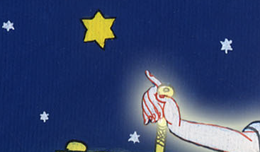
Isaiah 40:28

Slide 49
29He gives power to the weak.
He increases the strength of him who has no might.
30Even the youths faint and get weary,
and the young men utterly fall;

Slide 50
Isaiah 40:29-30

Slide 51
31but those who wait for Yahweh will renew their strength.
They will mount up with wings like eagles.
They will run, and not be weary.
They will walk, and not faint.

Slide 52
Isaiah 40:31

