Slide 1
24-5
This work is licensed under a Creative Commons Attribution-ShareAlike 4.0 International License.
Please add this statement to all the videos you create.
English Bible quotes are from the World English Bible US, which is in the public domain.
Notes:
Ch
24 Isaiah
1. Isaiah’s commission - Isaiah 6:1-8 (Center)
2. “Bring your worthless offerings no longer” - Isaiah 1:1-20 (Left Top)
3. “Those who fashion a graven image are all of them futile” - Isaiah 44:9-20
(Center Top)
4. “Comfort, oh comfort my people.” - Isaiah 40:1-31 (Right Top)
5. “The wolf will dwell with the lamb” - Isaiah 11:1-9, 12:1-6 (Right Center)
6. Immanuel - Isaiah 7:14, 9:1-7, 60:1-5, 61:1-3 (Right Bottom)
7. “Like a lamb that is led to slaughter” - Isaiah 53:1-12 (Center Bottom)
8. “The LORD of hosts will prepare a lavish banquet” - Isaiah 66:18-19, 25:6-9
(Left Bottom)
9. "Ho! Every one who thirsts, come to the waters” - Isaiah 55:1-13 (Left Center)

Slide 2
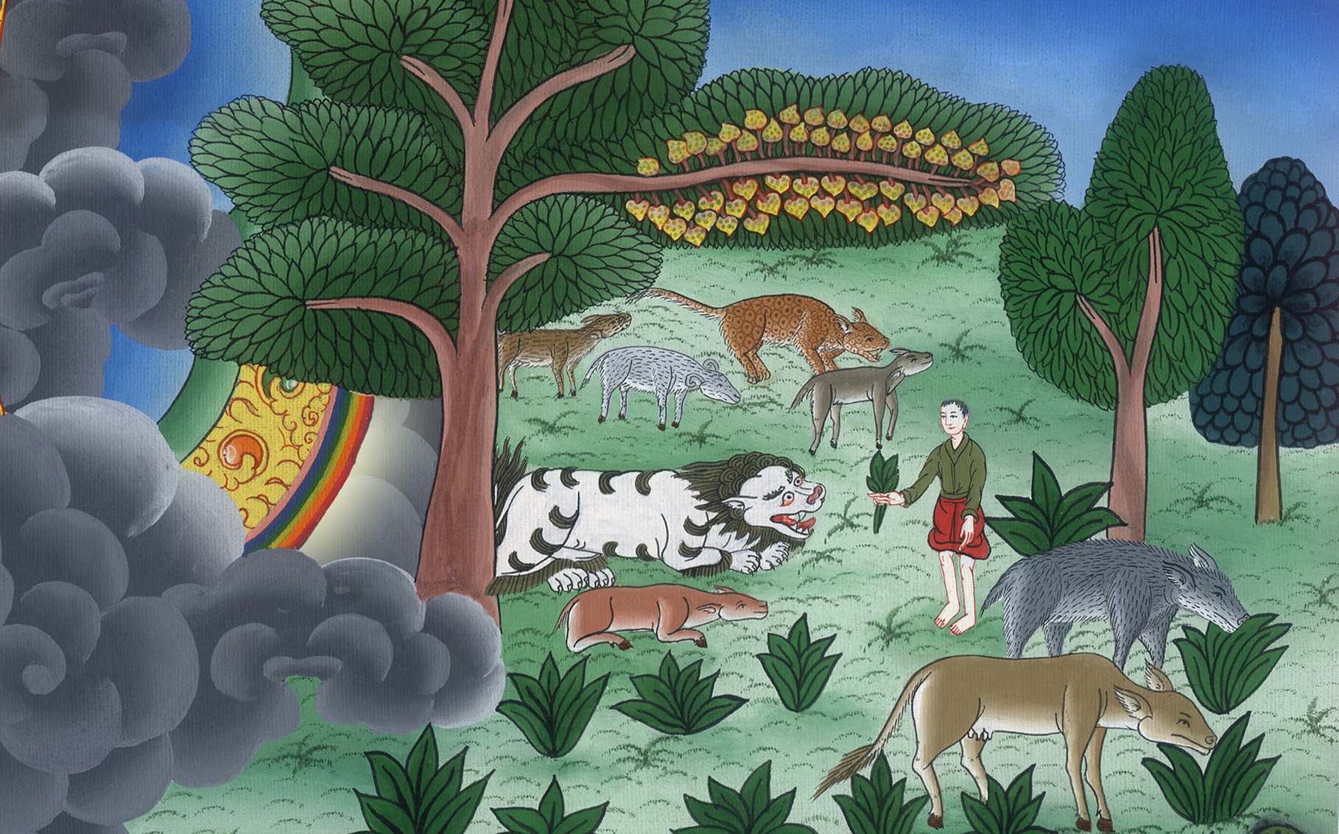
The wolf will dwell with the lamb –
Isaiah 11:1-9, 12:1-6

Slide 3
The wolf will dwell with the lamb – Isaiah 11:1-9, 12:1-6

Slide 4
The wolf will dwell with the lamb –
Isaiah 11:1-9, 12:1-6

Slide 5
1A shoot will come out of the stock of Jesse,
and a branch out of his roots will bear fruit.

Slide 6
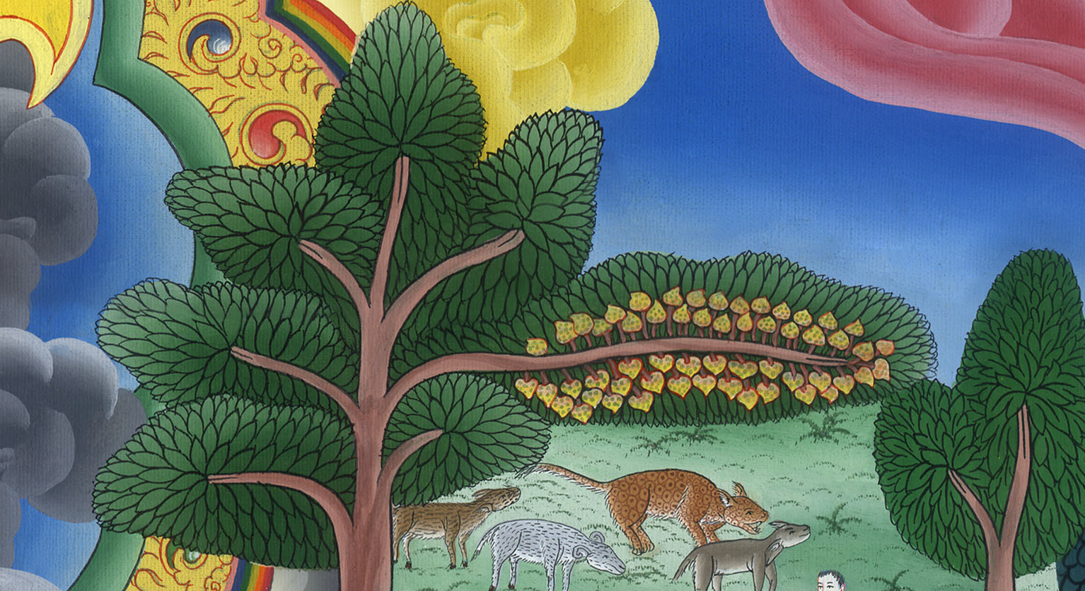
Isaiah 11:1

Slide 7
2Yahweh’s Spirit will rest on him:
the spirit of wisdom and understanding,
the spirit of counsel and might,
the spirit of knowledge and of the fear of Yahweh.

Slide 8
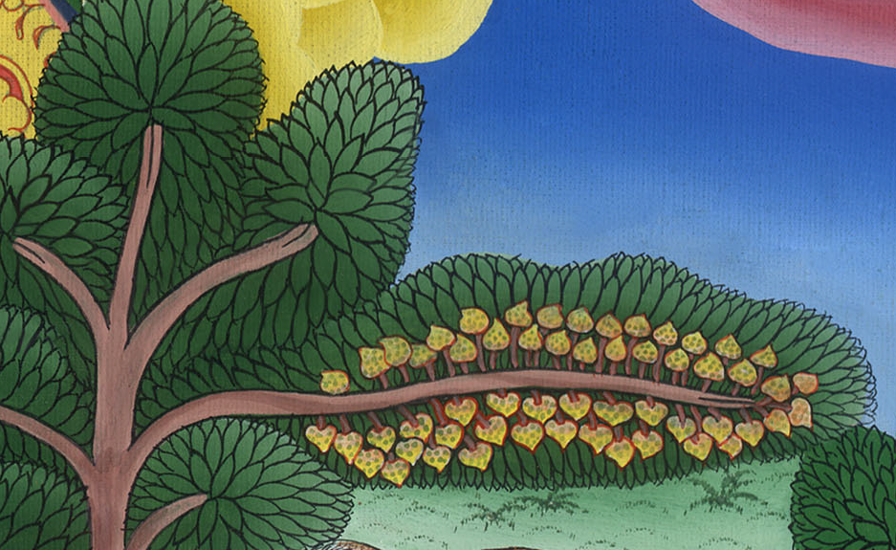
Isaiah 11:2

Slide 9
3His delight will be in the fear of Yahweh.
He will not judge by the sight of his eyes,
neither decide by the hearing of his ears;

Slide 10
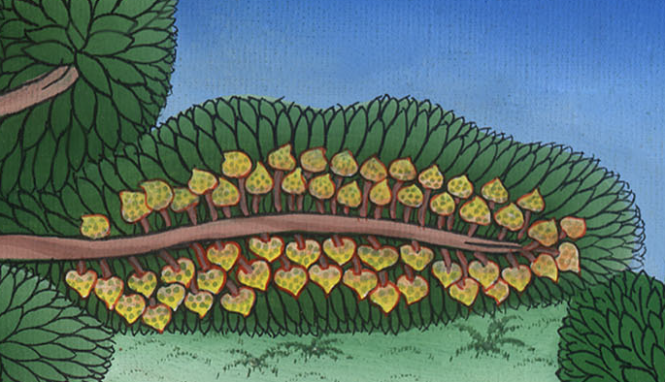
Isaiah 11:3

Slide 11
5Righteousness will be the belt around his waist,
and faithfulness the belt around his waist.

Slide 12
Isaiah 11:5

Slide 13
6The wolf will live with the lamb,
and the leopard will lie down with the young goat,
the calf, the young lion, and the fattened calf together;
and a little child will lead them.

Slide 14
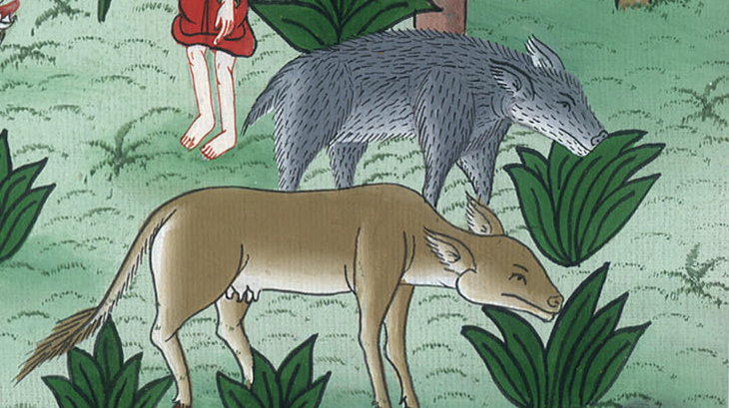
Isaiah 11:6

Slide 15
7The cow and the bear will graze.
Their young ones will lie down together.
The lion will eat straw like the ox.

Slide 16
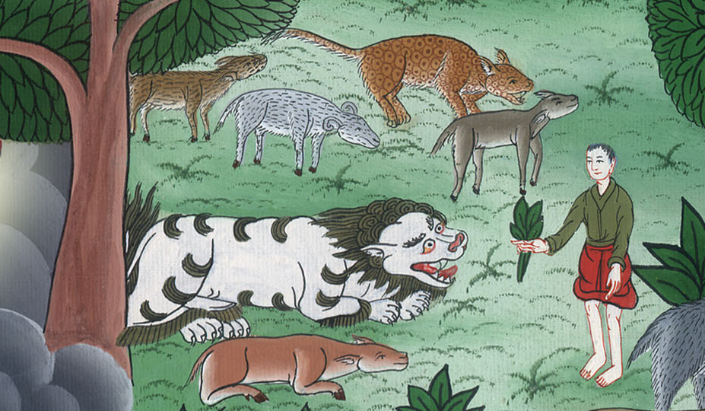
Isaiah 11:7

Slide 17
9They will not hurt nor destroy in all my holy mountain;
for the earth will be full of the knowledge of Yahweh,
as the waters cover the sea.

Slide 18
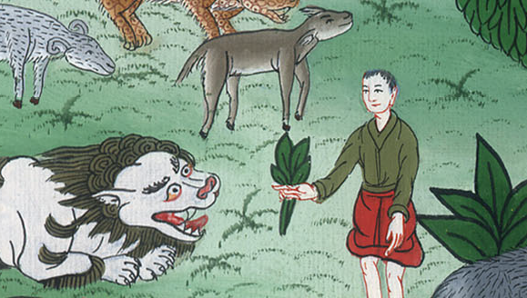
Isaiah 11:9

Slide 19
12:1In that day you will say, “I will give thanks to you, Yahweh; for though you were angry with me, your anger has turned away and you comfort me.

Slide 20
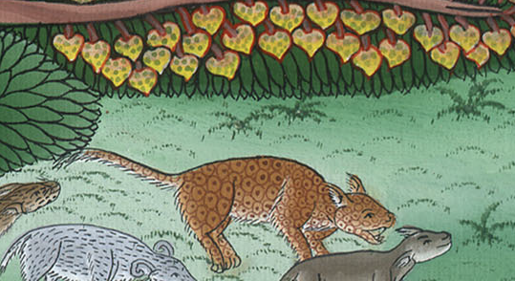
Isaiah 12:1

Slide 21
Behold, God is my salvation. I will trust, and will not be afraid; for Yah, Yahweh, is my strength and song; and he has become my salvation.”

Slide 22
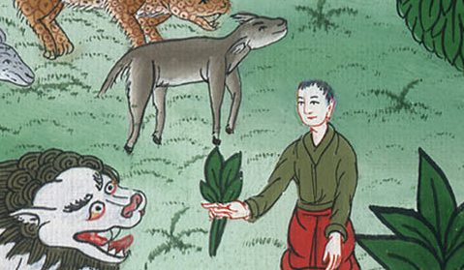
Isaiah 12:2

Slide 23
3Therefore with joy you will draw water out of the wells of salvation.

Slide 24
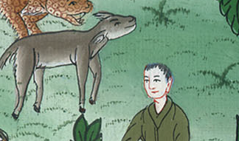
Isaiah 12:3

Slide 25
4In that day you will say, “Give thanks to Yahweh! Call on his name! Declare his doings among the peoples! Proclaim that his name is exalted!

Slide 26
Isaiah 12:4

Slide 27
5Sing to Yahweh, for he has done excellent things! Let this be known in all the earth!

Slide 28
Isaiah 12:5

Slide 29
6Cry aloud and shout, you inhabitant of Zion, for the Holy One of Israel is great among you!”

Slide 30
Isaiah 12:6

