Slide 1
24-6
This work is licensed under a Creative Commons Attribution-ShareAlike 4.0 International License.
Please add this statement to all the videos you create.
English Bible quotes are from the World English Bible US, which is in the public domain.
Notes:
Ch
24 Isaiah
1. Isaiah’s commission - Isaiah 6:1-8 (Center)
2. “Bring your worthless offerings no longer” - Isaiah 1:1-20 (Left Top)
3. “Those who fashion a graven image are all of them futile” - Isaiah 44:9-20
(Center Top)
4. “Comfort, oh comfort my people.” - Isaiah 40:1-31 (Right Top)
5. “The wolf will dwell with the lamb” - Isaiah 11:1-9, 12:1-6 (Right Center)
6. Immanuel - Isaiah 7:14, 9:1-7, 60:1-5, 61:1-3 (Right Bottom)
7. “Like a lamb that is led to slaughter” - Isaiah 53:1-12 (Center Bottom)
8. “The LORD of hosts will prepare a lavish banquet” - Isaiah 66:18-19, 25:6-9
(Left Bottom)
9. "Ho! Every one who thirsts, come to the waters” - Isaiah 55:1-13 (Left Center)

Slide 2
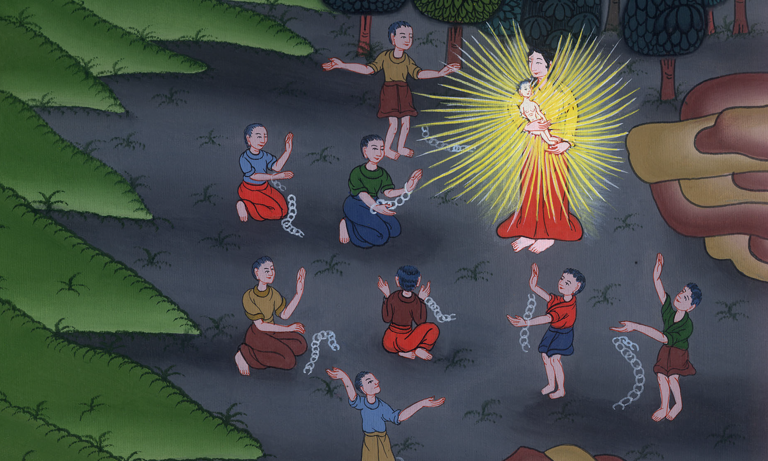
Immanuel –
Isaiah 7:14, 9:1-7, 60:1-5, 61:1-3

Slide 3
Immanuel – Isaiah 7:14, 9:1-7, 60:1-5, 61:1-3

Slide 4
Immanuel –
Isaiah 7:14, 9:1-7, 60:1-5, 61:1-3

Slide 5
14Therefore the Lord himself will give you a sign. Behold, the virgin will conceive, and bear a son, and shall call his name Immanuel.

Slide 6
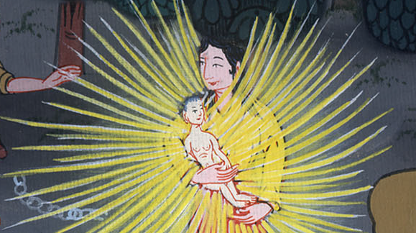
Isaiah 7:14

Slide 7
1But there shall be no more gloom for her who was in anguish…

Slide 8
Isaiah 9:1

Slide 9
2The people who walked in darkness have seen a great light. The light has shined on those who lived in the land of the shadow of death.

Slide 10
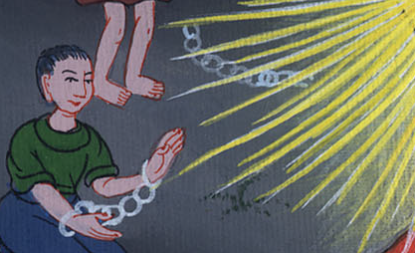
Isaiah 9:2

Slide 11
6For a child is born to us. A son is given to us; and the government will be on his shoulders. His name will be called Wonderful Counselor, Mighty God, Everlasting Father, Prince of Peace.

Slide 12
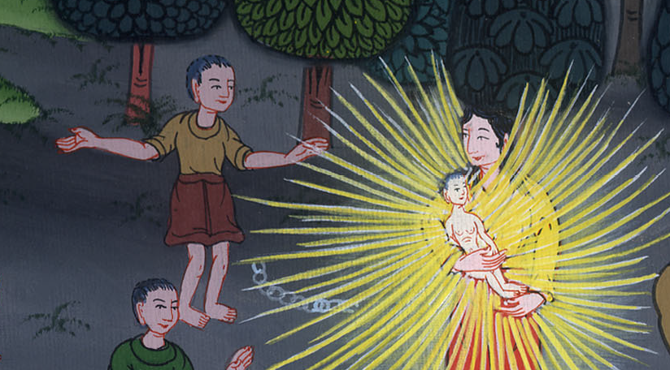
Isaiah 9:6

Slide 13
7Of the increase of his government and of peace there shall be no end, on David’s throne, and on his kingdom, to establish it, and to uphold it with justice and with righteousness from that time on, even forever. The zeal of Yahweh of Armies will perform this.

Slide 14
Isaiah 9:7

Slide 15
from that time on, even forever. The zeal of Yahweh of Armies will perform this.

Slide 16
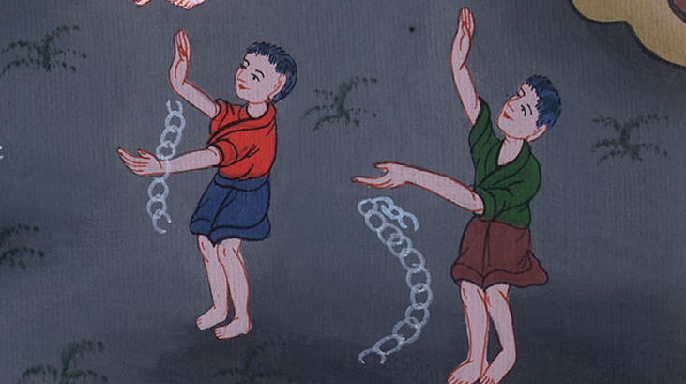
Isaiah 9:7

Slide 17
60:1“Arise, shine; for your light has come,
and Yahweh’s glory has risen on you!

Slide 18
Isaiah 60:1

Slide 19
2For behold, darkness will cover the earth,
and thick darkness the peoples;
but Yahweh will arise on you,
and his glory shall be seen on you.

Slide 20
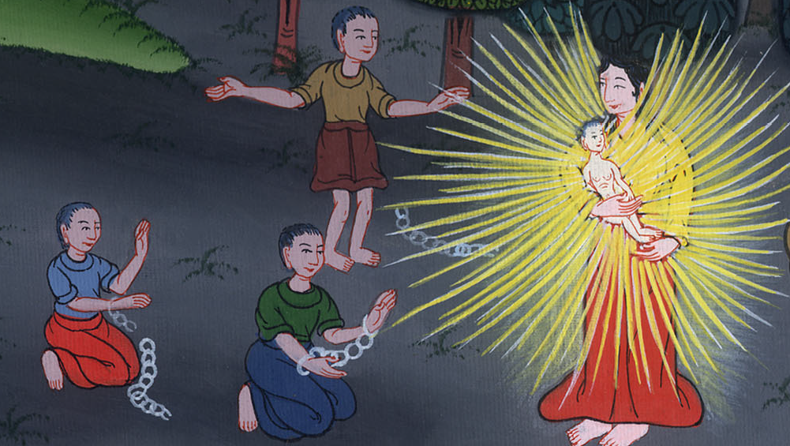
Isaiah 60:2

Slide 21
3Nations will come to your light,
and kings to the brightness of your rising.

Slide 22
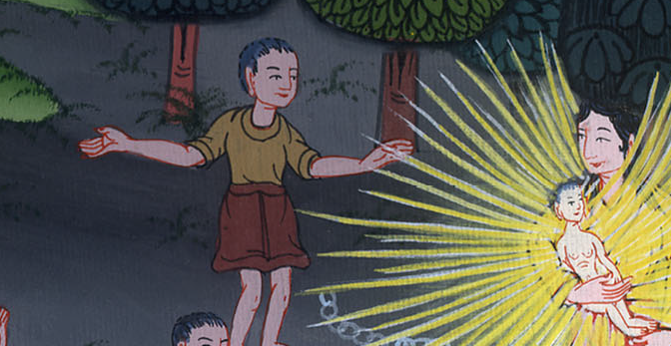
Isaiah 60:3

Slide 23
5Then you shall see and be radiant,
and your heart will thrill and be enlarged;
because the abundance of the sea will be turned to you.
The wealth of the nations will come to you.

Slide 24
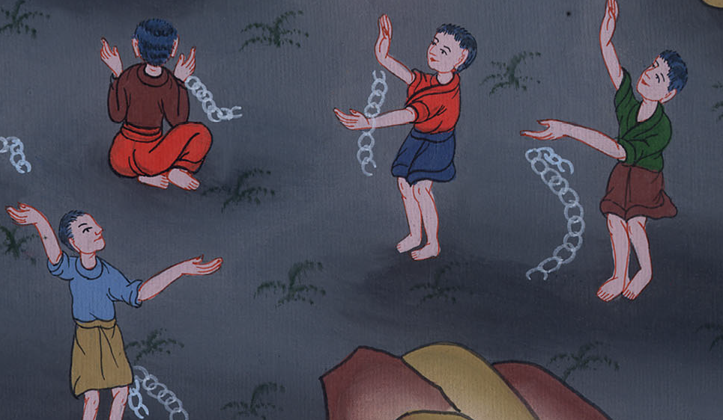
Isaiah 60:5

Slide 25
The Lord Yahweh’s Spirit is on me,
because Yahweh has anointed me to preach good news to the humble.

Slide 26
Isaiah 61:1

Slide 27
He has sent me to bind up the broken hearted,
to proclaim liberty to the captives
and release to those who are bound,

Slide 28
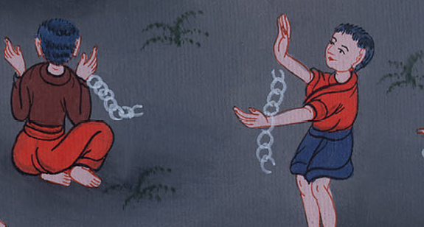
Isaiah 61:1

Slide 29
2to proclaim the year of Yahweh’s favor
and the day of vengeance of our God,
to comfort all who mourn,

Slide 30
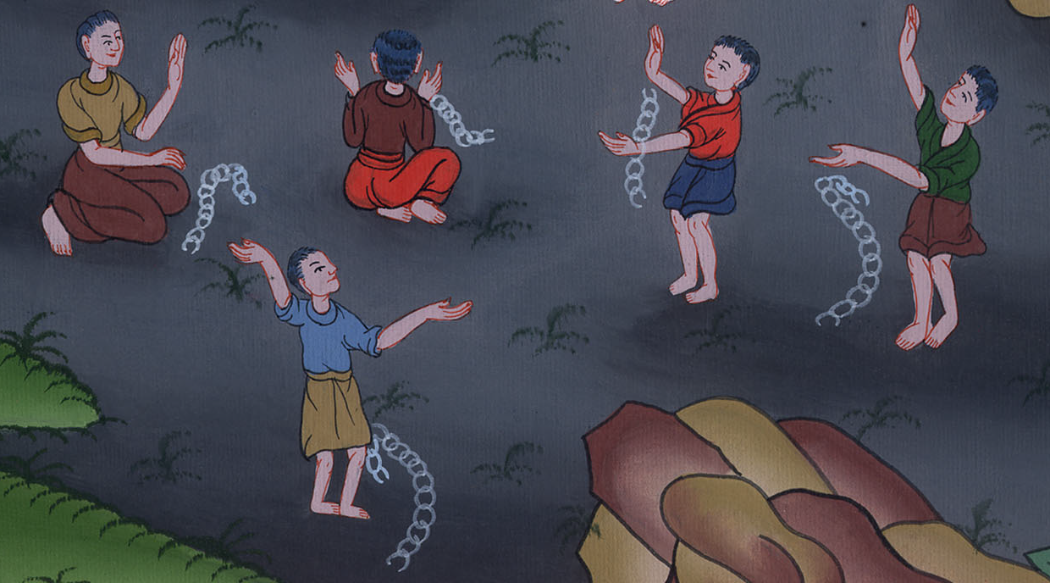
Isaiah 61:2

Slide 31
to comfort all who mourn,
3to provide for those who mourn in Zion,
to give to them a garland for ashes,
the oil of joy for mourning,
the garment of praise for the spirit of heaviness,

Slide 32
Isaiah 61:3

Slide 33
I will give them a spirit of praise
in place of a spirit of sadness.
They will be like oak trees that are strong and straight.
The Lord himself will plant them in the land.
That will show how glorious he is.

Slide 34
Isaiah 61:3

