Slide 1
24-7
This work is licensed under a Creative Commons Attribution-ShareAlike 4.0 International License.
Please add this statement to all the videos you create.
English Bible quotes are from the World English Bible US, which is in the public domain.
Notes:
Ch
24 Isaiah
1. Isaiah’s commission - Isaiah 6:1-8 (Center)
2. “Bring your worthless offerings no longer” - Isaiah 1:1-20 (Left Top)
3. “Those who fashion a graven image are all of them futile” - Isaiah 44:9-20
(Center Top)
4. “Comfort, oh comfort my people.” - Isaiah 40:1-31 (Right Top)
5. “The wolf will dwell with the lamb” - Isaiah 11:1-9, 12:1-6 (Right Center)
6. Immanuel - Isaiah 7:14, 9:1-7, 60:1-5, 61:1-3 (Right Bottom)
7. “Like a lamb that is led to slaughter” - Isaiah 53:1-12 (Center Bottom)
8. “The LORD of hosts will prepare a lavish banquet” - Isaiah 66:18-19, 25:6-9
(Left Bottom)
9. "Ho! Every one who thirsts, come to the waters” - Isaiah 55:1-13 (Left Center)

Slide 2
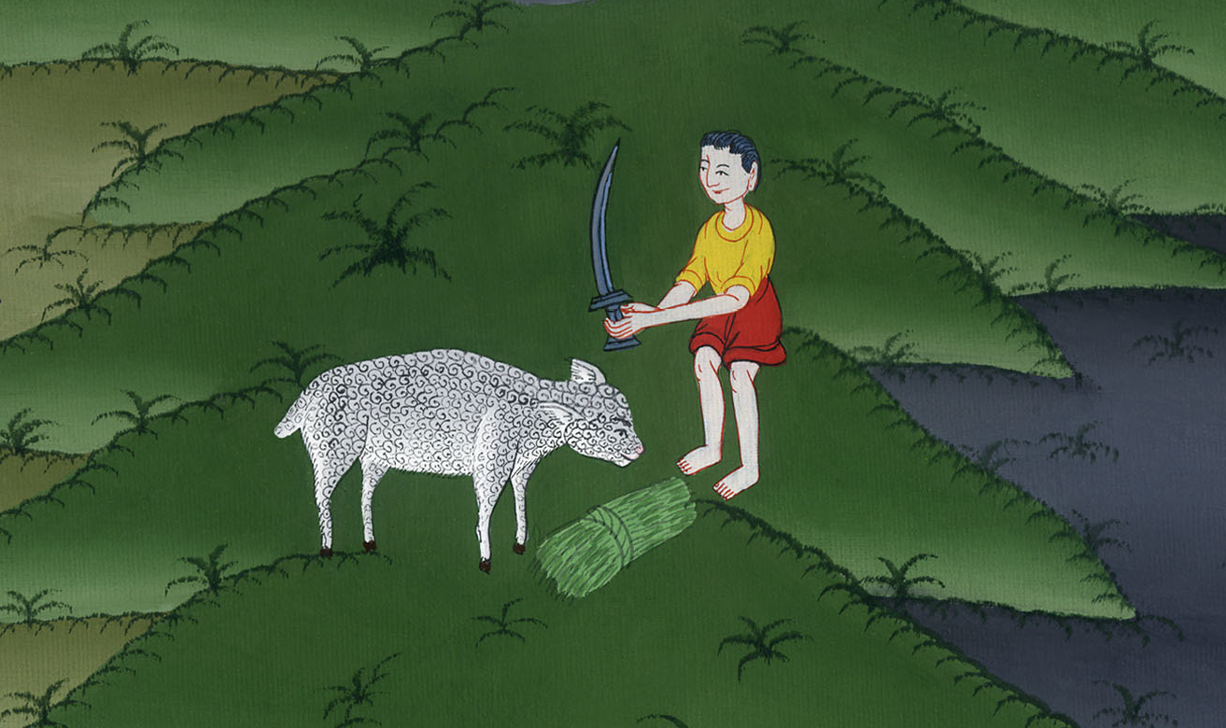
Like a lamb that is led to slaughter –
Isaiah 53:2-12

Slide 3
Like a lamb that is led to slaughter –
Isaiah 53:2-12

Slide 4
Like a lamb that is led to slaughter –
Isaiah 53:2-12

Slide 5
2For he grew up before him as a tender plant,
and as a root out of dry ground.
He has no good looks or majesty.
When we see him, there is no beauty that we should desire him.

Slide 6
Isaiah 53:2

Slide 7
3He was despised
and rejected by men,
a man of suffering
and acquainted with disease.
He was despised as one from whom men hide their face;
and we didn’t respect him.

Slide 8
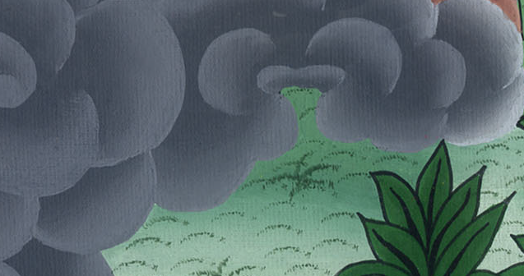
Isaiah 53:3

Slide 9
4Surely he has borne our sickness
and carried our suffering;
yet we considered him plagued,
struck by God, and afflicted.

Slide 10
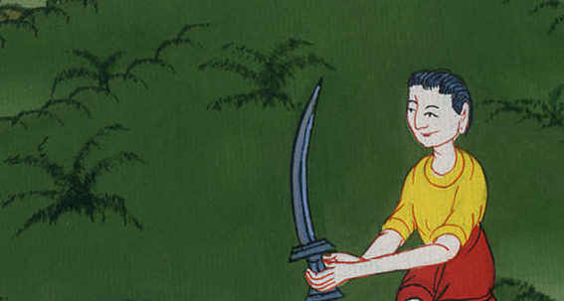
Isaiah 53:4

Slide 11
5But he was pierced for our transgressions.
He was crushed for our iniquities.
The punishment that brought our peace was on him;
and by his wounds we are healed.

Slide 12
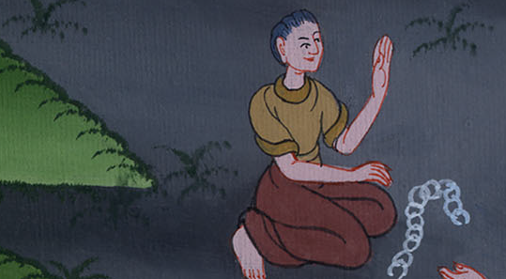
Isaiah 53:5

Slide 13
6All we like sheep have gone astray.
Everyone has turned to his own way;
and Yahweh has laid on him the iniquity of us all.

Slide 14
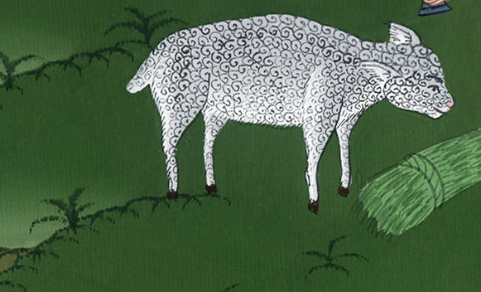
Isaiah 53:6

Slide 15
7He was oppressed,
yet when he was afflicted he didn’t open his mouth.
As a lamb that is led to the slaughter,
and as a sheep that before its shearers is silent,
so he didn’t open his mouth.

Slide 16
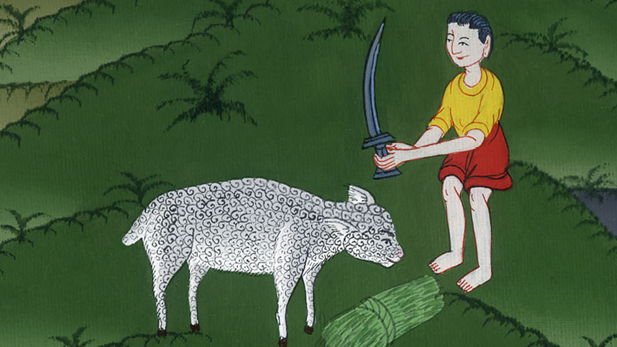
Isaiah 53:7

Slide 17
8He was taken away by oppression and judgment.
As for his generation,
who considered that he was cut off out of the land of the living
and stricken for the disobedience of my people?

Slide 18
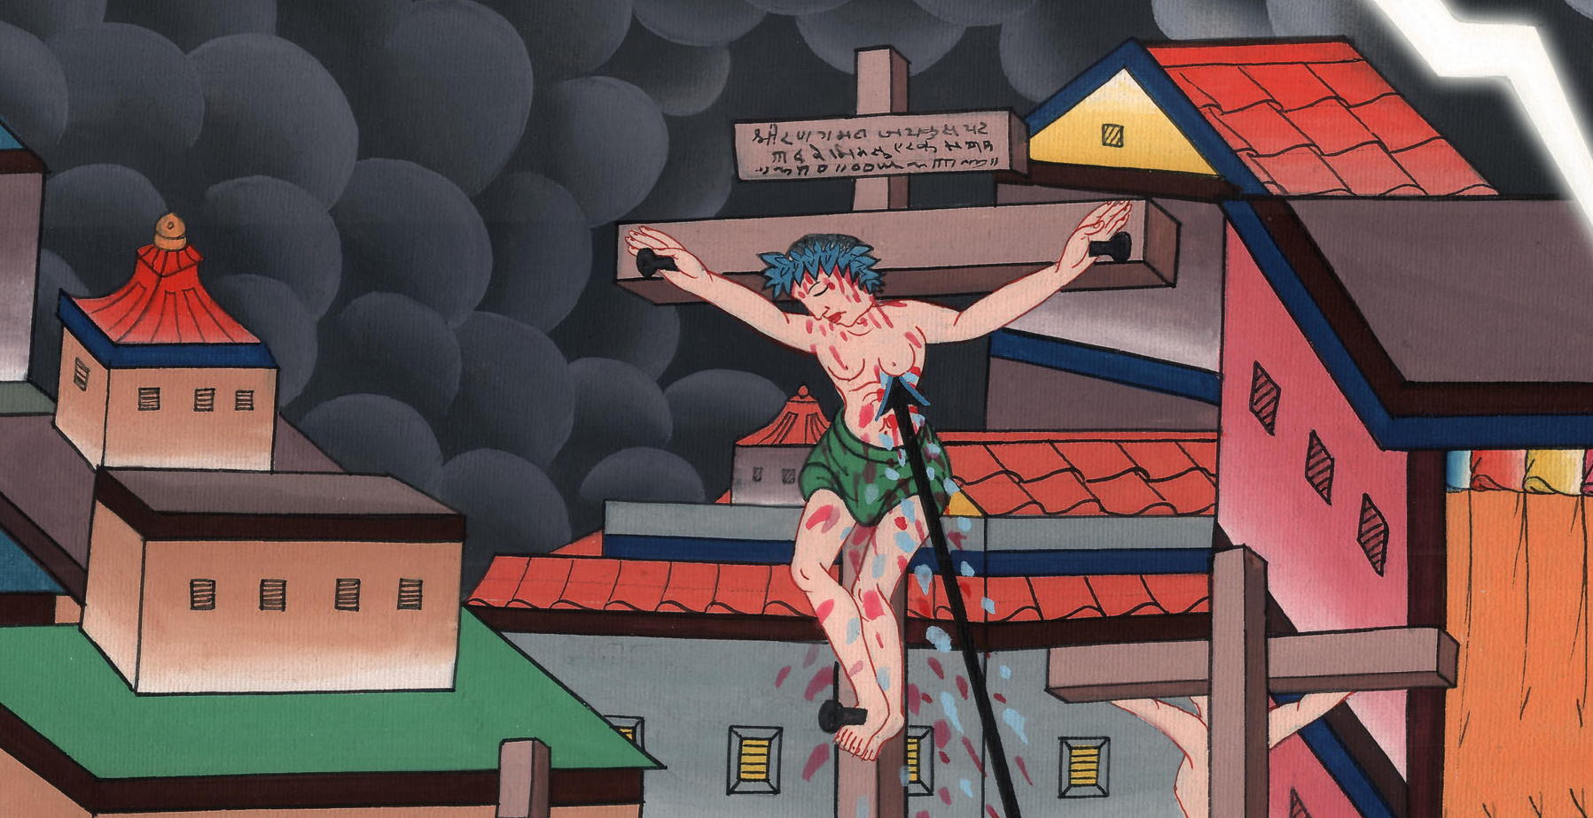
Isaiah 53:8

Slide 19
9They made his grave with the wicked,
and with a rich man in his death,
although he had done no violence,
nor was any deceit in his mouth.

Slide 20
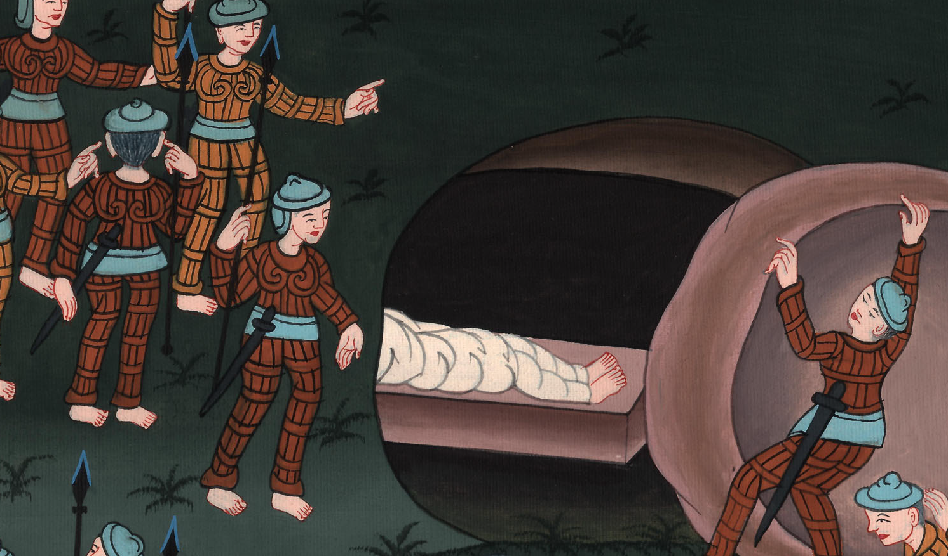
Isaiah 53:9

Slide 21
10Yet it pleased Yahweh to bruise him.
He has caused him to suffer.
When you make his soul an offering for sin,
he will see his offspring.
He will prolong his days
and Yahweh’s pleasure will prosper in his hand.

Slide 22
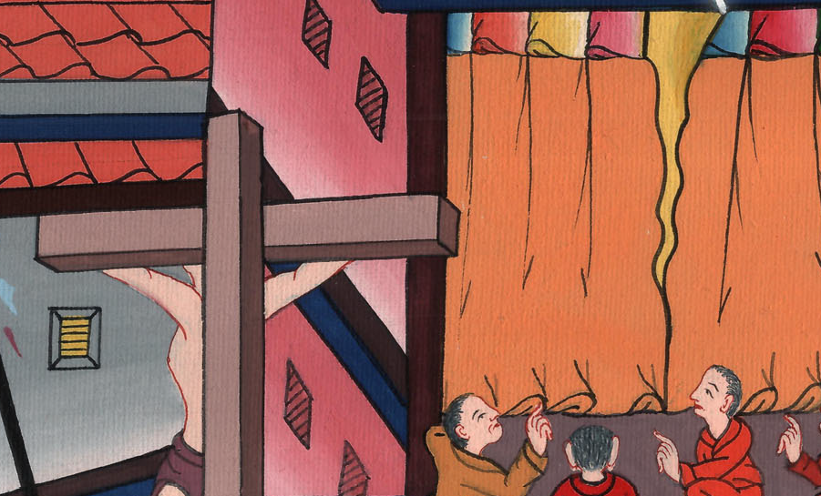
Isaiah 53:10

Slide 23
11After the suffering of his soul,
he will see the light and be satisfied.
My righteous servant will justify many by the knowledge of himself;
and he will bear their iniquities.

Slide 24
Isaiah 53:11

Slide 25
12Therefore I will give him a portion with the great.
He will divide the plunder with the strong,
because he poured out his soul to death
and was counted with the transgressors;
yet he bore the sins of many
and made intercession for the transgressors.

Slide 26
Isaiah 53:12

Slide 27
He took the sins of many people on himself.
And he gave his life for those who had done what is wrong.”

Slide 28
Isaiah 53:12

