Slide 1
24-8
This work is licensed under a Creative Commons Attribution-ShareAlike 4.0 International License.
Please add this statement to all the videos you create.
English Bible quotes are from the World English Bible US, which is in the public domain.
Notes:
Ch
24 Isaiah
1. Isaiah’s commission - Isaiah 6:1-8 (Center)
2. “Bring your worthless offerings no longer” - Isaiah 1:1-20 (Left Top)
3. “Those who fashion a graven image are all of them futile” - Isaiah 44:9-20
(Center Top)
4. “Comfort, oh comfort my people.” - Isaiah 40:1-31 (Right Top)
5. “The wolf will dwell with the lamb” - Isaiah 11:1-9, 12:1-6 (Right Center)
6. Immanuel - Isaiah 7:14, 9:1-7, 60:1-5, 61:1-3 (Right Bottom)
7. “Like a lamb that is led to slaughter” - Isaiah 53:1-12 (Center Bottom)
8. “The LORD of hosts will prepare a lavish banquet” - Isaiah 66:18-19, 25:6-9
(Left Bottom)
9. "Ho! Every one who thirsts, come to the waters” - Isaiah 55:1-13 (Left Center)

Slide 2
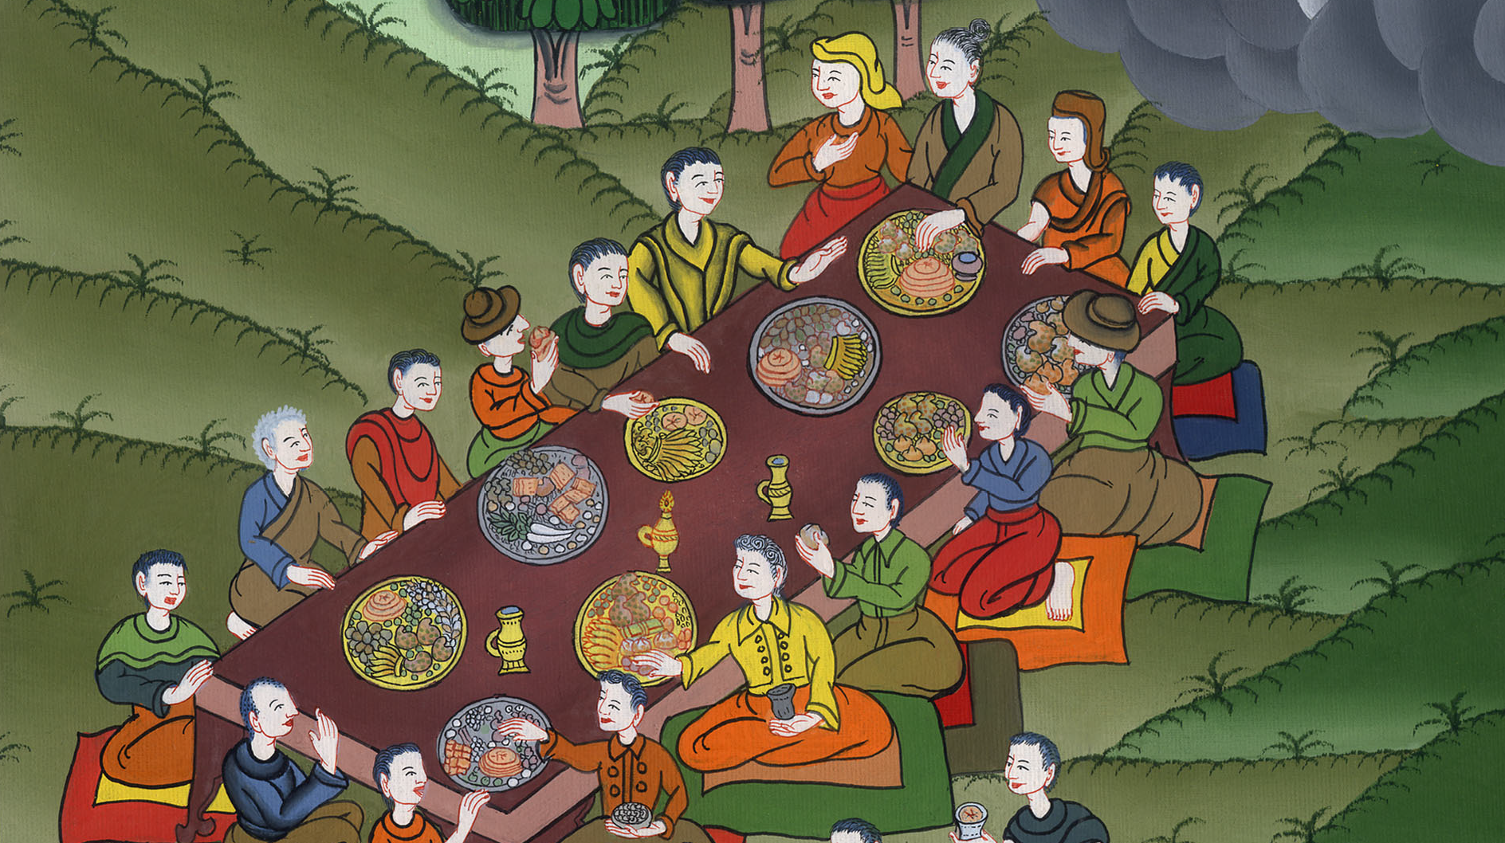
The Lord of hosts will prepare a lavish banquet – Isaiah 66:18-19, 25:6-9

Slide 3
The Lord of hosts will prepare a lavish banquet – Isaiah 66:18-19, 25:6-9

Slide 4
The Lord of hosts will prepare a lavish banquet – Isaiah 66:18-19, 25:6-9

Slide 5
18“For I know [the] works [of those who worship other gods] and their thoughts. The time comes that I will gather all nations and languages, and they will come, and will see my glory.

Slide 6
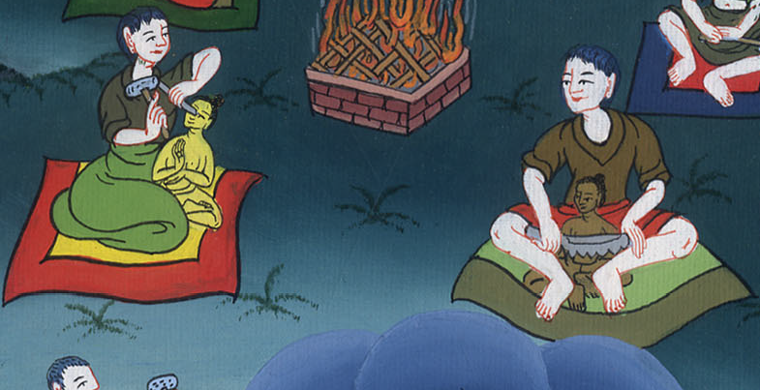
Isaiah 66:18

Slide 7
19“I will set a sign among them, and I will send those who escape of them to the nations, to Tarshish, Pul, and Lud, who draw the bow, to Tubal and Javan, to far-away islands, who have not heard my fame, nor have seen my glory; and they shall declare my glory among the nations.

Slide 8
Isaiah 66:19

Slide 9
6In this mountain, Yahweh of Armies will make all peoples a feast of choice meat, a feast of choice wines, of choice meat full of marrow, of well refined choice wines.

Slide 10
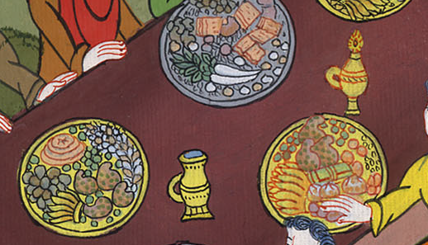
Isaiah 25:6

Slide 11
7He will destroy in this mountain the surface of the covering that covers all peoples, and the veil that is spread over all nations.

Slide 12
Isaiah 25:7

Slide 13
8He has swallowed up death forever! The Lord Yahweh will wipe away tears from off all faces. He will take the reproach of his people away from off all the earth, for Yahweh has spoken it.

Slide 14
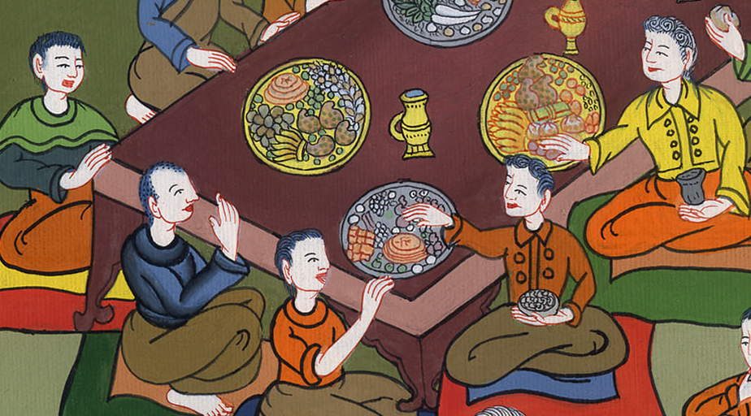
Isaiah 25:8

Slide 15
9It shall be said in that day, “Behold, this is our God! We have waited for him, and he will save us! This is Yahweh! We have waited for him. We will be glad and rejoice in his salvation!”

Slide 16
Isaiah 25:9

