Slide 1
24-9
This work is licensed under a Creative Commons Attribution-ShareAlike 4.0 International License.
Please add this statement to all the videos you create.
English Bible quotes are from the World English Bible US, which is in the public domain.
Notes:
24 Isaiah
1. Isaiah’s commission - Isaiah 6:1-8 (Center)
2. “Bring your worthless offerings no longer” - Isaiah 1:1-20 (Left Top)
3. “Those who fashion a graven image are all of them futile” - Isaiah 44:9-20
(Center Top)
4. “Comfort, oh comfort my people.” - Isaiah 40:1-31 (Right Top)
5. “The wolf will dwell with the lamb” - Isaiah 11:1-9, 12:1-6 (Right Center)
6. Immanuel - Isaiah 7:14, 9:1-7, 60:1-5, 61:1-3 (Right Bottom)
7. “Like a lamb that is led to slaughter” - Isaiah 53:1-12 (Center Bottom)
8. “The LORD of hosts will prepare a lavish banquet” - Isaiah 66:18-19, 25:6-9
(Left Bottom)
9. "Ho! Every one who thirsts, come to the waters” - Isaiah 55:1-13 (Left Center)

Slide 2
Everyone who thirsts, come to the waters - Isaiah 55:1-13

Slide 3
Everyone who thirsts, come to the waters - Isaiah 55:1-13

Slide 4
Everyone who thirsts, come to the waters - Isaiah 55:1-13

Slide 5
1“Hey! Come, everyone who thirsts, to the waters!
Come, he who has no money, buy, and eat!
Yes, come, buy wine and milk without money and without price.

Slide 6
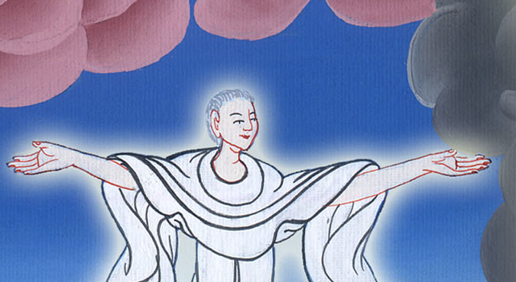
Isaiah 55:1

Slide 7
2Why do you spend money for that which is not bread,
and your labor for that which doesn’t satisfy?
Listen diligently to me, and eat that which is good,
and let your soul delight itself in richness.

Slide 8
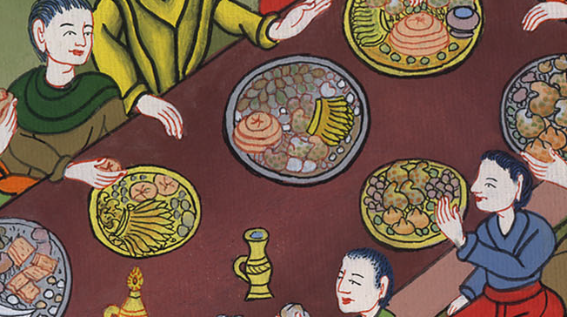
Isaiah 55:2

Slide 9
3Turn your ear, and come to me.
Hear, and your soul will live.
I will make an everlasting covenant with you, even the sure mercies of David.

Slide 10
Isaiah 55:3

Slide 11
4Behold, I have given him for a witness to the peoples,
a leader and commander to the peoples.

Slide 12
Isaiah 55:4

Slide 13
Behold, you shall call a nation that you don’t know;
and a nation that didn’t know you shall run to you,

Slide 14
Isaiah 55:5

Slide 15
because of Yahweh your God,
and for the Holy One of Israel;
for he has glorified you.”

Slide 16
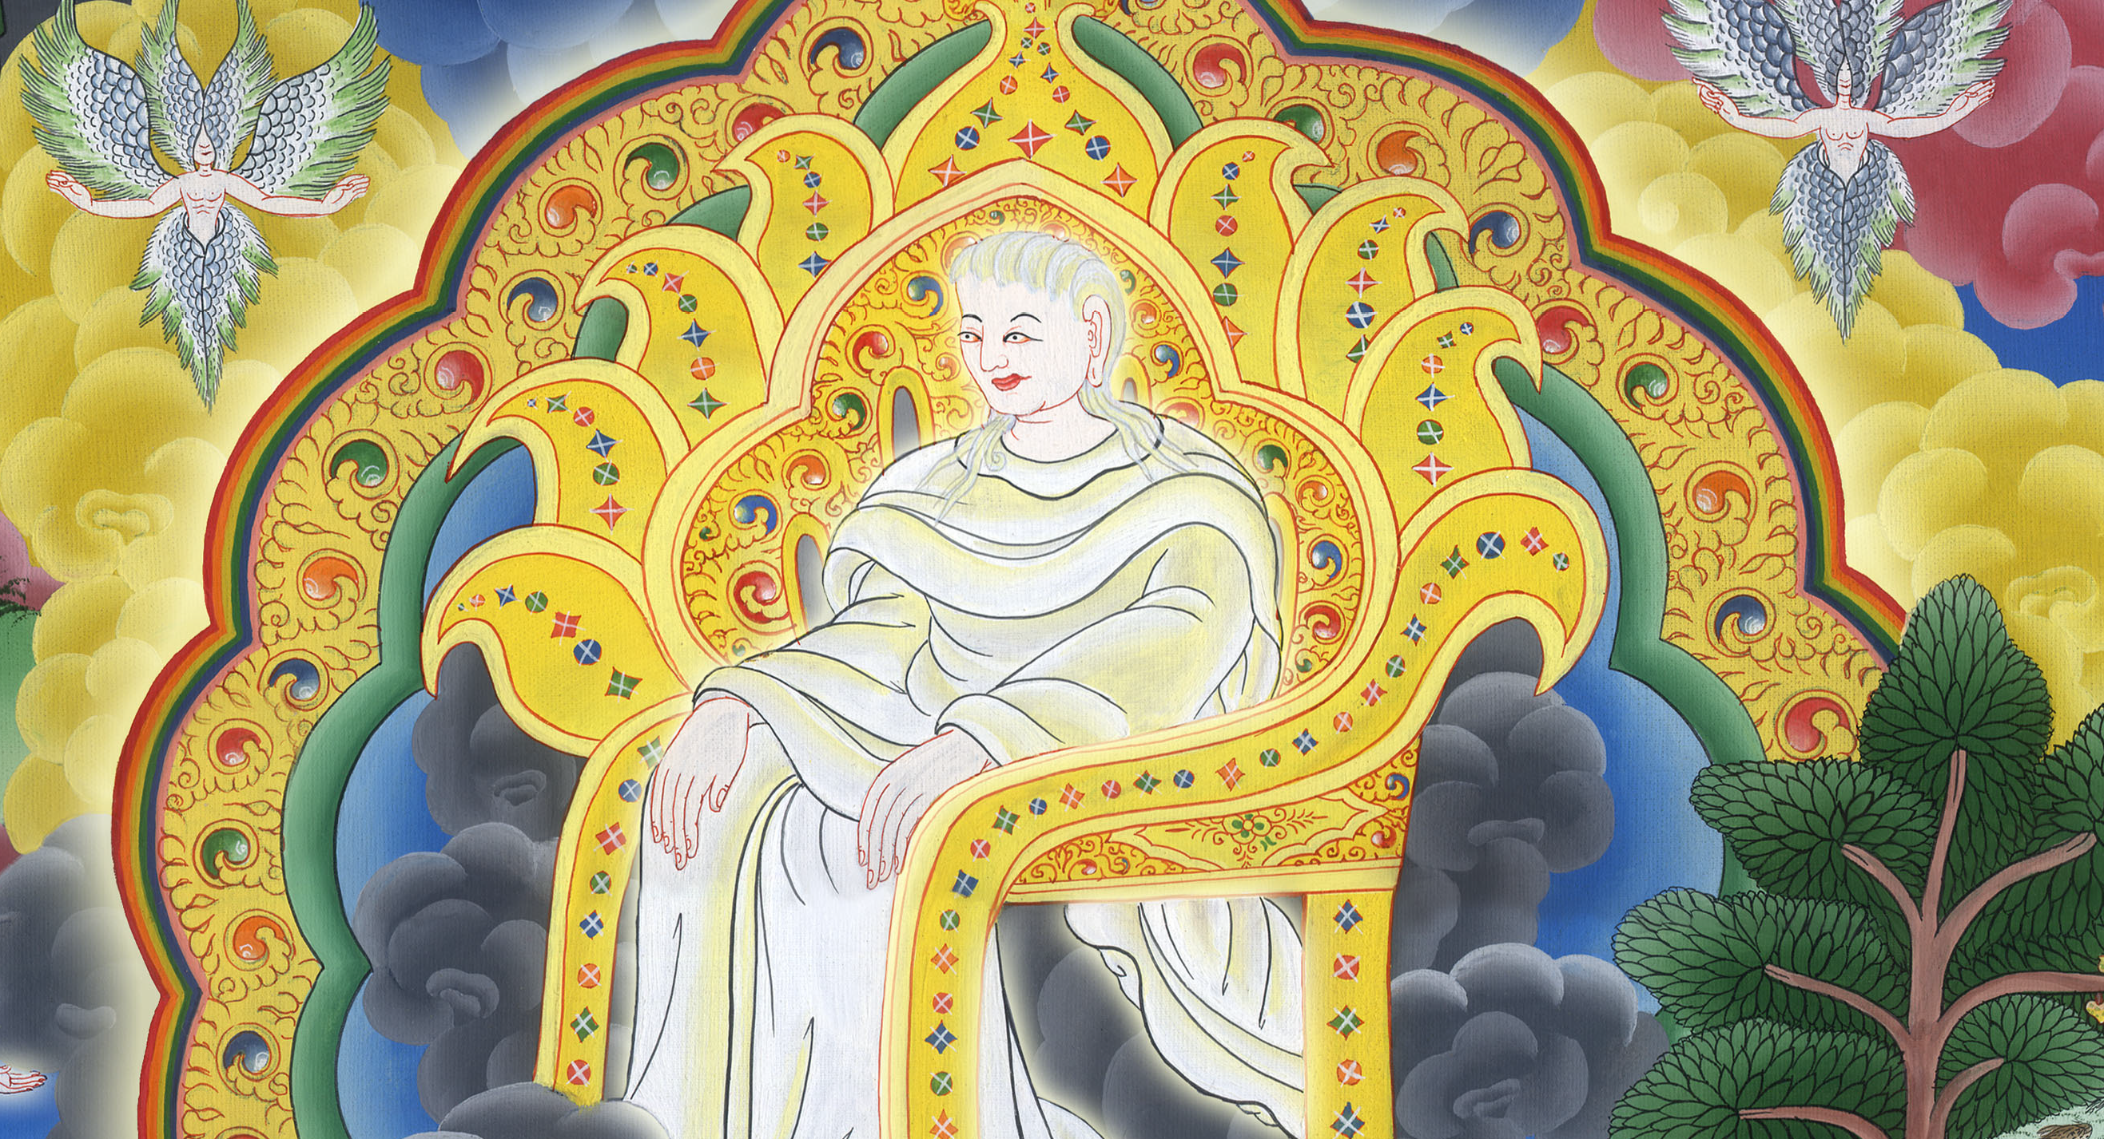
Isaiah 55:5

Slide 17
6Seek Yahweh while he may be found.
Call on him while he is near.

Slide 18
Isaiah 55:6

Slide 19
7Let the wicked forsake his way,
and the unrighteous man his thoughts.
Let him return to Yahweh, and he will have mercy on him,
to our God, for he will freely pardon.

Slide 20
Isaiah 55:7

Slide 21
8“For my thoughts are not your thoughts,
and your ways are not my ways,” says Yahweh.
9“For as the heavens are higher than the earth,
so are my ways higher than your ways,
and my thoughts than your thoughts.

Slide 22
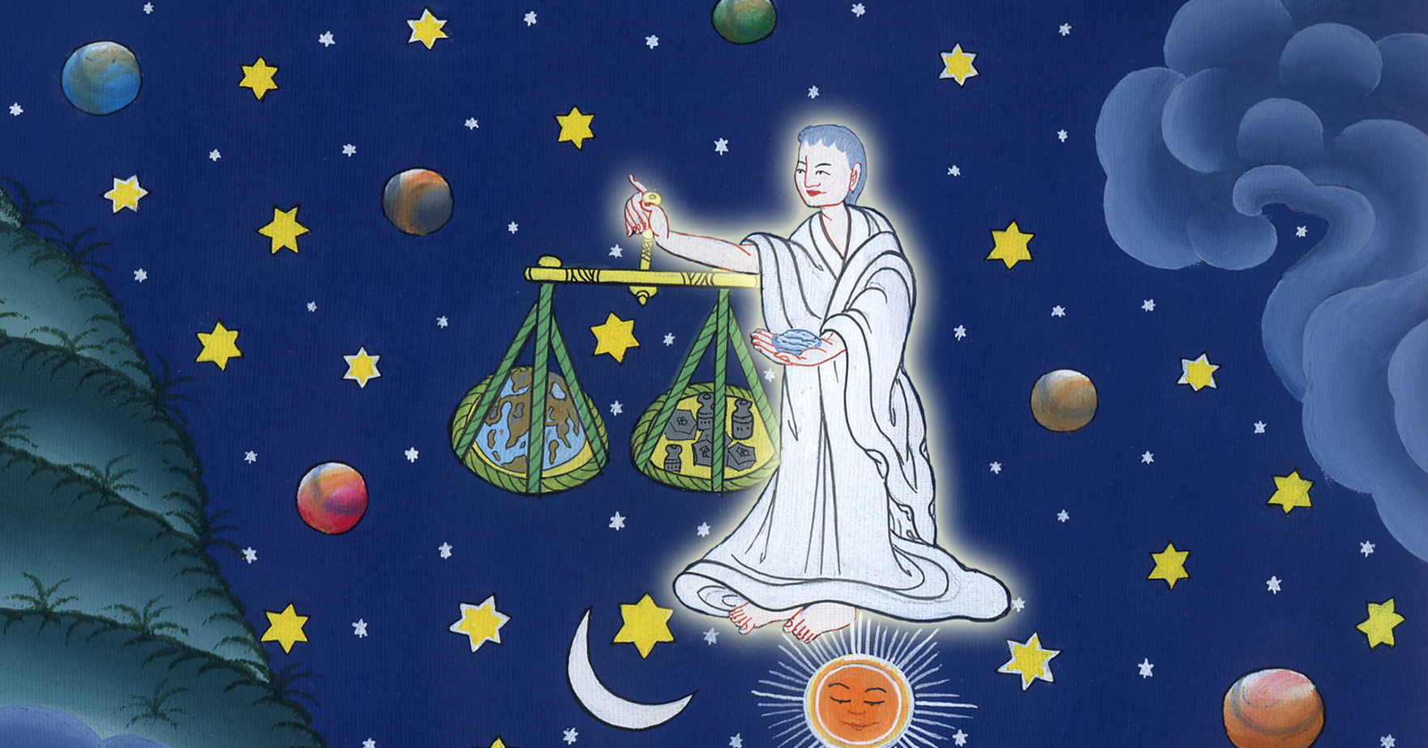
Isaiah 55:8,9

Slide 23
10For as the rain comes down and the snow from the sky,
and doesn’t return there, but waters the earth,
and makes it grow and bud,
and gives seed to the sower and bread to the eater;

Slide 24
Isaiah 55:10

Slide 25
11so is my word that goes out of my mouth:
it will not return to me void,
but it will accomplish that which I please,
and it will prosper in the thing I sent it to do.

Slide 26
Isaiah 55:11

Slide 27
12For you shall go out with joy,
and be led out with peace.
The mountains and the hills will break out before you into singing;
and all the trees of the fields will clap their hands.

Slide 28
12“My people, you will go out of Babylon with joy.
You will be led out of it in peace.
The mountains and hills
will burst into song as you go.
And all the trees in the fields
will clap their hands.
12ཁྱོད་ཚོ་བྷེ་བྷི་ལོན་ནས་དགའ་ཞིང་ཏོན། ཁྱོད་ཚོ་གྲོང་ཁྱེར་ནང་ནས་ཞི་བདེར་འཁྲིད།
རི་དང་རི་ཕྲན་རྣམས་ནི་གཞས་གཏོང་ངོ་། ཤིང་སྡོང་རྣམས་ནི་དགའ་སྤྲོའི་སྐད་འབོད་བྱེད།
Isaiah 55:12

