Slide 1
25-1
This work is licensed under a Creative Commons Attribution-Sharealike 4.0 International License.
Please add this statement to all the videos you create.
English Bible quotes are from the World English Bible US, which is in the public domain.
Notes:
Ch
25 Into Exile
1. Israel’s evil deeds -1 Kings 12:25- 13:5; 2 Kings 17:1-19 (Left Top)
2. Book of the law is found - 2 Kings 22-23:25 (Right Top)
3. Jehoiakim burns Jeremiah’s scroll - Jeremiah 36 (Right Bottom)
4. Jeremiah is thrown into the cistern - Jeremiah 38:1-13 (Left Bottom)
5. Destruction of Jerusalem/ Judah into exile - 2 Kings 24:8-16 , 25:8-21 Jeremiah
39:11-14 (Center)

Slide 2
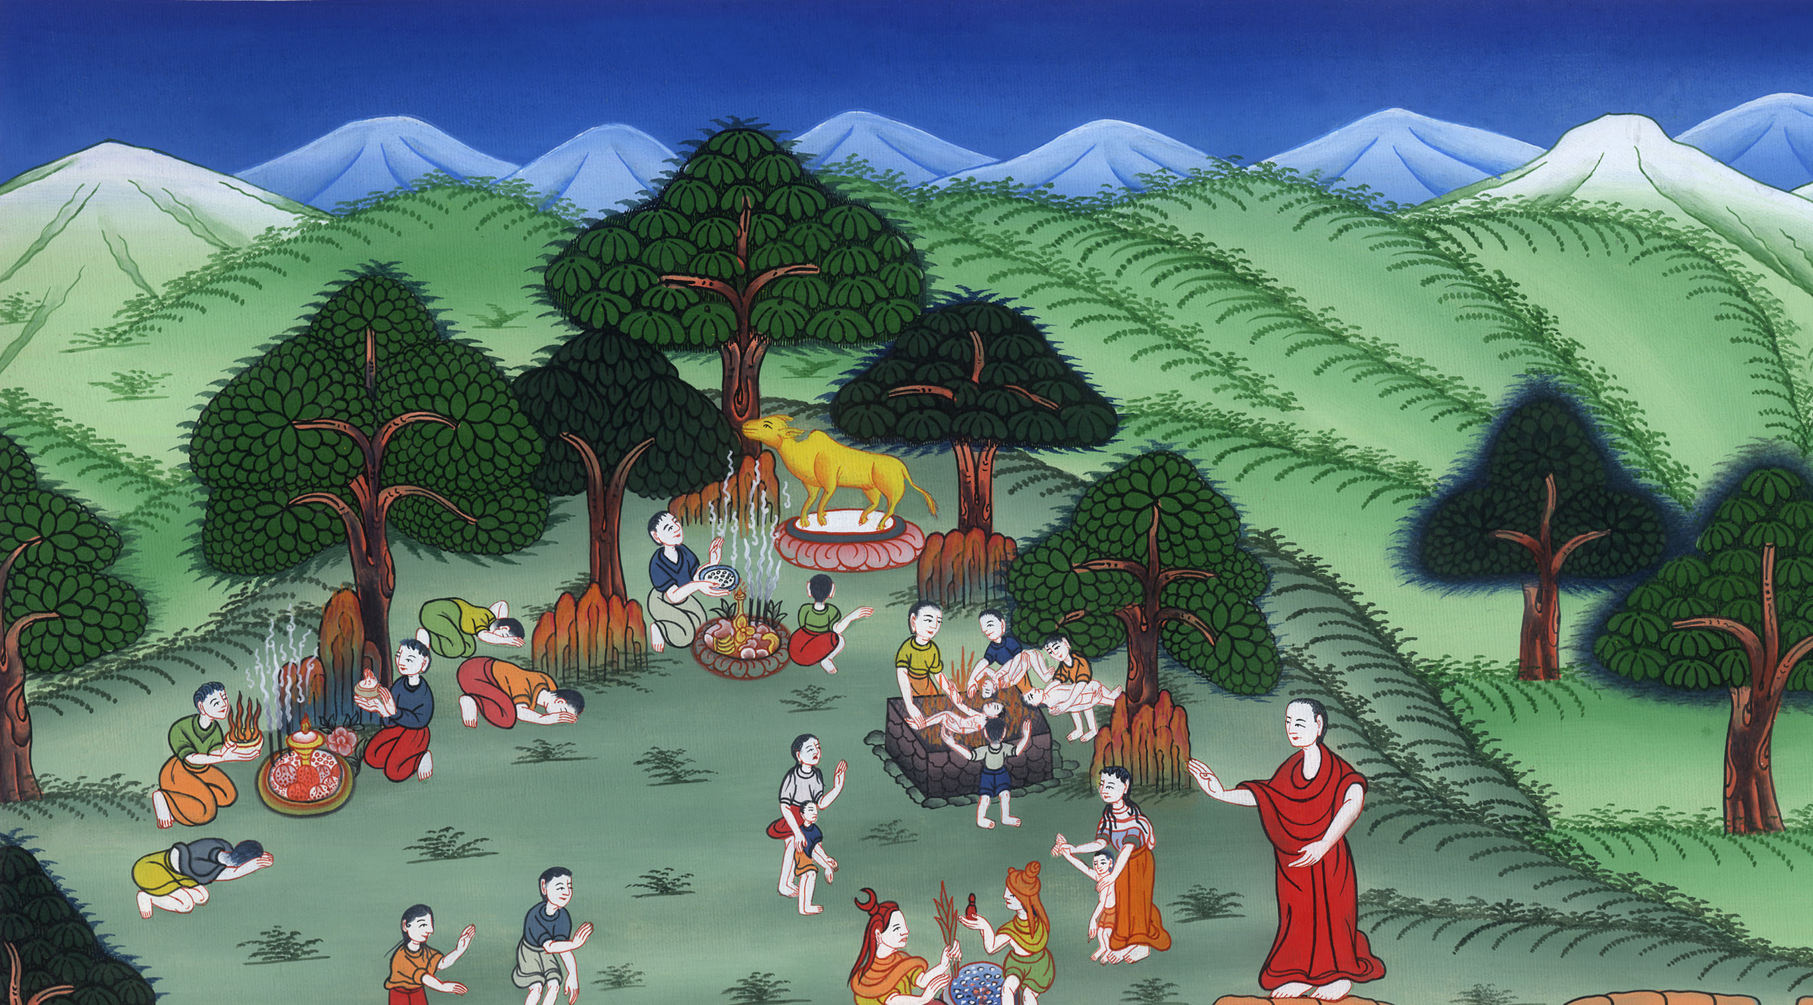
Israel’s evil deeds - 1 Kings 12:25-13:5; 2 Kings 17:1-19

Slide 3
25 Into Exile
1. Israel’s evil deeds - 1 Kings 12:25-13:5; 2 Kings 17:1-19 (Left Top)
John

Slide 4
Israel’s evil deeds - 1 Kings 12:25-13:5; 2 Kings 17:1-19

Slide 5
1 Kings 12:28So the king took counsel, and made two calves of gold; and he said to them, “It is too much for you to go up to Jerusalem. Look and behold your gods, Israel, which brought you up out of the land of Egypt!”
John

Slide 6
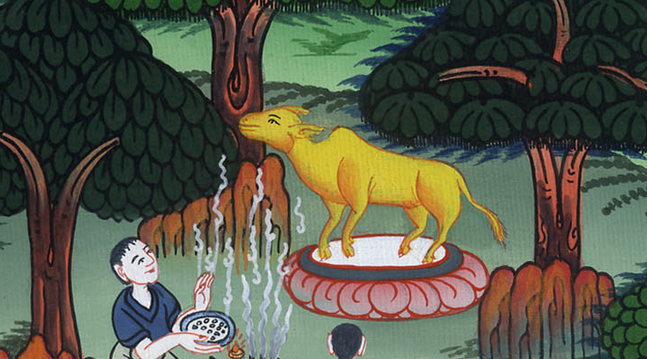
1 Kings 12:28

Slide 7
30This thing became a sin, for the people went even as far as Dan to worship before the one there.
John

Slide 8
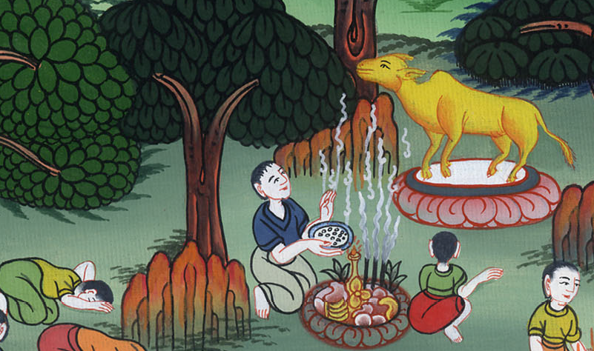
1 Kings 12:30

Slide 9
31He made houses of high places, and made priests from among all the people, who were not of the sons of Levi.
John

Slide 10
1 Kings 12:31

Slide 11
2 kings 17:15They rejected his statutes and his covenant that he made with their fathers, and his testimonies which he testified to them; and they followed vanity, and became vain, and followed the nations that were around them, concerning whom Yahweh had commanded them that they should not do like them.
John

Slide 12
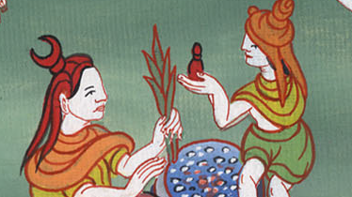
2 Kings 17:15

Slide 13
16They abandoned all the commandments of Yahweh their God, and made molten images for themselves, even two calves, and made an Asherah, and worshiped all the army of the sky, and served Baal.
John

Slide 14
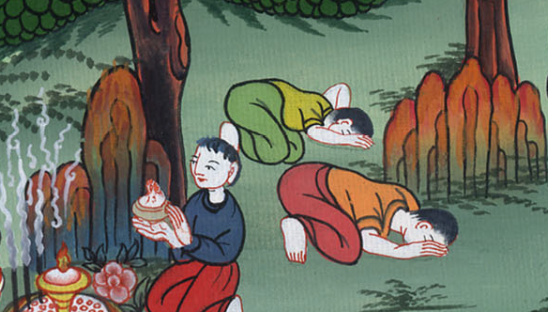
2 Kings 17:16

Slide 15
17They caused their sons and their daughters to pass through the fire, used divination and enchantments, and sold themselves to do that which was evil in Yahweh’s sight, to provoke him to anger.
John

Slide 16
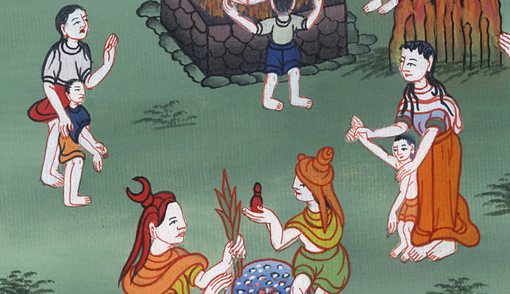
2 Kings 17:17

Slide 17
18Therefore Yahweh was very angry with Israel, and removed them out of his sight. There was none left but the tribe of Judah only.
John

Slide 18
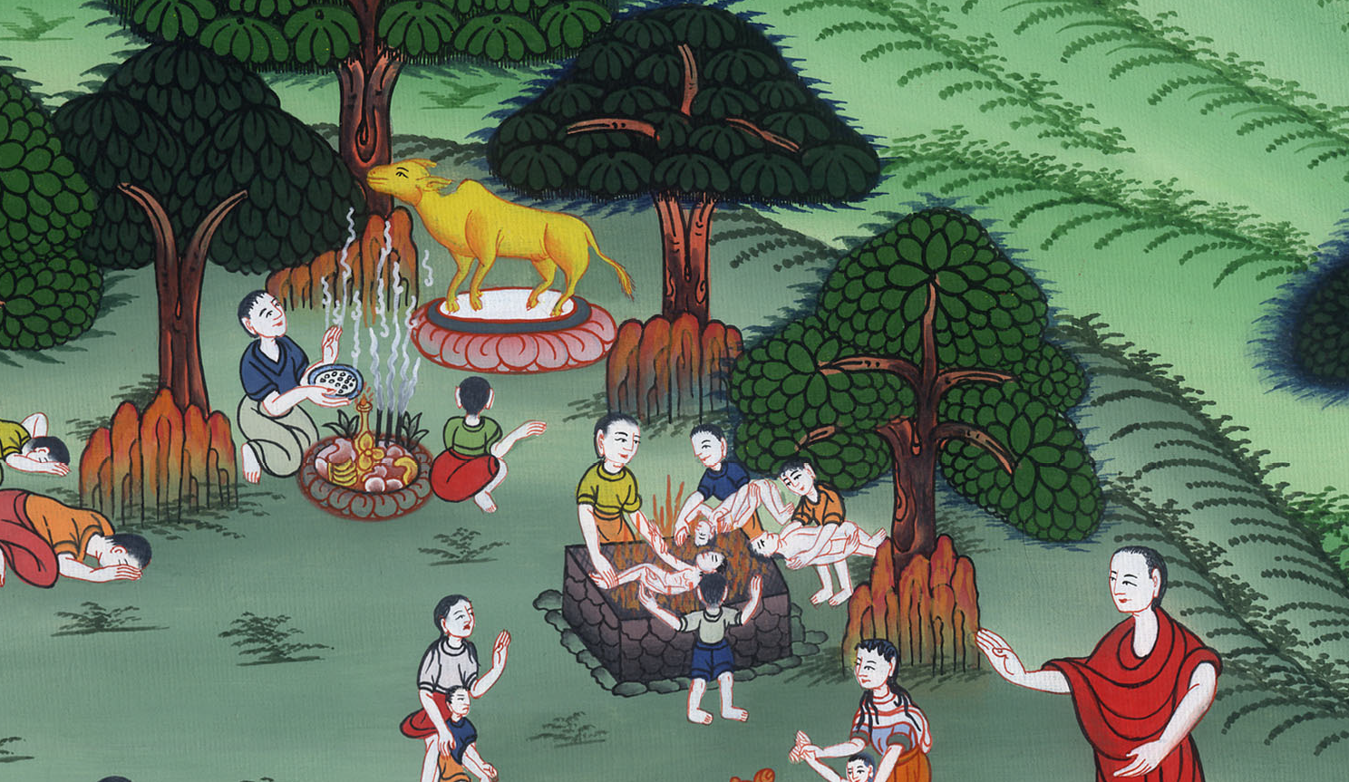
2 Kings 17:18

Slide 19
19Also Judah didn’t keep the commandments of Yahweh their God, but walked in the statutes of Israel which they made.
John

Slide 20
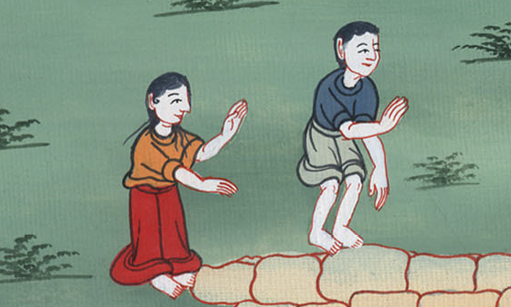
2 Kings 17:19

Slide 21
20Yahweh rejected all the offspring of Israel, afflicted them, and delivered them into the hands of raiders, until he had cast them out of his sight.
John

Slide 22
2 Kings 17:20

