Slide 1
25-2
This work is licensed under a Creative Commons Attribution-Sharealike 4.0 International License.
Please add this statement to all the videos you create.
English Bible quotes are from the World English Bible US, which is in the public domain.
Notes:
Ch
25 Into Exile
1. Israel’s evil deeds -1 Kings 12:25- 13:5; 2 Kings 17:1-19 (Left Top)
2. Book of the law is found - 2 Kings 22-23:25 (Right Top)
3. Jehoiakim burns Jeremiah’s scroll - Jeremiah 36 (Right Bottom)
4. Jeremiah is thrown into the cistern - Jeremiah 38:1-13 (Left Bottom)
5. Destruction of Jerusalem/ Judah into exile - 2 Kings 24:8-16 , 25:8-21 Jeremiah
39:11-14 (Center)

Slide 2
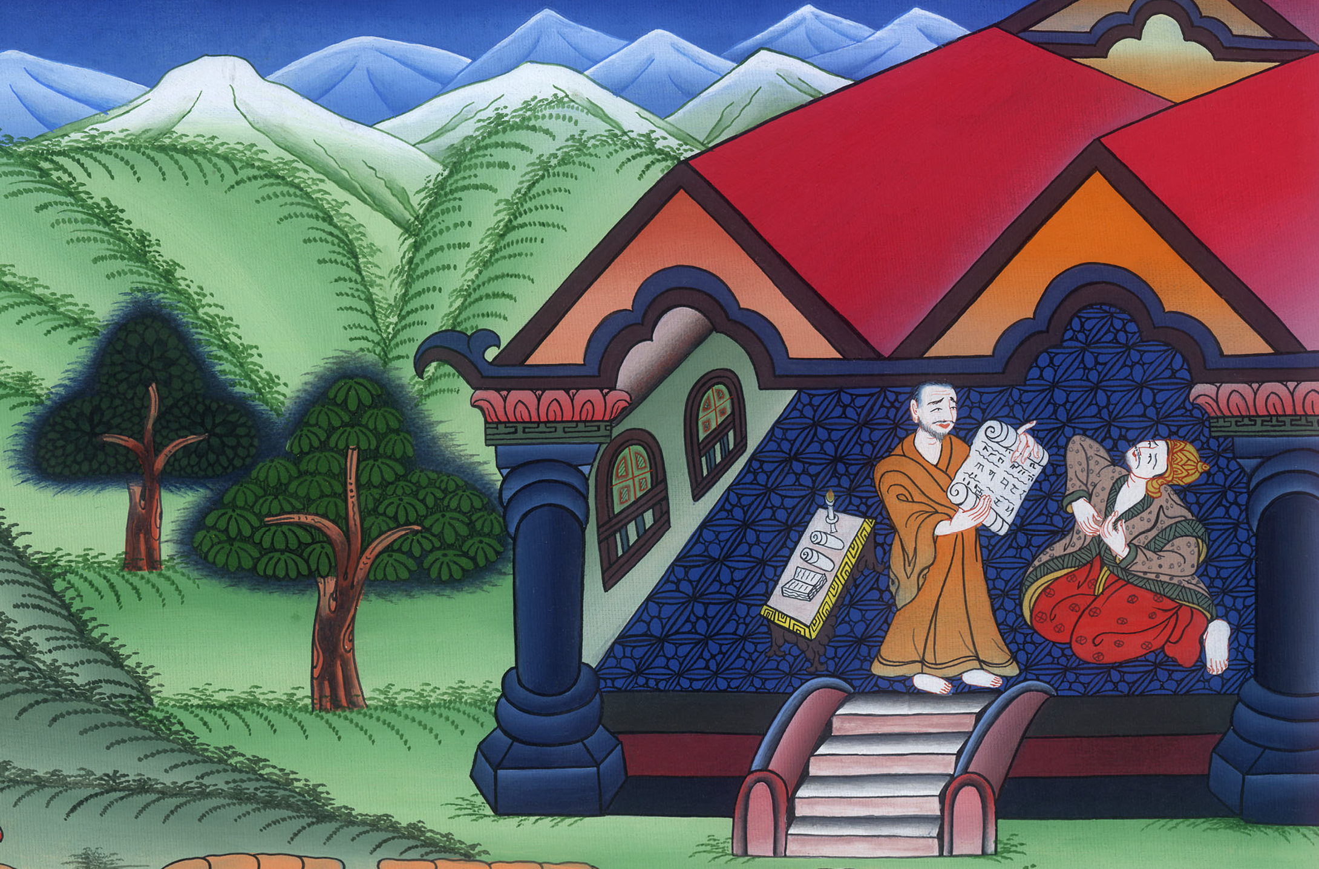
Book of the law is found –
2 Kings 22-23:25

Slide 3
2. Book of the law is found - 2 Kings 22-23:25 (Right Top)
John

Slide 4
Book of the law is found –
2 Kings 22-23:25

Slide 5
2Kings22:1Josiah was eight years old when he began to reign, and he reigned thirty-one years in Jerusalem.
John

Slide 6
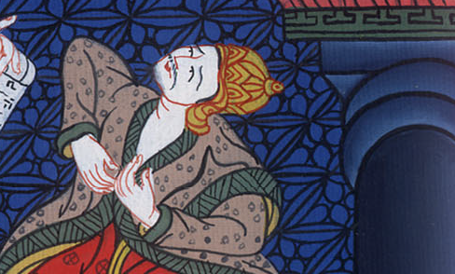
2 Kings 22:1

Slide 7
2He did that which was right in Yahweh’s eyes, and walked in all the ways of David his father, and didn’t turn away to the right hand or to the left.
John

Slide 8
2 Kings 22:2

Slide 9
3In the eighteenth year of King Josiah, the king sent Shaphan, the son of Azaliah the son of Meshullam, the scribe, to Yahweh’s house, saying,…. (Have them use the money that has been collected to repair the temple)
John

Slide 10
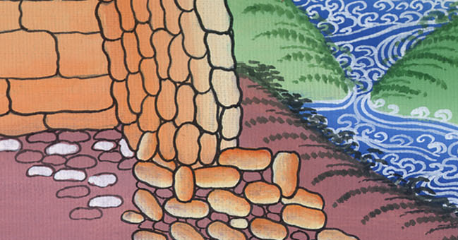
2 Kings 22:3

Slide 11
8Hilkiah the high priest said to Shaphan the scribe, “I have found the book of the law in Yahweh’s house.” Hilkiah delivered the book to Shaphan, and he read it.
John

Slide 12
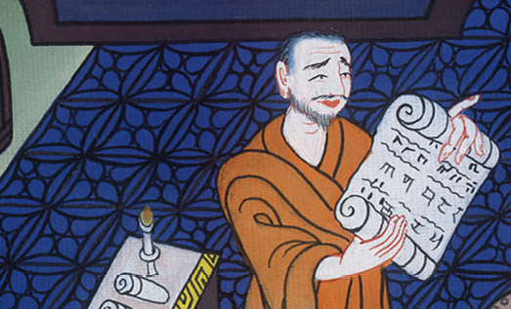
2 Kings 22:8

Slide 13
9Then Shaphan went to King Josiah. Shaphan told him, “Your officials have paid out the money that was in the Lord’s temple. They’ve put it in the care of the workers and directors there.”
John

Slide 14
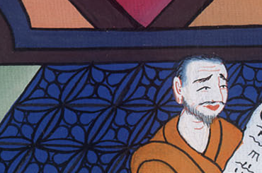
2 Kings ། 22:9

Slide 15
10Shaphan the scribe told the king, saying, “Hilkiah the priest has delivered a book to me.” Then Shaphan read it before the king.
11When the king had heard the words of the book of the law, he tore his clothes.
John

Slide 16
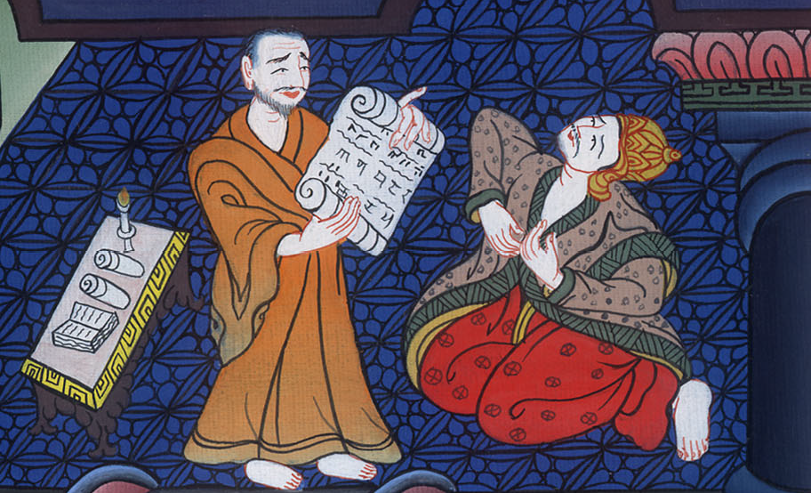
2 Kings 22:10

Slide 17
23: 2The king went up to Yahweh’s house, and all the men of Judah and all the inhabitants of Jerusalem with him—with the priests, the prophets, and all the people, both small and great; and he read in their hearing all the words of the book of the covenant which was found in Yahweh’s house.
John

Slide 18
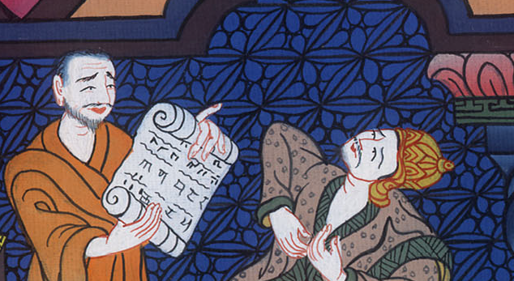
2 Kings 23:2

Slide 19
3The king stood by the pillar and made a covenant before Yahweh to walk after Yahweh and to keep his commandments, his testimonies, and his statutes with all his heart and all his soul, to confirm the words of this covenant that were written in this book; and all the people agreed to the covenant.
John

Slide 20
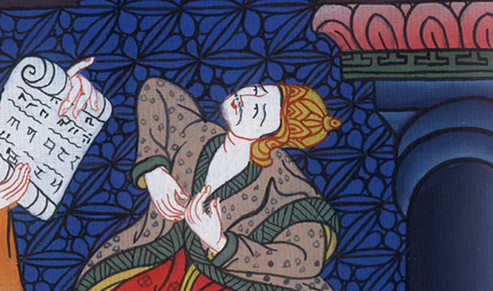
2 Kings ། 23:3

Slide 21
4The king commanded Hilkiah the high priest, and the priests of the second order, and the keepers of the threshold, to bring out of Yahweh’s temple all the vessels that were made for Baal, for the Asherah, and for all the army of the sky; and he burned them outside of Jerusalem in the fields of the Kidron, and carried their ashes to Bethel.
John

Slide 22
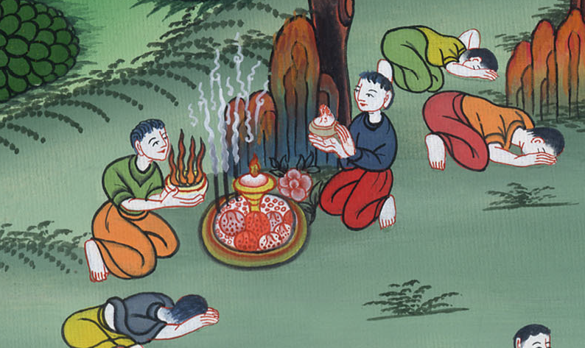
2 Kings 23:4

Slide 23
12The king broke down the altars… which the kings of Judah had made…
John

Slide 24
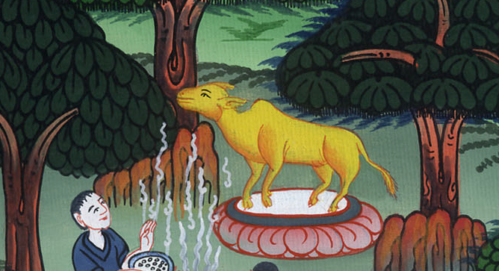
2 Kings 23:12

Slide 25
21The king commanded all the people, saying, “Keep the Passover to Yahweh your God, as it is written in this book of the covenant.”
John

Slide 26
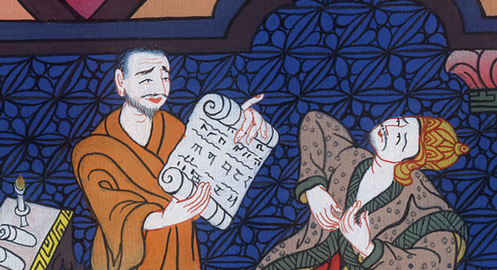
2 Kings 23:21

Slide 27
22Surely there was not kept such a Passover from the days of the judges who judged Israel, nor in all the days of the kings of Israel, nor of the kings of Judah;
John

Slide 28
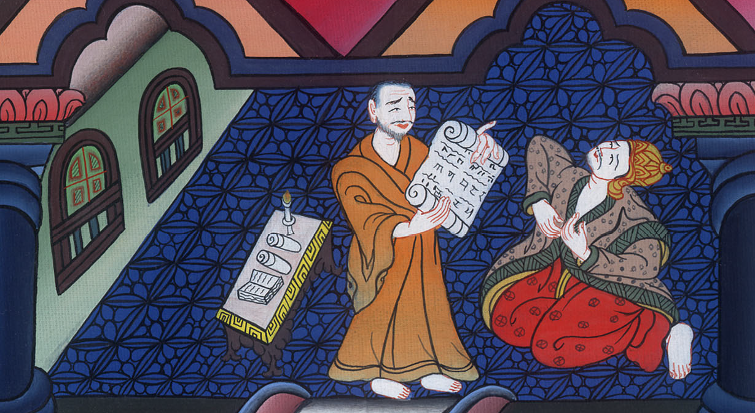
2 Kings 23:22

Slide 29
25There was no king like him before him, who turned to Yahweh with all his heart, and with all his soul, and with all his might, according to all the law of Moses; and there was none like him who arose after him.
John

Slide 30
2 Kings 23:25

