Slide 1
25-3
This work is licensed under a Creative Commons Attribution-Sharealike 4.0 International License.
Please add this statement to all the videos you create.
English Bible quotes are from the World English Bible US, which is in the public domain.
Notes:
CH
25 Into Exile
1. Israel’s evil deeds -1 Kings 12:25- 13:5; 2 Kings 17:1-19 (Left Top)
2. Book of the law is found - 2 Kings 22-23:25 (Right Top)
3. Jehoiakim burns Jeremiah’s scroll - Jeremiah 36 (Right Bottom)
4. Jeremiah is thrown into the cistern - Jeremiah 38:1-13 (Left Bottom)
5. Destruction of Jerusalem/ Judah into exile - 2 Kings 24:8-16 , 25:8-21 Jeremiah
39:11-14 (Center)

Slide 2
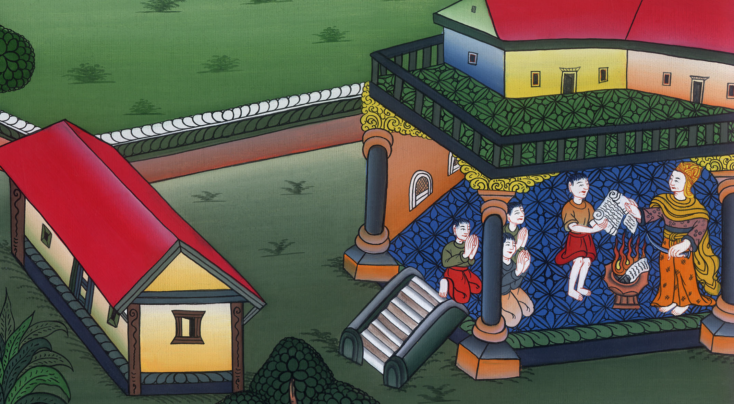
Jehoiakim burns Jeremiah’s scroll - Jeremiah 36

Slide 3
3. Jehoiakim burns Jeremiah’s scroll - Jeremiah 36 (Right Bottom)
John

Slide 4
Jehoiakim burns Jeremiah’s scroll - Jeremiah 36

Slide 5
Jeremiah36:1In the fourth year of Jehoiakim the son of Josiah, king of Judah, this word came to Jeremiah from Yahweh, saying,
John

Slide 6
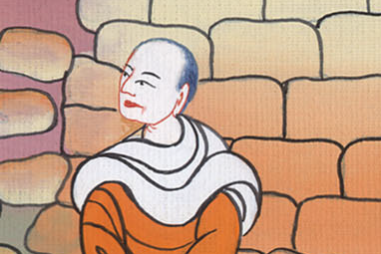
Jeremiah 36:1

Slide 7
2“Take a scroll of a book, and write in it all the words that I have spoken to you against Israel, against Judah, and against all the nations, from the day I spoke to you, from the days of Josiah even to this day.
John

Slide 8
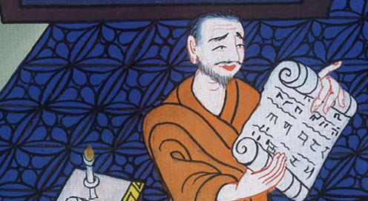
Jeremiah 36:2

Slide 9
3It may be that the house of Judah will hear all the evil which I intend to do to them, that they may each return from his evil way; that I may forgive their iniquity and their sin.”
John

Slide 10
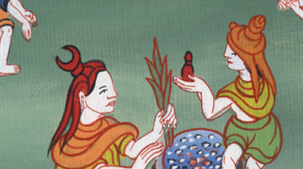
Jeremiah 36:3

Slide 11
4Then Jeremiah called Baruch the son of Neriah; and Baruch wrote from the mouth of Jeremiah all Yahweh’s words, which he had spoken to him, on a scroll of a book.
John

Slide 12
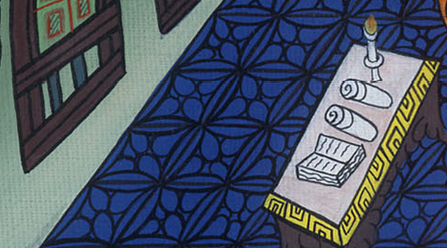
Jeremiah 36:4

Slide 13
5Jeremiah commanded Baruch, saying, “I am restricted. I can’t go into Yahweh’s house. 6Therefore you go, and read from the scroll which you have written from my mouth, Yahweh’s words, in the ears of the people in Yahweh’s house on the fast day.
John

Slide 14
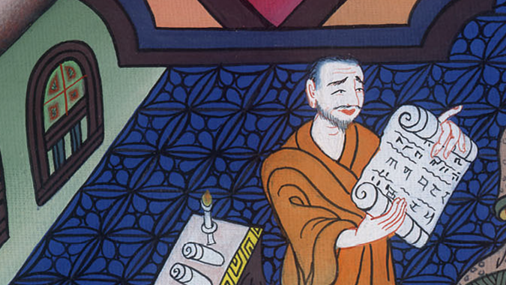
Jeremiah 36:5

Slide 15
Also you shall read them in the ears of all Judah who come out of their cities.
John

Slide 16
Jeremiah 36:6

Slide 17
7It may be they will present their supplication before Yahweh, and will each return from his evil way; for Yahweh has pronounced great anger and wrath against this people.”
John

Slide 18
Jeremiah 36:7

Slide 19
8Baruch the son of Neriah did according to all that Jeremiah the prophet commanded him, reading in the book Yahweh’s words in Yahweh’s house.
John

Slide 20
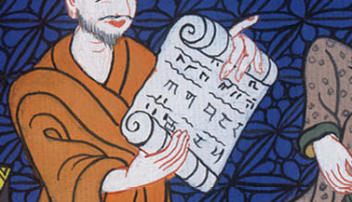
Jeremiah 36:7

Slide 21
21So the king sent Jehudi to get the scroll… Jehudi read it in the hearing of the king, and in the hearing of all the princes who stood beside the king.
John

Slide 22
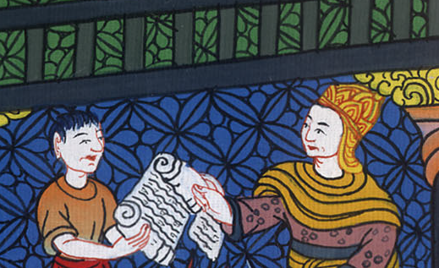
Jeremiah ། 36:21

Slide 23
22Now the king was sitting in the winter house in the ninth month, and there was a fire in the brazier burning before him.
John

Slide 24
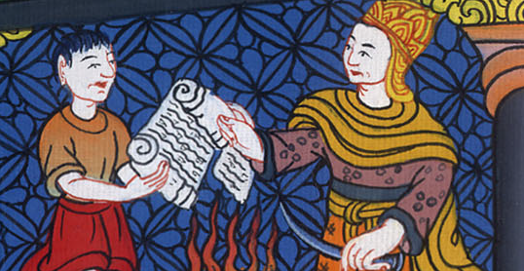
Jeremiah 36:22

Slide 25
23When Jehudi had read three or four columns, the king cut it with the penknife, and cast it into the fire that was in the brazier, until all the scroll was consumed in the fire that was in the brazier.
John

Slide 26
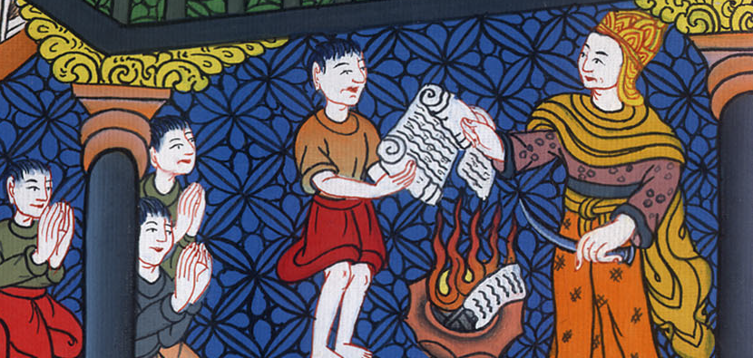
Jeremiah 36:23

Slide 27
24The king and his servants who heard all these words were not afraid, and didn’t tear their garments. 25Moreover Elnathan and Delaiah and Gemariah had made intercession to the king that he would not burn the scroll; but he would not listen to them.
John

Slide 28
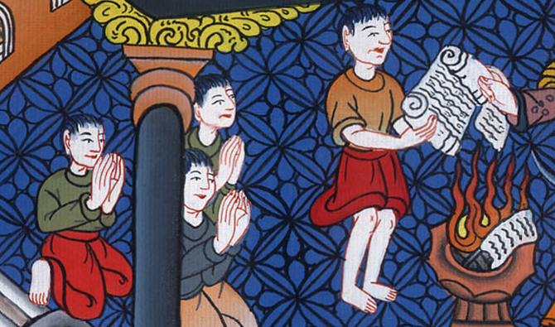
Jeremiah 36:24

Slide 29
26The king commanded Jerahmeel the king’s son, and Seraiah the son of Azriel, and Shelemiah the son of Abdeel, to arrest Baruch the scribe and Jeremiah the prophet; but Yahweh hid them.
John

Slide 30
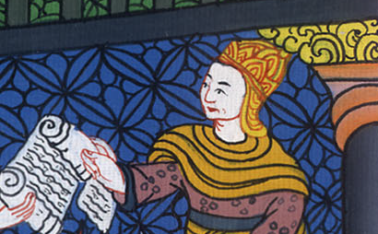
Jeremiah 36:26

Slide 31
27Then Yahweh’s word came to Jeremiah, after the king had burned the scroll, and the words which Baruch wrote at the mouth of Jeremiah, saying,
John

Slide 32
Jeremiah 36:27

Slide 33
28“Take again another scroll, and write in it all the former words that were in the first scroll, which Jehoiakim the king of Judah has burned.
John

Slide 34
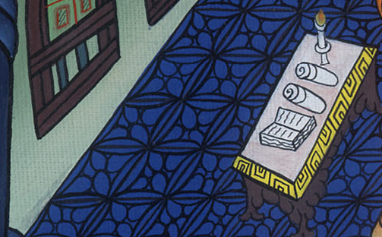
Jeremiah 36:28

Slide 35
29Concerning Jehoiakim king of Judah you shall say, ‘Yahweh says: “You have burned this scroll, saying, “Why have you written therein, saying, ‘The king of Babylon will certainly come and destroy this land, and will cause to cease from there man and animal?’”’
John

Slide 36
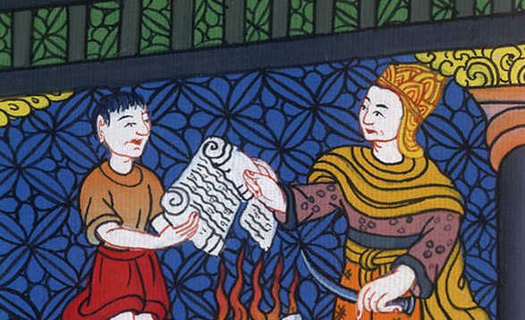
Jeremiah 36:29

Slide 37
30Therefore Yahweh says concerning Jehoiakim king of Judah: “He will have no one to sit on David’s throne. His dead body will be cast out in the day to the heat, and in the night to the frost.
John

Slide 38
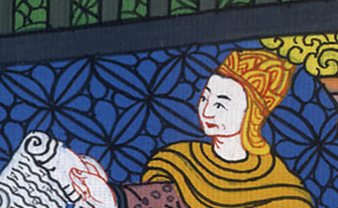
Jeremiah 36:30

Slide 39
31I will punish him, his offspring, and his servants for their iniquity. I will bring on them, on the inhabitants of Jerusalem, and on the men of Judah, all the evil that I have pronounced against them, but they didn’t listen.”’”
John

Slide 40
Jeremiah 36:31

