Slide 1
25-4
This work is licensed under a Creative Commons Attribution-Sharealike 4.0 International License.
Please add this statement to all the videos you create.
English Bible quotes are from the World English Bible US, which is in the public domain.
Notes:
Ch
25 Into Exile
1. Israel’s evil deeds -1 Kings 12:25- 13:5; 2 Kings 17:1-19 (Left Top)
2. Book of the law is found - 2 Kings 22-23:25 (Right Top)
3. Jehoiakim burns Jeremiah’s scroll - Jeremiah 36 (Right Bottom)
4. Jeremiah is thrown into the cistern - Jeremiah 38:1-13 (Left Bottom)
5. Destruction of Jerusalem/ Judah into exile - 2 Kings 24:8-16 , 25:8-21 Jeremiah
39:11-14 (Center)

Slide 2
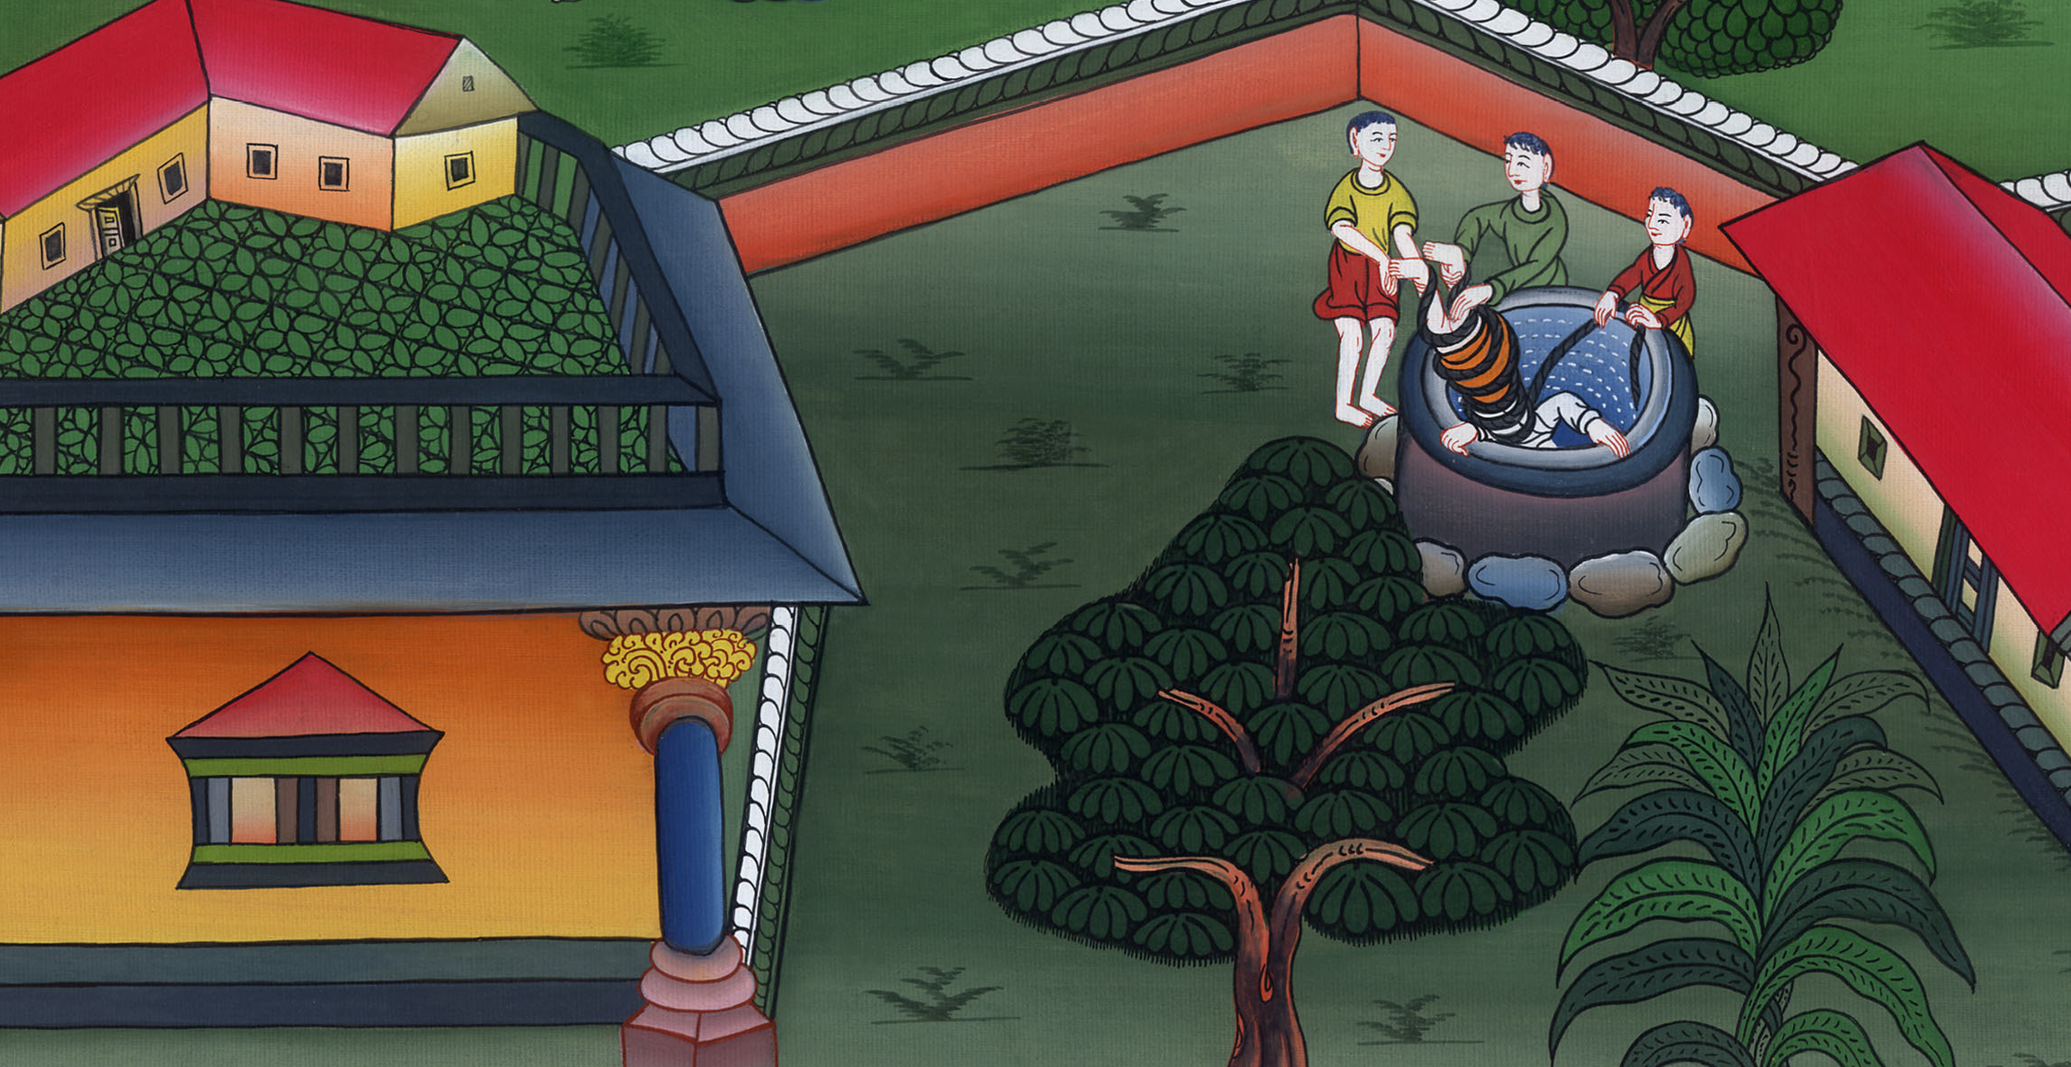
Jeremiah is thrown into the well - Jeremiah 38:1-13

Slide 3
4. Jeremiah is thrown into the well - Jeremiah 38:1-13 (Left Bottom)
John

Slide 4
Jeremiah is thrown into the well - Jeremiah 38:1-13

Slide 5
At the time that Zeddekia was king, the word of the Lord came to the Prophet Jeremiah.
John

Slide 7
Four of king Zeddekia’s officials heard Jeremiah say, 2“Yahweh says, ‘He who remains in this city will die by the sword, by the famine, and by the pestilence, but he who goes out to the Chaldeans will live. He will escape with his life and he will live.’
John

Slide 8
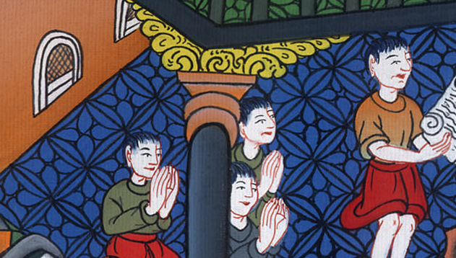
Jeremiah 38:1,2

Slide 9
3Yahweh says, ‘This city will surely be given into the hand of the army of the king of Babylon, and he will take it.’”
John

Slide 10
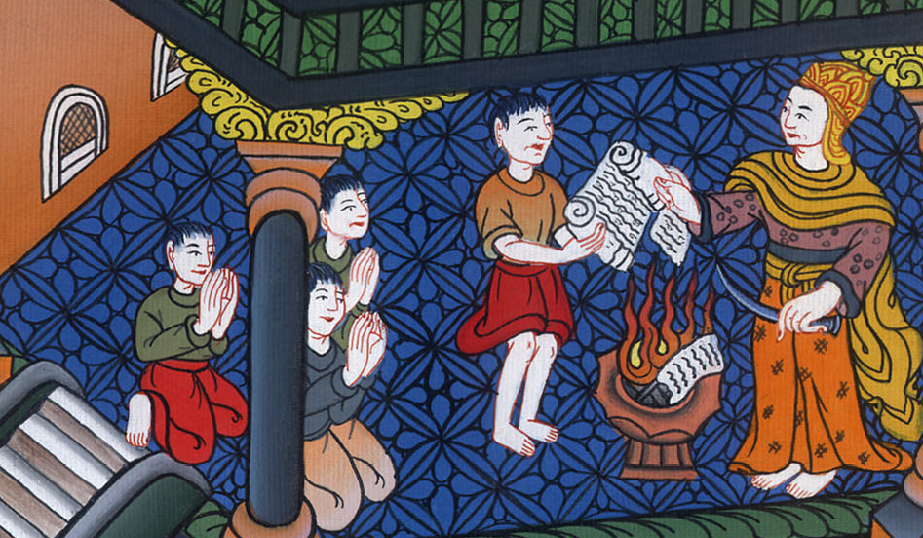
Jeremiah 38:3

Slide 11
4Then the princes said to the king, “Please let this man be put to death, because he weakens the hands of the men of war who remain in this city, and the hands of all the people, in speaking such words to them; for this man doesn’t seek the welfare of this people, but harm.”
John

Slide 12
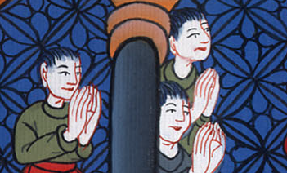
Jeremiah 38:4

Slide 13
5Zedekiah the king said, “Behold, he is in your hand; for the king can’t do anything to oppose you.”
John

Slide 14
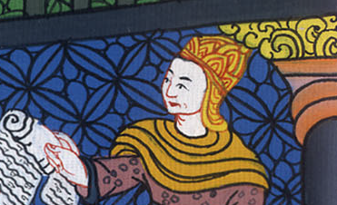
Jeremiah 38:5

Slide 15
6Then they took Jeremiah and threw him into the dungeon of Malchijah the king’s son, that was in the court of the guard. They let down Jeremiah with cords. In the dungeon there was no water, but mire; and Jeremiah sank in the mire.
John

Slide 16
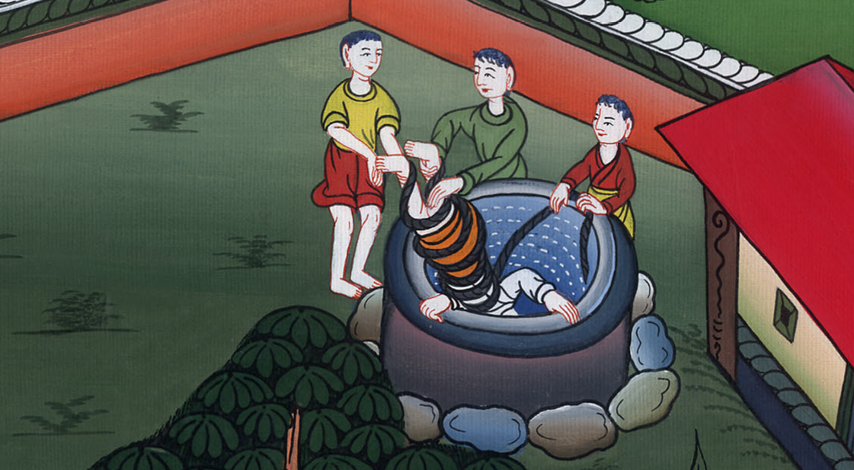
Jeremiah 38:6

Slide 17
7Now when Ebedmelech the Ethiopian, a eunuch, who was in the king’s house, heard that they had put Jeremiah in the dungeon (the king was then sitting in Benjamin’s gate),
John

Slide 18
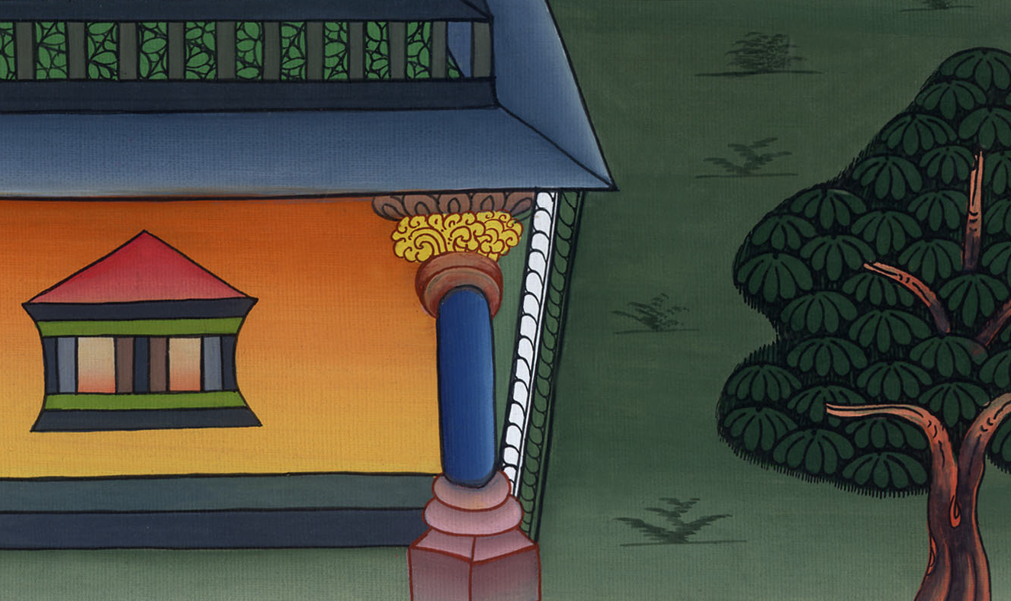
Jeremiah 38:7

Slide 19
8Ebedmelech went out of the king’s house, and spoke to the king, saying, 9“My lord the king, these men have done evil in all that they have done to Jeremiah the prophet, whom they have cast into the dungeon. He is likely to die in the place where he is, because of the famine; for there is no more bread in the city.”
John

Slide 20
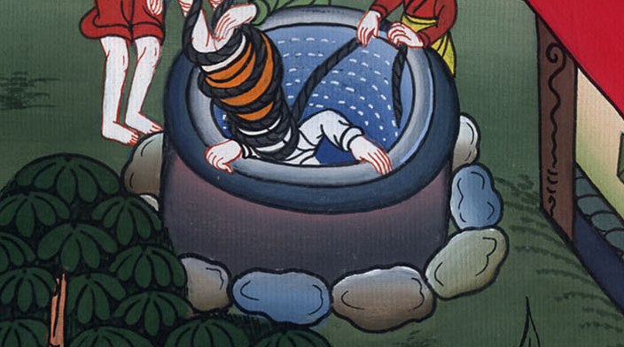
Jeremiah 38:8,9

Slide 21
10Then the king commanded Ebedmelech the Ethiopian, saying, “Take from here thirty men with you, and take up Jeremiah the prophet out of the dungeon, before he dies.”
John

Slide 22
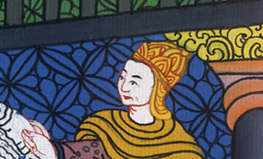
Jeremiah 38:10

Slide 23
13So they lifted Jeremiah up with the cords, and took him up out of the dungeon; and Jeremiah remained in the court of the guard.
John

Slide 24
Jeremiah 38:13

