Slide 1
25-5
This work is licensed under a Creative Commons Attribution-Sharealike 4.0 International License.
Please add this statement to all the videos you create.
English Bible quotes are from the World English Bible US, which is in the public domain.
Notes:
Ch
25 Into Exile
1. Israel’s evil deeds -1 Kings 12:25- 13:5; 2 Kings 17:1-19 (Left Top)
2. Book of the law is found - 2 Kings 22-23:25 (Right Top)
3. Jehoiakim burns Jeremiah’s scroll - Jeremiah 36 (Right Bottom)
4. Jeremiah is thrown into the cistern - Jeremiah 38:1-13 (Left Bottom)
5. Destruction of Jerusalem/ Judah into exile - 2 Kings 24:8-16 , 25:8-21 Jeremiah
39:11-14 (Center)

Slide 2
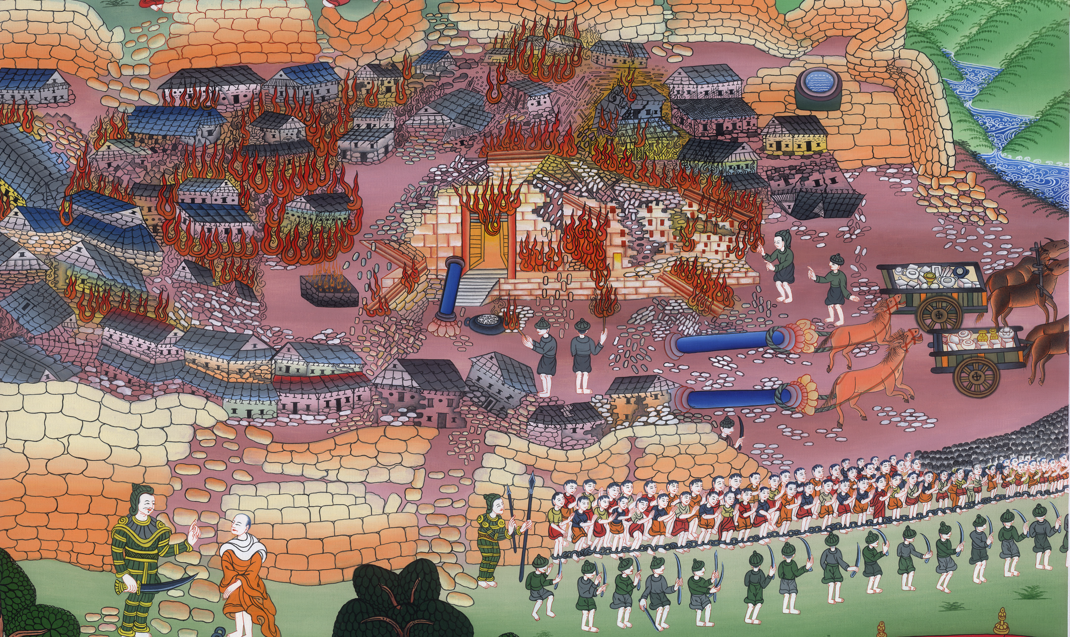
Destruction of Jerusalem/ Judah into exile –
2 Kings 24:8-16 , 25:8-21 Jeremiah 39:11-14

Slide 3
5. Destruction of Jerusalem/ Judah into exile - 2 Kings 24:8-16 , 25:8-21 Jeremiah
39:11-14 (Center)
John
ཡེར་མི་ཡཱ `

Slide 4
Destruction of Jerusalem/ Judah into exile –
2 Kings 24:8-16 , 25:8-21 Jeremiah 39:11-14

Slide 5
2 Kings:10At that time the servants of Nebuchadnezzar king of Babylon came up to Jerusalem, and the city was besieged. 11Nebuchadnezzar king of Babylon came to the city while his servants were besieging it,
John

Slide 6
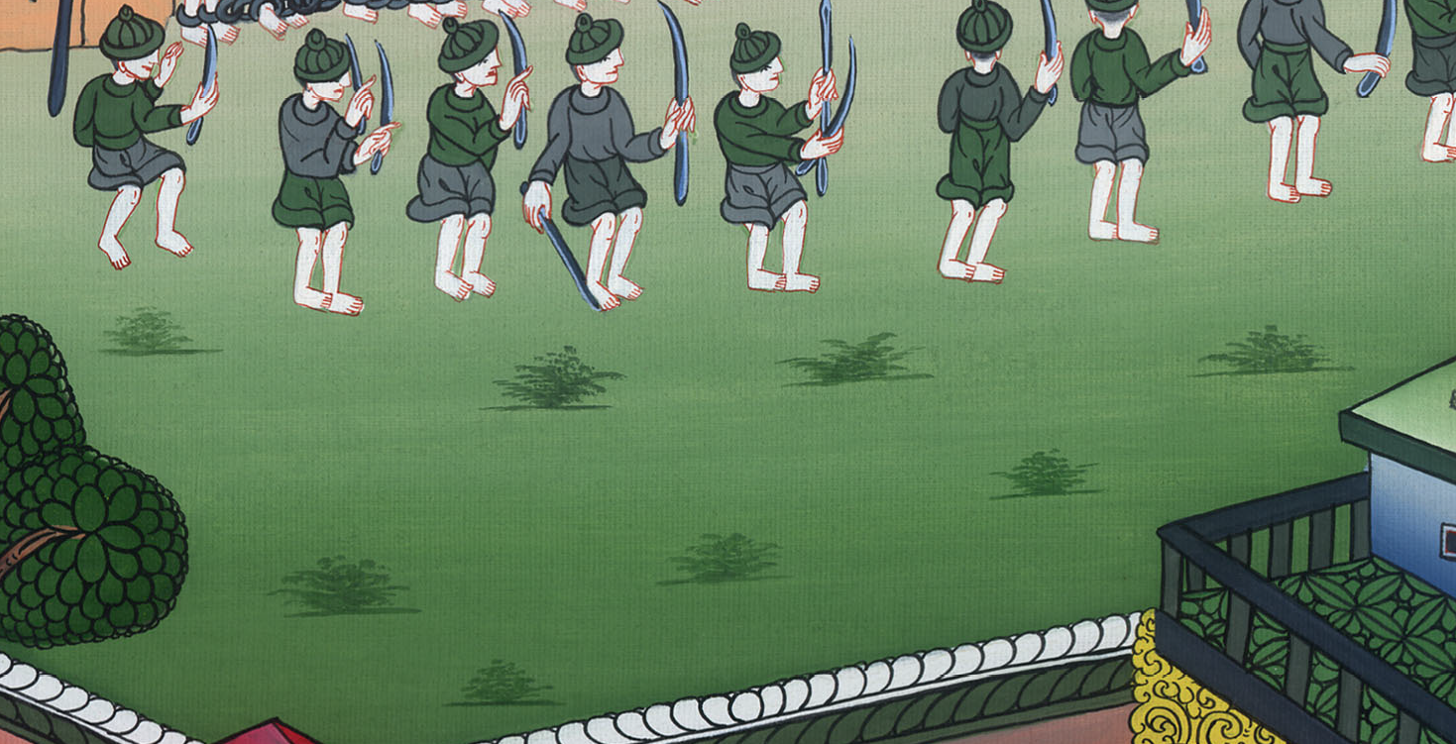
2 Kings 24:10,11

Slide 7
13He (Nebuchadnezzar) carried out from there all the treasures of Yahweh’s house and the treasures of the king’s house, and cut in pieces all the vessels of gold which Solomon king of Israel had made in Yahweh’s temple, as Yahweh had said.
John

Slide 8
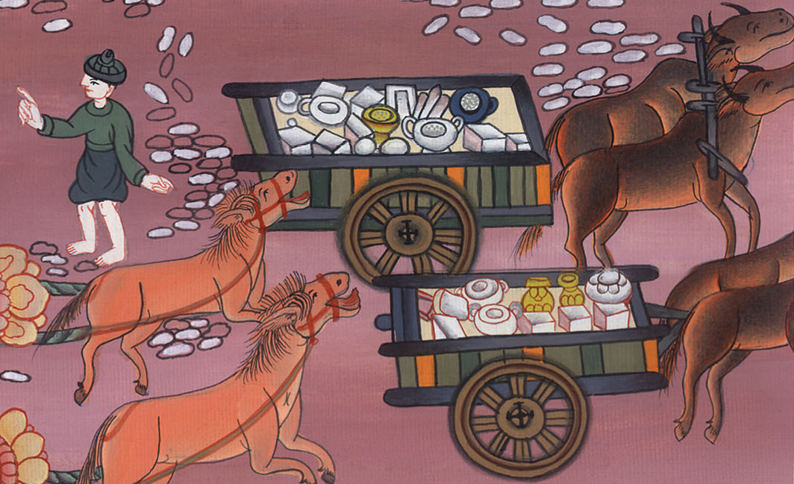
2 Kings 24:13

Slide 9
14He carried away all Jerusalem, and all the princes, and all the mighty men of valor, even ten thousand captives, and all the craftsmen and the smiths. No one remained except the poorest people of the land.
John

Slide 10
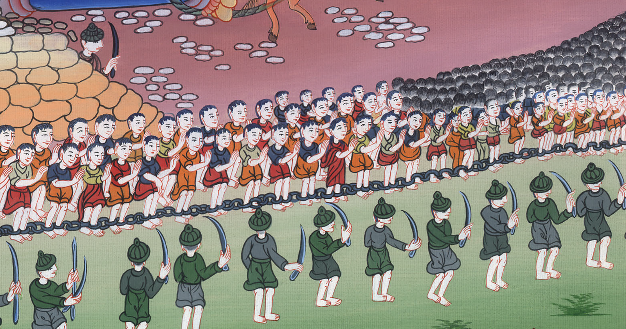
2 Kings 24:14

Slide 11
25:9He (Nebuzaradan, commander of the royal guard) burned Yahweh’s house, the king’s house, and all the houses of Jerusalem. He burned every great house with fire.
John

Slide 12
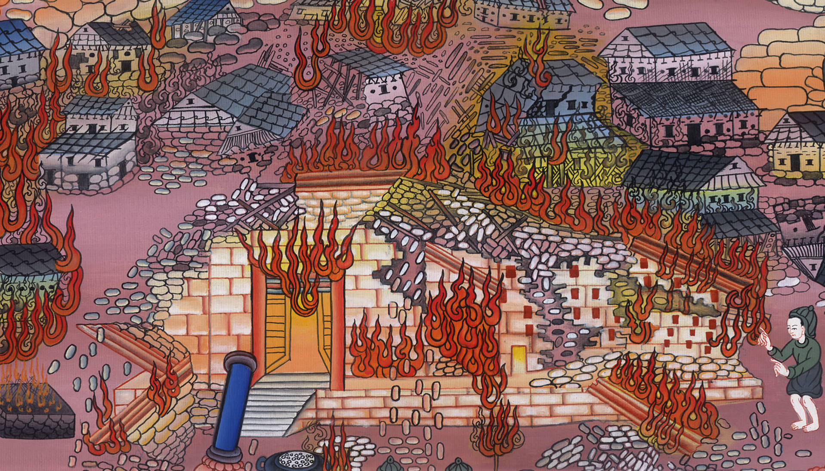
2 Kings 25:9

Slide 13
10All the army of the Chaldeans, who were with the captain of the guard, broke down the walls around Jerusalem.
John

Slide 14
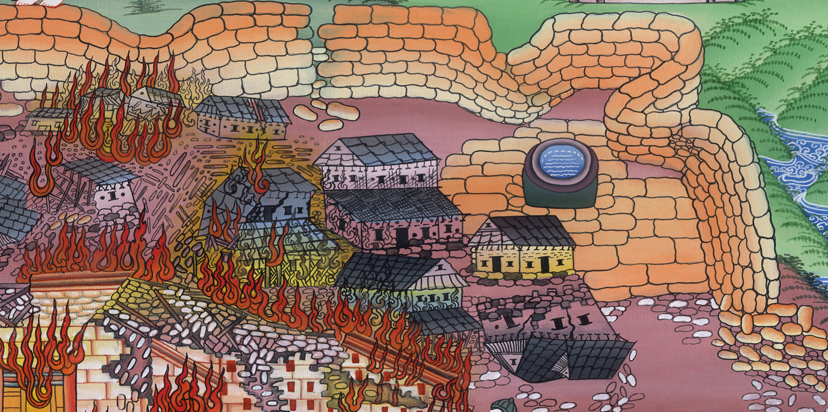
2 Kings 25:10

Slide 15
21…
So Judah was carried away captive out of his land.
John

Slide 16
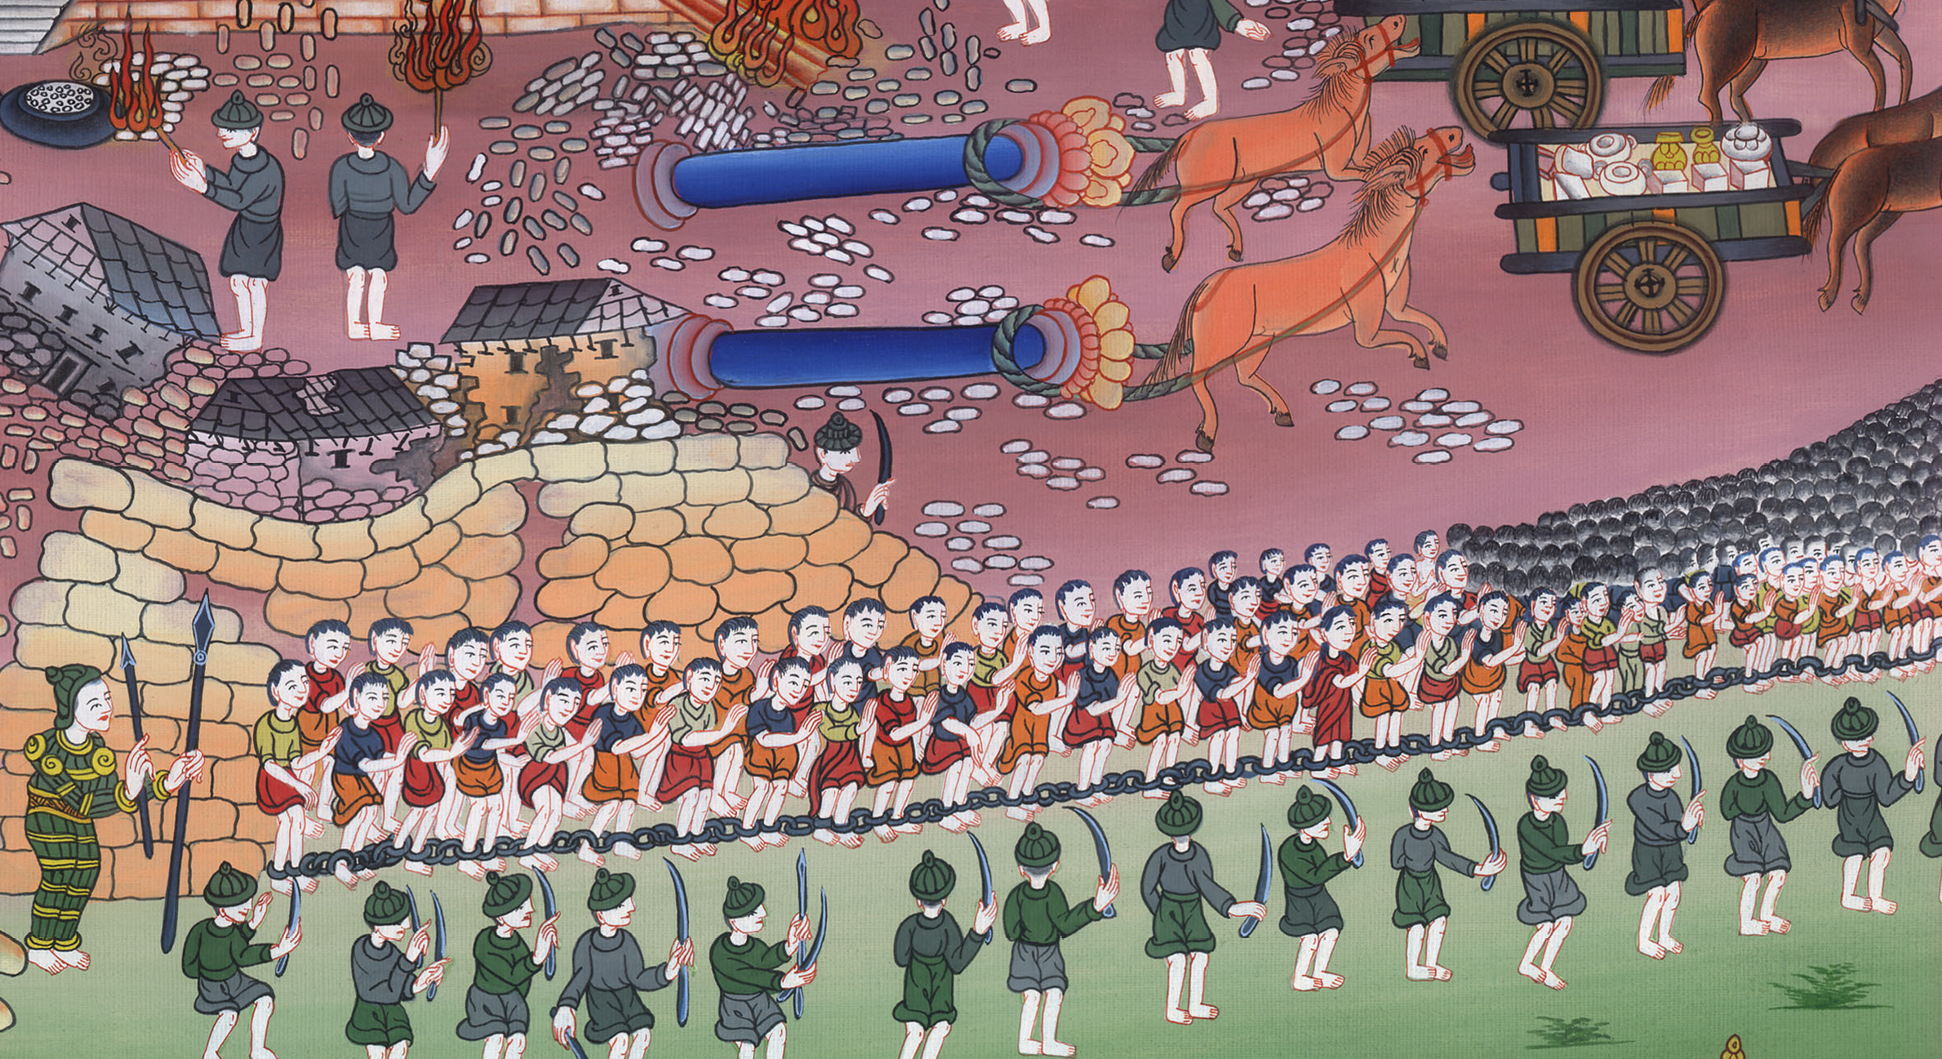
2 Kings 25:21

Slide 17
Jeremiah39: 11Now Nebuchadnezzar king of Babylon commanded Nebuzaradan the captain of the guard concerning Jeremiah, saying,
John

Slide 18
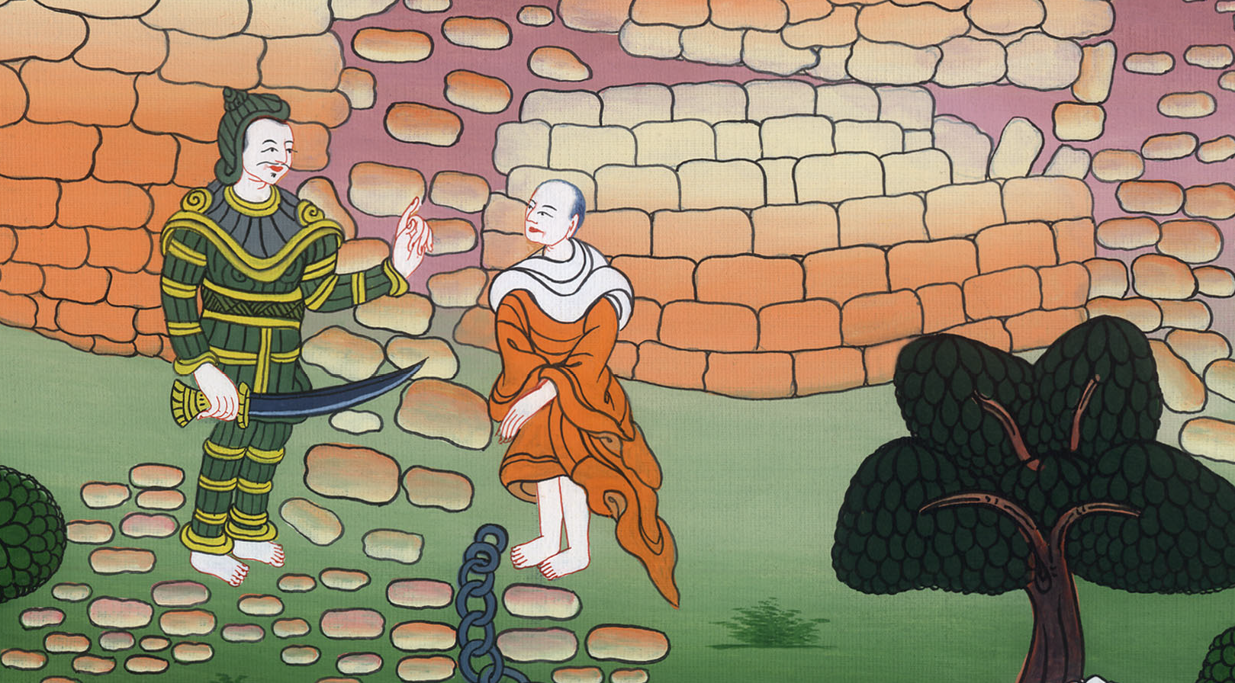
Jeremiah 39:11

Slide 19
12“Take him and take care of him. Do him no harm; but do to him even as he tells you.” (So Jeremiah remained among his own people.)
John

Slide 20
Jeremiah 39:12

