Slide 1
26-1
This work is licensed under a Creative Commons Attribution-Sharealike 4.0 International License.
Please add this statement to all the videos you create.
English Bible quotes are from the World English Bible US, which is in the public domain.
Notes:
Ch
26 Daniel
1. Daniel and friends eat vegetables – Daniel 1:1-21 (Center Top)
2. Nebuchadnezzar’s Statue dream – Daniel 2:1-49 (Left Top)
3. The furnace – Daniel 3:1-30 (Right Top)
4. Nebuchadnezzar’s Tree Dream – Daniel 4:1-37 (Right Bottom)
5. Handwriting on the wall – Daniel 5:1-31 (Center Bottom)
6. Daniel’s prayer life – Daniel 6:1-11 [Daniel 7-12 – Visions] (Left Bottom)
7. Lion’s den – Daniel 6:12-28 (Center)

Slide 2
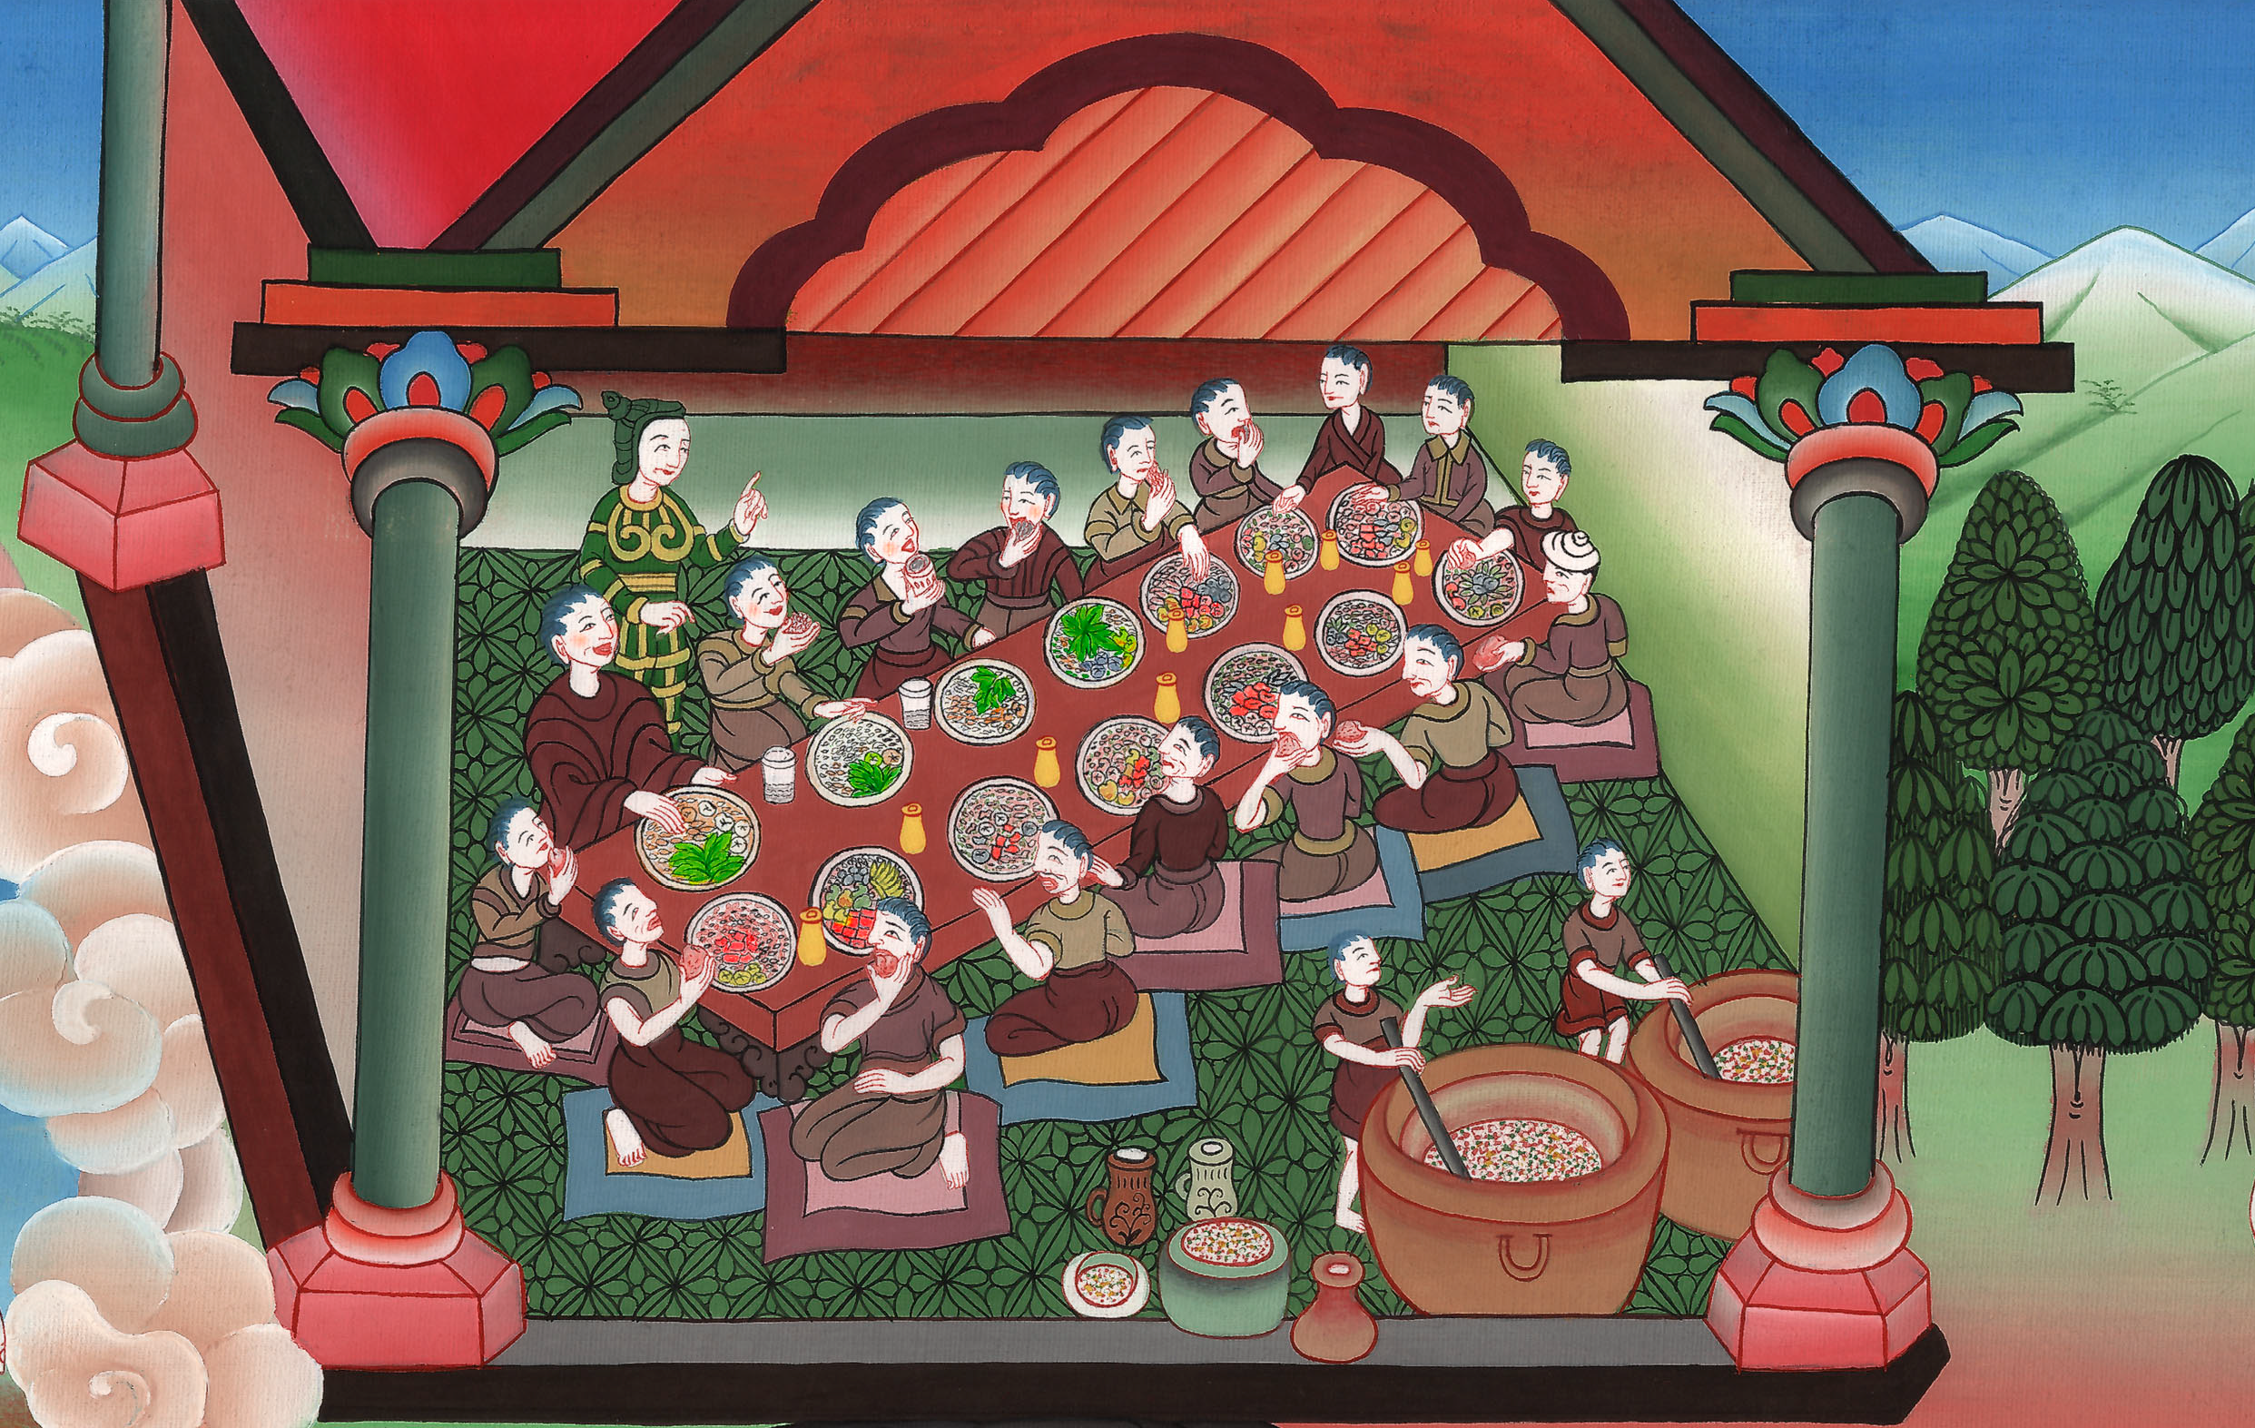
Daniel and friends eat vegetables –
Daniel 1:1-21

Slide 3
26 Daniel
1. Daniel and friends eat vegetables – Daniel 1:1-21 (Center Top)
John

Slide 4
Daniel and friends eat vegetables –
Daniel 1:1-21

Slide 5
Daniel1:1In the third year of the reign of Jehoiakim king of Judah, Nebuchadnezzar king of Babylon came to Jerusalem and besieged it.
John

Slide 6
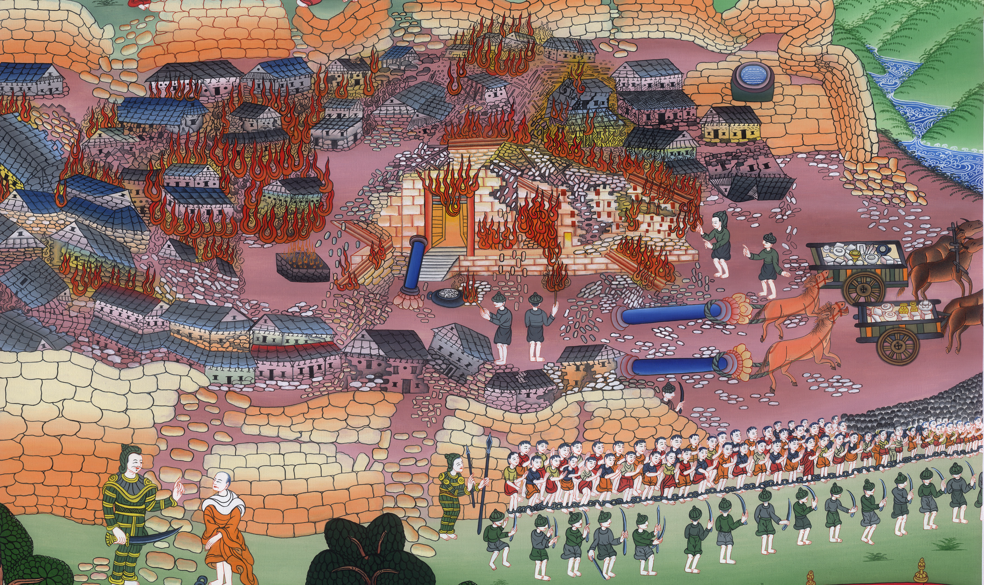
Daniel 1:1

Slide 7
2The Lord gave Jehoiakim king of Judah into his hand, with some of the vessels of the house of God; and he carried them into the land of Shinar to the house of his god. He brought the vessels into the treasure house of his god.
John

Slide 8
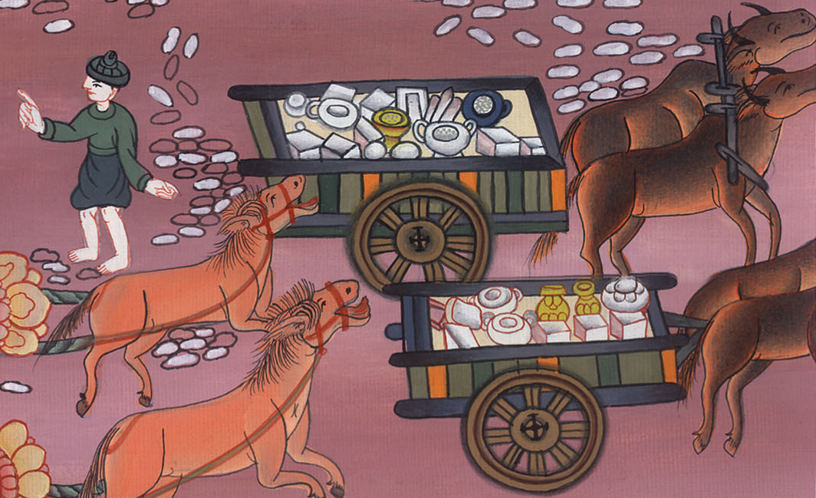
Daniel 1:2

Slide 9
3The king spoke to Ashpenaz, the master of his eunuchs, that he should bring in some of the children of Israel, even of the royal offspring and of the nobles:
John

Slide 10
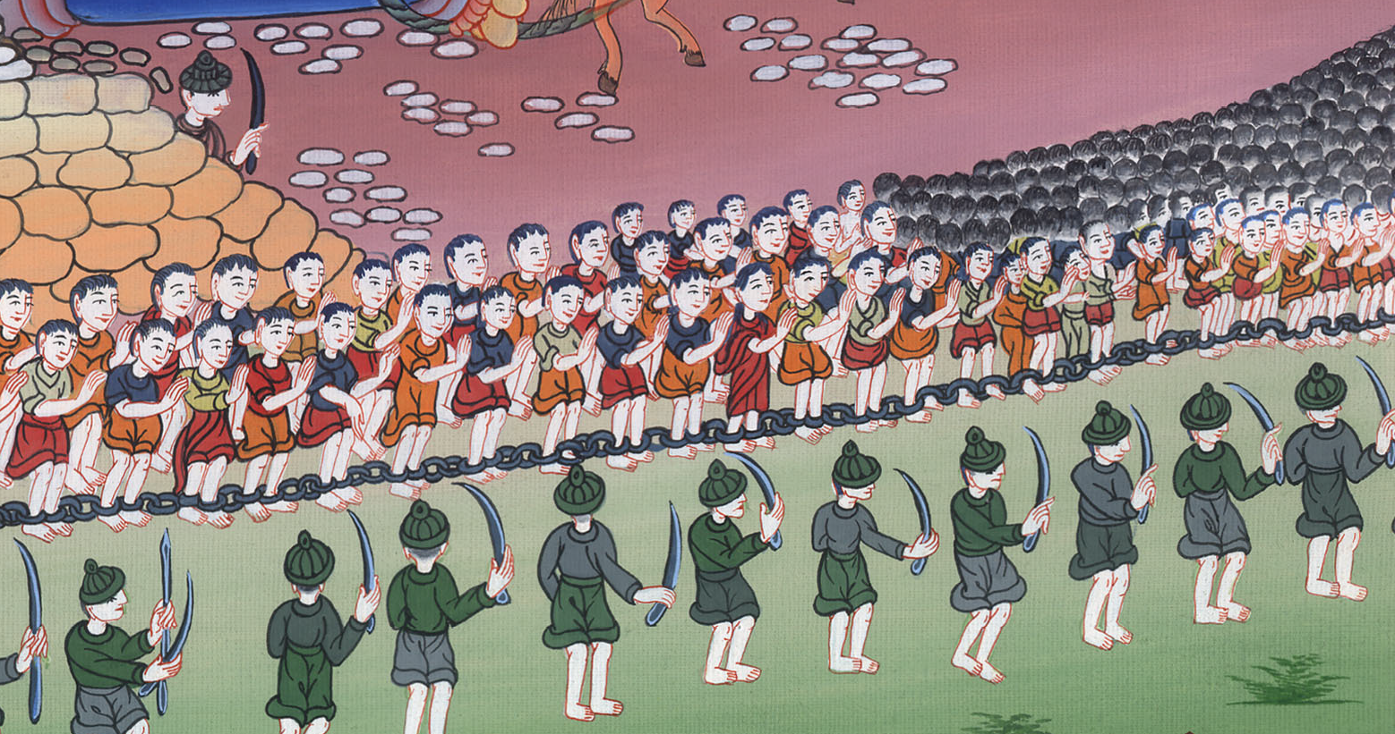
Daniel 1:3

Slide 11
4youths in whom was no defect, but well-favored, skillful in all wisdom, endowed with knowledge, understanding science, and who had the ability to stand in the king’s palace; and that he should teach them the learning and the language of the Chaldeans.
John

Slide 12
Daniel 1:4

Slide 13
5The king appointed for them a daily portion of the king’s delicacies and of the wine which he drank, and that they should be nourished three years, that at its end they should stand before the king.
John

Slide 14
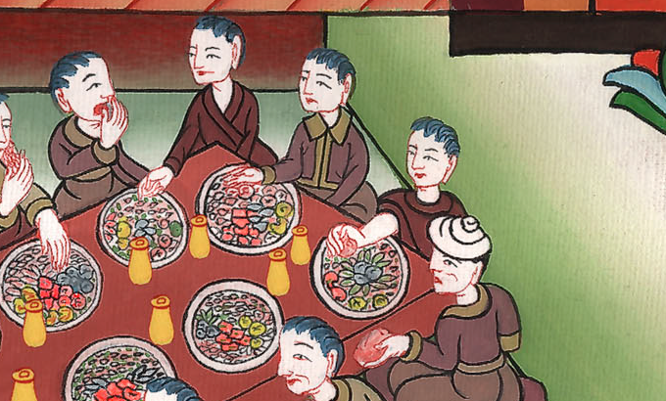
Daniel 1:5

Slide 15
6Now among these of the children of Judah were Daniel, Hananiah, Mishael, and Azariah.
John

Slide 16
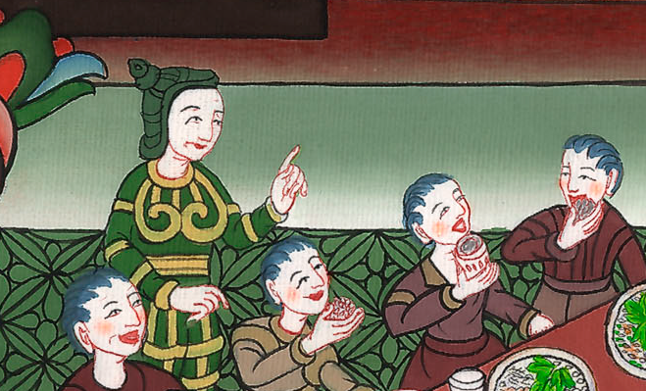
Daniel 1:6

Slide 17
8But Daniel purposed in his heart that he would not defile himself with the king’s delicacies, nor with the wine which he drank. Therefore he requested of the prince of the eunuchs that he might not defile himself.
John

Slide 18
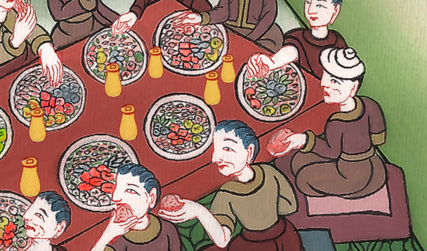
Daniel 1:8

Slide 19
9Now God made Daniel find kindness and compassion in the sight of the prince of the eunuchs.
John

Slide 20
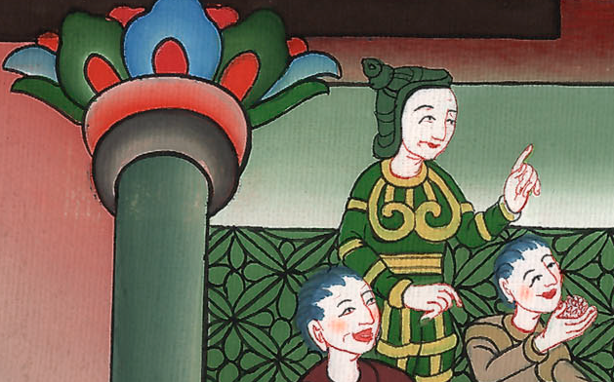
Daniel 1:9

Slide 21
10The prince of the eunuchs said to Daniel, “I fear my lord the king, who has appointed your food and your drink. For why should he see your faces worse looking than the youths who are of your own age? Then you would endanger my head with the king.”
John

Slide 22
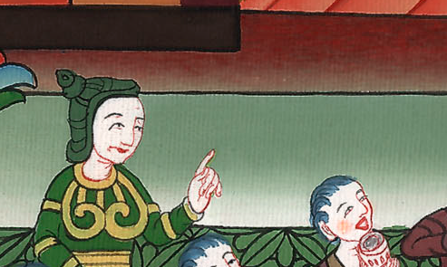
Daniel 1:10

Slide 23
11Then Daniel said to the steward whom the prince of the eunuchs had appointed over Daniel, Hananiah, Mishael, and Azariah:
John

Slide 24
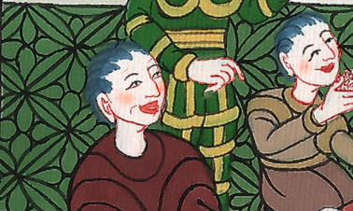
Daniel 1:11

Slide 25
12“Test your servants, I beg you, ten days; and let them give us vegetables to eat and water to drink.
John

Slide 26
Daniel 1:12

Slide 27
13Then let our faces be examined before you, and the face of the youths who eat of the king’s delicacies; and as you see, deal with your servants.” 14So he listened to them in this matter, and tested them for ten days.
John

Slide 28
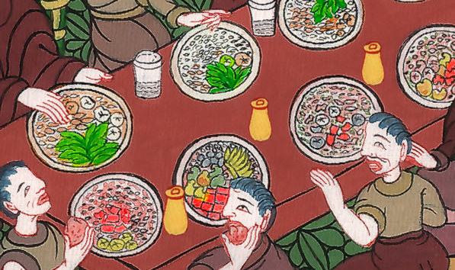
Daniel 1:13

Slide 29
15At the end of ten days, their faces appeared fairer and they were fatter in flesh than all the youths who ate of the king’s delicacies.
John

Slide 30
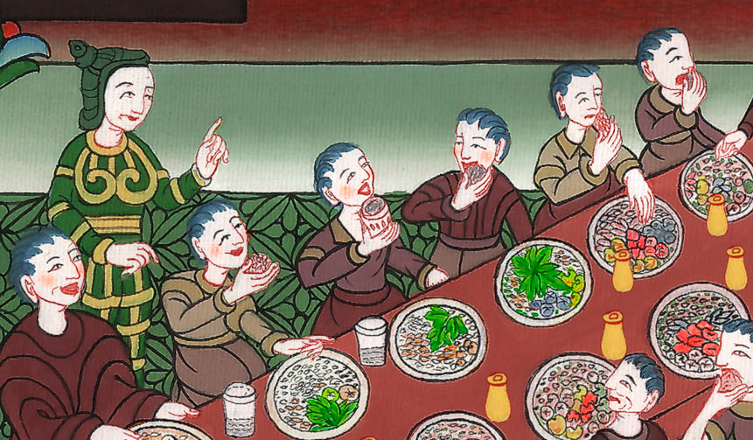
Daniel 1:15

Slide 31
16So the steward took away their delicacies and the wine that they were given to drink, and gave them vegetables.
John

Slide 32
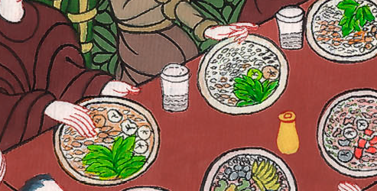
Daniel 1:16

Slide 33
17Now as for these four youths, God gave them knowledge and skill in all learning and wisdom; and Daniel had understanding in all visions and dreams.
John

Slide 34
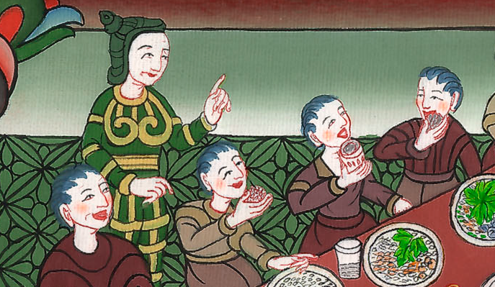
Daniel 1:17

Slide 35
18At the end of the days which the king had appointed for bringing them in, the prince of the eunuchs brought them in before Nebuchadnezzar.
John

Slide 36
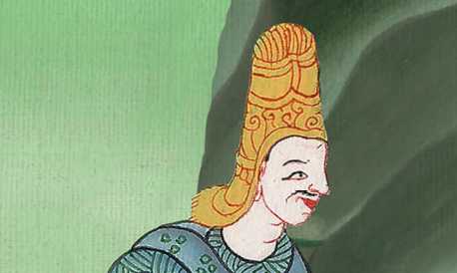
Daniel 1:18

Slide 37
19The king talked with them; and among them all was found no one like Daniel, Hananiah, Mishael, and Azariah. Therefore stood they before the king.
John

Slide 38
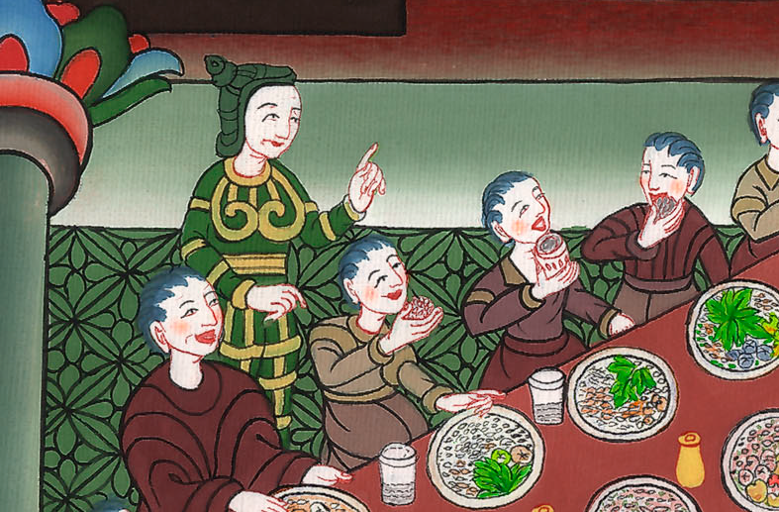
Daniel 1:19

Slide 39
20In every matter of wisdom and understanding concerning which the king inquired of them, he found them ten times better than all the magicians and enchanters who were in all his realm.
John

Slide 40
Daniel 1:20

