Slide 1
26-2
This work is licensed under a Creative Commons Attribution-Sharealike 4.0 International License.
Please add this statement to all the videos you create.
English Bible quotes are from the World English Bible US, which is in the public domain.
Notes:
Ch
26 Daniel
1. Daniel and friends eat vegetables – Daniel 1:1-21 (Center Top)
2. Nebuchadnezzar’s Statue dream – Daniel 2:1-49 (Left Top)
3. The furnace – Daniel 3:1-30 (Right Top)
4. Nebuchadnezzar’s Tree Dream – Daniel 4:1-37 (Right Bottom)
5. Handwriting on the wall – Daniel 5:1-31 (Center Bottom)
6. Daniel’s prayer life – Daniel 6:1-11 [Daniel 7-12 – Visions] (Left Bottom)
7. Lion’s den – Daniel 6:12-28 (Center)

Slide 2
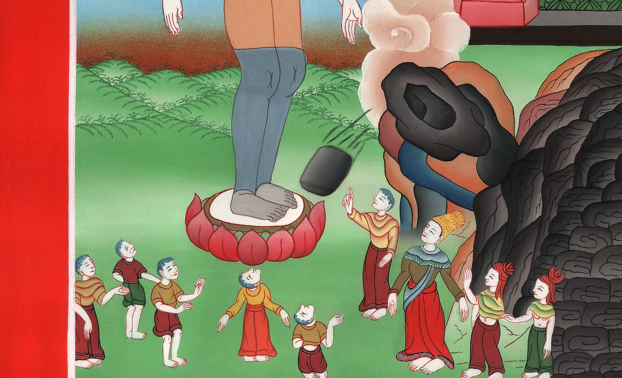
Nebuchadnezzar’s Statue dream – Daniel 2:1-49

Slide 3
Nebuchadnezzar’s Statue dream – Daniel 2:1-49
John

Slide 4
Nebuchadnezzar’s Statue dream – Daniel 2:1-49

Slide 5
Daniel2:1In the second year of the reign of Nebuchadnezzar, Nebuchadnezzar dreamed dreams; and his spirit was troubled, and his sleep went from him.
John

Slide 6
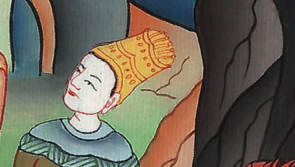
Daniel 2:1

Slide 7
2Then the king commanded that the magicians, the enchanters, the sorcerers, and the Chaldeans be called to tell the king his dreams. So they came in and stood before the king.
John

Slide 8
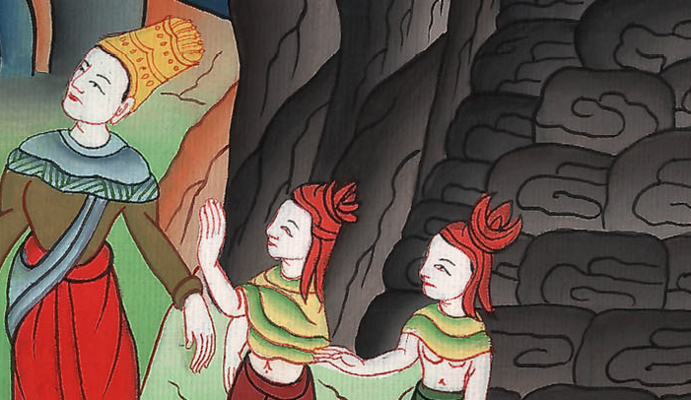
Daniel 2:2

Slide 9
3The king said to them, “I have dreamed a dream, and my spirit is troubled to know the dream.”
John

Slide 10
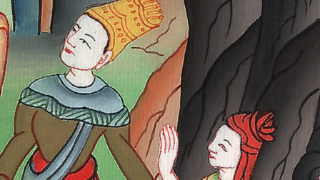
Daniel 2:3

Slide 11
4Then the Chaldeans spoke to the king in the Syrian language, “O king, live forever! Tell your servants the dream, and we will show the interpretation.”
John

Slide 12
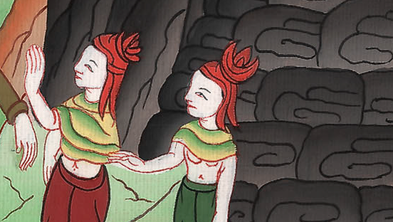
Daniel 2:4

Slide 13
5The king answered the Chaldeans, “The thing has gone from me. If you don’t make known to me the dream and its interpretation, you will be cut in pieces, and your houses will be made a dunghill.
John

Slide 14
Daniel 2:5

Slide 15
6But if you show the dream and its interpretation, you will receive from me gifts, rewards, and great honor. Therefore show me the dream and its interpretation.”
John

Slide 16
Daniel 2:6

Slide 17
10The Chaldeans answered the king and said, “There is not a man on the earth who can show the king’s matter, because no king, lord, or ruler has asked such a thing of any magician, enchanter, or Chaldean. 11It is a rare thing that the king requires, and there is no other who can show it before the king except the gods, whose dwelling is not with flesh.”
John

Slide 18
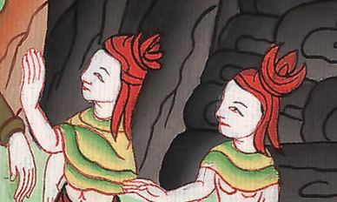
Daniel 2:10,11

Slide 19
12Because of this, the king was angry and very furious, and commanded that all the wise men of Babylon be destroyed. 13So the decree went out, and the wise men were to be slain. They sought Daniel and his companions to be slain.
John

Slide 20
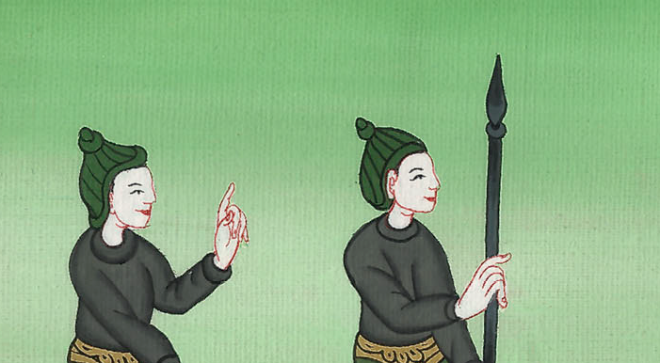
Daniel 2:12

Slide 21
14Then Daniel returned answer with counsel and prudence to Arioch the captain of the king’s guard, who had gone out to kill the wise men of Babylon. 15He answered Arioch the king’s captain, “Why is the decree so urgent from the king?” Then Arioch made the thing known to Daniel.
John

Slide 22
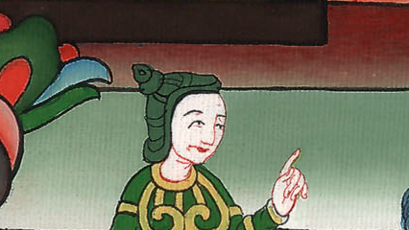
Daniel 2:14,15

Slide 23
16Daniel went in, and desired of the king that he would appoint him a time, and he would show the king the interpretation.
John

Slide 24
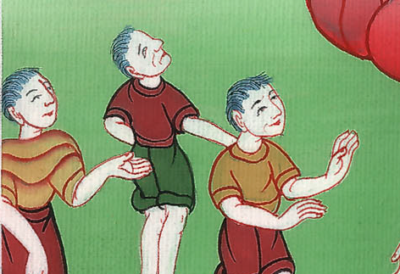
Daniel 2:16

Slide 25
17Then Daniel went to his house and made the thing known to Hananiah, Mishael, and Azariah, his companions: 18that they would desire mercies of the God of heaven concerning this secret, that Daniel and his companions would not perish with the rest of the wise men of Babylon.
John

Slide 26
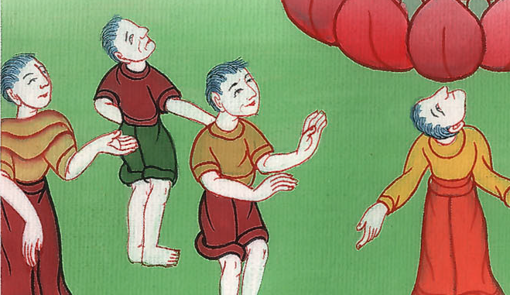
Daniel 2:17,18

Slide 27
19Then the secret was revealed to Daniel in a vision of the night. Then Daniel blessed the God of heaven. 20Daniel answered,
“Blessed be the name of God forever and ever;
for wisdom and might are his.
John

Slide 28
Daniel 2:19,20

Slide 29
21He changes the times and the seasons.
He removes kings and sets up kings.
He gives wisdom to the wise,
and knowledge to those who have understanding.
John

Slide 30
Daniel 2:21

Slide 31
22He reveals the deep and secret things.
He knows what is in the darkness,
and the light dwells with him.
John

Slide 32
Daniel 2:22

Slide 33
23I thank you and praise you,
O God of my fathers,
who have given me wisdom and might,
and have now made known to me what we desired of you;
for you have made known to us the king’s matter.”
John

Slide 34
Daniel 2:23

Slide 35
24Therefore Daniel went in to Arioch, whom the king had appointed to destroy the wise men of Babylon. He went and said this to him: “Don’t destroy the wise men of Babylon. Bring me in before the king, and I will show to the king the interpretation.”
John

Slide 36
Daniel 2:24

Slide 37
25Then Arioch brought in Daniel before the king in haste, and said this to him: “I have found a man of the children of the captivity of Judah who will make known to the king the interpretation.”
John

Slide 38
Daniel 2:25

Slide 39
26The king answered Daniel, whose name was Belteshazzar, “Are you able to make known to me the dream which I have seen, and its interpretation?”
John

Slide 40
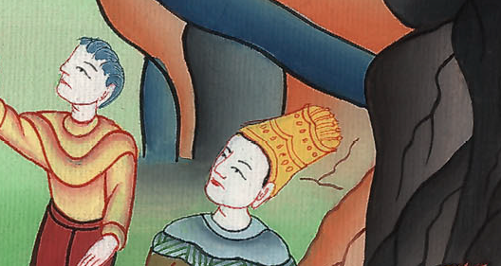
Daniel 2:26

Slide 41
27Daniel answered before the king, and said, “The secret which the king has demanded can’t be shown to the king by wise men, enchanters, magicians, or soothsayers;
John

Slide 42
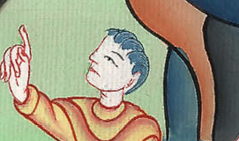
Daniel 2:27

Slide 43
28but there is a God in heaven who reveals secrets, and he has made known to King Nebuchadnezzar what will be in the latter days. Your dream and the visions of your head on your bed are these:
John

Slide 44
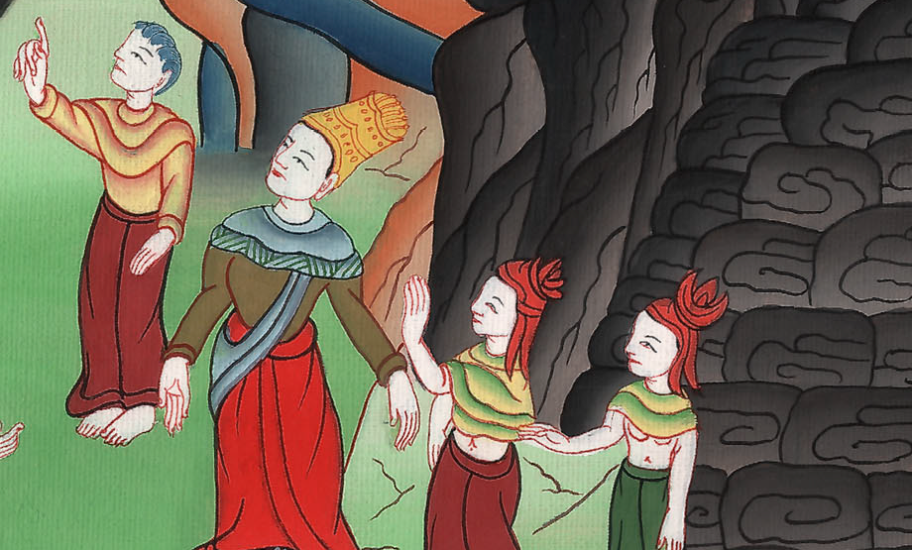
Daniel 2:28

Slide 45
29“As for you, O king, your thoughts came on your bed, what should happen hereafter; and he who reveals secrets has made known to you what will happen.
John

Slide 46
Daniel 2:29

Slide 47
30But as for me, this secret is not revealed to me for any wisdom that I have more than any living, but to the intent that the interpretation may be made known to the king, and that you may know the thoughts of your heart.
John

Slide 48
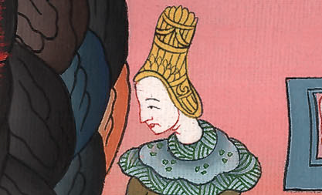
Daniel 2:30

Slide 49
31“You, O king, saw, and behold, a great image. This image, which was mighty, and whose brightness was excellent, stood before you; and its appearance was terrifying.
John

Slide 50
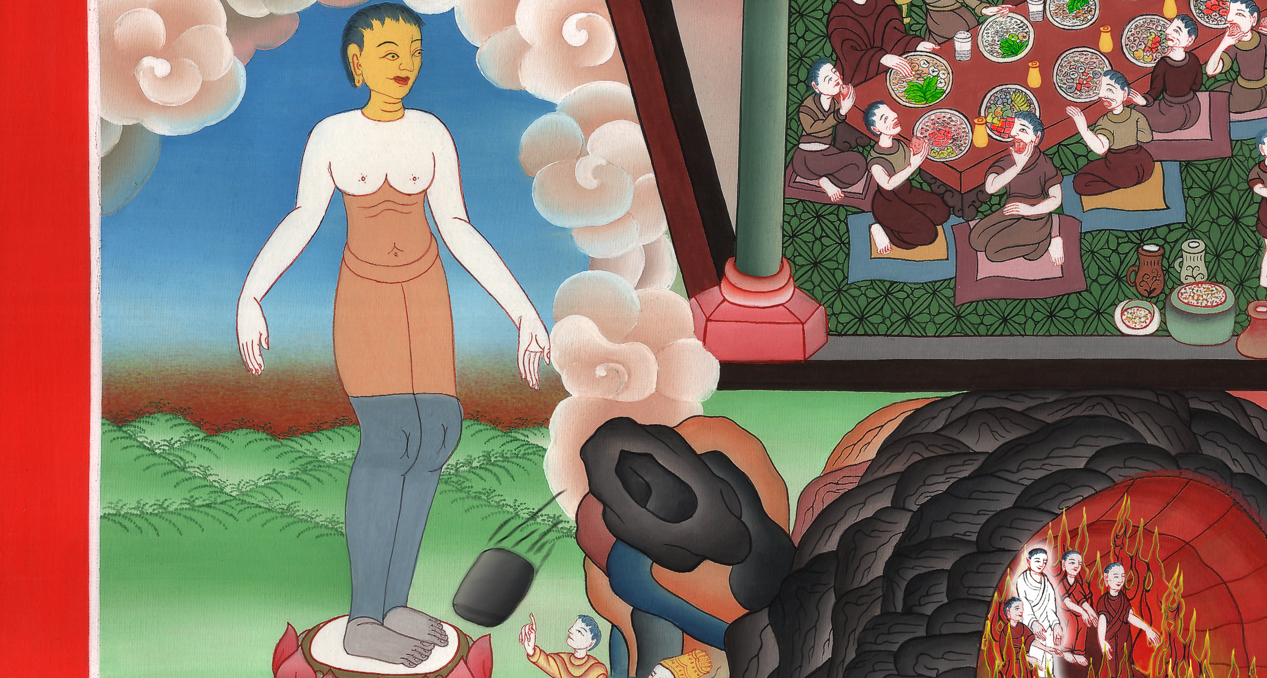
Daniel 2:31

Slide 51
32As for this image, its head was of fine gold, its breast and its arms of silver, its belly and its thighs of bronze, 33its legs of iron, its feet part of iron and part of clay.
John

Slide 52
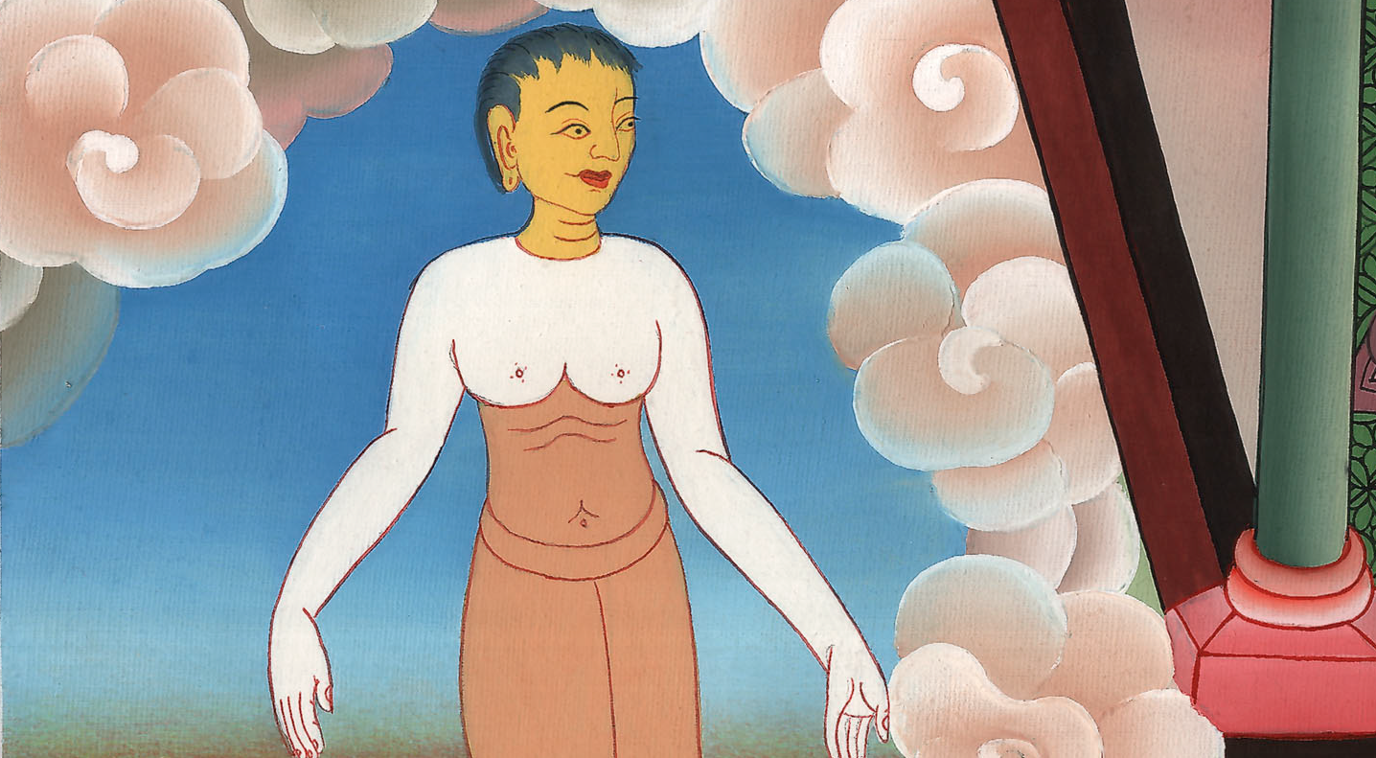
Daniel 2:32

Slide 53
34You saw until a stone was cut out without hands, which struck the image on its feet that were of iron and clay, and broke them in pieces.
John

Slide 54
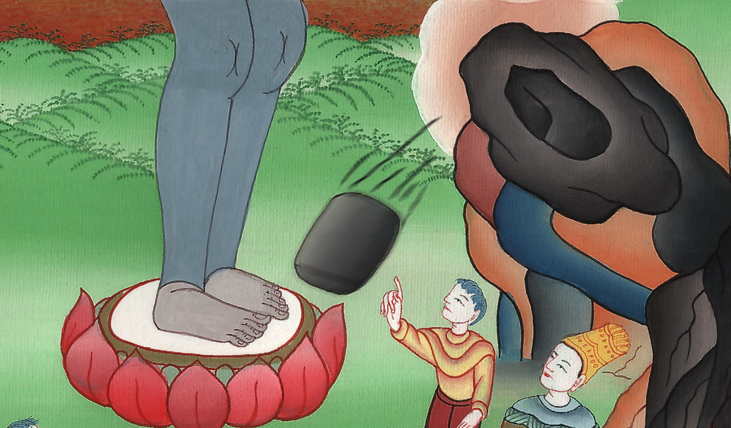
Daniel 2:34

Slide 55
35Then the iron, the clay, the bronze, the silver, and the gold were broken in pieces together, and became like the chaff of the summer threshing floors. The wind carried them away, so that no place was found for them. The stone that struck the image became a great mountain and filled the whole earth.
John

Slide 56
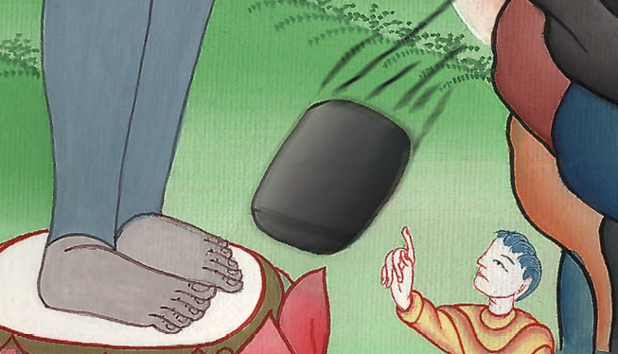
Daniel 2:35

Slide 57
36“This is the dream; and we will tell its interpretation before the king. 37You, O king, are king of kings, to whom the God of heaven has given the kingdom, the power, the strength, and the glory. 38… You are the head of gold.
John

Slide 58
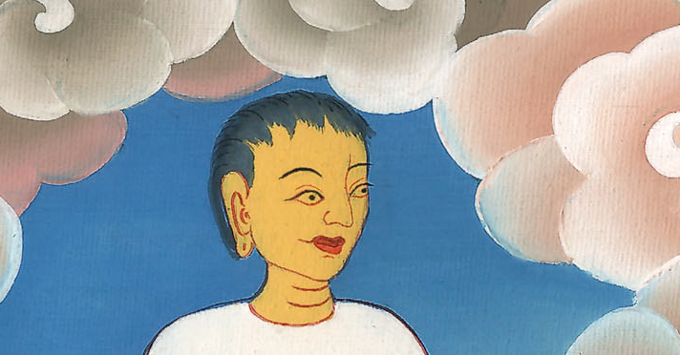
Daniel 2:36-38

Slide 59
39“After you, another kingdom will arise that is inferior to you; and another third kingdom of bronze, which will rule over all the earth.
John

Slide 60
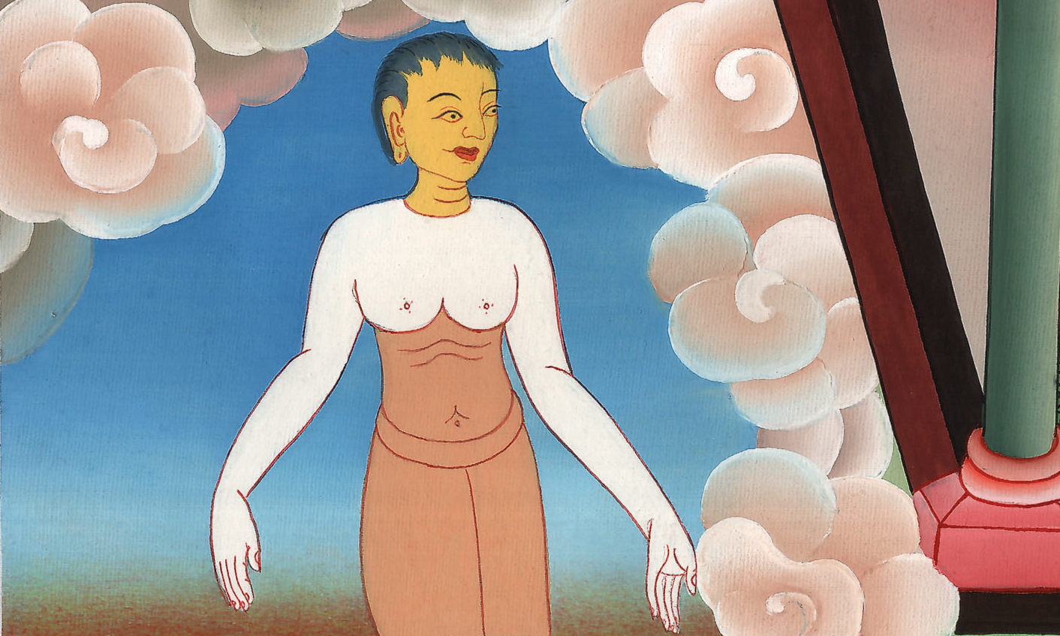
Daniel 2:39

Slide 61
40The fourth kingdom will be strong as iron, because iron breaks in pieces and subdues all things; and as iron that crushes all these, it will break in pieces and crush.
John

Slide 62
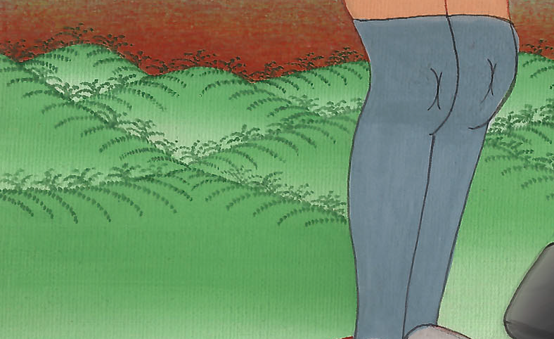
Daniel 2:40

Slide 63
43Whereas you saw the iron mixed with miry clay, they will mingle themselves with the seed of men; but they won’t cling to one another, even as iron does not mix with clay.
John

Slide 64
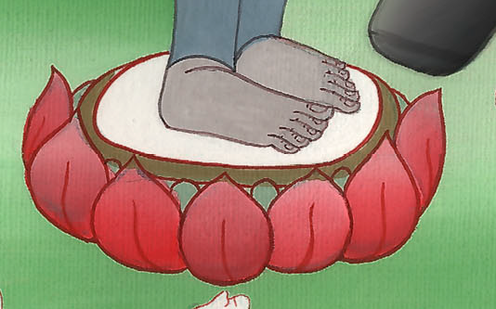
Daniel 2:43

Slide 65
44“In the days of those kings the God of heaven will set up a kingdom which will never be destroyed, nor will its sovereignty be left to another people; but it will break in pieces and consume all these kingdoms, and it will stand forever.
John

Slide 66
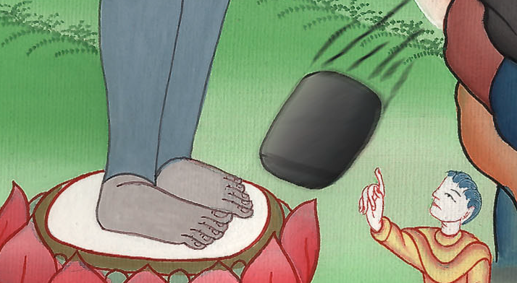
Daniel 2:44

Slide 67
46Then King Nebuchadnezzar fell on his face, worshiped Daniel, and commanded that they should offer an offering and sweet odors to him.
John

Slide 68
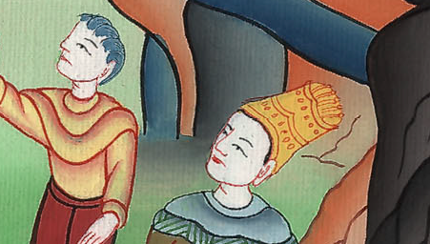
Daniel 2:46

Slide 69
47The king answered to Daniel, and said, “Of a truth your God is the God of gods, and the Lord of kings, and a revealer of secrets, since you have been able to reveal this secret.”
John

Slide 70
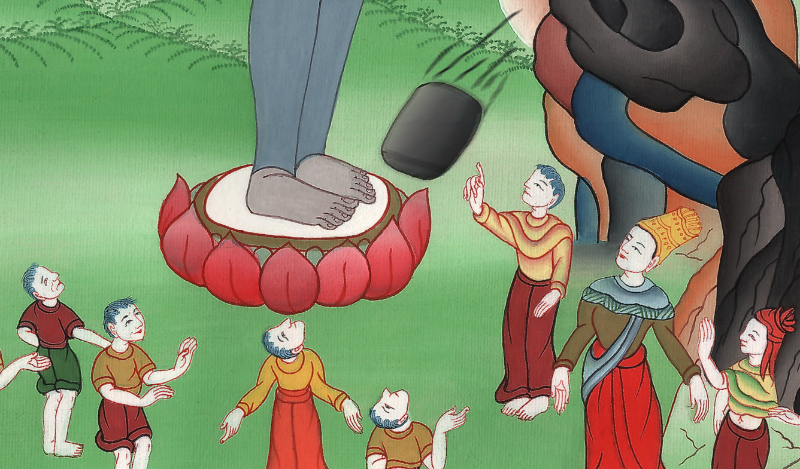
Daniel 2:47

Slide 71
48Then the king made Daniel great and gave him many great gifts, and made him rule over the whole province of Babylon and to be chief governor over all the wise men of Babylon.
John

Slide 72
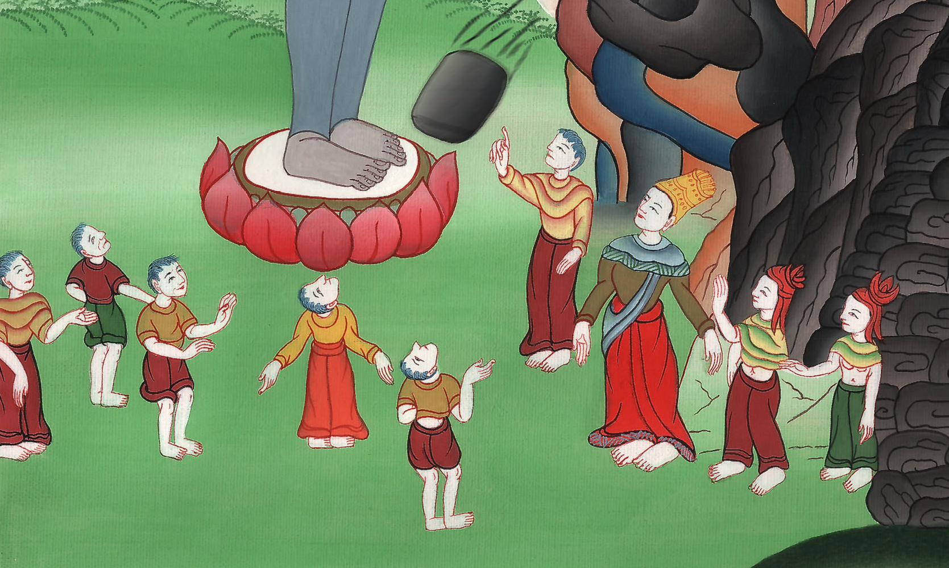
Daniel 2:48

Slide 73
49Daniel requested of the king, and he appointed Shadrach, Meshach, and Abednego over the affairs of the province of Babylon, but Daniel was in the king’s gate.
John

Slide 74
Daniel 2:49

