Slide 1
26-3
This work is licensed under a Creative Commons Attribution-Sharealike 4.0 International License.
Please add this statement to all the videos you create.
English Bible quotes are from the World English Bible US, which is in the public domain.
Notes:
Ch
26 Daniel
1. Daniel and friends eat vegetables – Daniel 1:1-21 (Center Top)
2. Nebuchadnezzar’s Statue dream – Daniel 2:1-49 (Left Top)
3. The furnace – Daniel 3:1-30 (Right Top)
4. Nebuchadnezzar’s Tree Dream – Daniel 4:1-37 (Right Bottom)
5. Handwriting on the wall – Daniel 5:1-31 (Center Bottom)
6. Daniel’s prayer life – Daniel 6:1-11 [Daniel 7-12 – Visions] (Left Bottom)
7. Lion’s den – Daniel 6:12-28 (Center)

Slide 2
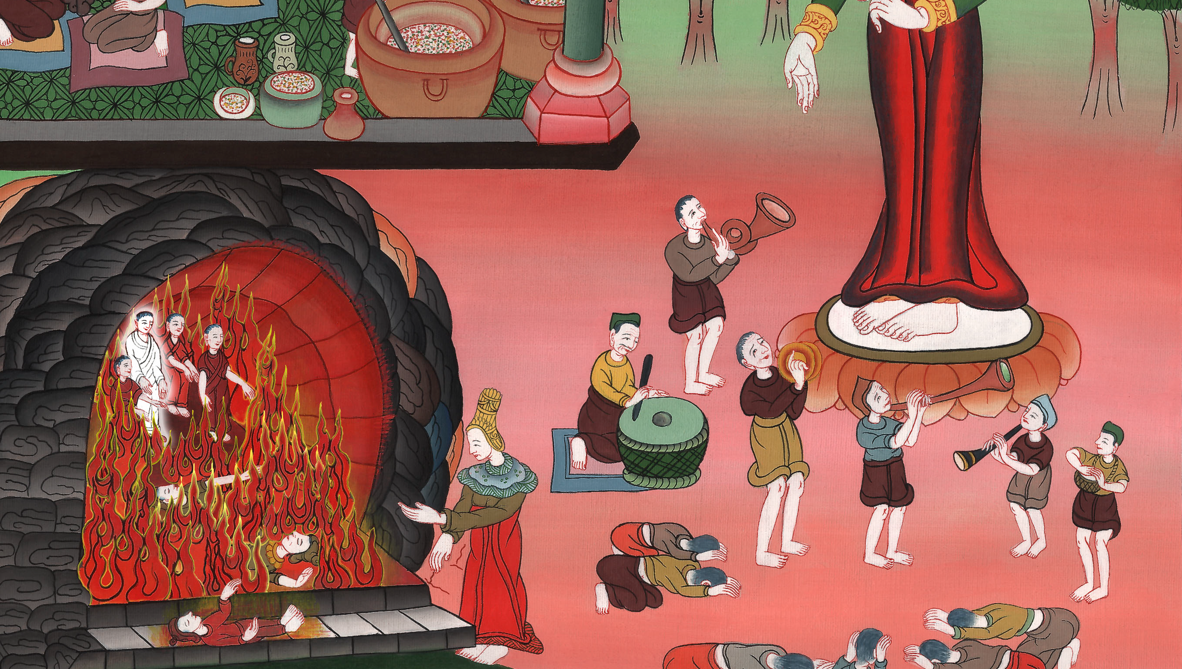
The furnace -
Daniel 3:1-30

Slide 3
3. The furnace Daniel 3:1-30 (Right Top)
John

Slide 4
The furnace –
Daniel 3:1-30

Slide 5
Daniel3:1Nebuchadnezzar the king made an image of gold, whose height was sixty cubits and its width six cubits. He set it up in the plain of Dura, in the province of Babylon.
John

Slide 6
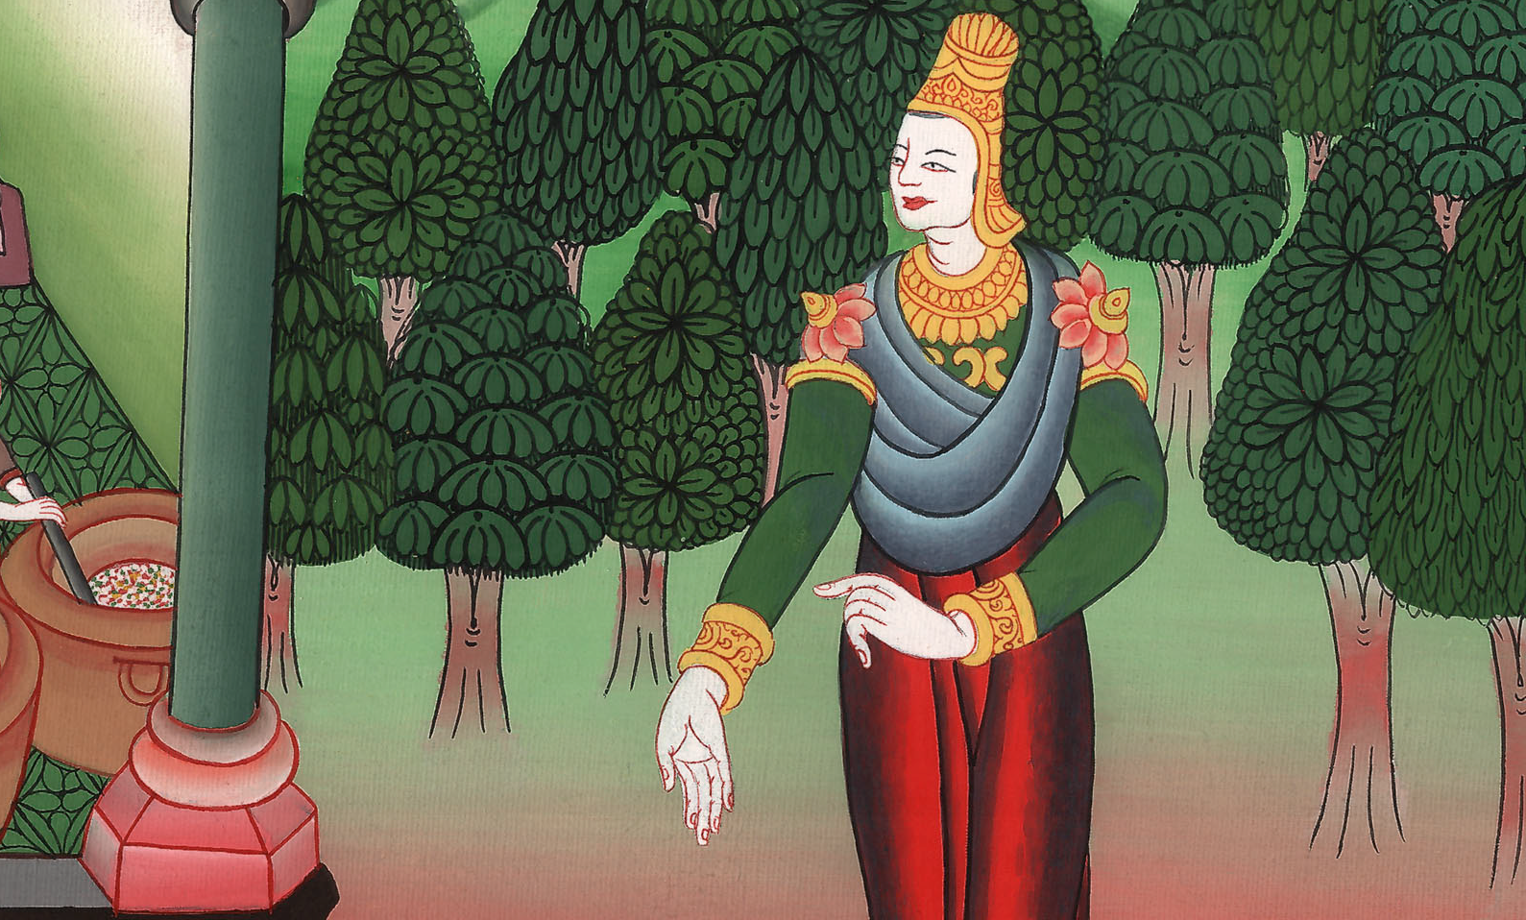
Daniel 3:1

Slide 7
2Then Nebuchadnezzar the king sent to gather together the local governors, the deputies, and the governors, the judges, the treasurers, the counselors, the sheriffs, and all the rulers of the provinces, to come to the dedication of the image which Nebuchadnezzar the king had set up.
John

Slide 8
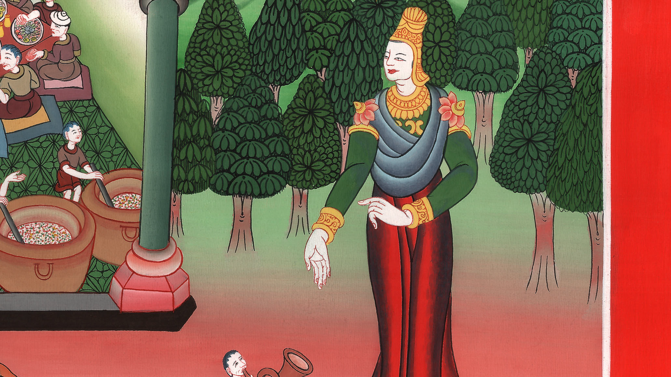
Daniel 3:2

Slide 9
3Then the local governors, the deputies, and the governors, the judges, the treasurers, the counselors, the sheriffs, and all the rulers of the provinces were gathered together to the dedication of the image that Nebuchadnezzar the king had set up; and they stood before the image that Nebuchadnezzar had set up.
John

Slide 10
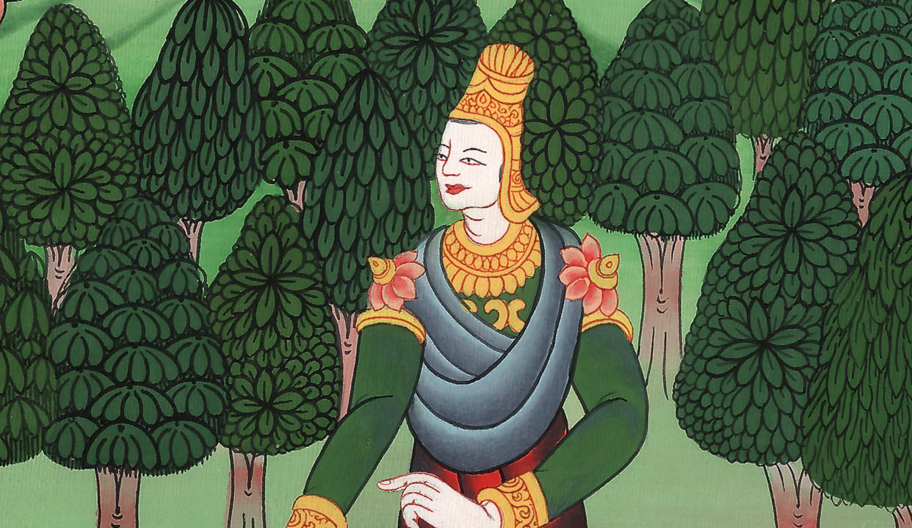
Daniel 3:3

Slide 11
4Then the herald cried aloud, “To you it is commanded, peoples, nations, and languages,
John

Slide 12
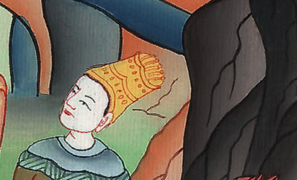
Daniel 3:4

Slide 13
5that whenever you hear the sound of the horn, flute, zither, lyre, harp, pipe, and all kinds of music, you fall down and worship the golden image that Nebuchadnezzar the king has set up.
John

Slide 14
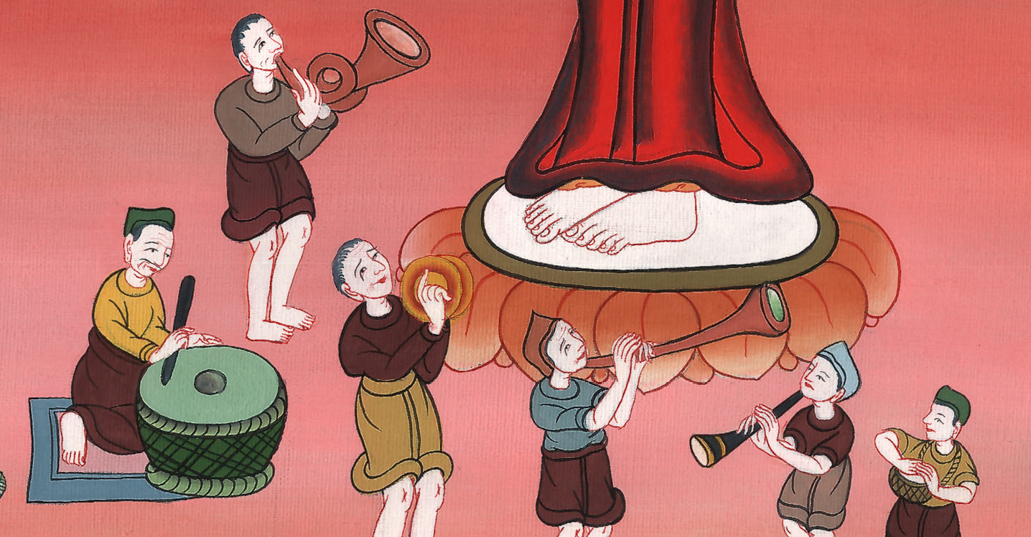
Daniel 3:5

Slide 15
6Whoever doesn’t fall down and worship shall be cast into the middle of a burning fiery furnace the same hour.”
John

Slide 16
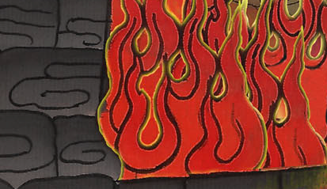
Daniel 3:6

Slide 17
7Therefore at that time, when all the peoples heard the sound of the horn, flute, zither, lyre, harp, pipe, and all kinds of music, all the peoples, the nations, and the languages fell down and worshiped the golden image that Nebuchadnezzar the king had set up.
John

Slide 18
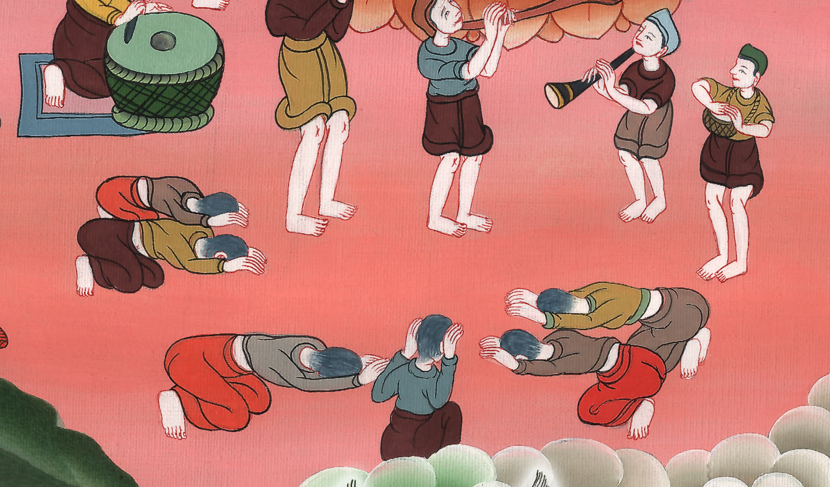
Daniel 3:7

Slide 19
8Therefore at that time certain Chaldeans came near and brought accusation against the Jews. 9They answered Nebuchadnezzar the king, “O king, live for ever!
John

Slide 20
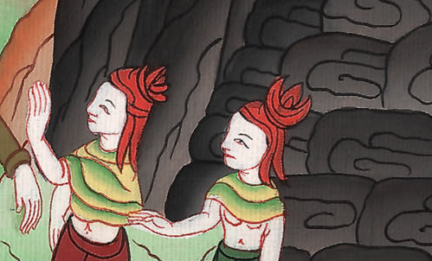
Daniel 3:8,9

Slide 21
10You, O king, have made a decree that every man who hears the sound of the horn, flute, zither, lyre, harp, pipe, and all kinds of music shall fall down and worship the golden image; 11and whoever doesn’t fall down and worship shall be cast into the middle of a burning fiery furnace.
John

Slide 22
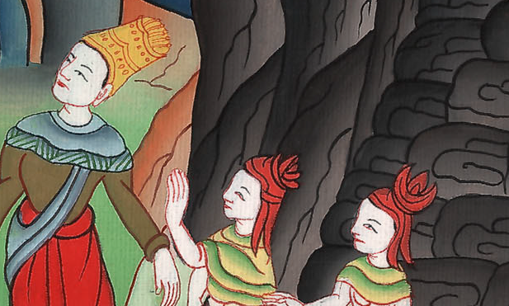
Daniel 3:10,11

Slide 23
12There are certain Jews whom you have appointed over the affairs of the province of Babylon: Shadrach, Meshach, and Abednego. These men, O king, have not respected you. They don’t serve your gods, and don’t worship the golden image which you have set up.”
John

Slide 24
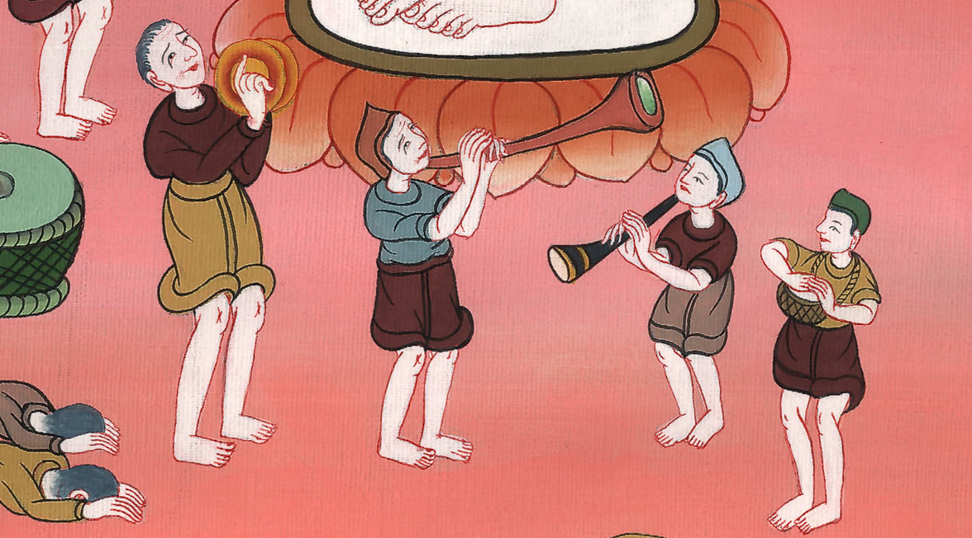
Daniel 3:12

Slide 25
13Then Nebuchadnezzar in rage and fury commanded that Shadrach, Meshach, and Abednego be brought. Then these men were brought before the king.
John

Slide 26
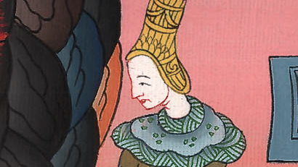
Daniel 3:13

Slide 27
14Nebuchadnezzar answered them, “Is it true, Shadrach, Meshach, and Abednego, that you don’t serve my gods and you don’t worship the golden image which I have set up?
John

Slide 28
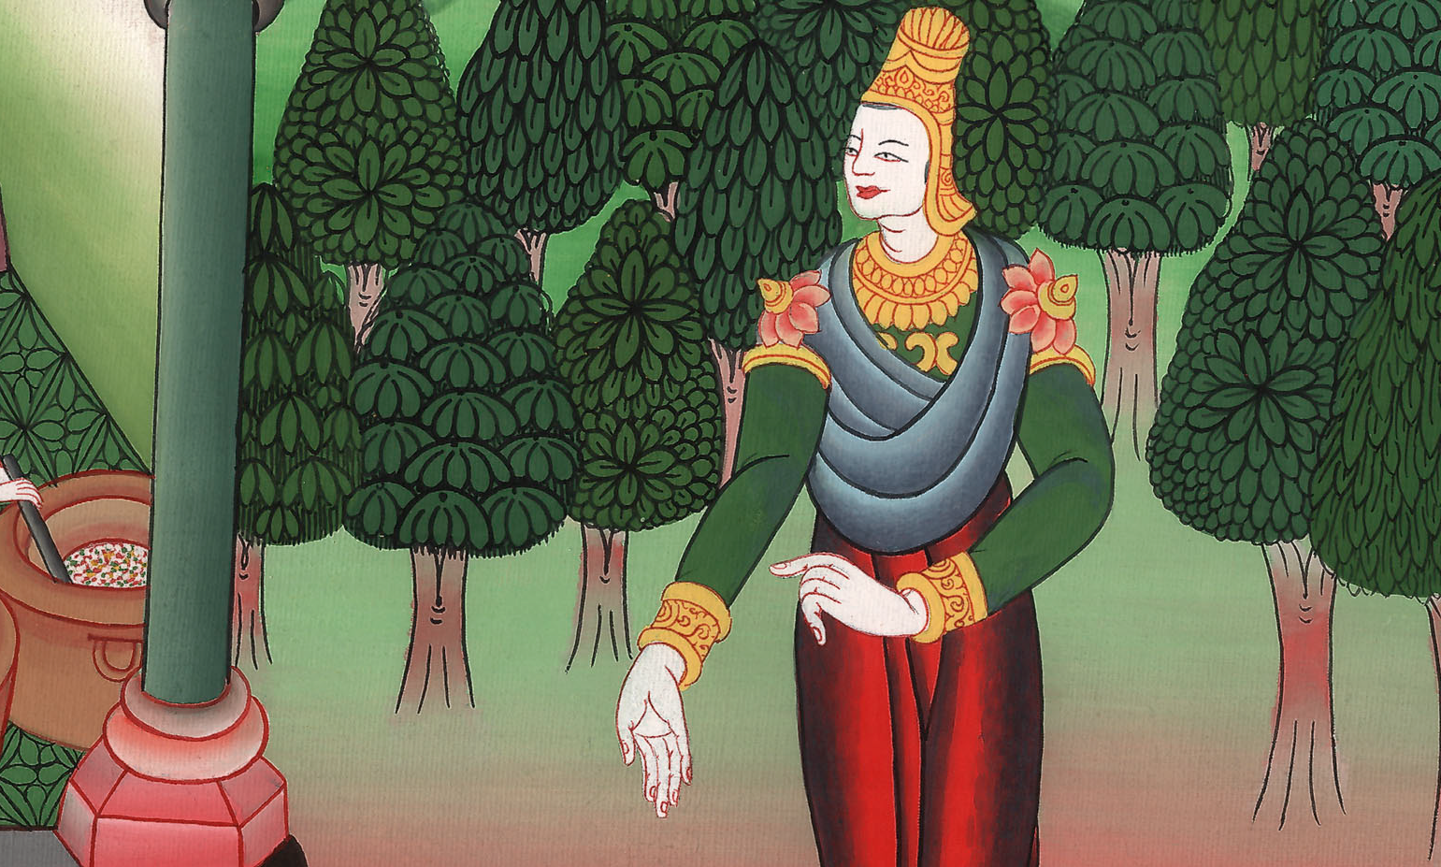
Daniel 3:14

Slide 29
15Now if you are ready whenever you hear the sound of the horn, flute, zither, lyre, harp, pipe, and all kinds of music to fall down and worship the image which I have made, good; but if you don’t worship, you shall be cast the same hour into the middle of a burning fiery furnace. Who is that god who will deliver you out of my hands?”
John

Slide 30
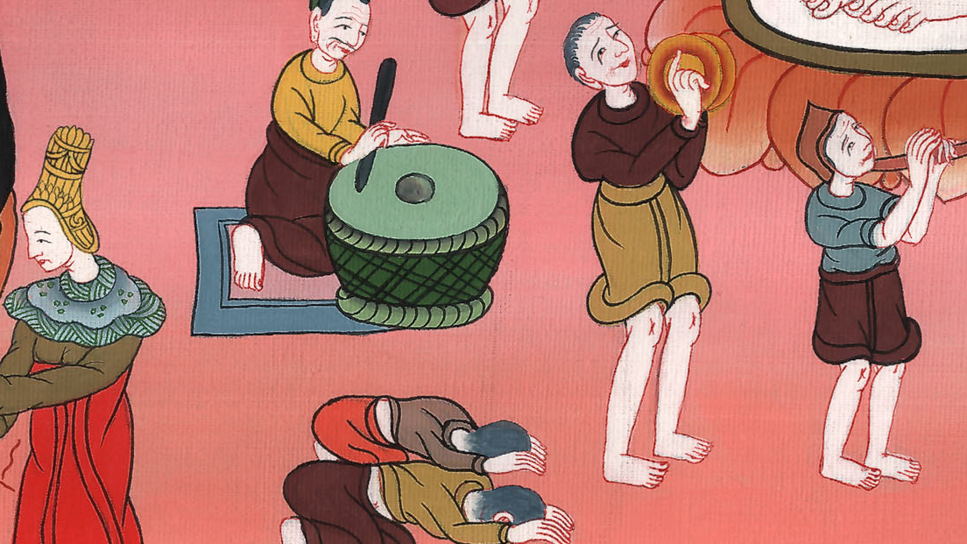
Daniel 3:15

Slide 31
16Shadrach, Meshach, and Abednego answered the king, “Nebuchadnezzar, we have no need to answer you in this matter. 17If it happens, our God whom we serve is able to deliver us from the burning fiery furnace; and he will deliver us out of your hand, O king.
John

Slide 32
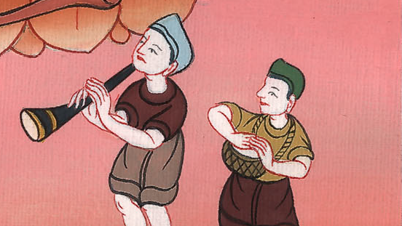
Daniel 3:16,17

Slide 33
18But if not, let it be known to you, O king, that we will not serve your gods or worship the golden image which you have set up.”
John

Slide 34
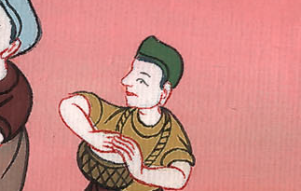
Daniel 3:18

Slide 35
19Then Nebuchadnezzar was full of fury, and the form of his appearance was changed against Shadrach, Meshach, and Abednego. He spoke, and commanded that they should heat the furnace seven times more than it was usually heated.
John

Slide 36
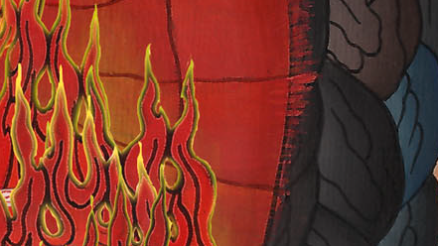
Daniel 3:19

Slide 37
20He commanded certain mighty men who were in his army to bind Shadrach, Meshach, and Abednego, and to cast them into the burning fiery furnace.
John

Slide 38
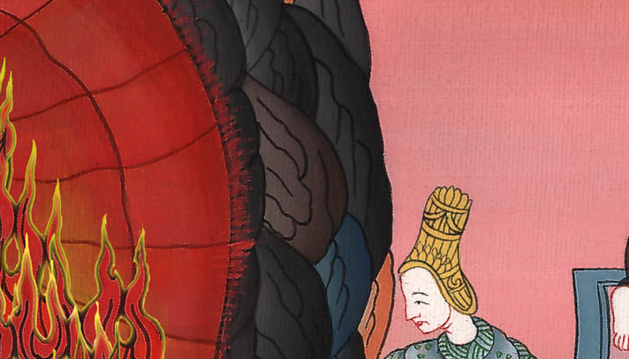
Daniel 3:20

Slide 39
22Therefore because the king’s commandment was urgent and the furnace exceedingly hot, the flame of the fire killed those men who took up Shadrach, Meshach, and Abednego. 23These three men, Shadrach, Meshach, and Abednego, fell down bound into the middle of the burning fiery furnace.
John

Slide 40
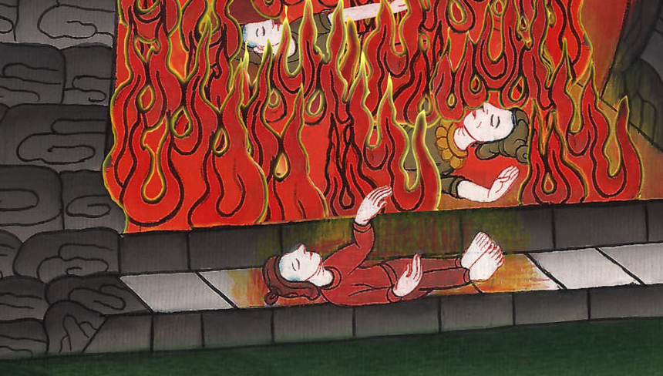
Daniel 3:22,23

Slide 41
24Then Nebuchadnezzar the king was astonished and rose up in haste. He spoke and said to his counselors, “Didn’t we cast three men bound into the middle of the fire?”
They answered the king, “True, O king.”
John

Slide 42
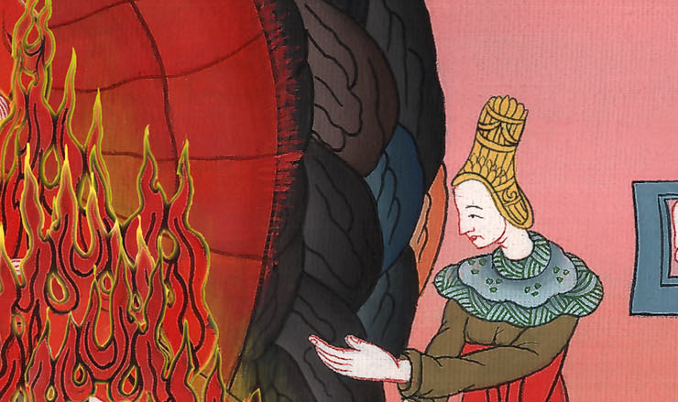
Daniel 3:24

Slide 43
25He answered, “Look, I see four men loose, walking in the middle of the fire, and they are unharmed. The appearance of the fourth is like a son of the gods.”
John

Slide 44
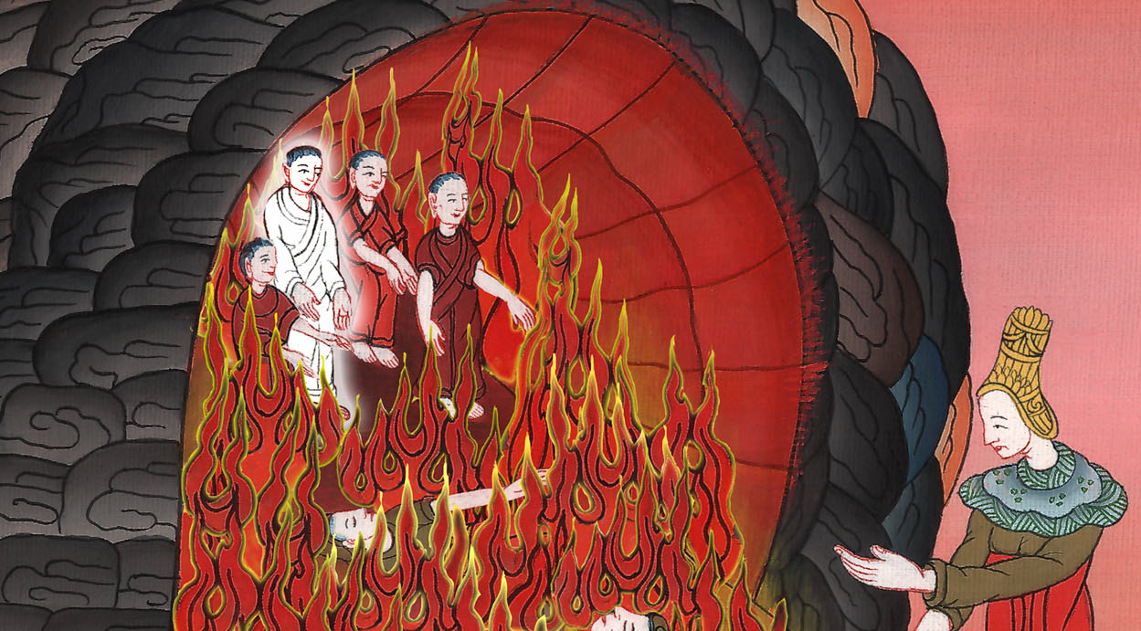
Daniel 3:25

Slide 45
26Then Nebuchadnezzar came near to the mouth of the burning fiery furnace. He spoke and said, “Shadrach, Meshach, and Abednego, you servants of the Most High God, come out, and come here!”
Then Shadrach, Meshach, and Abednego came out of the middle of the fire.
John

Slide 46
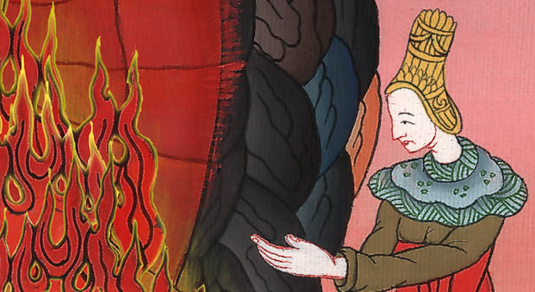
Daniel 3:26

Slide 47
27The local governors, the deputies, and the governors, and the king’s counselors, being gathered together, saw these men, that the fire had no power on their bodies. The hair of their head wasn’t singed. Their pants weren’t changed. The smell of fire wasn’t even on them.
John

Slide 48
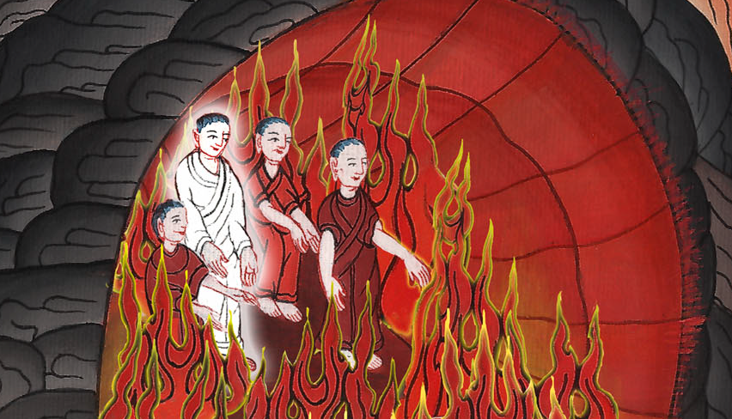
Daniel 3:27

Slide 49
28Nebuchadnezzar spoke and said, “Blessed be the God of Shadrach, Meshach, and Abednego, who has sent his angel and delivered his servants who trusted in him, and have changed the king’s word, and have yielded their bodies, that they might not serve nor worship any god except their own God.
John

Slide 50
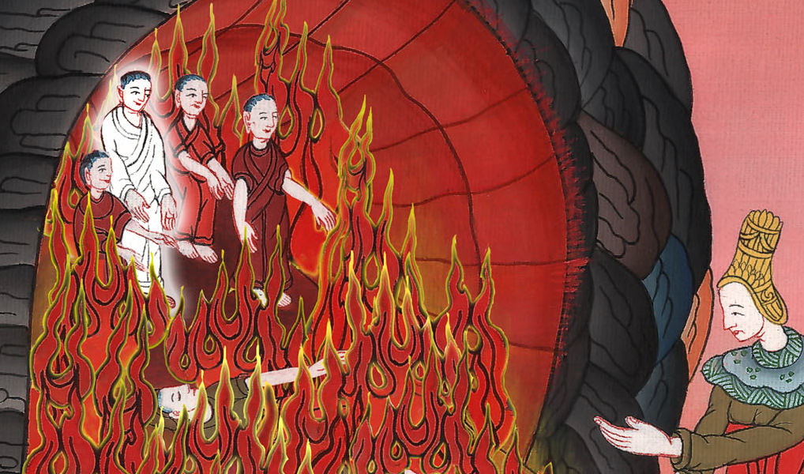
Daniel 3:28

Slide 51
29Therefore I make a decree that every people, nation, and language which speak anything evil against the God of Shadrach, Meshach, and Abednego shall be cut in pieces, and their houses shall be made a dunghill, because there is no other god who is able to deliver like this.”
John

Slide 52
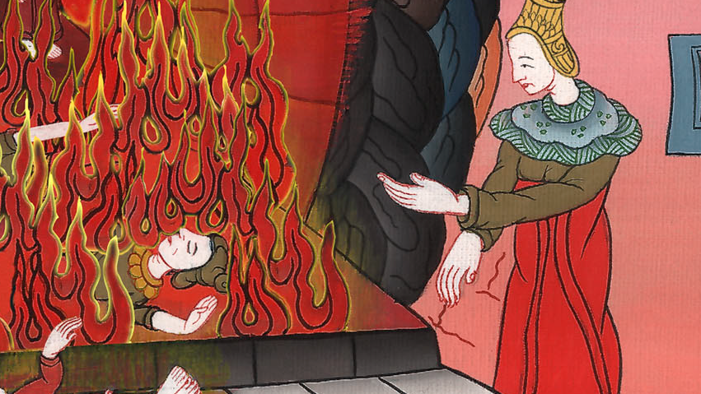
Daniel 3:29

Slide 53
30Then the king promoted Shadrach, Meshach, and Abednego in the province of Babylon.
John

Slide 54
Daniel 3:30

