Slide 1
26-4
This work is licensed under a Creative Commons Attribution-Sharealike 4.0 International License.
Please add this statement to all the videos you create.
English Bible quotes are from the World English Bible US, which is in the public domain.
Notes:
Ch
26 Daniel
1. Daniel and friends eat vegetables – Daniel 1:1-21 (Center Top)
2. Nebuchadnezzar’s Statue dream – Daniel 2:1-49 (Left Top)
3. The furnace – Daniel 3:1-30 (Right Top)
4. Nebuchadnezzar’s Tree Dream – Daniel 4:1-37 (Right Bottom)
5. Handwriting on the wall – Daniel 5:1-31 (Center Bottom)
6. Daniel’s prayer life – Daniel 6:1-11 [Daniel 7-12 – Visions] (Left Bottom)
7. Lion’s den – Daniel 6:12-28 (Center)

Slide 2
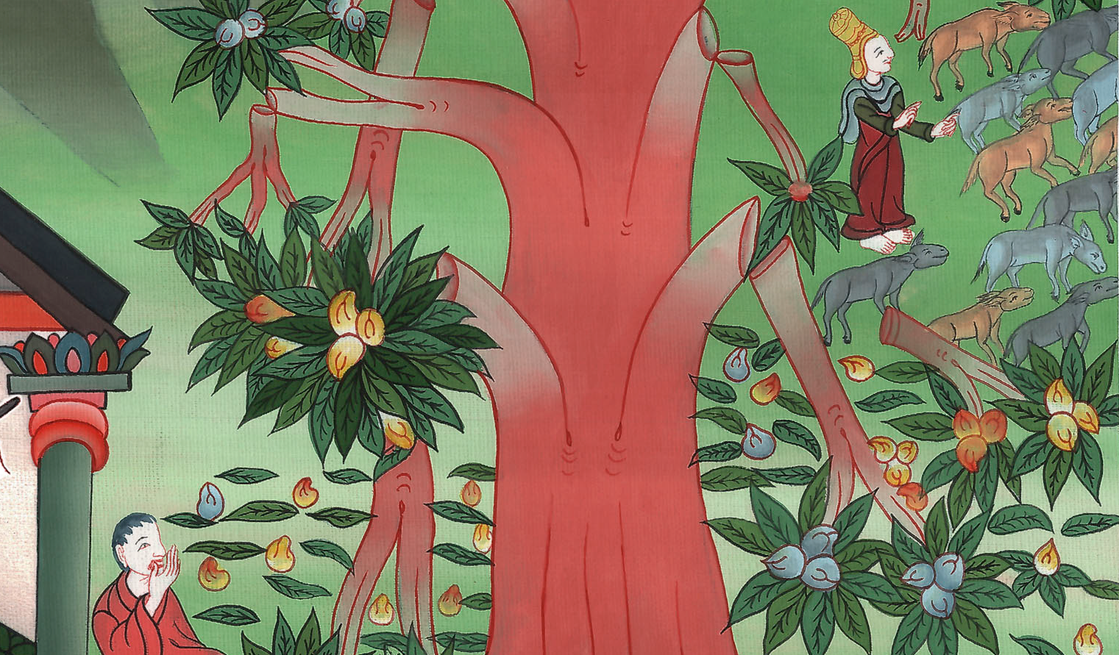
Nebuchadnezzar’s Tree Dream – Daniel 4:1-37

Slide 3
4. Nebuchadnezzar’s Tree Dream – Daniel 4:1-37 (Right Bottom)
John

Slide 4
Nebuchadnezzar’s Tree Dream – Daniel 4:1-37

Slide 5
Daniel4:1Nebuchadnezzar the king,
to all the peoples, nations, and languages, who dwell in all the earth: Peace be multiplied to you.
John

Slide 6
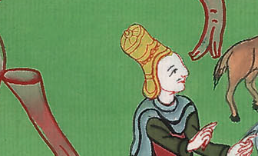
Daniel 4:1

Slide 7
2It has seemed good to me to show the signs and wonders that the Most High God has worked toward me.
John

Slide 8
Daniel 4:2

Slide 9
3How great are his signs!
How mighty are his wonders!
His kingdom is an everlasting kingdom.
His dominion is from generation to generation.
John

Slide 10
Daniel 4:3

Slide 11
4I, Nebuchadnezzar, was at rest in my house, and flourishing in my palace. 5I saw a dream which made me afraid; and the thoughts on my bed and the visions of my head troubled me.
John

Slide 12
Daniel 4:4,5

Slide 13
6Therefore I made a decree to bring in all the wise men of Babylon before me, that they might make known to me the interpretation of the dream.
John

Slide 14
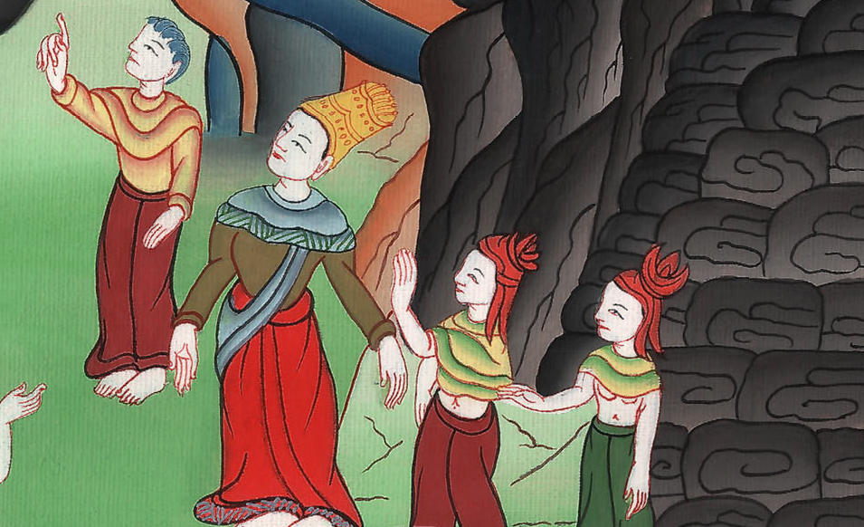
Daniel 4:6

Slide 15
7Then the magicians, the enchanters, the Chaldeans, and the soothsayers came in; and I told them the dream, but they didn’t make known to me its interpretation.
John

Slide 16
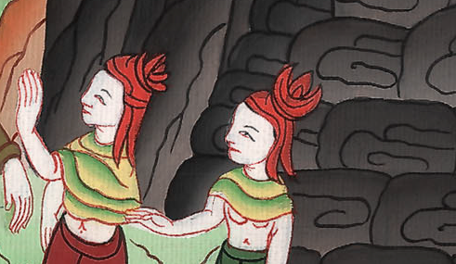
Daniel 4:7

Slide 17
8But at last, Daniel came in before me, whose name was Belteshazzar according to the name of my god, and in whom is the spirit of the holy gods. I told the dream before him, saying,
John

Slide 18
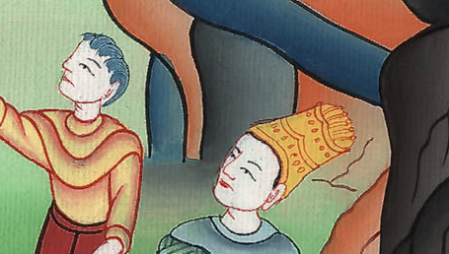
Daniel 4:8

Slide 19
9“Belteshazzar, master of the magicians, because I know that the spirit of the holy gods is in you and no secret troubles you, tell me the visions of my dream that I have seen, and its interpretation.
John

Slide 20
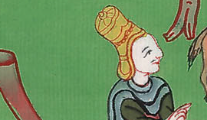
Daniel 4:9

Slide 21
10These were the visions of my head on my bed: I saw, and behold, a tree in the middle of the earth; and its height was great. 11The tree grew and was strong. Its height reached to the sky and its sight to the end of all the earth.
John

Slide 22
Daniel 4:10,11

Slide 23
12Its leaves were beautiful, and it had much fruit, and in it was food for all. The animals of the field had shade under it, and the birds of the sky lived in its branches, and all flesh was fed from it.
John

Slide 24
Daniel 4:12

Slide 25
13“I saw in the visions of my head on my bed, and behold, a holy watcher came down from the sky.
John

Slide 26
Daniel 4:13

Slide 27
14He cried aloud and said this: ‘Cut down the tree, and cut off its branches! Shake off its leaves and scatter its fruit! Let the animals get away from under it and the birds from its branches.
John

Slide 28
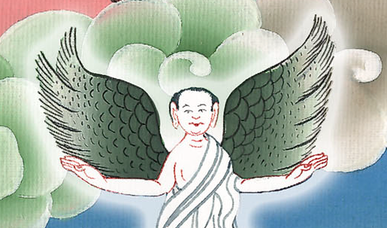
Daniel 4:14

Slide 29
15Nevertheless leave the stump of its roots in the earth, even with a band of iron and bronze, in the tender grass of the field; and let it be wet with the dew of the sky. Let his portion be with the animals in the grass of the earth.
John

Slide 30
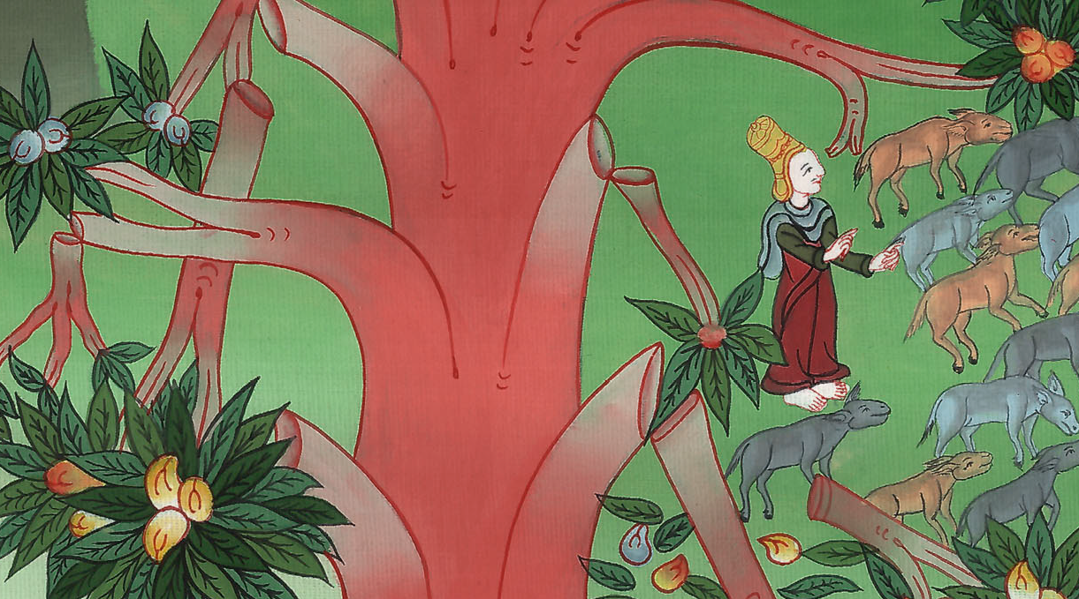
Daniel 4:15

Slide 31
16Let his heart be changed from man’s, and let an animal’s heart be given to him. Then let seven times pass over him.
John

Slide 32
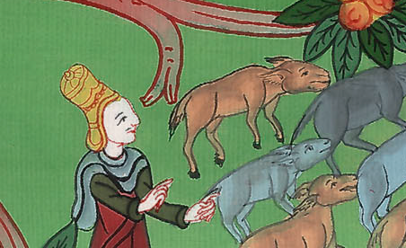
Daniel 4:16

Slide 33
19Then Daniel, whose name was Belteshazzar, was stricken mute for a while, and his thoughts troubled him. The king answered, “Belteshazzar, don’t let the dream or the interpretation, trouble you.”
John

Slide 34
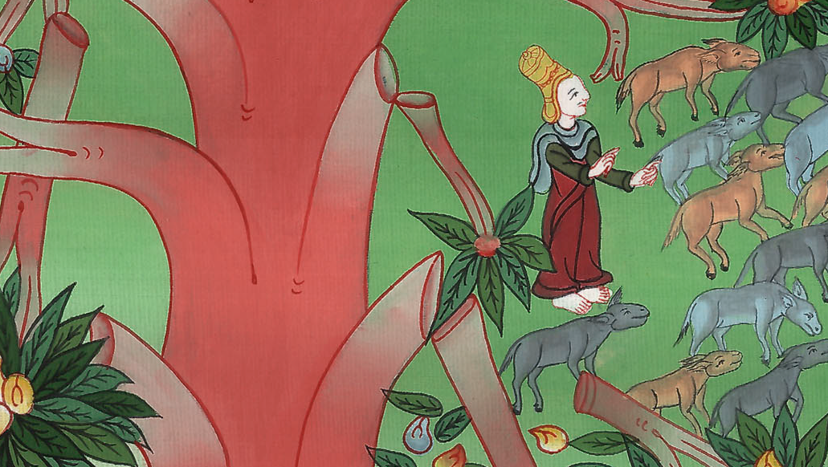
Daniel 4:18

Slide 35
Belteshazzar answered, “My lord, may the dream be for those who hate you, and its interpretation to your adversaries.
John

Slide 36
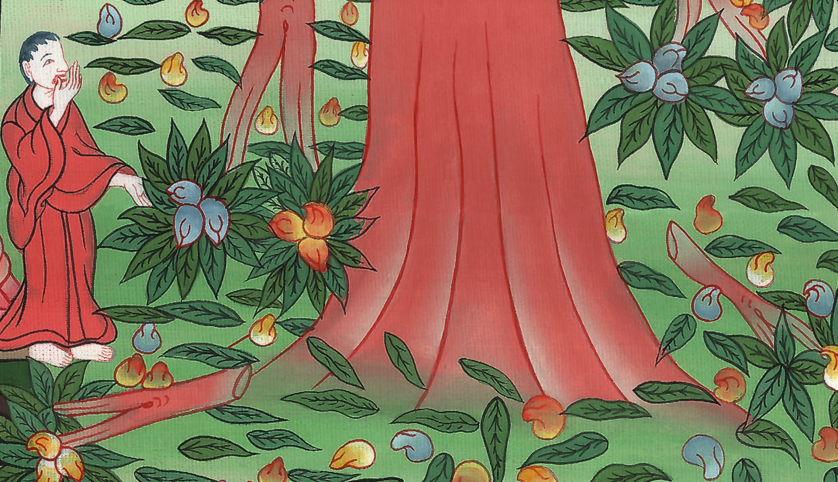
Daniel 4:19

Slide 37
20The tree that you saw, which grew and was strong, whose height reached to the sky and its sight to all the earth; 21whose leaves were beautiful and its fruit plentiful, and in it was food for all; under which the animals of the field lived, and on whose branches the birds of the sky had their habitation—
John

Slide 38
Daniel 4:20,21

Slide 39
22it is you, O king, that have grown and become strong; for your greatness has grown, and reaches to the sky, and your dominion to the end of the earth.
John

Slide 40
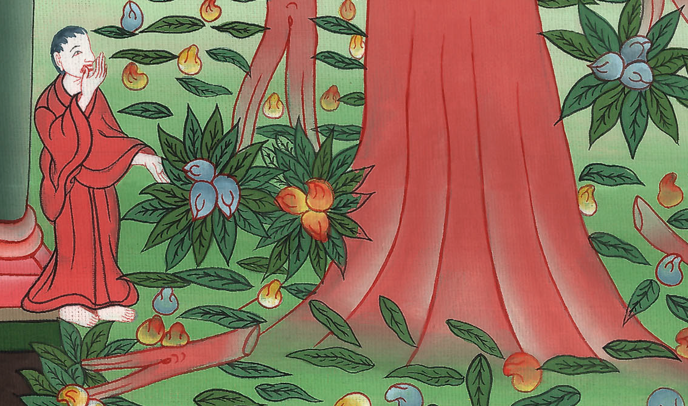
Daniel 4:22

Slide 41
24“This is the interpretation, O king, and it is the decree of the Most High, which has come on my lord the king:
John

Slide 42
Daniel 4:24

Slide 43
25You will be driven from men and your dwelling shall be with the animals of the field. You will be made to eat grass as oxen, and will be wet with the dew of the sky, and seven times shall pass over you, until you know that the Most High rules in the kingdom of men, and gives it to whomever he will.
John

Slide 44
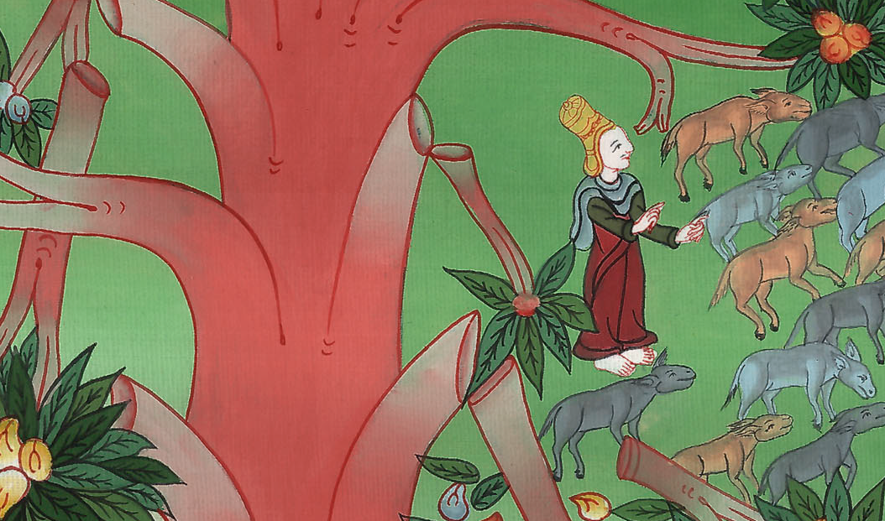
Daniel 4:25

Slide 45
26Whereas it was commanded to leave the stump of the roots of the tree, your kingdom shall be sure to you after you know that Heavens rules.
John

Slide 46
Daniel 4:26

Slide 47
27Therefore, O king, let my counsel be acceptable to you, and break off your sins by righteousness, and your iniquities by showing mercy to the poor. Perhaps there may be a lengthening of your tranquility.”
John

Slide 48
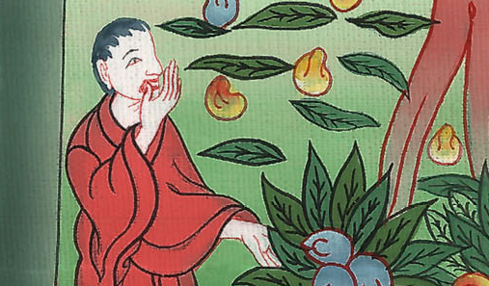
Daniel 4:27

Slide 49
28All this came on the King Nebuchadnezzar. 29At the end of twelve months he was walking in the royal palace of Babylon.
John

Slide 50
Daniel 4:28,29

Slide 51
30The king spoke and said, “Is not this great Babylon, which I have built for the royal dwelling place by the might of my power and for the glory of my majesty?”
John

Slide 52
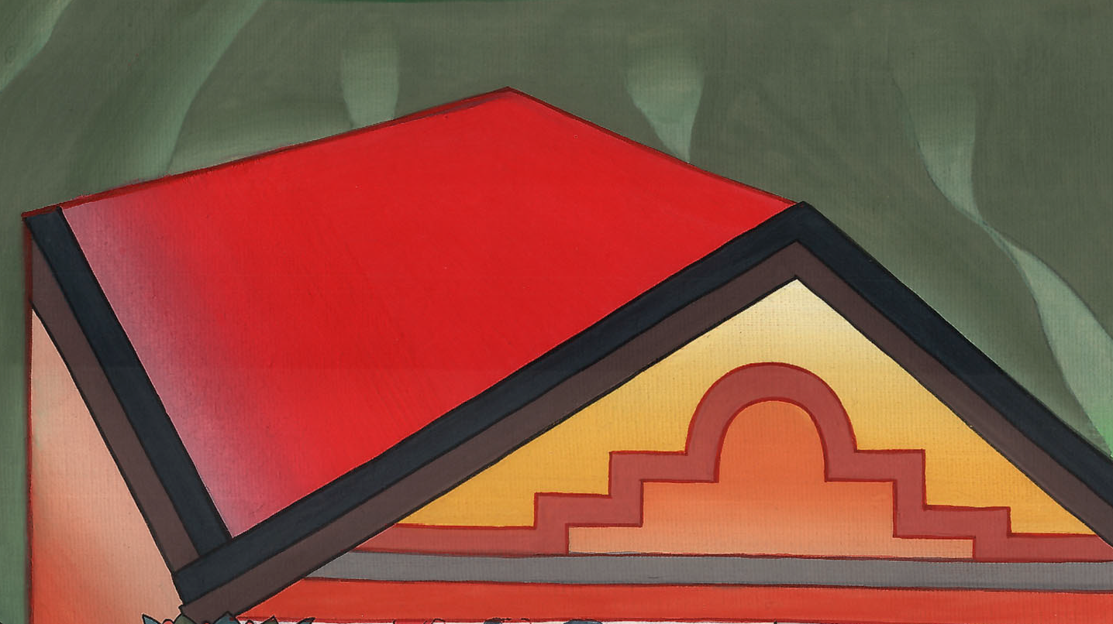
Daniel 4:30

Slide 53
31While the word was in the king’s mouth, a voice came from the sky, saying, “O King Nebuchadnezzar, to you it is spoken: ‘The kingdom has departed from you.
John

Slide 54
Daniel 4:31

Slide 55
32You shall be driven from men, and your dwelling shall be with the animals of the field. You shall be made to eat grass like oxen. Seven times shall pass over you, until you know that the Most High rules in the kingdom of men, and gives it to whomever he will.’”
John

Slide 56
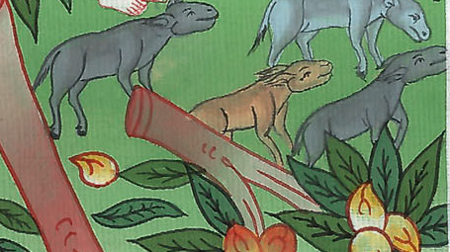
Daniel 4:32

Slide 57
33This was fulfilled the same hour on Nebuchadnezzar. He was driven from men and ate grass like oxen; and his body was wet with the dew of the sky until his hair had grown like eagles’ feathers, and his nails like birds’ claws.
John

Slide 58
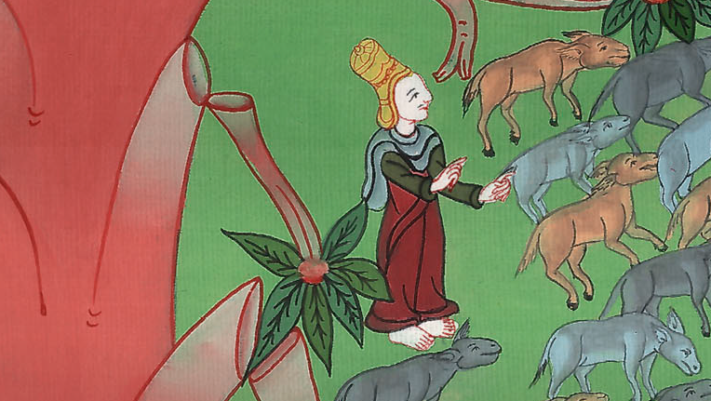
Daniel 4:33

Slide 59
34At the end of the days I, Nebuchadnezzar, lifted up my eyes to heaven, and my understanding returned to me; and I blessed the Most High, and I praised and honored him who lives forever,
for his dominion is an everlasting dominion,
and his kingdom from generation to generation.
John

Slide 60
Daniel 4:34

Slide 61
36At the same time my understanding returned to me; and for the glory of my kingdom, my majesty and brightness returned to me. My counselors and my lords sought me; and I was established in my kingdom, and excellent greatness was added to me.
John

Slide 62
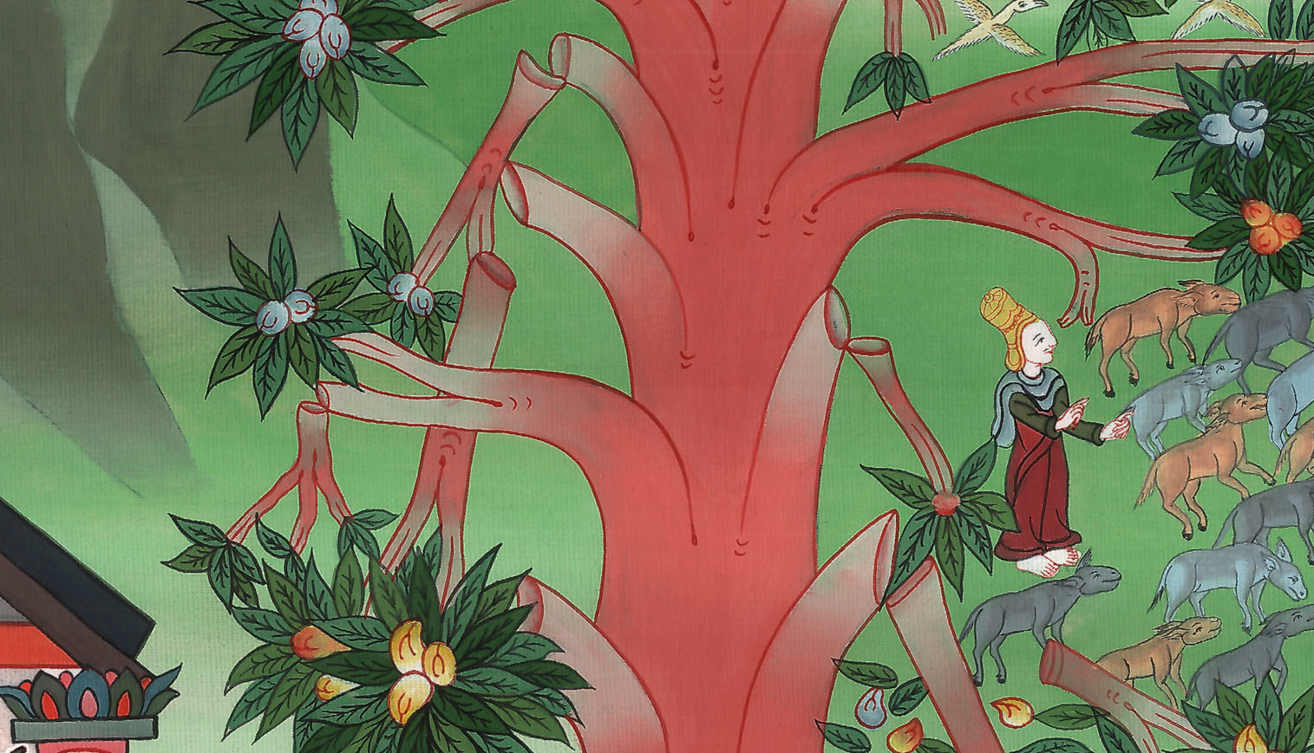
Daniel 4:36

Slide 63
37Now I, Nebuchadnezzar, praise and extol and honor the King of heaven; for all his works are truth, and his ways justice; and those who walk in pride he is able to abase.
John

Slide 64
Daniel 4:37

