Slide 1
26-5
This work is licensed under a Creative Commons Attribution-Sharealike 4.0 International License.
Please add this statement to all the videos you create.
English Bible quotes are from the World English Bible US, which is in the public domain.
Notes:
Ch
26 Daniel
1. Daniel and friends eat vegetables – Daniel 1:1-21 (Center Top)
2. Nebuchadnezzar’s Statue dream – Daniel 2:1-49 (Left Top)
3. The furnace – Daniel 3:1-30 (Right Top)
4. Nebuchadnezzar’s Tree Dream – Daniel 4:1-37 (Right Bottom)
5. Handwriting on the wall – Daniel 5:1-31 (Center Bottom)
6. Daniel’s prayer life – Daniel 6:1-11 [Daniel 7-12 – Visions] (Left Bottom)
7. Lion’s den – Daniel 6:12-28 (Center)

Slide 2
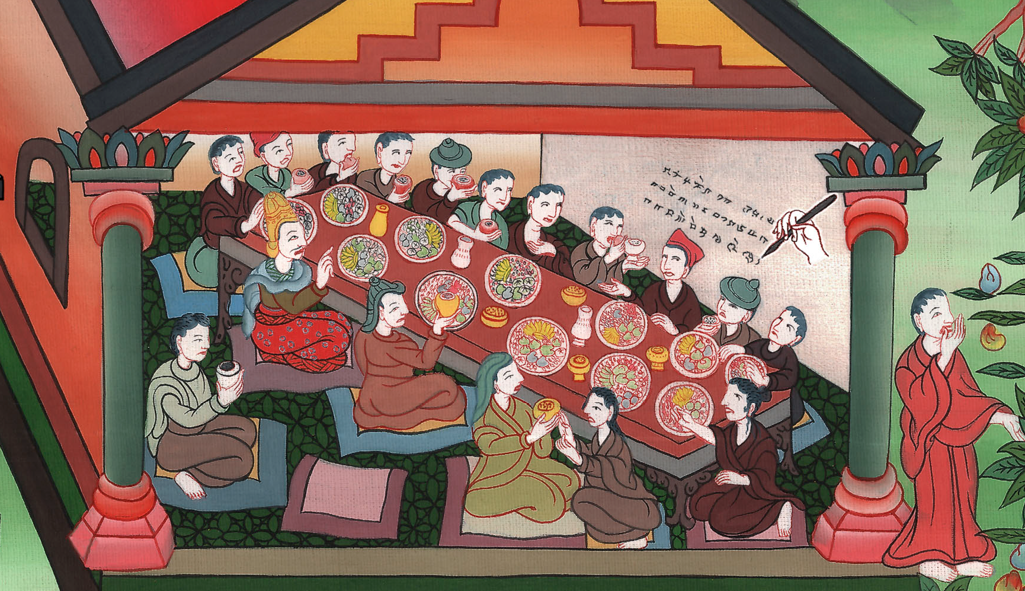
Handwriting on the wall –
Daniel 5:1-31

Slide 3
5. Handwriting on the wall – Daniel 5:1-31 (Center Bottom)
John

Slide 4
Handwriting on the wall –
Daniel 5:1-31

Slide 5
Daniel5:1Belshazzar the king made a great feast to a thousand of his lords, and drank wine before the thousand.
John

Slide 6
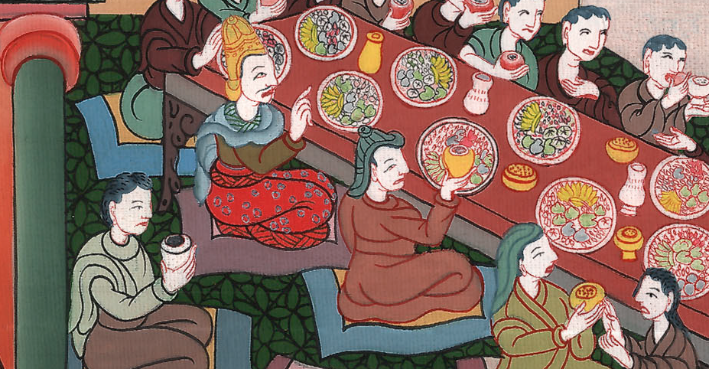
Daniel 5:1

Slide 7
2Belshazzar, while he tasted the wine, commanded that the golden and silver vessels which Nebuchadnezzar his father had taken out of the temple which was in Jerusalem be brought to him, that the king and his lords, his wives and his concubines, might drink from them.
John

Slide 8
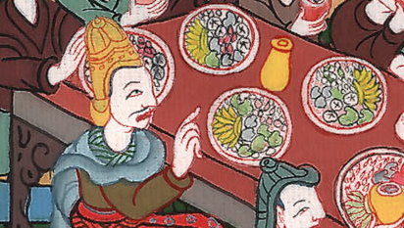
Daniel 5:2

Slide 9
3Then they brought the golden vessels that were taken out of the temple of God’s house which was at Jerusalem; and the king and his lords, his wives and his concubines, drank from them.
John

Slide 10
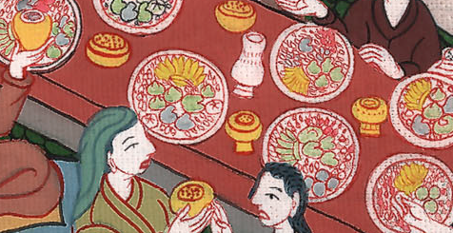
Daniel 5:3

Slide 11
4They drank wine, and praised the gods of gold, and of silver, of bronze, of iron, of wood, and of stone.
John

Slide 12
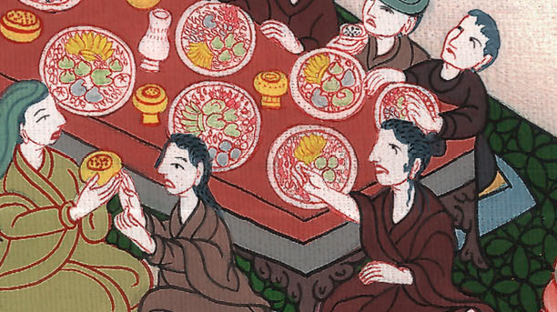
Daniel 5:4

Slide 13
5In the same hour, the fingers of a man’s hand came out and wrote near the lamp stand on the plaster of the wall of the king’s palace. The king saw the part of the hand that wrote.
John

Slide 14
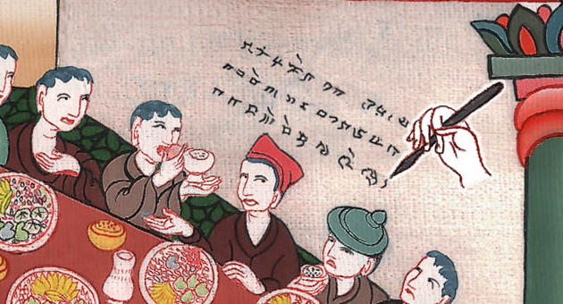
Daniel 5:5

Slide 15
6Then the king’s face was changed in him, and his thoughts troubled him; and the joints of his thighs were loosened, and his knees struck one against another.
7The king cried aloud to bring in the enchanters, the Chaldeans, and the soothsayers.
John

Slide 16
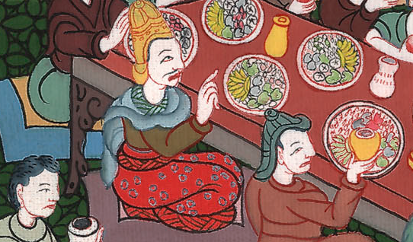
Daniel 5:6,7

Slide 17
The king spoke and said to the wise men of Babylon, “Whoever reads this writing and shows me its interpretation shall be clothed with purple, and have a chain of gold about his neck, and shall be the third ruler in the kingdom.”
John

Slide 18
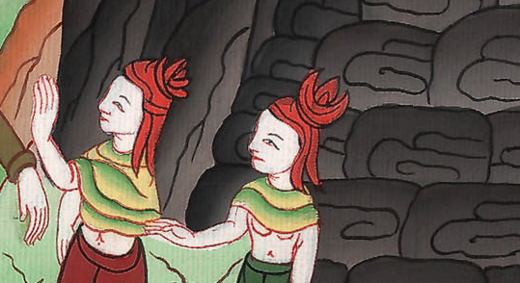
Daniel 5:7

Slide 19
8Then all the king’s wise men came in; but they could not read the writing, and couldn’t make known to the king the interpretation. 9Then King Belshazzar was greatly troubled, and his face was changed in him, and his lords were perplexed.
John

Slide 20
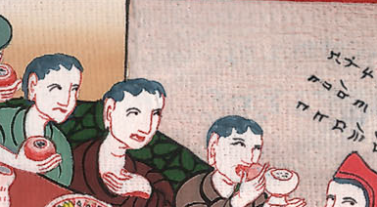
Daniel 5:8,9

Slide 21
10The queen by reason of the words of the king and his lords came into the banquet house. The queen spoke and said, “O king, live forever; don’t let your thoughts trouble you, nor let your face be changed.
John

Slide 22
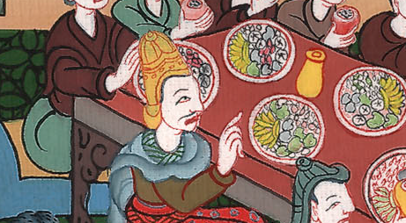
Daniel 5:10

Slide 23
11There is a man in your kingdom in whom is the spirit of the holy gods; and in the days of your father, light and understanding and wisdom, like the wisdom of the gods, were found in him. The king, Nebuchadnezzar, your father—yes, the king, your father—made him master of the magicians, enchanters, Chaldeans, and soothsayers,
John

Slide 24
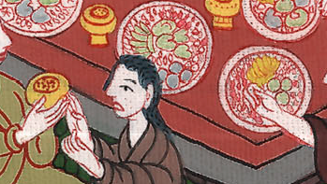
Daniel 5:11

Slide 25
12because an excellent spirit, knowledge, understanding, interpreting of dreams, showing of dark sentences, and dissolving of doubts were found in the same Daniel, whom the king named Belteshazzar. Now let Daniel be called, and he will show the interpretation.”
John

Slide 26
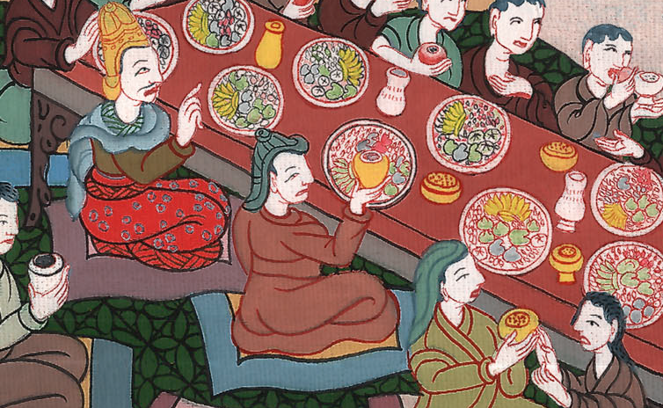
Daniel 5:12

Slide 27
13Then Daniel was brought in before the king. The king spoke and said to Daniel, “Are you that Daniel of the children of the captivity of Judah, whom the king my father brought out of Judah?
John

Slide 28
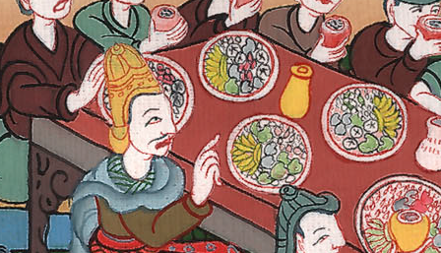
Daniel 5:13

Slide 29
14I have heard of you, that the spirit of the gods is in you and that light, understanding, and excellent wisdom are found in you.
John

Slide 30
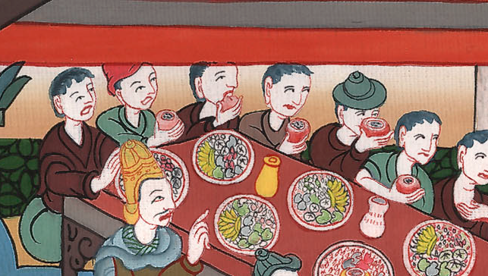
Daniel 5:14

Slide 31
15Now the wise men, the enchanters, have been brought in before me, that they should read this writing, and make known to me its interpretation; but they could not show the interpretation of the thing.
John

Slide 32
Daniel 5:15

Slide 33
16But I have heard of you, that you can give interpretations and dissolve doubts. Now if you can read the writing and make known to me its interpretation, you shall be clothed with purple, and have a chain of gold around your neck, and shall be the third ruler in the kingdom.”
John

Slide 34
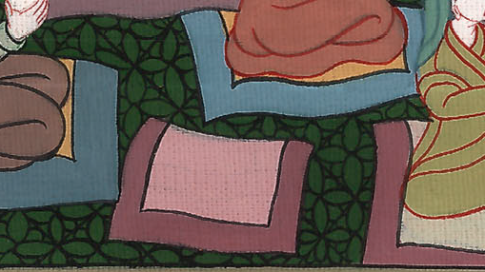
Daniel 5:16

Slide 35
17Then Daniel answered before the king, “Let your gifts be to yourself, and give your rewards to another. Nevertheless, I will read the writing to the king, and make known to him the interpretation.
John

Slide 36
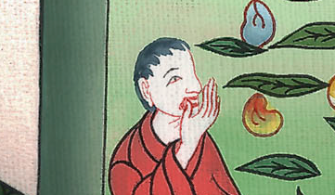
Daniel 5:17

Slide 37
18“To you, king, the Most High God gave Nebuchadnezzar your father the kingdom, and greatness, and glory, and majesty.
John

Slide 38
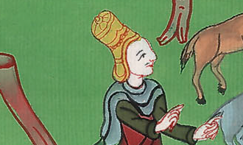
Daniel 5:18

Slide 39
20But when his heart was lifted up, and his spirit was hardened so that he dealt proudly, he was deposed from his kingly throne, and they took his glory from him.
John

Slide 40
Daniel 5:20

Slide 41
22“You, his son, Belshazzar, have not humbled your heart, though you knew all this, 23but have lifted up yourself against the Lord of heaven; and they have brought the vessels of his house before you…
John

Slide 42
Daniel 5:22,23

Slide 43
24Then the part of the hand was sent from before him, and this writing was inscribed.
25“This is the writing that was inscribed: ‘MENE, MENE, TEKEL, UPHARSIN.’
John

Slide 44
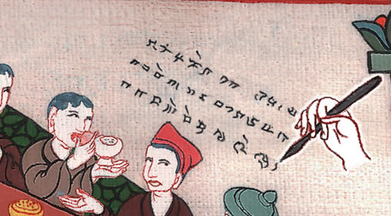
Daniel 5:24,25

Slide 45
26“This is the interpretation of the thing:
MENE: God has counted your kingdom, and brought it to an end.
John

Slide 46
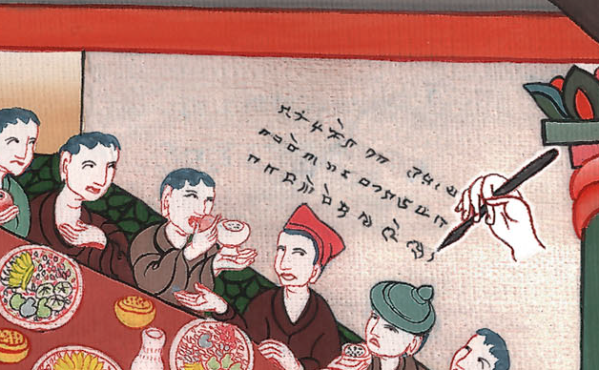
Daniel 5:26

Slide 47
27TEKEL: you are weighed in the balances, and are found wanting.
John

Slide 48
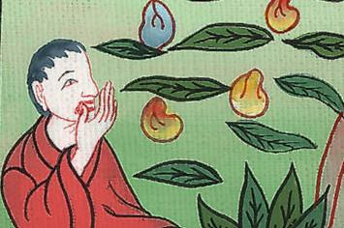
Daniel 5:27

Slide 49
28PERES: your kingdom is divided, and given to the Medes and Persians.”
John

Slide 50
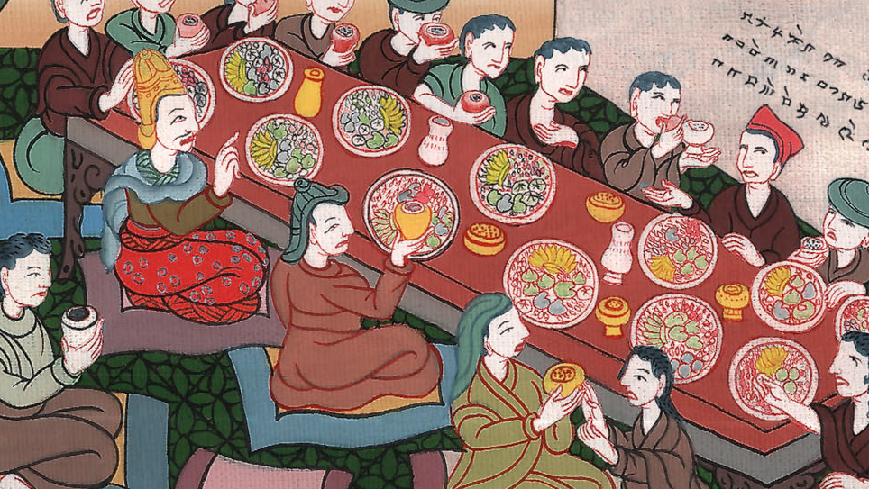
Daniel 5:28

Slide 51
29Then Belshazzar commanded, and they clothed Daniel with purple, and put a chain of gold about his neck, and made proclamation concerning him, that he should be the third ruler in the kingdom.
John

Slide 52
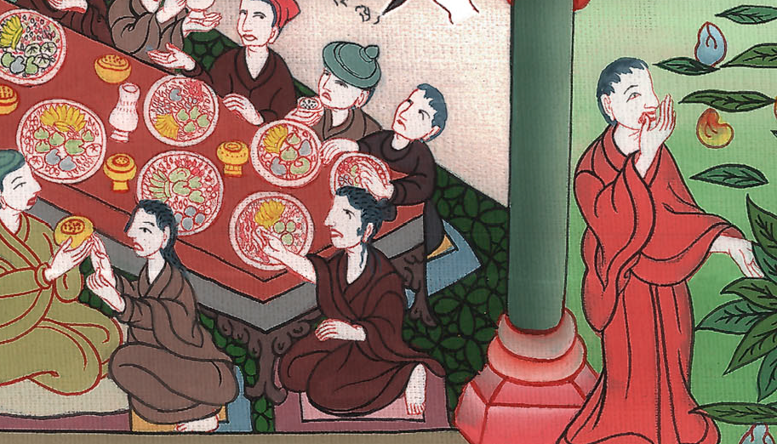
Daniel 5:29

Slide 53
30In that night Belshazzar the Chaldean King was slain. 31Darius the Mede received the kingdom, being about sixty-two years old.
John

Slide 54
Daniel 5:30,31

