Slide 1
26-6
This work is licensed under a Creative Commons Attribution-Sharealike 4.0 International License.
Please add this statement to all the videos you create.
English Bible quotes are from the World English Bible US, which is in the public domain.
Notes:
Ch
26 Daniel
1. Daniel and friends eat vegetables – Daniel 1:1-21 (Center Top)
2. Nebuchadnezzar’s Statue dream – Daniel 2:1-49 (Left Top)
3. The furnace – Daniel 3:1-30 (Right Top)
4. Nebuchadnezzar’s Tree Dream – Daniel 4:1-37 (Right Bottom)
5. Handwriting on the wall – Daniel 5:1-31 (Center Bottom)
6. Daniel’s prayer life – Daniel 6:1-11 [Daniel 7-12 – Visions] (Left Bottom)
7. Lion’s den – Daniel 6:12-28 (Center)

Slide 2
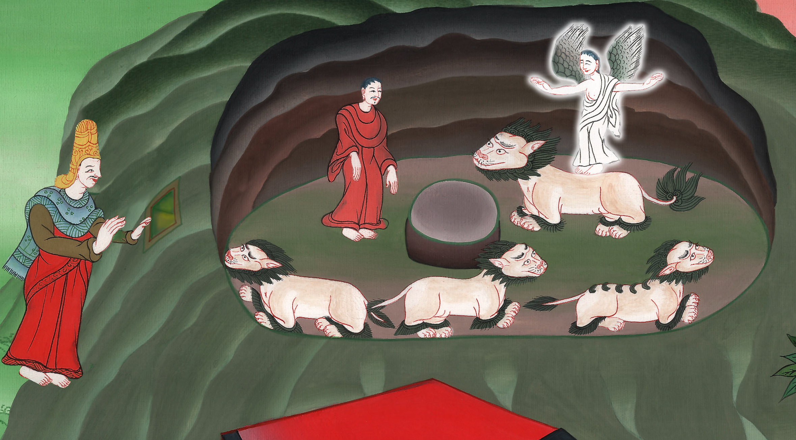
Lion’s den –
Daniel 6

Slide 3
6. Lion’s den – Daniel 6 (Center)
John

Slide 4
Lion’s den –
Daniel 6

Slide 5
Daniel6:1It pleased Darius to set over the kingdom one hundred twenty local governors, who should be throughout the whole kingdom; 2and over them three presidents, of whom Daniel was one, that these local governors might give account to them, and that the king should suffer no loss.
John

Slide 6
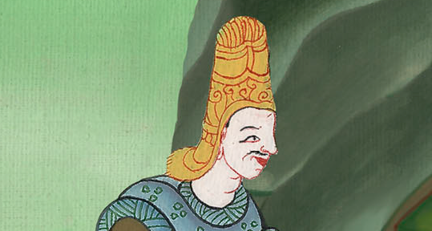
Daniel 6:1,2

Slide 7
3Then this Daniel was distinguished above the presidents and the local governors, because an excellent spirit was in him; and the king thought to set him over the whole realm.
John

Slide 8
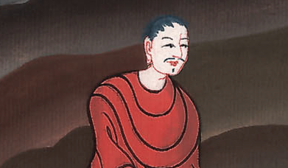
Daniel 6:3

Slide 9
4Then the presidents and the local governors sought to find occasion against Daniel as touching the kingdom; but they could find no occasion or fault, because he was faithful. There wasn’t any error or fault found in him.
John

Slide 10
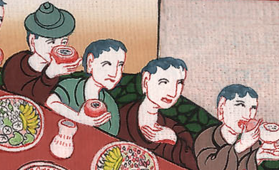
Daniel 6:4

Slide 11
5Then these men said, “We won’t find any occasion against this Daniel, unless we find it against him concerning the law of his God.”
John

Slide 12
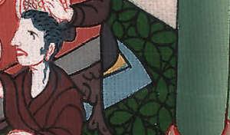
Daniel 6:5

Slide 13
6Then these presidents and local governors assembled together to the king, and said this to him, “King Darius, live forever!
John

Slide 14
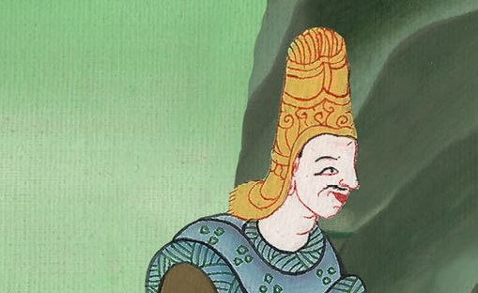
Daniel 6:6

Slide 15
7All the presidents of the kingdom, the deputies and the local governors, the counselors and the governors, have consulted together to establish a royal statute and to make a strong decree, that whoever asks a petition of any god or man for thirty days, except of you, O king, he shall be cast into the den of lions.
John

Slide 16
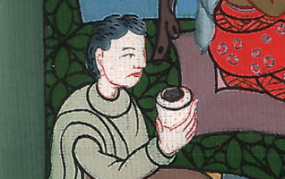
Daniel 6:7

Slide 17
8Now, O king, establish the decree and sign the writing, that it not be changed, according to the law of the Medes and Persians, which doesn’t alter.” 9Therefore King Darius signed the writing and the decree.
John

Slide 18
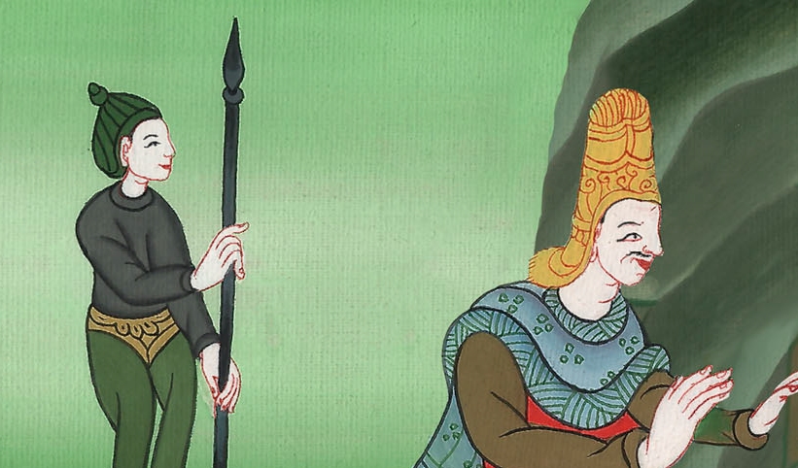
Daniel 6:8,9

Slide 19
10When Daniel knew that the writing was signed, he went into his house (now his windows were open in his room toward Jerusalem) and he kneeled on his knees three times a day, and prayed, and gave thanks before his God, as he did before.
John

Slide 20
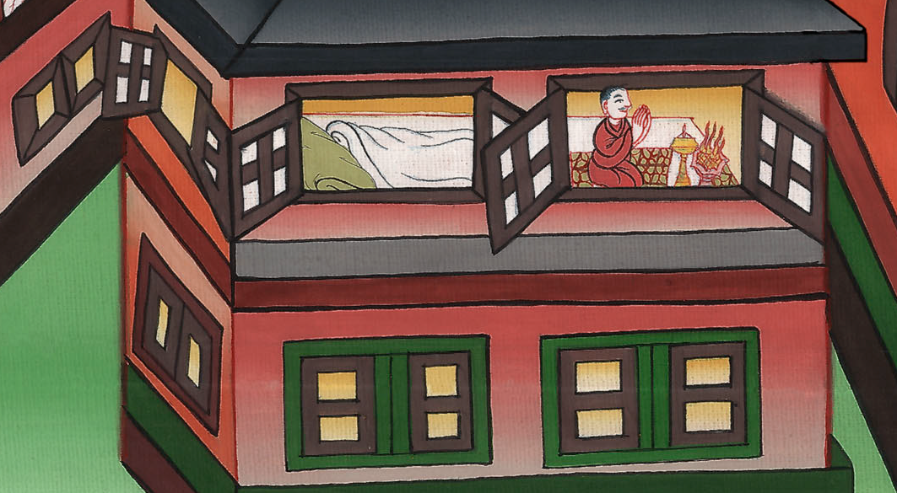
Daniel 6:10

Slide 21
11Then these men assembled together, and found Daniel making petition and supplication before his God.
John

Slide 22
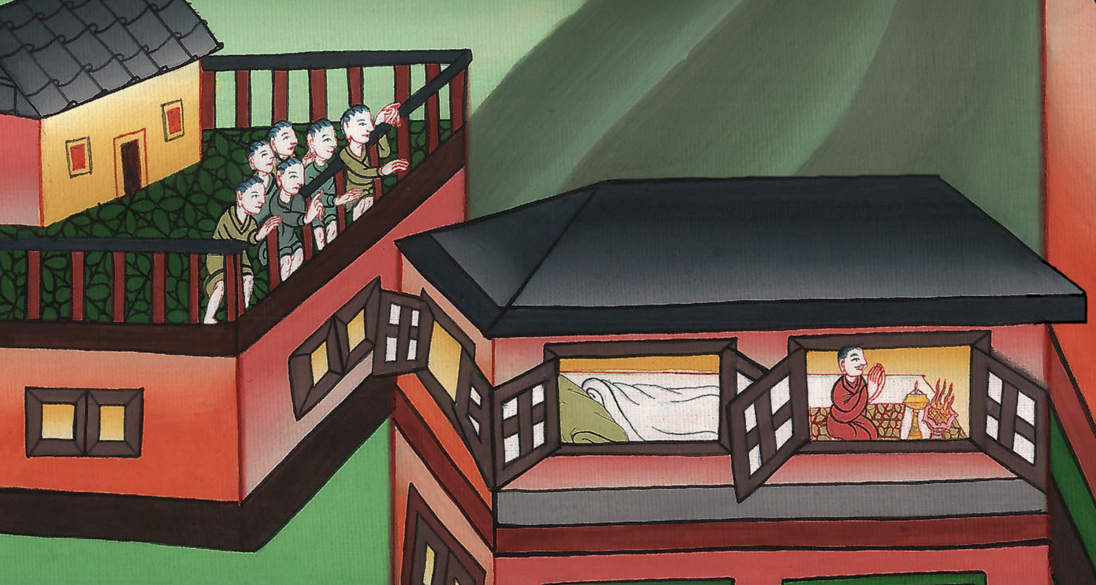
Daniel 6:11

Slide 23
12Then they came near, and spoke before the king concerning the king’s decree: “Haven’t you signed a decree that every man who makes a petition to any god or man within thirty days, except to you, O king, shall be cast into the den of lions?”
John

Slide 24
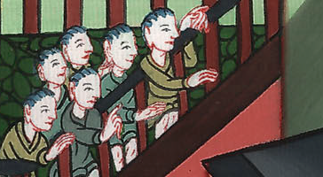
Daniel 6:12

Slide 25
The king answered, “This thing is true, according to the law of the Medes and Persians, which doesn’t alter.”
John

Slide 26
Daniel 6:12

Slide 27
13Then they answered and said before the king, “That Daniel, who is of the children of the captivity of Judah, doesn’t respect you, O king, nor the decree that you have signed, but makes his petition three times a day.”
John

Slide 28
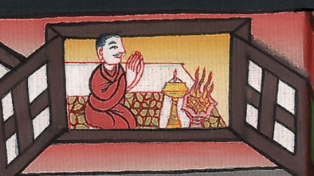
Daniel 6:13

Slide 29
14Then the king, when he heard these words, was very displeased, and set his heart on Daniel to deliver him; and he labored until the going down of the sun to rescue him.
John

Slide 30
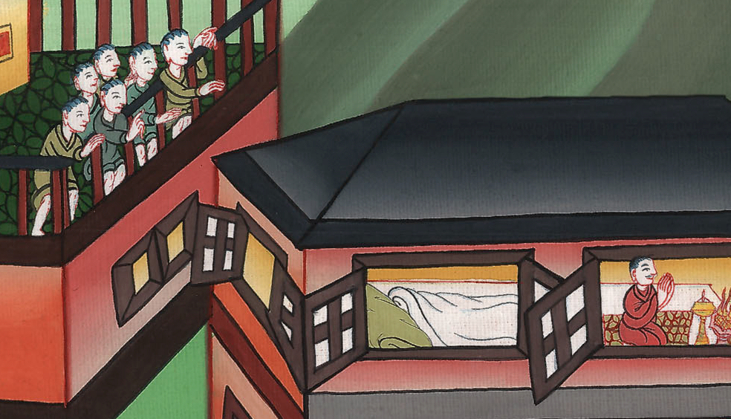
Daniel 6:14

Slide 31
15Then these men assembled together to the king, and said to the king, “Know, O king, that it is a law of the Medes and Persians, that no decree nor statute which the king establishes may be changed.”
John

Slide 32
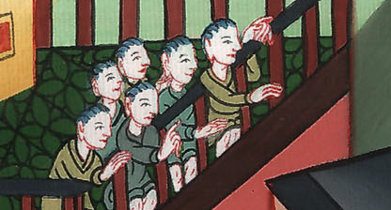
Daniel 6:15

Slide 33
16Then the king commanded, and they brought Daniel and cast him into the den of lions. The king spoke and said to Daniel, “Your God whom you serve continually, he will deliver you.”
John

Slide 34
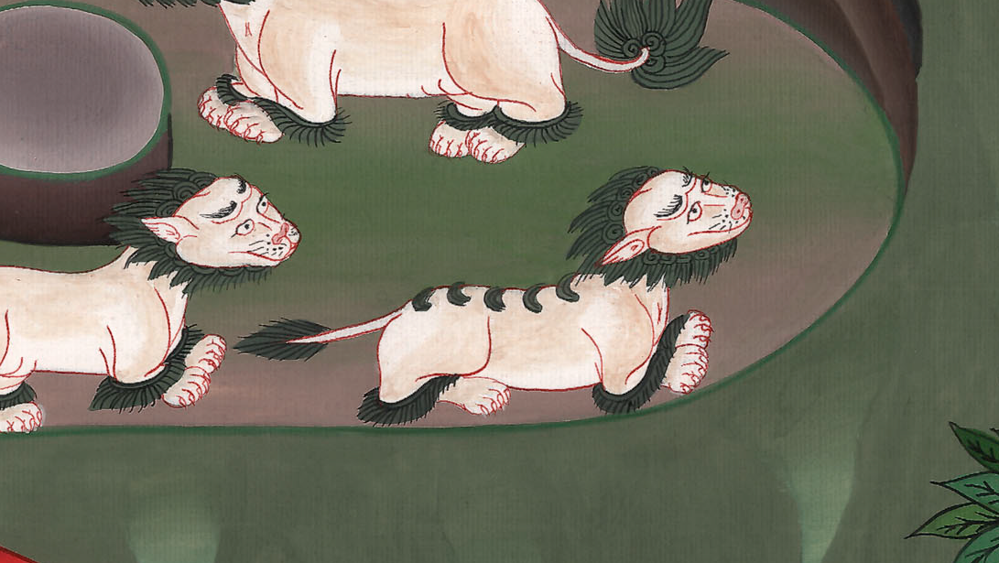
Daniel 6:16

Slide 35
17A stone was brought, and laid on the mouth of the den; and the king sealed it with his own signet, and with the signet of his lords; that nothing might be changed concerning Daniel.
John

Slide 36
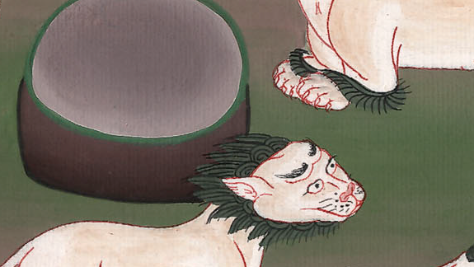
Daniel 6:17

Slide 37
18Then the king went to his palace, and passed the night fasting. No musical instruments were brought before him; and his sleep fled from him.
John

Slide 38
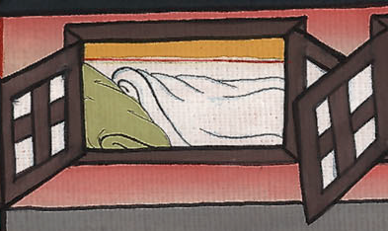
Daniel 6:18

Slide 39
19Then the king arose very early in the morning, and went in haste to the den of lions. 20When he came near to the den to Daniel, he cried with a troubled voice. The king spoke and said to Daniel, “Daniel, servant of the living God, is your God, whom you serve continually, able to deliver you from the lions?”
John

Slide 40
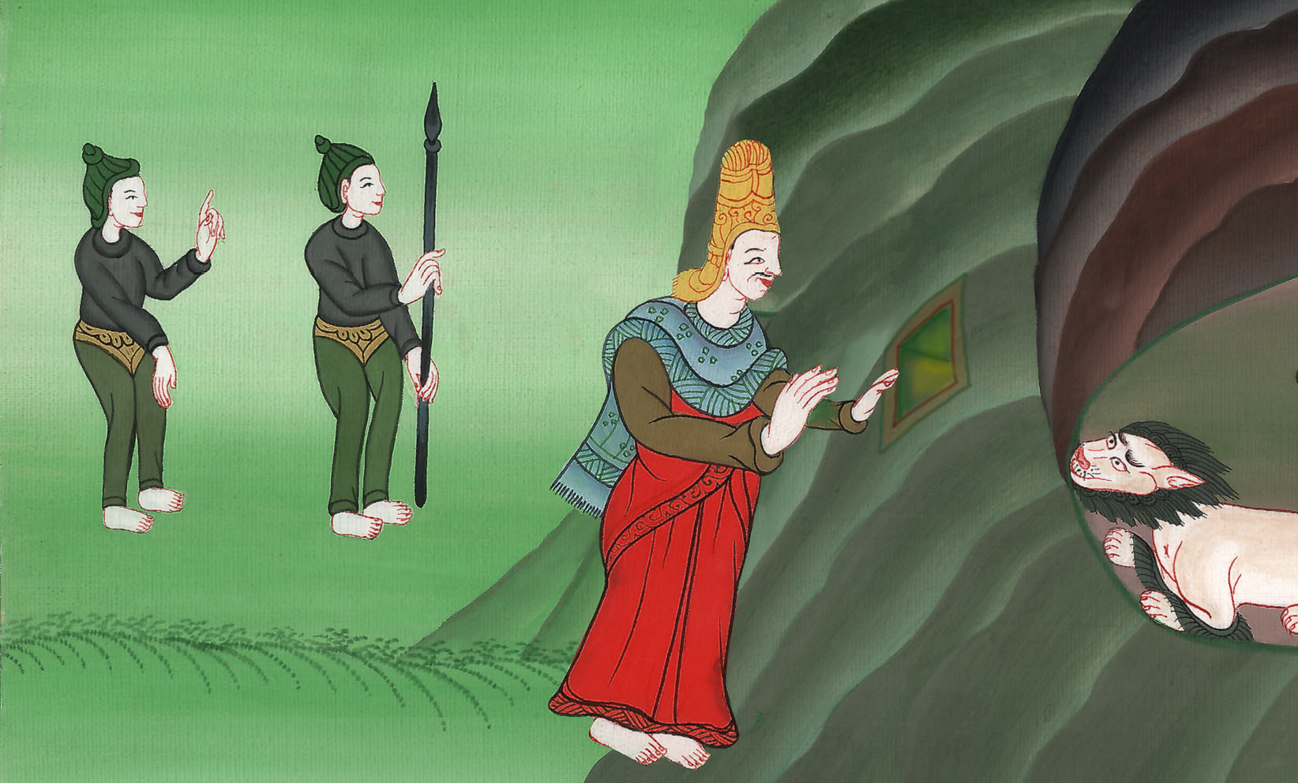
Daniel 6:19,20

Slide 41
21Then Daniel said to the king, “O king, live forever! 22My God has sent his angel, and has shut the lions’ mouths, and they have not hurt me, because innocence was found in me before him; and also before you, O king, I have done no harm.”
John

Slide 42
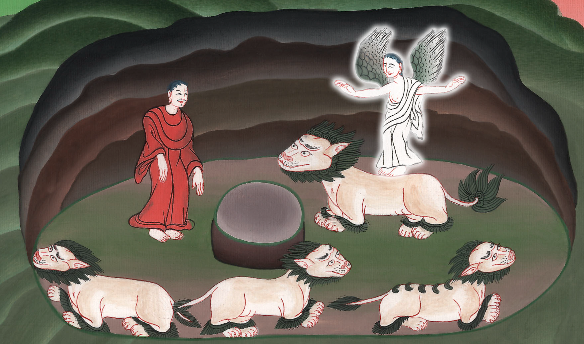
Daniel 6:21,22

Slide 43
23Then the king was exceedingly glad, and commanded that they should take Daniel up out of the den. So Daniel was taken up out of the den, and no kind of harm was found on him, because he had trusted in his God.
John

Slide 44
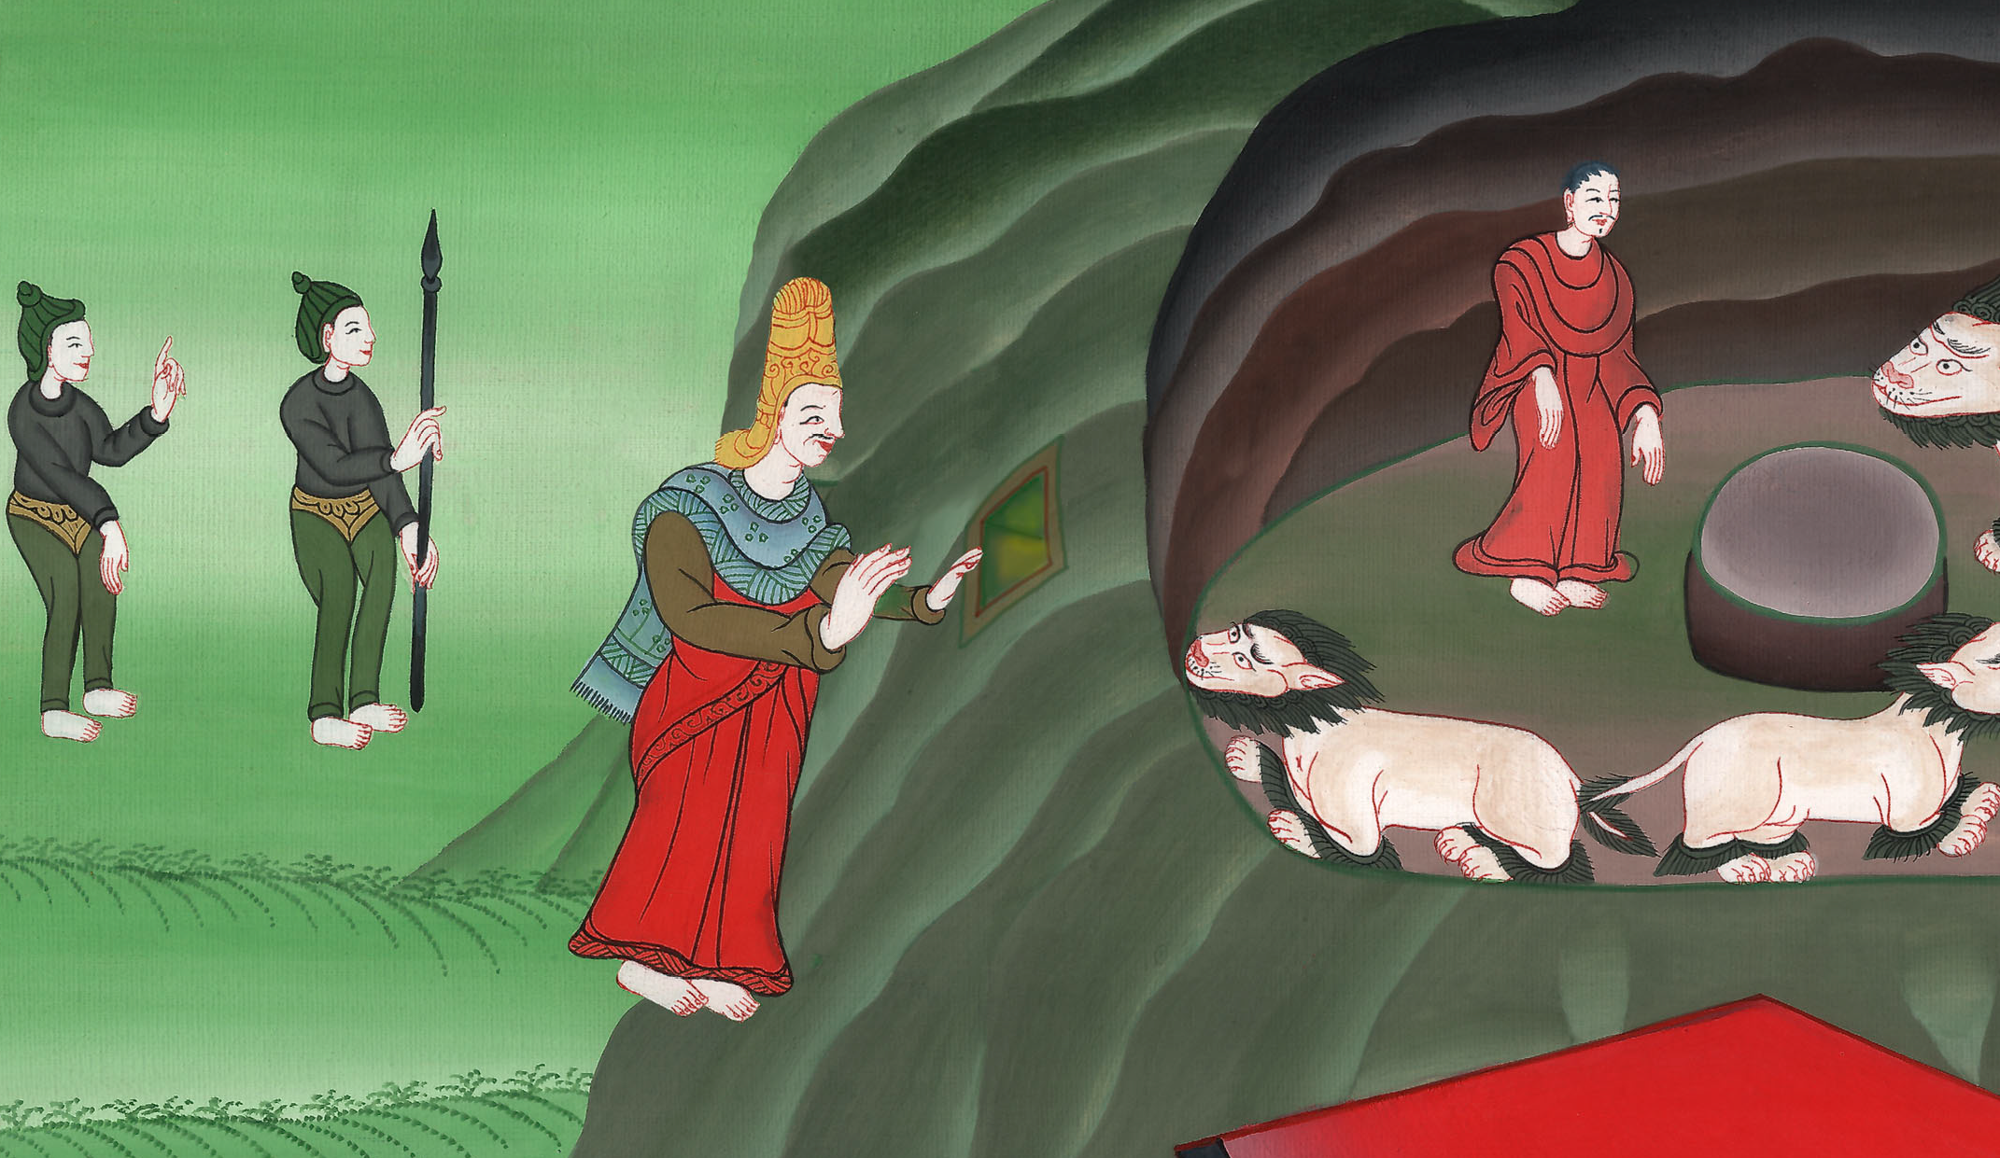
Daniel 6:23

Slide 45
24The king commanded, and they brought those men who had accused Daniel, and they cast them into the den of lions—them, their children, and their wives; and the lions mauled them, and broke all their bones in pieces before they came to the bottom of the den.
John

Slide 46
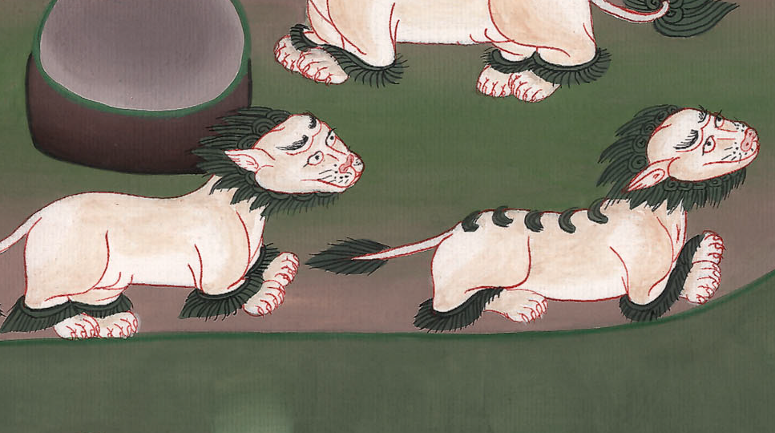
Daniel 6:24

Slide 47
25Then King Darius wrote to all the peoples, nations, and languages who dwell in all the earth:
“Peace be multiplied to you.
John

Slide 48
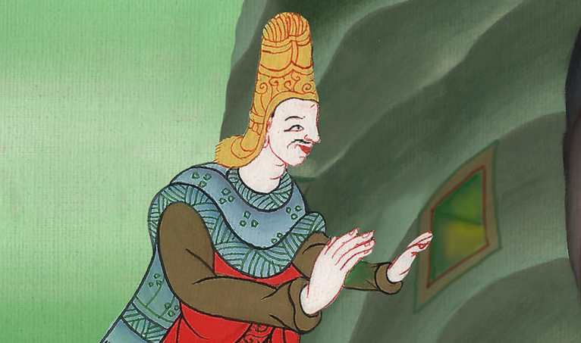
Daniel 6:25

Slide 49
26“I make a decree that in all the dominion of my kingdom men tremble and fear before the God of Daniel.
“For he is the living God,
and steadfast forever.
His kingdom is that which will not be destroyed.
His dominion will be even to the end.
John

Slide 50
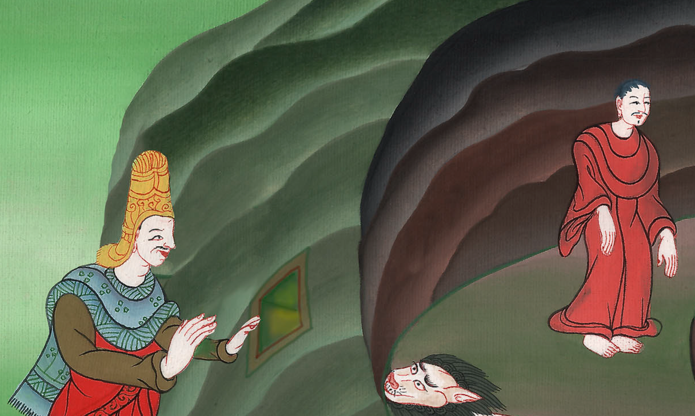
Daniel 6:26

Slide 51
27He delivers and rescues.
He works signs and wonders in heaven and in earth,
who has delivered Daniel from the power of the lions.”
John

Slide 52
Daniel 6:27

