Slide 1
27-1
This work is licensed under a Creative Commons Attribution-ShareAlike 4.0 International License.
Please add this statement to all the videos you create.
English Bible quotes are from the World English Bible US, which is in the public domain.
Notes:
Ch
27 Rebuilding of the Temple
1. Cyrus tells Jews to rebuild the temple - Ezra 1:1-11 (Left Top)
2. The altar is built - Ezra 3:1-6 (Right Top)
3. The foundation of the Temple is laid - Ezra 3:7-13 (Right 2nd)
4. Construction of the Temple stops - Ezra 4:1-5, 24 (Right 3rd)
5. Haggai and Zechariah give prophecy and rebuilding resumes - Ezra 5:1-17 (Left
Center)
6. King Darius pays for all the construction - Ezra 6:1-14 (Left Center)

Slide 2
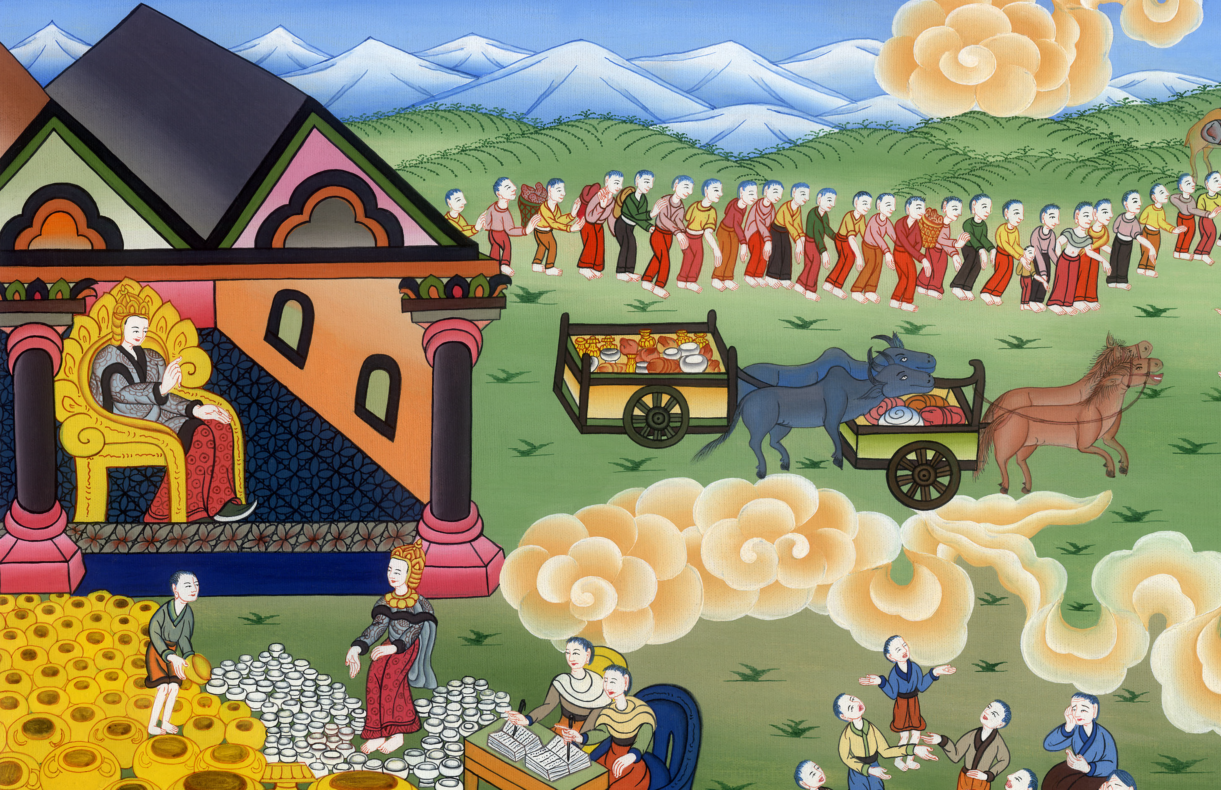
Cyrus tells Jews to rebuild the temple –
Ezra 1:1-11,2

Slide 3
27 Rebuilding of the Temple
1. Cyrus tells Jews to rebuild the temple - Ezra 1:1-11,2 (Left Top)
John

Slide 4
Cyrus tells Jews to rebuild the temple –
Ezra 1:1-11,2

Slide 5
Ezra1:1Now in the first year of Cyrus king of Persia, that Yahweh’s word by Jeremiah’s mouth might be accomplished, Yahweh stirred up the spirit of Cyrus king of Persia, so that he made a proclamation throughout all his kingdom, and put it also in writing, saying,
John

Slide 6
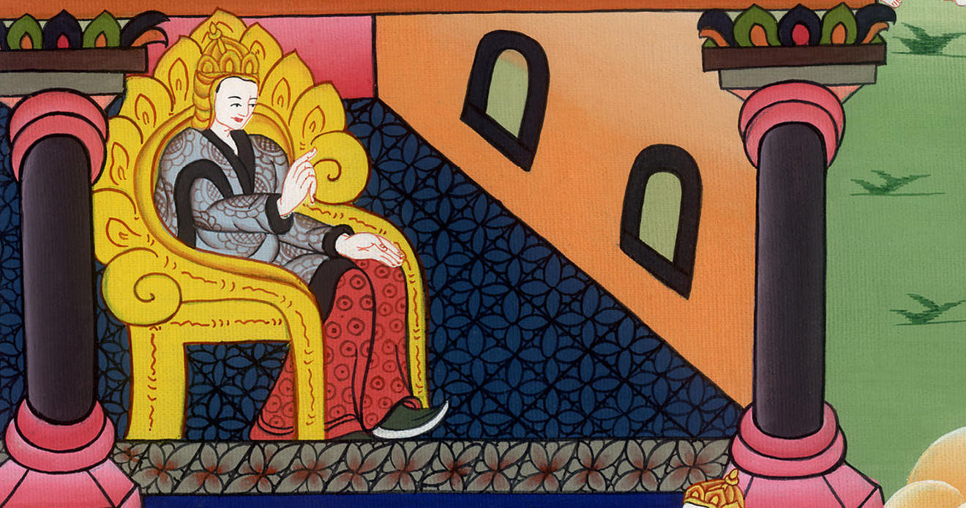
Ezra 1:1

Slide 7
2“Cyrus king of Persia says, ‘Yahweh, the God of heaven, has given me all the kingdoms of the earth; and he has commanded me to build him a house in Jerusalem, which is in Judah.
John

Slide 8
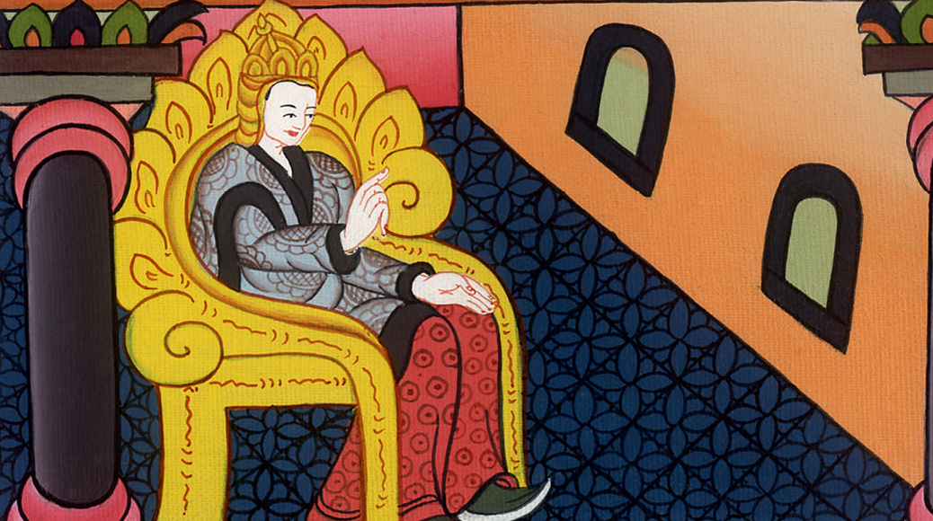
Ezra 1:2

Slide 9
3Whoever there is among you of all his people, may his God be with him, and let him go up to Jerusalem, which is in Judah, and build the house of Yahweh, the God of Israel (he is God), which is in Jerusalem.
John

Slide 10
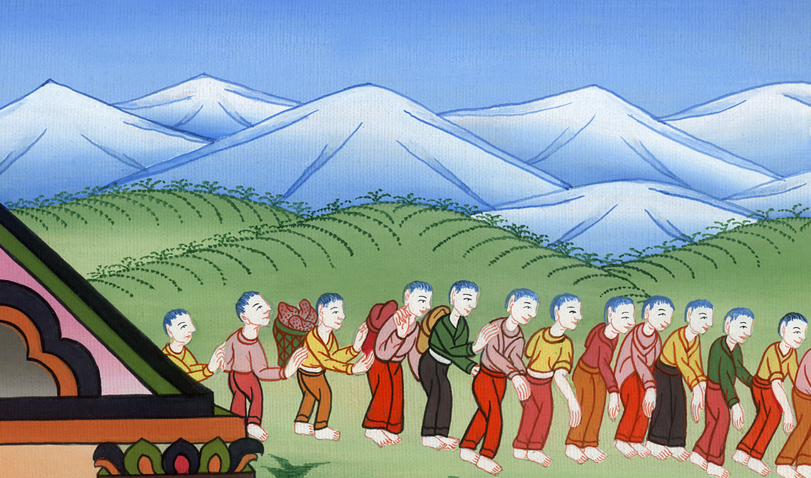
Ezra 1:3

Slide 11
4Whoever is left, in any place where he lives, let the men of his place help him with silver, with gold, with goods, and with animals, in addition to the free will offering for God’s house which is in Jerusalem.’”
John

Slide 12
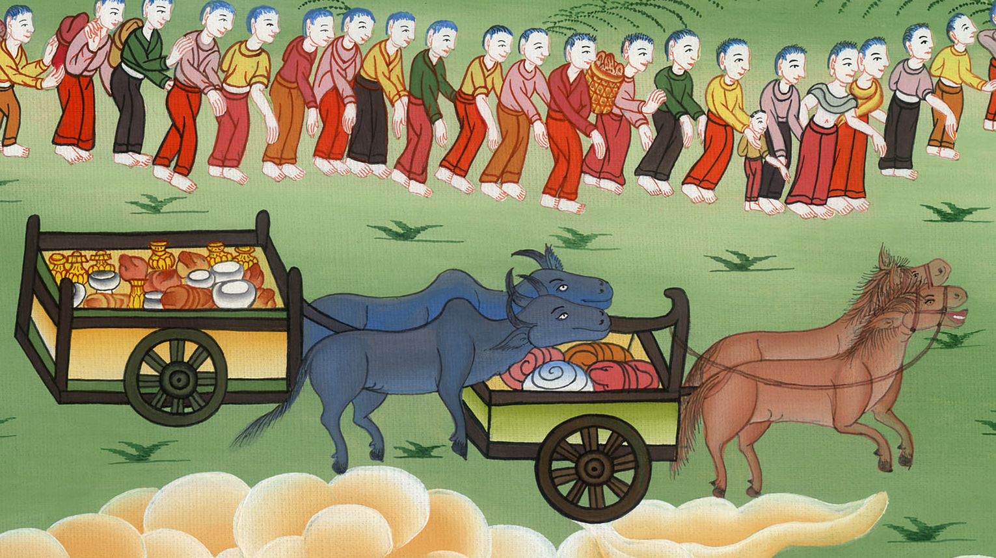
Ezra 1:4

Slide 13
5Then the heads of fathers’ households of Judah and Benjamin, the priests and the Levites, all whose spirit God had stirred to go up, rose up to build Yahweh’s house which is in Jerusalem.
John

Slide 14
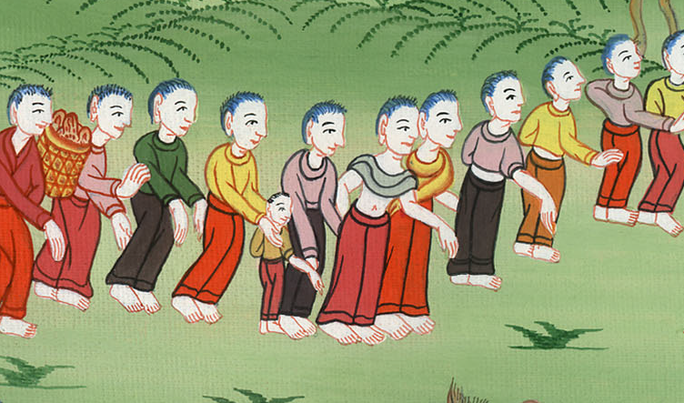
Ezra 1:5

Slide 15
6All those who were around them strengthened their hands with vessels of silver, with gold, with goods, with animals, and with precious things, in addition to all that was willingly offered.
John

Slide 16
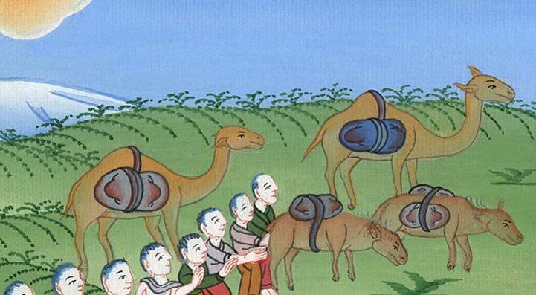
Ezra 1:6

Slide 17
7Also Cyrus the king brought out the vessels of Yahweh’s house, which Nebuchadnezzar had brought out of Jerusalem, and had put in the house of his gods;
John

Slide 18
Ezra 1:7

Slide 19
11All the vessels of gold and of silver were five thousand four hundred. Sheshbazzar brought all these up when the captives were brought up from Babylon to Jerusalem.
John

Slide 20
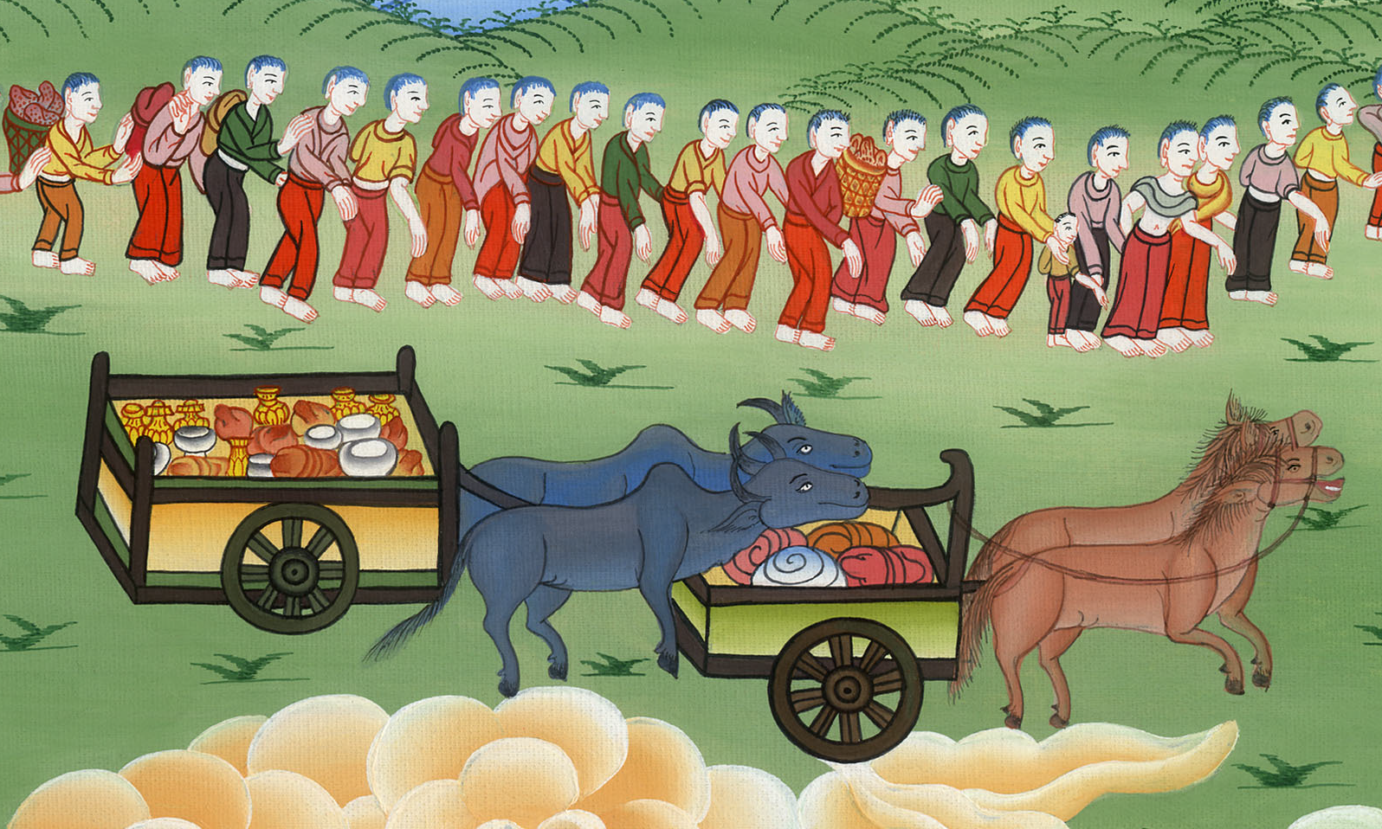
Ezra 1:11

Slide 21
2:1Now these are the children of the province who went up out of the captivity of those who had been carried away, whom Nebuchadnezzar the king of Babylon had carried away to Babylon, and who returned to Jerusalem and Judah, everyone to his city;
John

Slide 22
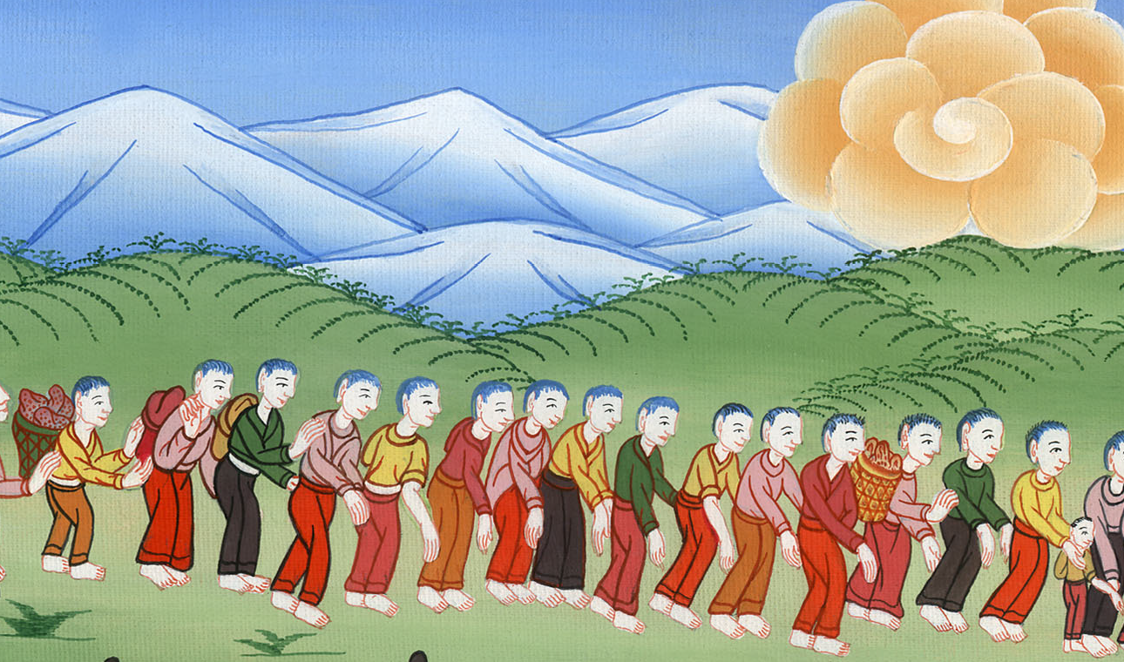
Ezra 2:1

Slide 23
64The whole assembly together was forty-two thousand three hundred sixty, .
John

Slide 24
Ezra 2:64

