Slide 1
27-2
This work is licensed under a Creative Commons Attribution-Sharealike 4.0 International License.
Please add this statement to all the videos you create.
English Bible quotes are from the World English Bible US, which is in the public domain.
Notes:
Ch
27 Rebuilding of the Temple
1. Cyrus tells Jews to rebuild the temple - Ezra 1:1-11 (Left Top)
2. The altar is built - Ezra 3:1-6 (Right Top)
3. The foundation of the Temple is laid - Ezra 3:7-13 (Right 2nd)
4. Construction of the Temple stops - Ezra 4:1-5, 24 (Right 3rd)
5. Haggai and Zechariah give prophecy and rebuilding resumes - Ezra 5:1-17 (Left
Center)
6. King Darius pays for all the construction - Ezra 6:1-14 (Left Center)

Slide 2
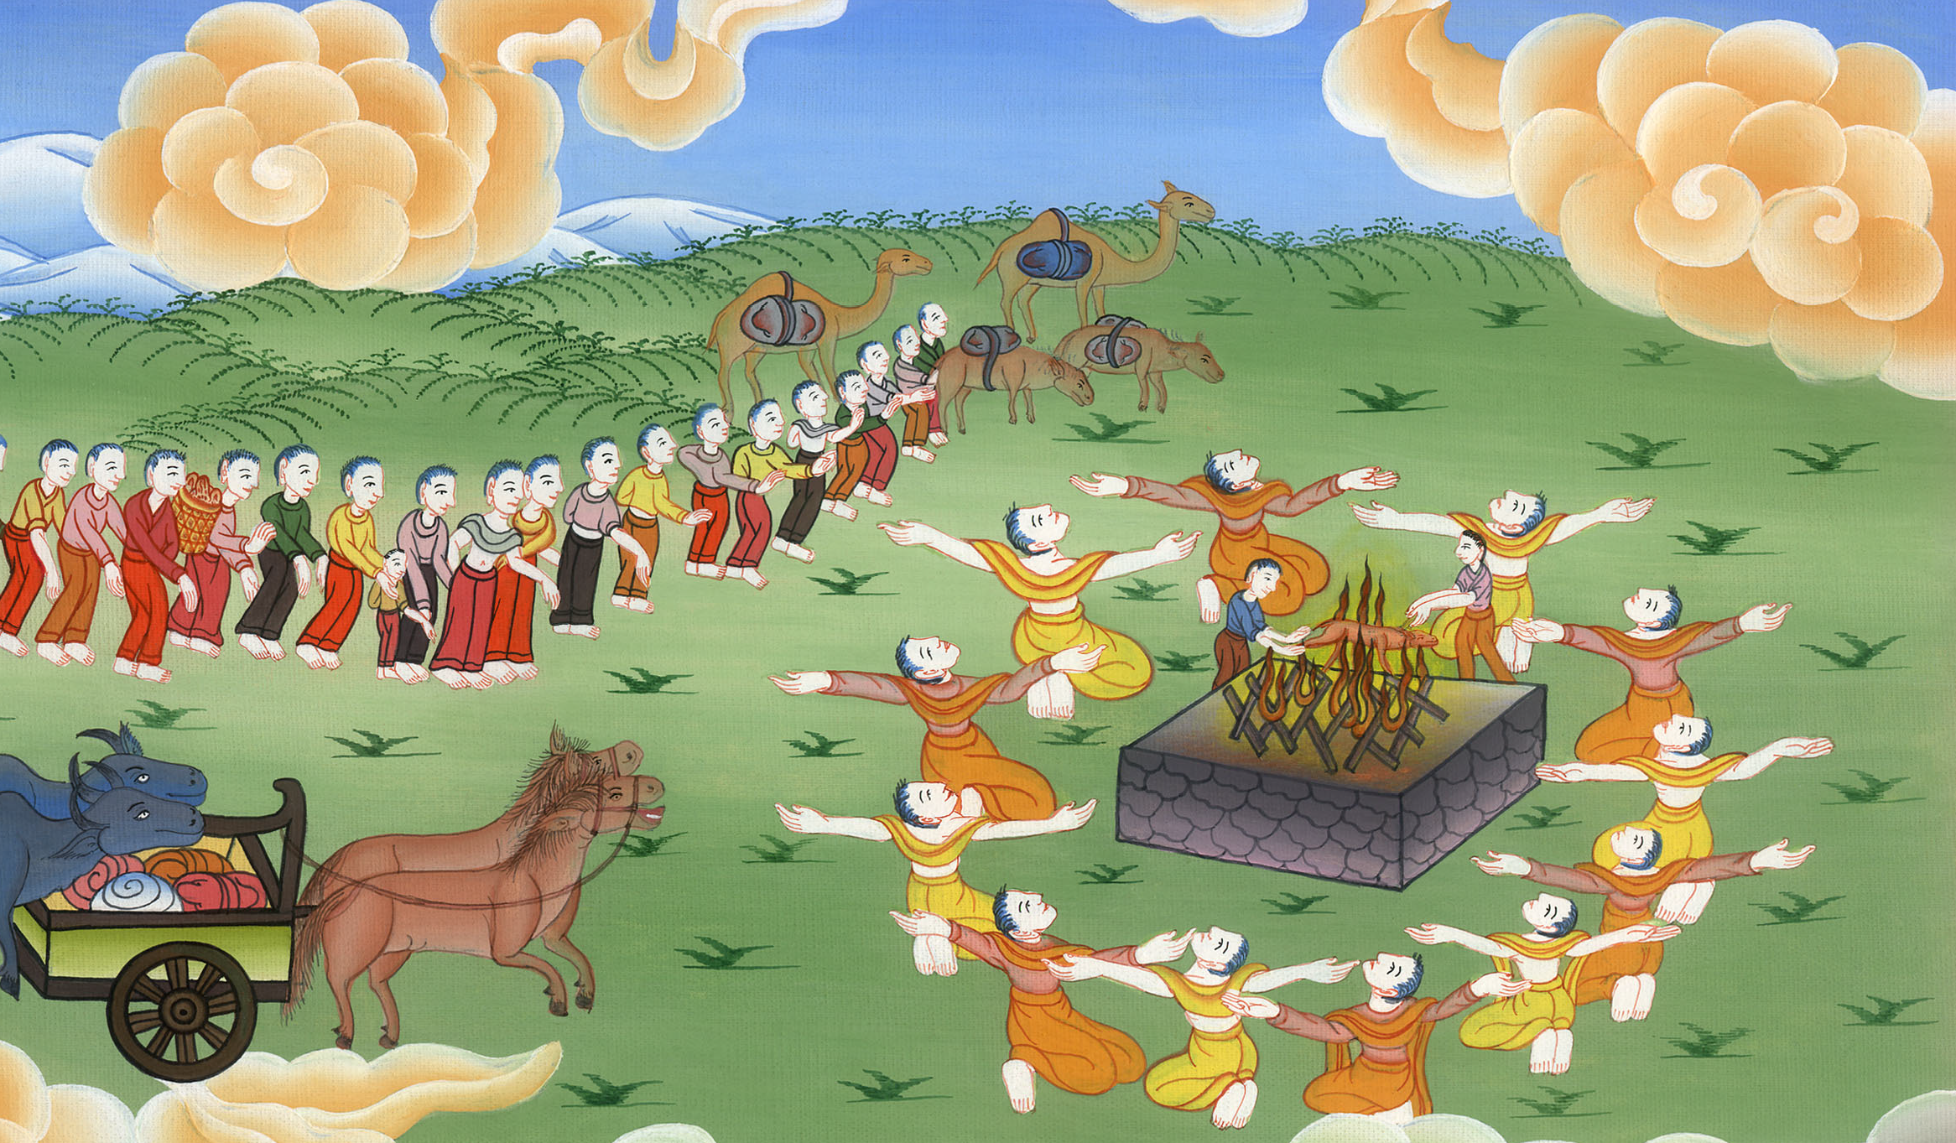
2. The altar is built - Ezra 2:64,3:1-6

Slide 3
2. The altar is built - Ezra 2:64,3:1-6 (Right Top)
John

Slide 4
2. The altar is built - Ezra 2:64,3:1-6

Slide 5
Ezra3:1When the seventh month had come, and the children of Israel were in the cities, the people gathered themselves together as one man to Jerusalem.
John

Slide 6
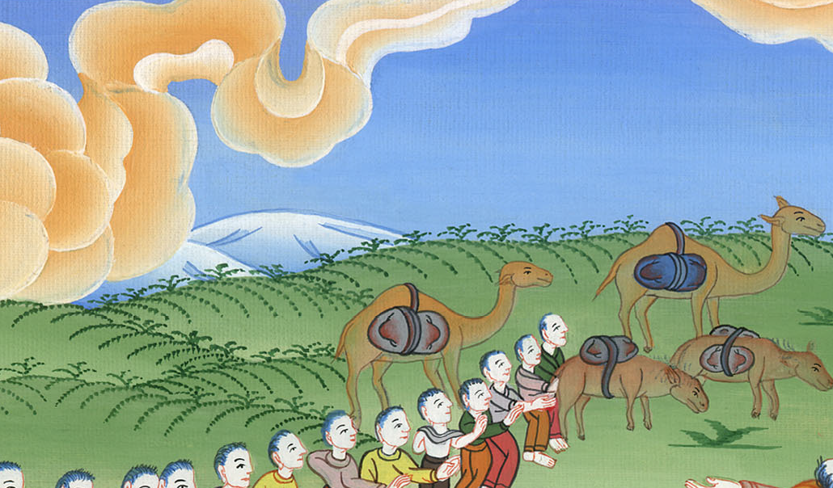
Ezra 3:1

Slide 7
2:68Some of the heads of fathers’ households, when they came to Yahweh’s house which is in Jerusalem, offered willingly for God’s house to set it up in its place.
John

Slide 8
Ezra 2:68

Slide 9
3:2Then Jeshua the son of Jozadak stood up… and built the altar of the God of Israel, to offer burnt offerings on it, as it is written in the law of Moses the man of God.
John

Slide 10
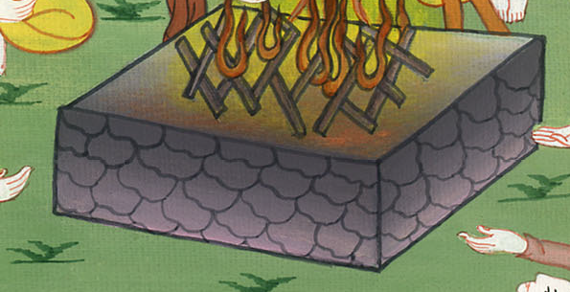
Ezra 3:2

Slide 11
3In spite of their fear because of the peoples of the surrounding lands, they set the altar on its base; and they offered burnt offerings on it to Yahweh, even burnt offerings morning and evening.
John

Slide 12
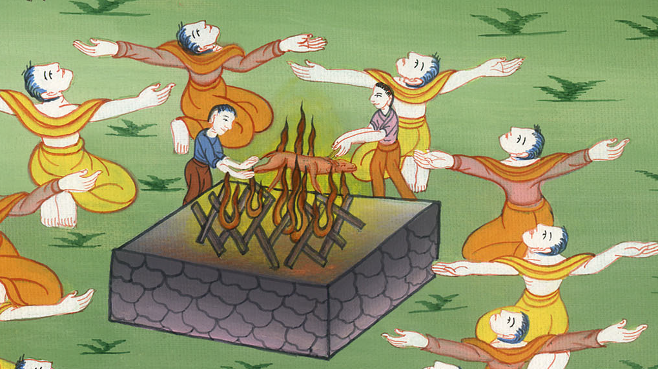
Ezra 3:3

Slide 13
4They kept the feast of booths, as it is written, and offered the daily burnt offerings by number, according to the ordinance, as the duty of every day required;
John

Slide 14
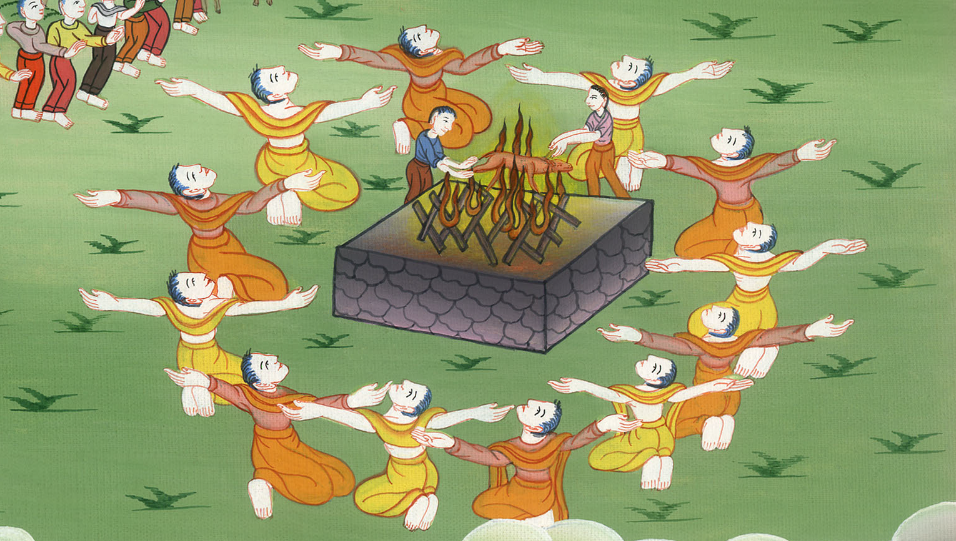
Ezra 3:4

Slide 15
5and afterward the continual burnt offering, the offerings of the new moons, of all the set feasts of Yahweh that were consecrated, and of everyone who willingly offered a free will offering to Yahweh.
John

Slide 16
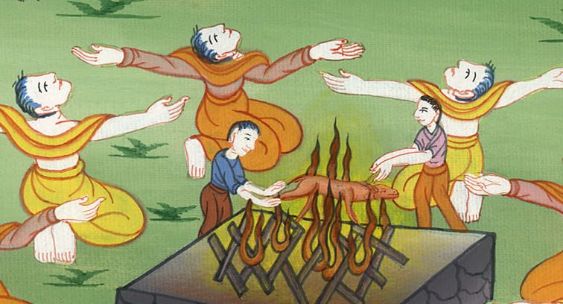
Ezra 3:5

Slide 17
6From the first day of the seventh month, they began to offer burnt offerings to Yahweh; but the foundation of Yahweh’s temple was not yet laid.
John

Slide 18
Ezra 3:6

