Slide 1
27-3
This work is licensed under a Creative Commons Attribution-Sharealike 4.0 International License.
Please add this statement to all the videos you create.
English Bible quotes are from the World English Bible US, which is in the public domain.
Notes:
Ch
27 Rebuilding of the Temple
1. Cyrus tells Jews to rebuild the temple - Ezra 1:1-11 (Left Top)
2. The altar is built - Ezra 3:1-6 (Right Top)
3. The foundation of the Temple is laid - Ezra 3:7-13 (Right 2nd)
4. Construction of the Temple stops - Ezra 4:1-5, 24 (Right 3rd)
5. Haggai and Zechariah give prophecy and rebuilding resumes - Ezra 5:1-17 (Left
Center)
6. King Darius pays for all the construction - Ezra 6:1-14 (Left Center)

Slide 2
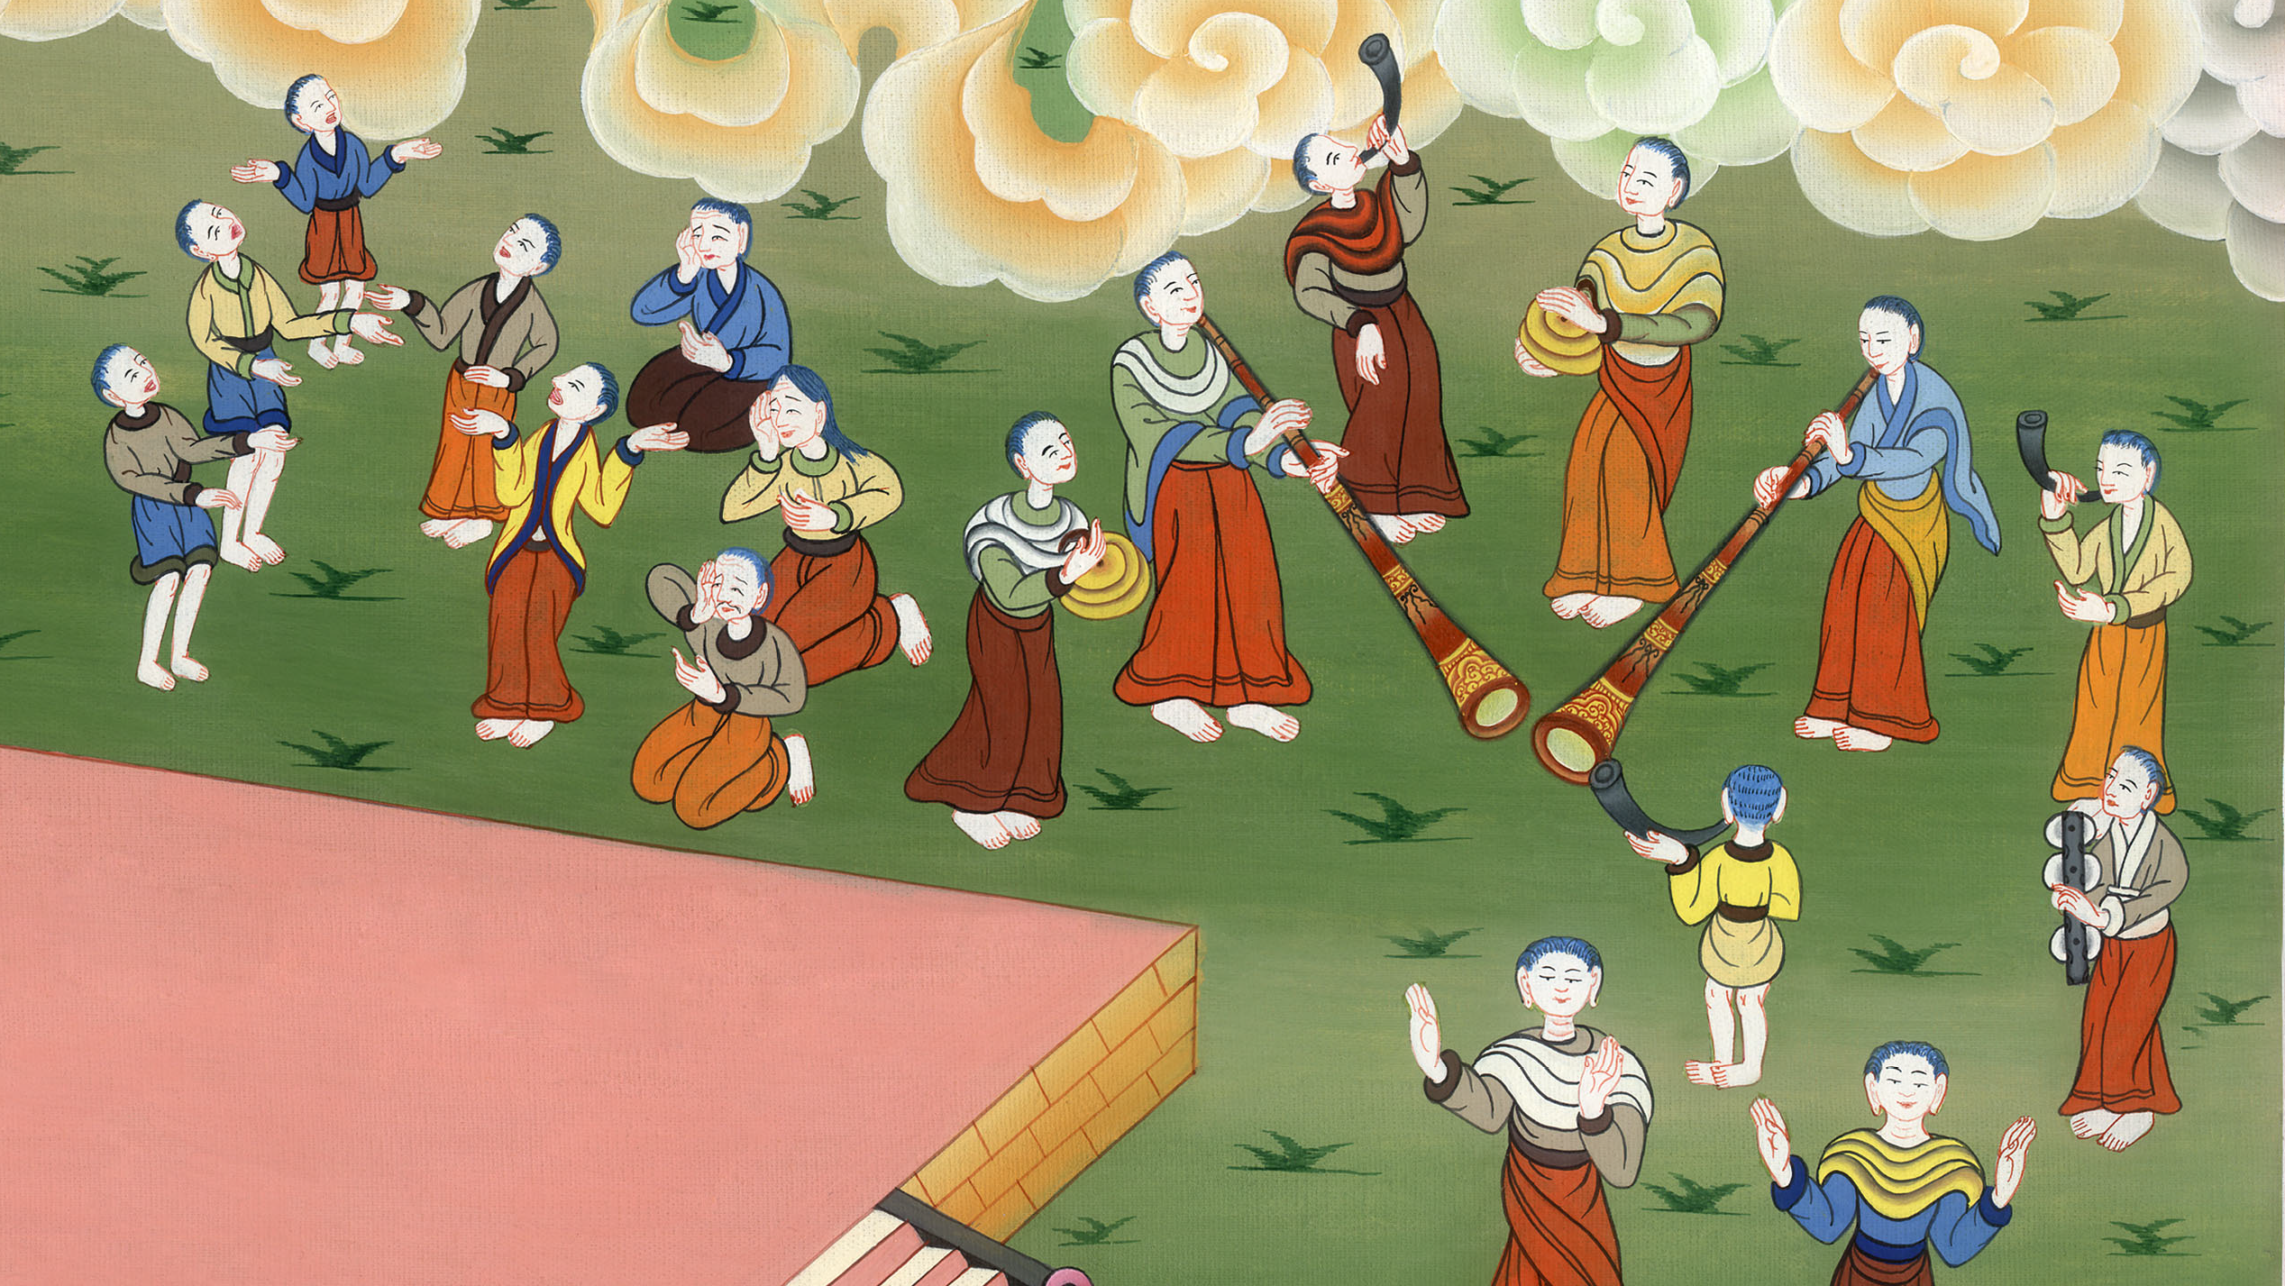
The foundation of the Temple is laid –
Ezra 2:64, 3:7-13

Slide 3
3. The foundation of the Temple is laid - Ezra 2:64, 3:7-13 (Right 2nd)
John

Slide 4
The foundation of the Temple is laid –
Ezra 2:64, 3:7-13

Slide 5
Ezra3:7They also gave money to the masons and to the carpenters. They also gave food, drink, and oil to the people of Sidon and Tyre to bring cedar trees from Lebanon to the sea, to Joppa, according to the grant that they had from Cyrus King of Persia.
John

Slide 6
Ezra 3:7

Slide 7
8Now in the second year of their coming to God’s house at Jerusalem, in the second month, Zerubbabel the son of Shealtiel, Jeshua the son of Jozadak, and the rest of their brothers the priests and the Levites, and all those who had come out of the captivity to Jerusalem, began the work and appointed the Levites, from twenty years old and upward, to have the oversight of the work of Yahweh’s house.
John

Slide 8
Ezra 3:8

Slide 9
8…Zerubbabel began the work and appointed the Levites, from twenty years old and upward, to have the oversight of the work of Yahweh’s house.
John

Slide 10
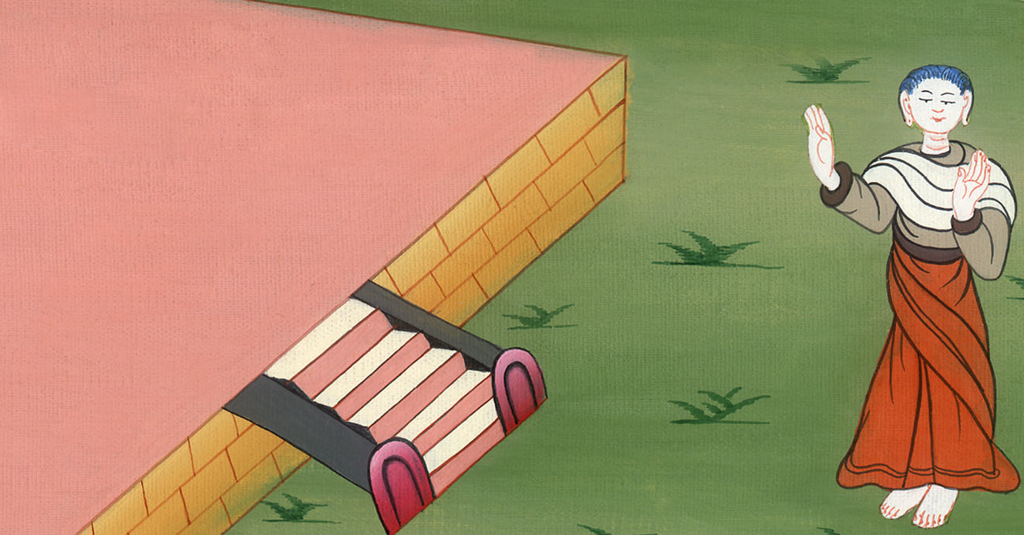
Ezra 3:8

Slide 11
10When the builders laid the foundation of Yahweh’s temple, they set the priests in their vestments with trumpets, with the Levites the sons of Asaph with cymbals, to praise Yahweh,
John

Slide 12
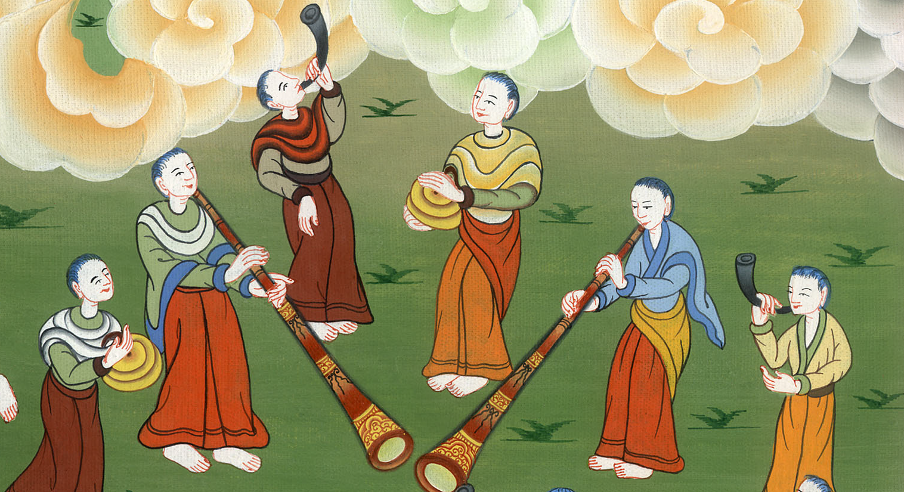
Ezra 3:10

Slide 13
10…according to the directions of David king of Israel.
John

Slide 14
Ezra 3:10

Slide 15
11They sang to one another in praising and giving thanks to Yahweh, “For he is good, for his loving kindness endures forever toward Israel..
John

Slide 16
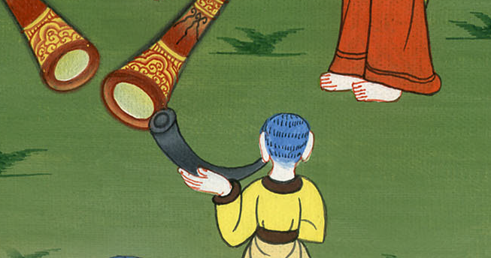
Ezra 3:11

Slide 17
All the people shouted with a great shout, when they praised Yahweh, because the foundation of Yahweh’s house had been laid.
John

Slide 18
Ezra 3:11

Slide 19
12But many of the priests and Levites and heads of fathers’ households, the old men who had seen the first house, when the foundation of this house was laid before their eyes, wept with a loud voice. Many also shouted aloud for joy,
John

Slide 20
Ezra 3:12

Slide 21
13so that the people could not discern the noise of the shout of joy from the noise of the weeping of the people; for the people shouted with a loud shout, and the noise was heard far away.
John

Slide 22
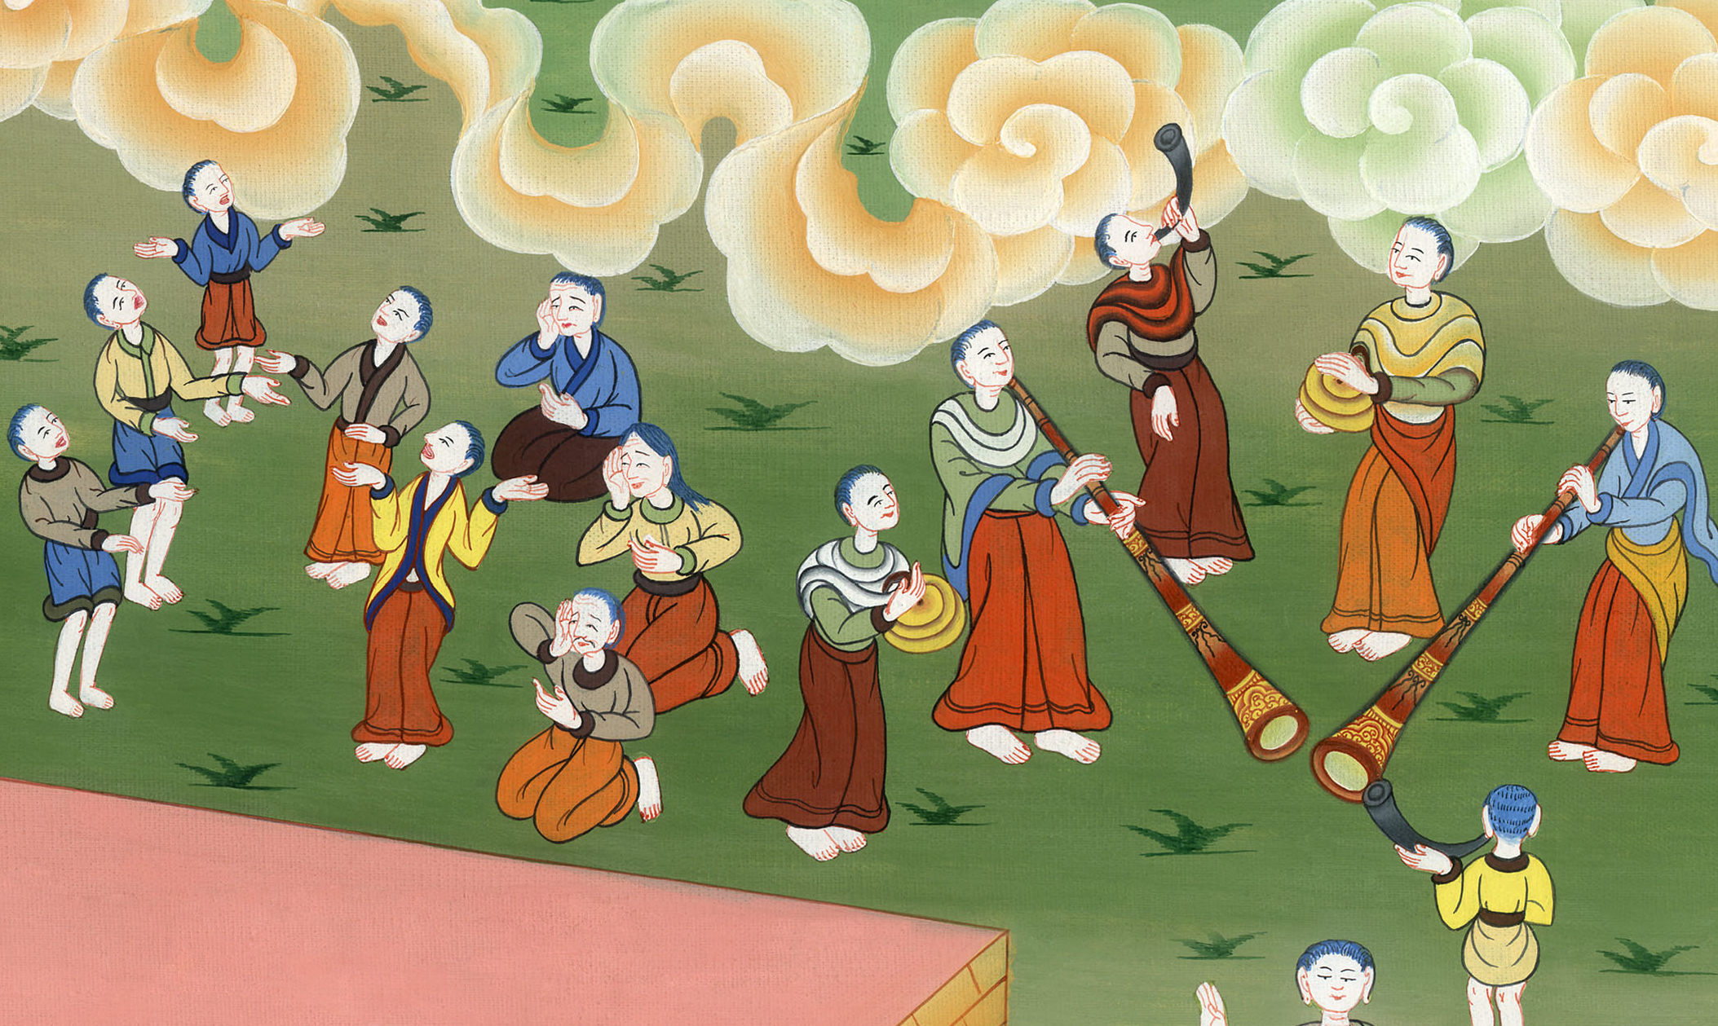
Ezra 3:13

