Slide 1
27-4
This work is licensed under a Creative Commons Attribution-Sharealike 4.0 International License.
Please add this statement to all the videos you create.
English Bible quotes are from the World English Bible US, which is in the public domain.
Notes:
Ch
27 Rebuilding of the Temple
1. Cyrus tells Jews to rebuild the temple - Ezra 1:1-11 (Left Top)
2. The altar is built - Ezra 3:1-6 (Right Top)
3. The foundation of the Temple is laid - Ezra 3:7-13 (Right 2nd)
4. Construction of the Temple stops - Ezra 4:1-5, 24 (Right 3rd)
5. Haggai and Zechariah give prophecy and rebuilding resumes - Ezra 5:1-17 (Left
Center)
6. King Darius pays for all the construction - Ezra 6:1-14 (Left Center)

Slide 2
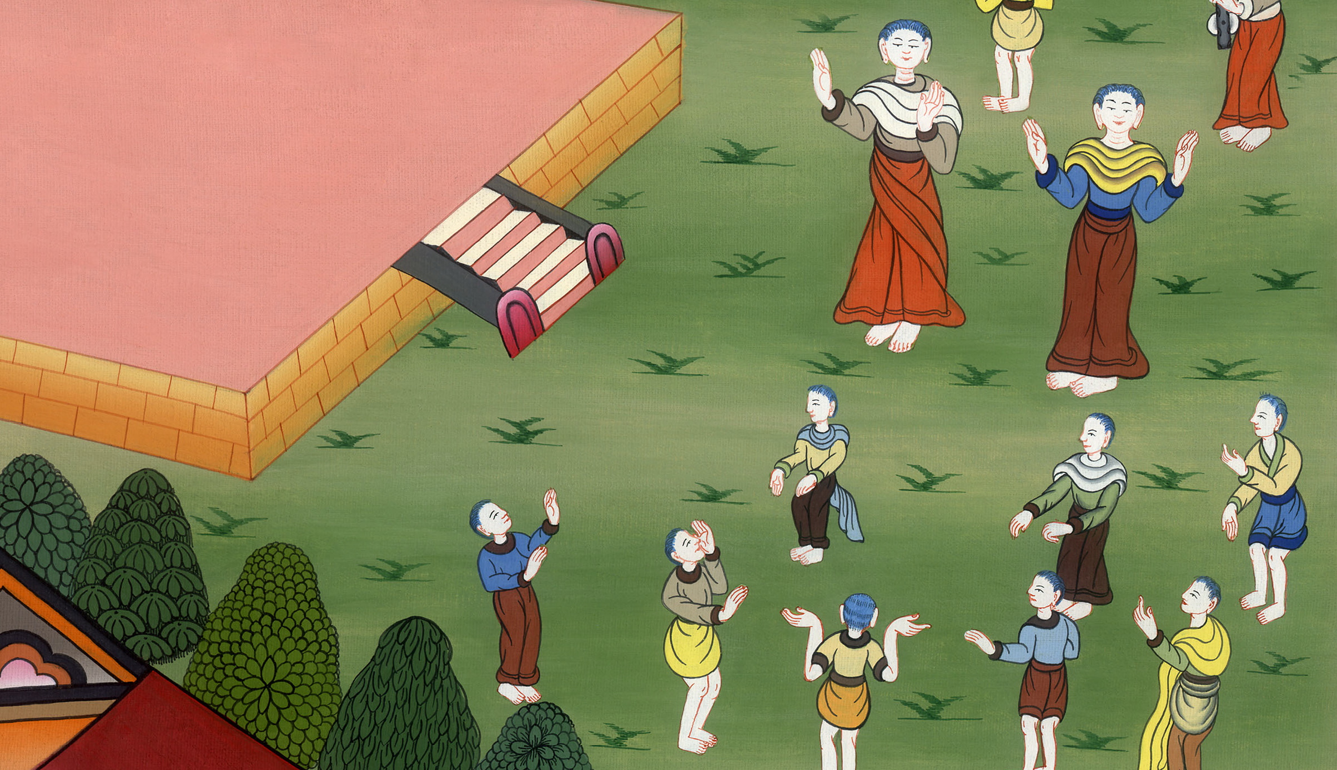
Construction of the Temple stops - Ezra 4:1-5, 24

Slide 3
4. Construction of the Temple stops - Ezra 4:1-5, 24 (Right 3rd)
John

Slide 4
Construction of the Temple stops - Ezra 4:1-5, 24

Slide 5
Ezra4:1Now when the adversaries of Judah and Benjamin heard that the children of the captivity were building a temple to Yahweh, the God of Israel,
John

Slide 6
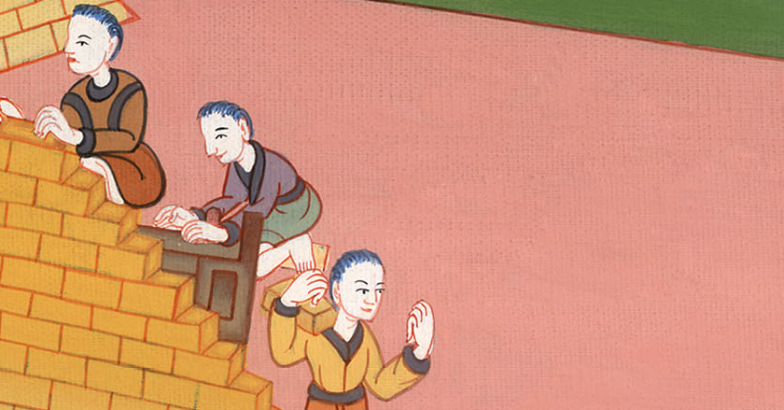
Ezra 4:1

Slide 7
2they came near to Zerubbabel, and to the heads of fathers’ households, and said to them, “Let us build with you, for we seek your God as you do; and we have been sacrificing to him since the days of Esar Haddon king of Assyria, who brought us up here.”
John

Slide 8
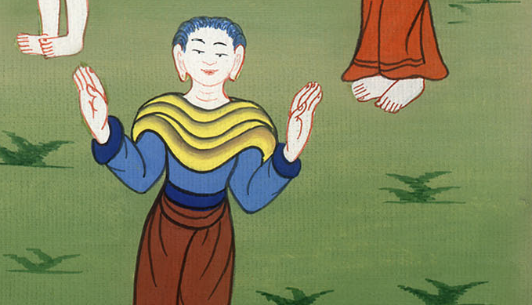
Ezra 4:2

Slide 9
3But Zerubbabel, Jeshua, and the rest of the heads of fathers’ households of Israel said to them, “You have nothing to do with us in building a house to our God; but we ourselves together will build to Yahweh, the God of Israel, as King Cyrus the king of Persia has commanded us.”
John

Slide 10
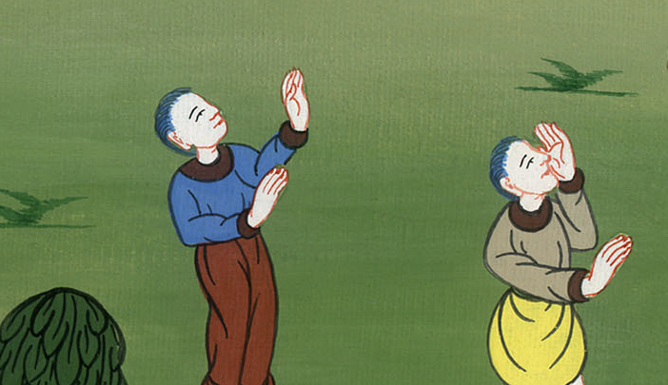
Ezra 4:3

Slide 11
4Then the people of the land weakened the hands of the people of Judah, and troubled them in building.
John

Slide 12
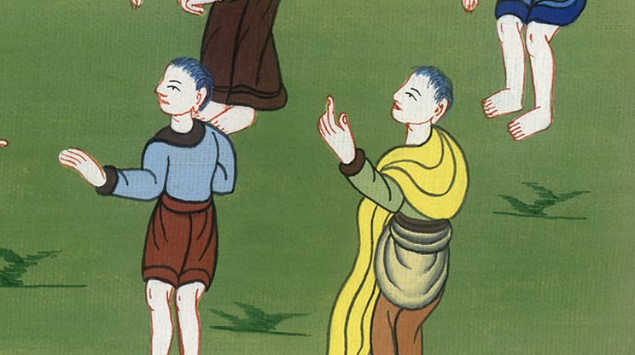
Ezra 4:4

Slide 13
5They hired counselors against them to frustrate their purpose all the days of Cyrus king of Persia, even until the reign of Darius king of Persia.
John

Slide 14
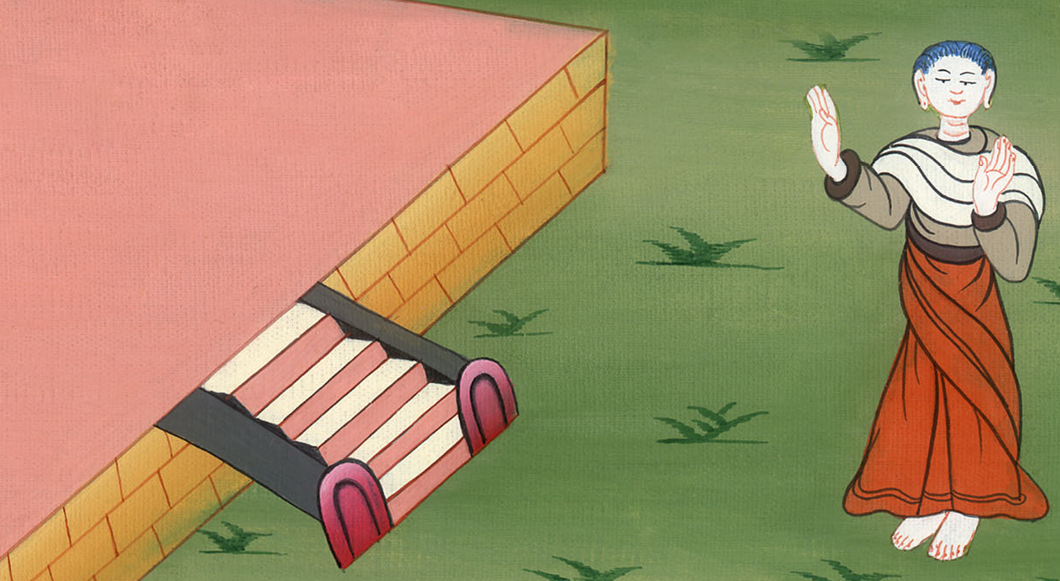
Ezra 4:5

Slide 15
6In the reign of Ahasuerus, in the beginning of his reign, they wrote an accusation against the inhabitants of Judah and Jerusalem.
John

Slide 16
Ezra 4:6

Slide 17
24Then work stopped on God’s house which is at Jerusalem. It stopped until the second year of the reign of Darius king of Persia.
John

Slide 18
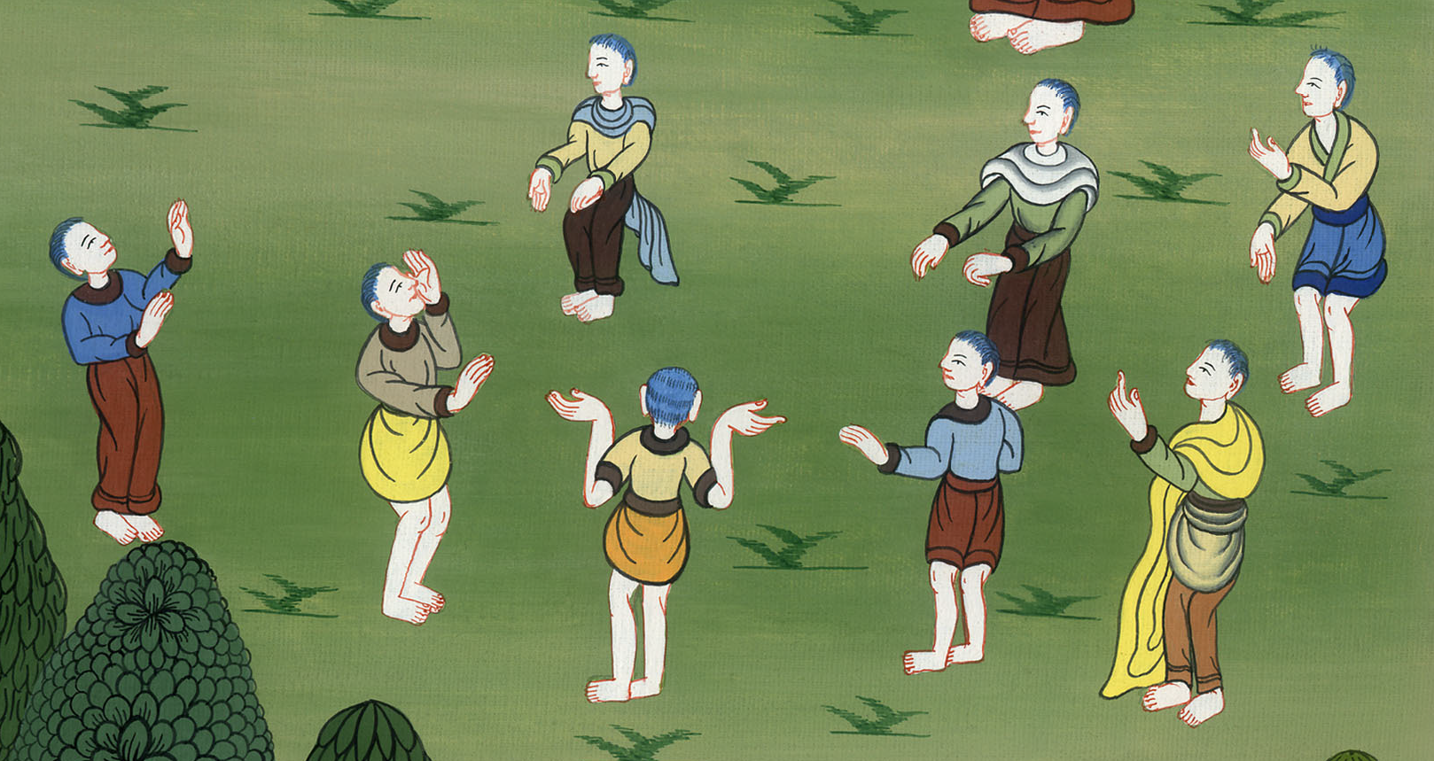
Ezra 4:24

